Slide 1


Gemini – Shaping the Future of Enterprise Java
Mike Keith
michael.keith@oracle.com
Glyn Normington
gnormington@vmware.com

Slide 2
What is Enterprise Java?
Application Frameworks
Server Infrastructure
Java EE
Presentation/ Web
Enterprise Integration
Web Services/ SOA
Persistence/ Database
Notes:
Not sure when the creation review is
Be able to leverage some of the other runtime projects, like Equinox, EclipseLink, Jetty, etc.
Lots of interest
Targeting OSGi, but we are espousing and trying to popularize the notion of modularity and enterprise modules, so is somewhat a case of the medium being the message
Many of the subprojects are OSGi Ris, which require Apache license, so we have board approval for dual licensing

Slide 3
The Good
and the Problems
Horizontal choice
3rd party add-ons and frameworks
Depth and maturity
Standards and pluggability
Reusable infrastructure
It’s all (or at least most) or nothing
Non-standard ways of integrating
Time-honored ways of coupling
Pluggability achieved using fragile mechanisms
Sometimes an impediment
Notes:
Not sure when the creation review is
Be able to leverage some of the other runtime projects, like Equinox, EclipseLink, Jetty, etc.
Lots of interest
Targeting OSGi, but we are espousing and trying to popularize the notion of modularity and enterprise modules, so is somewhat a case of the medium being the message
Many of the subprojects are OSGi Ris, which require Apache license, so we have board approval for dual licensing

Slide 4
Solution
Modularity – the red pill of enlightenment?
Leverage existing standards
Decouple the technologies
Integration mechanism uses module standards
Infrastructure is available but does not impose
It’s about the granularity of Choice
Notes:
Not sure when the creation review is
Be able to leverage some of the other runtime projects, like Equinox, EclipseLink, Jetty, etc.
Lots of interest
Targeting OSGi, but we are espousing and trying to popularize the notion of modularity and enterprise modules, so is somewhat a case of the medium being the message
Many of the subprojects are OSGi Ris, which require Apache license, so we have board approval for dual licensing

Slide 5
Enterprise Modules Project
Nicknamed “Gemini”
Subproject of Eclipse Runtime Project
An OSGi-based project, but its philosophy of “Modularity” is more general
Collection of subprojects, each demonstrating modularity of a standard technology
Dual-licensed – EPL and Apache v2
Notes:
Not sure when the creation review is
Be able to leverage some of the other runtime projects, like Equinox, EclipseLink, Jetty, etc.
Lots of interest
Targeting OSGi, but we are espousing and trying to popularize the notion of modularity and enterprise modules, so is somewhat a case of the medium being the message
Many of the subprojects are OSGi Ris, which require Apache license, so we have board approval for dual licensing

Slide 6
Questions about Gemini
Is it an Application server?
Why at Eclipse?
Is it focused specifically at Equinox?
How does it fit in with Java EE?
Why are there two similar projects –
Gemini and Aries?
Who is using Gemini now?
Notes:
Not sure when the creation review is
Be able to leverage some of the other runtime projects, like Equinox, EclipseLink, Jetty, etc.
Lots of interest
Targeting OSGi, but we are espousing and trying to popularize the notion of modularity and enterprise modules, so is somewhat a case of the medium being the message
Many of the subprojects are OSGi Ris, which require Apache license, so we have board approval for dual licensing

Slide 7
Project Goals
Prime Directive:
Provide a home for modular adaptations of Java EE and enterprise technologies
Visible, accessible and open
Community input and community contribution
Living implementations
Notes:
OSGi RIs are not all that visible on the OSGi site. Wanted a place to give people better access to them
SpringSource wanted an appropriate place for their DM project, which forms the Blueprint RI
OSGi is not meant as a place for product development, want the impls to continue to develop and evolve
Wanted the community to be able to control and contribute to the evolution of those projects

Slide 8
Participation
Initial committers are the companies that contributed the RI code to the OSGi Alliance
  Oracle
  SpringSource
A few of the other interested parties:
  EclipseSource
  SAP
  Swordfish
Red Hat
ECF
Infor
Notes:
If you haven’t already noticed, just like it isn’t trying to create a single entity (such as a container) Gemini is not really a single project
It is a group of projects, each of which is an independent project, but that works seamlessly with the others
SpringSource is donating the Spring DB project and the Web container code that they wrote, Oracle is donating the rest
Lots of interest, plus some individuals that want to be involved

Slide 9
Specification Implementations
Gemini Subproject | OSGi Specification
Gemini Naming | JNDI Services
Gemini DBAccess | JDBC Service
Gemini Management | JMX Management Model
Gemini JPA | JPA Service
Gemini Blueprint | Blueprint Container
Gemini Web | Web Applications
Notes:
Web Container should be able to be integrated with existing web containers (e.g. Jetty)
Database Access will add support for a number of databases
Blueprint Service is the Spring-DM (Dynamic Modules) project and will be living within Gemini
JPA will integrate with EL and provide generic library support for other providers
JCA is not in the pending Enterprise release, but will be pursued more actively once the current release is shipped

Slide 10
Gemini DBAccess
Implementation of OSGi JDBC Service specification
Exposes JDBC driver as a service
Depending on existing driver OSGi support, it either wraps a driver JAR or imports it
Create implementations for a number of different databases
Initial support for Derby embedded and client/server, Java DB

Slide 11
Gemini Naming
Provides implementation of JNDI that follows the rules of OSGi JNDI Services Specification
Useful for traditional Java EE applications that have JNDI lookups throughout the code
Not expected to *replace* service lookup or service instance injection

Slide 12
Gemini Management
Implementation of EEG JMX Management Model Specification
Provides the MBeans for managing the framework via JMX
Thin layer that hooks into the existing management interfaces on framework classes
Minimal future development (only needs to change when new APIs are added to OSGi)

Slide 13
Gemini JPA
Code to provide support for the OSGi JPA Service
Library can be used by other providers to more quickly be able to implement the spec
Hooks into EclipseLink provider
EclipseLink already supported OSGi for 2 years, but now being retrofitted to use the current spec
Innovation in areas that spec does not cover

Slide 14
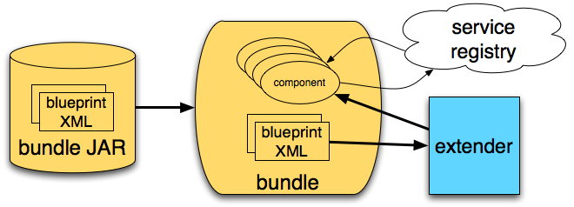
Gemini Blueprint
Implementation of OSGi Blueprint Container
  Based on Spring DM project
  Uses Spring framework
Used by Eclipse Virgo project and others
Developed by VMware (SpringSource) and Oracle/BEA

Slide 15
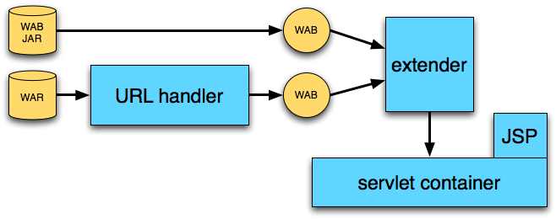
Gemini Web
Implementation of OSGi Web
Applications specification
  Servlet 2.5, JSP 2.1
  Uses Apache Tomcat, Jasper
Used by Eclipse Virgo project and others
Developed by VMware (SpringSource)

Slide 16

Status
Project proposal and acceptance
Resource and Repository Provisioning
Code completed and tested
Code CQ’ed and committed to Gemini
Project makeup
http://www.eclipse.org/gemini

Slide 17
Future
Get as much feedback as possible
Use the project as a place for people to access the specs separately or together
Experiment and innovate in additional technologies
Leverage the experience as input to next round of specifications
Virgo talk (next) shows container usage
http://www.eclipse.org/gemini

