Slide 1
Virgo 3.0.0 Release Review
Planned Review Date: 17-24 August 2011
Communication Channel: Virgo forum
Glyn Normington (Project Lead)

Slide 2
Introduction
Virgo is a mature project derived from SpringSource dm Server v2. Version 3 represents the first major functional enhancement since the contribution.
Release contents
  Tomcat based web server for enterprise Java applications
  Jetty based web server for enterprise Java applications
  Kernel – base for web servers and other server types
  Snaps framework for modular OSGi web applications
  Documentation
  New version of GreenPages sample

Slide 3
Features
The objective of this release is closer integration with other Eclipse RT projects.
Major features:
  Provide Jetty based alternative to Virgo Tomcat Server
  Support snaps modular OSGi web applications framework
  Upgrade Equinox to 3.7 and OSGi 4.3
  Upgrade Tomcat to version 7 and Servlet 3.0
  Upgrade Spring framework to 3.0.5
  Upgrade Gemini Web to 2.0 and make web behaviour conform strictly to the OSGi web spec
  Replace the Equinox shell with Apache Felix Gogo, including telnet and ssh access
  Base region support on OSGi standard framework hooks via Equinox region digraph support
  Use Equinox rather than Felix OSGi service implementations
  Allow PARs to contain plans
  Support OSGi Log service
  Integrate Declarative Services support in both kernel and user region
  Separate Configuration Admin instances in kernel and user region

Slide 4
Non-Code Aspects
User documentation:
  User Guide
  Programmer Guide
  Snaps User Guide
  2.x to 3.0 migration notes
  A Guide to the GreenPages Sample
I18n enabled, English resource files only
GreenPages sample v2.4.0 will be released with Virgo 3.0

Slide 5
APIs
The APIs in this release meet Eclipse Quality standards
Migration from Virgo 2.1 is straightforward and documented

Slide 6
Architectural Issues
p2 integration deferred to a future release (probably 3.5) as it is taking longer than expected to finalise

Slide 7
Tool Usability
Virgo tooling has been donated to Eclipse
  First milestone issued
  Work in progress to clean up the dependencies and fix various bugs

Slide 8
Incubation Content
Virgo 3.0 includes bundles from Equinox bundles project that are in incubation
  Region digraph (moved from Virgo)
  Console supportability (integrates Apache Felix Gogo)
Rationale for inclusion
  Region digraph is stable and mature
  New console no longer depends on OSGi Alliance standard being finalised
The download page will note the incubation content to avoid misleading anyone

Slide 9
End-of-Life
Web Application Bundles are now processed in strict conformance with the OSGi specification
  Previous behaviour can be enabled by a configuration property
  This property causes a message to be issued to warn that the property may not be supported in future releases

Slide 10
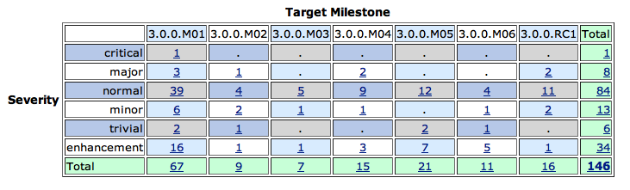
Bugzilla
Fixed

Slide 11
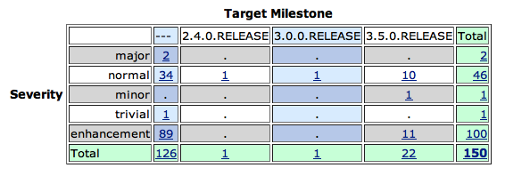
Bugzilla
Not fixed
  Both major bugs relate to the tooling

Slide 12
Standards
Virgo requires Java 6 or later
Virgo supports OSGi v4.3
The Gemini Web container provides support for Web Bundles as defined by OSGi Enterprise Spec v4.2
Tomcat 7 provides underlying servlet 3.0 support
Kernel uses OSGi standard framework hooks
Lazily activated bundles are started in conformance with the OSGi specification

Slide 13
UI Usability
Admin Console
  no usability issues raised by users
Shell
  Completely replaced by new shell based on Apache Felix Gogo

Slide 14
Schedule
Release slipped from June 2011 to August 2011

Slide 15
Communities
Bugzilla in active use by users and contributors
Virgo forum and virgo-dev similarly active
Weekly Virgo community call
Blogs
Twitter is used for propagating news updates
IRC channel has seen a small number of users
Committers have demo'd Virgo at EclipseCon and elsewhere
Presentations at EclipseCon and OSGi conferences
Interaction with Gemini, Equinox, Jetty, and p2 projects
Notes:
http://www.readtfb.net/tag/virgo/
http://maniagnosis.crsr.net/2010/06/requiescat-in-pace-springsource-dm.html
http://www.redmonk.com/cote/2010/01/13/virgo/

Slide 16
IP Log
The Eclipse IP policies and procedures have been followed
Frozen IP log:
  https://bugs.eclipse.org/bugs/attachment.cgi?id=200883

Slide 17
Credits and Kudos
New committers:
  Hristo Illiev (SAP AG)
  Borislav Kapukaranov (SAP AG)
  Violeta Georgieva (SAP AG)
  Dmitry Sklyut (Chariot Solutions)

