Slide 1
Virgo Graduation & 2.1.0 Release Review
Planned Review Date: 20 October 2010
Communication Channel: Virgo forum
Glyn Normington (Project Lead)

Slide 2
Introduction
Virgo is a mature project derived from SpringSource dm Server v2
Release contents
  Web server for enterprise Java applications
  Kernel – base for web server and other server types
  Samples
  Documentation
Virgo is an active project, ready for graduation
  Committers: 3 (SpringSource/VMware)
  Non-committer code contributors: 5

Slide 3
Features
The objective of this release is migration of community and applications from SpringSource dm Server 2.0.x.
Virgo specific features:
  5x startup performance
  Tomcat & Logback upgrades
  Equinox console integration

Slide 4
Features (continued)
Features inherited from SpringSource dm Server:
  admin console for management and fault diagnosis
  plans define the artifacts that comprise an application
  automatic provisioning from local and remote repositories
  web container for WAR files and Web Application Bundles
    Built on Gemini Web
  user region to isolate the kernel from applications
  Spring 3 - Virgo packages Spring 3.0 final, but can easily be configured to use a different version of Spring
  hot deployment
  logging via embedded LogBack

Slide 5
Non-Code Aspects
User documentation:
  User Guide
  Programmer Guide
Tutorial:
  Creating an Application with Virgo
Samples:
  GreenPages, Formtags, Config props, & OSGi samples
Webinar
I18n enabled, English resource files only

Slide 6
APIs
The APIs in this release meet Eclipse Quality standards
Migration from dm Server 2.0.x is straightforward and documented
Some internal APIs have been promoted to external to improve extensibility

Slide 7
Architectural Issues
Kernel/app isolation allows app dependencies to be upgraded independently of kernel dependencies, e.g. Spring
Equinox was recently upgraded to 3.6
Web support based on Tomcat
  Tomcat provided via Gemini Web
  Jetty support high priority for post 2.1.0
Virgo uses 3 OSGi service impls from Apache Felix
  Migration to Equinox equivalents post 2.1.0
p2 support under investigation

Slide 8
Tool Usability
SpringSource Tool Suite supports Virgo
  Runs a Virgo server instance
  Fast deploy/debug/update cycle
We plan to donate this tooling to Eclipse

Slide 9
End-of-Life
The following dm Server features did not make it through the Eclipse IP process:
  Jline based kernel shell – replaced by Equinox console command
  Tanuki service wrapper - dropped

Slide 10
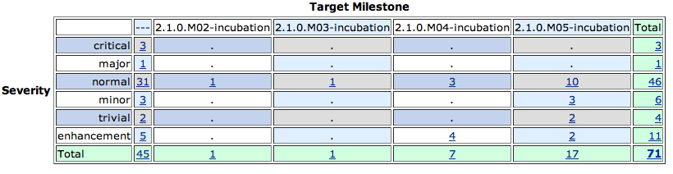
Bugzilla
Fixed
  Excludes CQ tracking bugs

Slide 11
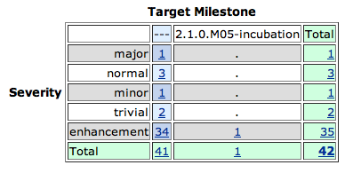
Bugzilla
Not fixed, all P3
Major bug is obscure and relates to deleting symlinks
  Following up with raiser

Slide 12
Standards
Virgo requires Java 6 or later
The Gemini Web container provides support for Web Bundles as defined by OSGi Enterprise Spec v4.2
Tomcat 6.0.x provides underlying servlet 2.5 support
Kernel uses prototype composite bundle (OSGi RFC 138) support in Equinox
  Project lead engaged in OSGi process to standardise this

Slide 13
UI Usability
Admin Console
  developed over two releases of dm Server
  no usability issues raised by users
Equinox shell command
  Replaces dm Server kernel shell

Slide 14
Schedule
First release slipped from 1Q10 to 4Q10
First milestone was a stable target for migration testing
  This shipped in 2Q10

Slide 15
Communities
Bugzilla in active use by users and contributors
Virgo forum and virgo-dev similarly active
Weekly Virgo community call although attendance is low (2-4 people)
Blogs
  SpringSource blog covers Virgo milestones
  Other blogs have complimented Virgo code quality
Twitter is used for propagating news updates
Committers have demo'd Virgo at Sofia and Walldorf Eclipse DemoCamps
Webinar in August
Presentations at EclipseCon and OSGi conferences
Interaction with Gemini, Equinox, Jetty, p2, Logback, & Spring projects
Notes:
http://www.readtfb.net/tag/virgo/
http://maniagnosis.crsr.net/2010/06/requiescat-in-pace-springsource-dm.html
http://www.redmonk.com/cote/2010/01/13/virgo/

Slide 16
IP Log
The Eclipse IP policies and procedures have been followed
IP Log:
  http://www.eclipse.org/projects/ip_log.php?projectid=rt.virgo
  Request to freeze the IP log sent to IP team on 27 September 2010
  Pending CQs to be removed from frozen IP log as they are not needed for 2.1.0 release

Slide 17
Graduation
Virgo must exit incubation to release 2.1.0
The dm Server project came with a stable codebase, a diverse set of users, and an open development process
The codebase is stable and demonstrable
  See webinar
The community is diverse and active
The project is open and transparent
The team is adhering to the Eclipse development process and IP policy and relates well to other RT projects. The project lead is an active member of the RT PMC

Slide 18
Credits and Kudos
Non-commiter code contributors:
  Nikolai Tankov (SAP AG)
  Hristo Illiev (SAP AG)
  Borislav Kapukaranov (SAP AG)
  Dmitry Sklyut (Chariot Solutions)
  Olivier Girardot
  Florian Waibel (EclipseSource)

