Slide 1
Virgo 3.6.0 Release Review
Planned Review Date: 12-19 December 2012
Communication Channel: Virgo forum
Glyn Normington (Project Lead)

Slide 2
Introduction
Virgo Version 3.6 is the third major functional enhancement release since the contribution.
Release contents
  Tomcat based web servers for enterprise Java applications
  Jetty based web server for enterprise Java applications
  Kernel – base for web servers and other server types
  Nano – small/fast kernel subset
  Nano full – Tomcat OpenEJB based server for Java EE web profile applications
  Snaps framework for modular OSGi web applications
  Eclipse-based tooling
  Documentation

Slide 3
Features
The objectives of this release are support for Java EE Web Profile applications and an improved and extended web admin console.
Major features:
  Virgo Nano Full support for Java EE Web Profile support
  New web admin console built into all deliverables, including Nano and Kernel
  Shortened deployed paths to avoid win32 pathlength issues
  Upgrade to Spring framework 3.1.0 and support Spring framework 3.2.x
  Support Java 7
  Bulk deployment in the Nano deployer
  Enable Logback mbean and expose this on the web admin console
  Add Virgo tooling support for Nano
  Various dependency upgrades and diagnostic improvements

Slide 4
Non-Code Aspects
User documentation:
  User Guide
  Programmer Guide
  Snaps User Guide
  Tooling Guide
  3.5 to 3.6 migration notes
  A Guide to the GreenPages Sample
I18n enabled, English resource files only

Slide 5
APIs
The APIs in this release meet Eclipse Quality standards
Migration from Virgo 3.5 is straightforward and documented

Slide 6
Architectural Issues
None

Slide 7
Tool Usability
Various improvements have been made to the Virgo tooling
  Functional and usability improvements
  Bug fixes

Slide 8
Incubation Content
None

Slide 9
End-of-Life
No issues

Slide 10
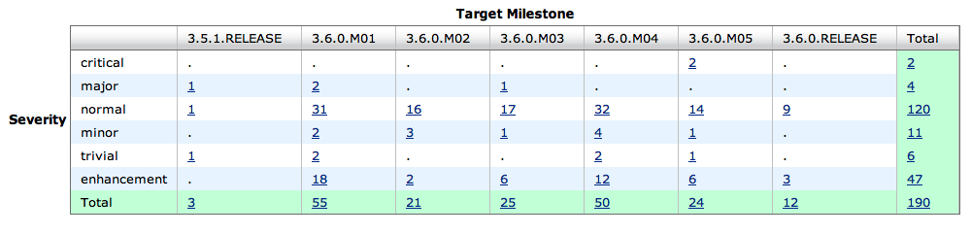
Bugzilla
Fixed

Slide 11
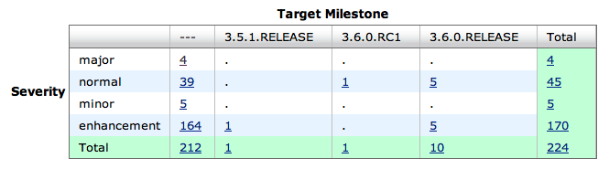
Bugzilla
Not fixed
Major bugs are:
  Problem packaging a certain WAR in the tooling
  Problem with tooling when split across filesystem partitions
  Problem deploying a sample (partially fixed)
  Update site restructure proposal

Slide 12
Standards
Virgo requires Sun Java 6 or Sun Java7
Virgo supports OSGi v4.3
The Gemini Web container provides support for Web Bundles as defined by OSGi Enterprise Spec v4.2
Tomcat 7 and Jetty 8 provides underlying servlet 3.0 support
Kernel uses OSGi standard framework hooks
Virgo supports the OSGi Blueprint service, OSGi Declarative Services, OSGi JMX Management, and OSGi Log Service
Virgo Nano Full integrates OpenEjb and other components providing Java EE Web Profile function

Slide 13
UI Usability
Admin Console
  No usability issues raised by users
  New web admin console has much improved usability after adding several new features and fixing some bugs
Shell
  No usability issues raised by users

Slide 14
Schedule
The Virgo 3.6 schedule has seen some minor slippage, but the 4Q2012 date has been communicated for quite some time now.

Slide 15
Communities
Bugzilla in active use by users and contributors
Virgo forum and virgo-dev similarly active
Weekly Virgo community call
Blogs
Twitter is used for propagating news updates
Committers have demo'd Virgo at EclipseCon and elsewhere
Presentations at EclipseCon and OSGi conferences
Interaction with Gemini, Equinox, Jetty, and Gyrex projects
Notes:
http://www.readtfb.net/tag/virgo/
http://maniagnosis.crsr.net/2010/06/requiescat-in-pace-springsource-dm.html
http://www.redmonk.com/cote/2010/01/13/virgo/

Slide 16
IP Log
The Eclipse IP policies and procedures have been followed
Approved IP Log:
  https://bugs.eclipse.org/bugs/attachment.cgi?id=224568

