Slide 1

Wiseman: enabling JMX applications via WS-Management
JSR-262(Web Services Connector): JMX apps talking WS-Management
Presenter:
Simeon Pinder Software Designer
Hewlett-Packard
Notes:
Title: Wiseman: enabling JMX applications via WS-Management
Abstract:
The presentation covers many topics in brief today. For the uninitiated, Wiseman is an open-source implementation of WS-Management sponsored by Java.net.
What follows are discussions of JMX(dominant management protocol for java applications) and a connector that exposes a SOAP interface.
Some Wiseman tooling is described to facilitate WS-Management communication, and finally there will be a demonstration of a sample WS-Man enabled application.
Time required:
50 minute timeslot, the last 10 of which should be reserved for a demo WS-Management Dashboard exchanges.
This leaves time for 13-20 Slides assuming 2-3 Minutes a slide.
Resources Required:
Laptop Projector

Slide 2
Agenda
WS-Management/Wiseman refresher/described
JMX: Management for the Java world
JSR-262: A Web-Services Connector for JMX Agents
Wiseman tooling: Metadata Explorer/Viewer
Wiseman tooling: Resource Accessor
Demo: WS-Management Dashboard
  Tomcat
  JVM
  Windows Vista
  Glassfish(optional)
Notes:
Title: Wiseman: enabling JMX applications via WS-Management
Abstract:
The presentation covers many topics in brief today. For the uninitiated, Wiseman is an open-source implementation of WS-Management sponsored by Java.net.
What follows are discussions of JMX(dominant management protocol for java applications) and a connector that exposes a SOAP interface.
Some Wiseman tooling is described to facilitate WS-Management communication, and finally there will be a demonstration of a sample WS-Man enabled application.
Time required:
50 minute timeslot, the last 10 of which should be reserved for a demo of the traffic light client/server which showing the WS-Man message exchanges.
This leaves time for 13-20 Slides assuming 2-3 Minutes a slide.
Resources Required:
Laptop Projector

Slide 3
WS-Management refresher
The Problem Space: when A and B communicate
Machine B
Machine A
A) Web Browser READ Webserver
B) Book READ/WRITE Book
C) Business Model READ/WRITE Business Model
? Custom Data ? XML ? WebServices . . . . .
Notes:
Warn: 50,000 foot view…. Reams of information on each component.
Two different machines sharing any information: A <-> B
A) Simple – Everyone does it B)Text organized, a bit trickier but yawn C) Business Model swap…. ???
Automated transfer across different platforms and operating systems ===➔ Web Services
Web service: loaded term, we’ll define it as a protocol for interoperating/sharing information(ideally in automated fashion).
(WS*, WS-Management)SOAP based webservices.. .. as opposed to REST style web services.

Slide 4
WS-Management refresher
Protocol: rules about how information is communicated. CLIENT <->SERVER
<?xml version="1.0"?>
<soap:Envelope xmlns:soap="http://www.w3.org/2001/12/soap-envelope" soap:encodingStyle="http://www.w3.org/2001/12/soap-encoding">
<soap:Header>
...
</soap:Header>
<soap:Body>
...
</soap:Body>
</soap:Envelope>
Notes:
Protocol is important. Be mindful of the level of the protocol.
Management defined: Requires monitoring information for the entities being managed and exposed mechanism to effect the managed.
What: Machine, Operating System, Bank Account, Printer, Policy information, etc…
How : Disable NIC, Update/Restart OS, Update balances, Empty queue, Update approach, (it’s your data… won’t pretend to tell you what to do with it)
Caveat: Metadata(data about data). Likely to be confusing.
Converged on SOAP as extensible mechanism of grouping XML content.

Slide 5
What is WS-Man used for?
Exposing Management Models/Resources as Web Services
  CIM, JMX or Custom Models
  Resource fragment/portion modification/viewing.
Vendor Independent, Architecture Independent
XML based
Available natively on Window(Vista, XP, 2003)
JSR-262 connector provides on ramp for JMX applications bringing
Notes:
-OK, we get that we need a protocol … but why do we really need WS-Management
-Move this slide later, before Demo:
-Your back end model is any data that you’d like to expose. Everyone has reams of data they’d like to manage.

Slide 6
WS-Management refresher
Resource/Model oriented Web Services.
Extends familiar WS* specifications.
WS-Management
WS-Addressing
WS-Transfer
WS-Enumeration
WS-Management
Catalog
WS-Eventing
Notes:
WS-Management pushes you to think of your applications as resources that have state and state changes.
Understanding Model Driven Architectures will help here.
Lists the specifications to use, enhances regions and refocuses how specifications to be interpreted. WS-Addressing ... Default Addressing Model.
Catalog mentioned here to mention legacy and reference ongoing efforts to address service lookup need. Unfinished as of 11/26/07 in DMTF.

Slide 7
Action Dispatching
WS* -> method focused. First element of SOAP body. WSDL is the interface.
WS-Management: more metadata built into each request.
WS-Management leverages SOAP Headers more than alternative protocols.
More on this later …
Notes:
-not here to discuss/defend/attack WS-*. WS*, WS-Management and REST are alternative approaches.
-explain what action dispatching is: SOAP header
-insert small picture of envelope and headers, possibly first body element.
-simpler addressing/mapping with more meta data built in.

Slide 8
Sample Message
<?xml version="1.0" encoding="UTF-8"?>
<env:Envelope>
<env:Header>
<wsa:Action>http://schemas.xmlsoap.org/ws/2004/09/transfer/Get
</wsa:Action>
<wsa:MessageID >uuid:3eb09bda-e3be-4450-8edb-1f74d77bc0c3
</wsa:MessageID>
<wsa:To>http://localhost:8080/wsman/</wsa:To>
<wsman:ResourceURI>wsman:book/store</wsman:ResourceURI>
<wsman:SelectorSet>
<wsman:Selector Name="SystemName">war-peace-vol-1 </wsman:Selector>
</wsman:SelectorSet>
</env:Header>
<env:Body/>
</env:Envelope>
Notes:
-Example message ..
-more in depth examples later

Slide 9

What is Wiseman?
A pure Java 5.0+ Implementation of WS-Management
Provides both Server and Client APIs:
Protocol involves CLIENT & SERVER.
Default server implementation uses Tomcat or J2EE Servlet Support and deploys as .war
  J2SE deployments now possible. (Http Server footprint)
1.0 Binary release(June 2007), next release in development. (http://wiseman.dev.java.net)
Leverages JAXWS 2.1.1
  JAXB - XML to Java Binding
  SAAJ - SOAP API
Notes:
Wiseman makes heavy use of Generics in JDK 5
SOAP with Attachments API for Java (SAAJ)
JAXWS to Project GlassFish: JAXWS(Annotation style Webservices development Newest WS* evolution)
No relation.

Slide 10

What is JMX?
JMX(Java Management Extensions) is a cross-platform and extensible java management ecosystem for monitoring/managing/objects/devices/etc…
Defacto standard for management in java and built into JDK 5.0 and beyond.
MBean ➔represents/instruments the data to be managed.
M a n a g e d B e a n s
Notes:
-JMX a specification for defining extensible management components in a cross-platform manner using Java.
Actually a few standards that evolved around exposing and sharing mgmt information. Dvlped by industry leaders in X-platform mgmt.
-MBean: where rubber meets the road. Central management component.
-Insert graphic for the MBean.
-Link MBean back to an abstract representation of resource to be managed, like WS-Management approach.

Slide 11
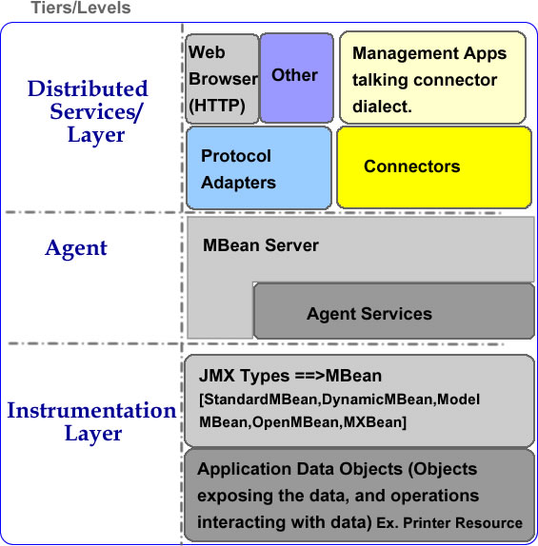
JMX Tiers…
Notes:
-JMX ecosystem defined by associated public JMX specifications
-MBean exposes attributes, operations, parameters, notifications … JMX type exposing most management information programmatically available.
-Instrumentation(get at data and expose as JMX type)
-Agent(repository for JMX types), and other directory lookup functionality
-Distributed Layer(Extensible to include any existing protocols and ones not yet thought of)
-Adapter: Ex. Html way of browsing and making simple op calls.
-Connector explicitly has i)Client proxy ii) Server stub. More on that later.

Slide 12
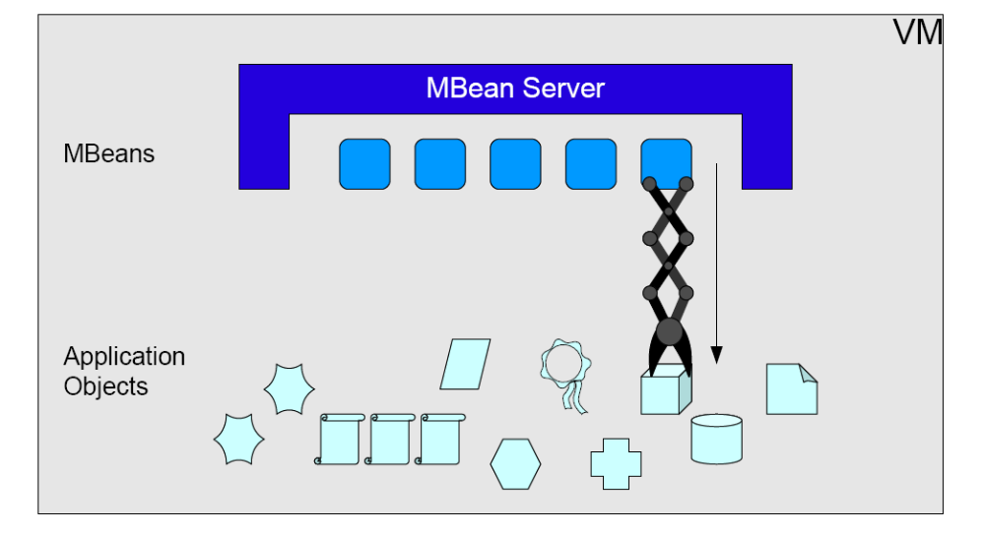
JMX Review
Notes:
-Wow … what was that again?
-Key take aways:
-For Java applications, there’s an established standard in place based off public specifications. Been around a few years.
-Tiered and flexible architecture:
-Still too many details? Every organization is implicitly aware of what’s to be managed, wrap your existing application monitoring code in JMX types living in an MBean server.

Slide 13

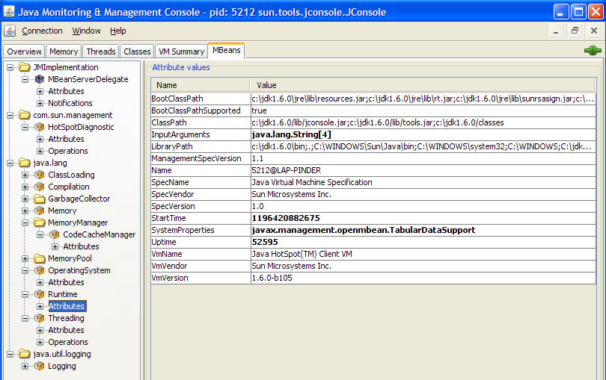
JMX Already in your JDK
Notes:
-You were thinking “Pie in the sky” … maybe not in a red dress… but
-Key take aways:
-Delivered natively on every platform where Sun JDK 5.0 and beyond runs.
-NOTE: JDK vs. JRE distinction. JRE is more lightweight.
-Actual Java Virtual Machine is instrumented with MBeans
-JConsole is a JMX aware MBean browser also delivered with the platform JDK.
-Tomcat, JBoss, HP, BEA, Sun, etc .. See references link at end for link list 90 or so java software products that have already instrumented their applications and talk JMX locally.
- Cool .. so all I need now is an adapter/connector to monitor/manage their software applications?

Slide 14
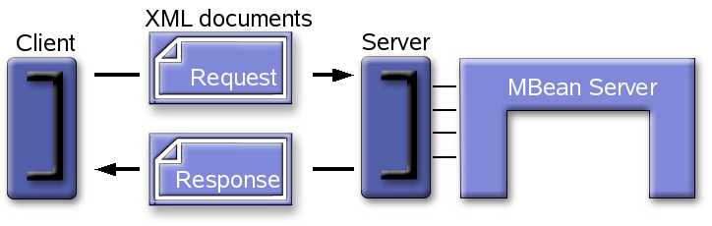
JSR 262: WS JMX Connector
Html Adaptor a little thin to transfer Business Model content in a flexible fashion.
Distributed Services Layer: Finally a Web Service Protocol Adaptor for JMX Agents.
Notes:
-Distributed layer left open for extension.
-HTTP Adaptor example thin: HTML is primarily for displaying content.
Remember: Much time/energy taking very specific content(Bank account info) in a clean, html page for the average user.
-What if:
-you don’t care about how it looks to the average user. Just want content? Put on the make up later?
-how do you specify a new Business Model version(CREATE) to your JMX application? What does it look like serialized?
-Back to the Web Service paradigm. Extensible mechanism that works….
-Early draft of JSR-262 connector takes JMX data and exposes via WS-Management protocol.
-Alternative deployment mechanisms(servlet, connector instance in running thread)
-MBean attributes exposed as WS-Management resources.
-MBean Notification mechanism exposed as WS-Eventing mechanism.
-MBean operations are exposed as WS-Management custom operations.

Slide 15
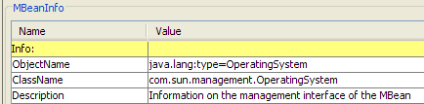

JSR 262: WS JMX Connector
JMX WS Connector: https://ws-jmx-connector.dev.java.net/
The Early Access release comes with examples for:
-simple jmx access to the connector
-servlet deployment approach
-security enabled communications using connector
Notes:
-again, not just pie in the sky or plans to implement.
-Early draft has been available for months.
-If you know how the MBeans are addressed and how the connector exposes them via WS-Management … you’re home free
-Using JConsole to browse the default Mbeans, and the specification to understand how the connector exposes the information via WS-Management

Slide 16
JMX and WS-Man use cases
Arbitrary MBeans exposed as WS-Management resources
    I have MBeans, whose interfaces I may not know a priori (discovered at runtime), and which I want to expose through WS-Management
    To JMX-Aware WS-Management clients (not necessarilly Java)
    To JMX clients through WS-Management (JMX Connector)
    Example: Monitoring & Management of the JVM MBeans, custom MBeans, etc...
WS-Management resources implemented as MBeans
    Derived from an arbitrary model (e.g. from WS-CIM)
    Or mapped to an arbitrary model (e.g. to WS-CIM)
    Exposed as “native” WS-Management resources (JMX is an implementation detail).

Slide 17
Do I have all the pieces?
Can I begin managing arbitrary JMX implementations
With my WS-Management clients today?
Yes … well technically.
With recent Windows updates, WS-Management is available from a large Widows(Vista, XP and 2003) install base and with the JSR 262 connector there are thousands more OS-agnostic sources of Management information avialable for use…..
Current WS-Management specification does not really address catalog/index information…. Like UDDI repository
In other words, where’s the JConsole for WS-Management data?
Notes:
-the number of WS-Management servers/instances out there is bigger than you think.
-WS-Management specification lacks a Catalog mechanism… WS-Catalog was never finished. Resource Catalog is now under development.
-Why is that a problem. Once you expose management data, there is too much of it.
-How do you filter?
-How do you find out all the connection information that you need to make the right request? What ResourceURI? To? Selectors? Which operations does a specific WS-Management resource support?
-If you know ahead of time then you don’t care, but if you don’t … :-/ ….
-Wiseman Tooling provides an answer.

Slide 18
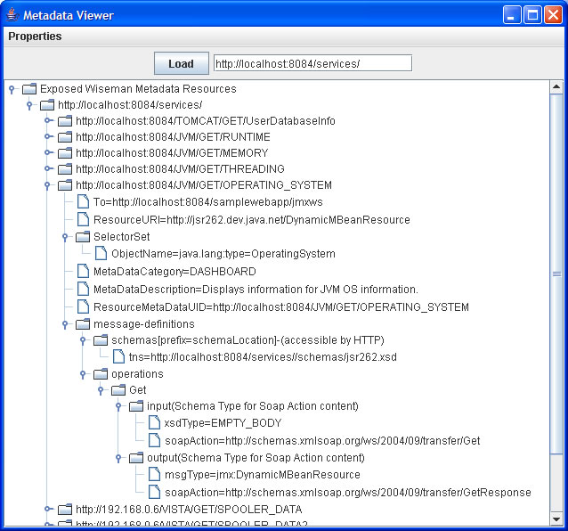
Wiseman Tooling: Metadata Explorer/Viewer
-Respect
the Default
Addressing
Model.
-Define the
metadata for
the service
at the
source/
Implementation
-WS-MetadataExhange
Notes:
Wisema provides tooling around describing and browsing WS-Management metadata/connection information
Respect the Default Addressing Model, experiences learned from successful interoperation with Microsoft, OpenWsman, etc. …
Leverages Java language structure(Annotations) for scalable mechanism to define metadata closest to where it’s defined… i.e. server implementation.
Is an implementation of the public Metadata Exchange WS* standard.
At the code level, WS-Management metadata defined using standard Java language freature called Annotations. Scalable and exposed through familiar protocol.

Slide 19
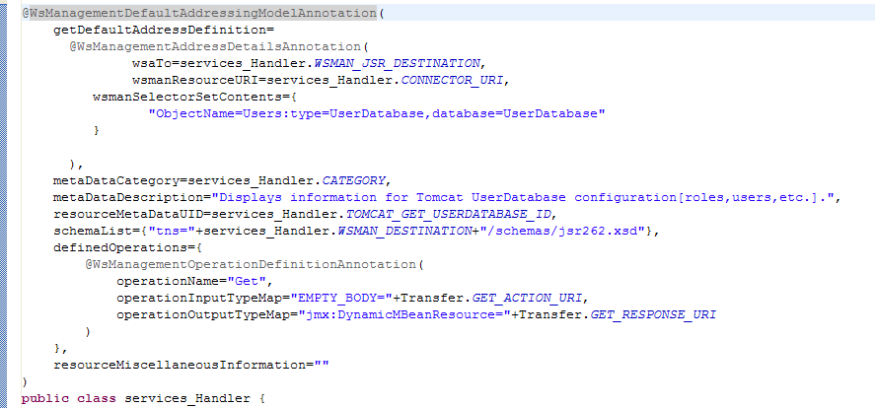
Wiseman Tooling: Metadata Explorer/Viewer
Notes:
Adds a couple extra metadata description headers to make the information more human readable.
By defining this information on top of the server implementation class, we can:
share variables and reuse operation descriptions
changes to server side implementation can quickly be reflected in the exposed metadata for this service
Metadata is defined by the person most knowledgeable about the implementation(a.k.a. server side developer)

Slide 20
Do I have all the pieces now?
Yes! We’ll demonstrate how quickly end-to-end applications can come together in a few minutes.
So what’s the hold up?
Let’s see what’s involved in a simple WS-Management conversation with the server.
We’ll leverage the Wiseman client side apis and a bit more tooling to see the application work.
Notes:
-There are tons of WS-Management servers out there, what’s involved in developing a successful client application?
-Step back, WS-Management is a protocol meaning that both client and server side apis are important.
-Another piece of Wiseman tooling makes this last step a snap.

Slide 21
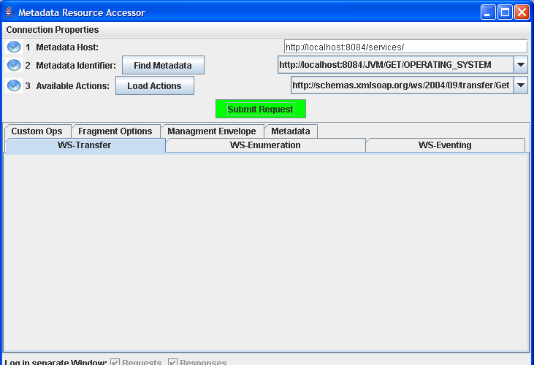
Wiseman Tooling: Resource Accessor
Notes:
Wiseman provides tooling around describing and browsing WS-Management metadata/connection information
Respect the Default Addressing Model, experiences learned from successful interoperation with Microsoft, OpenWsman, etc. …
Leverages Java language structure(Annotations) for scalable mechanism to define metadata closest to where it’s defined… i.e. server implementation.
Is an implementation of the public Metadata Exchange WS* standard.

Slide 22
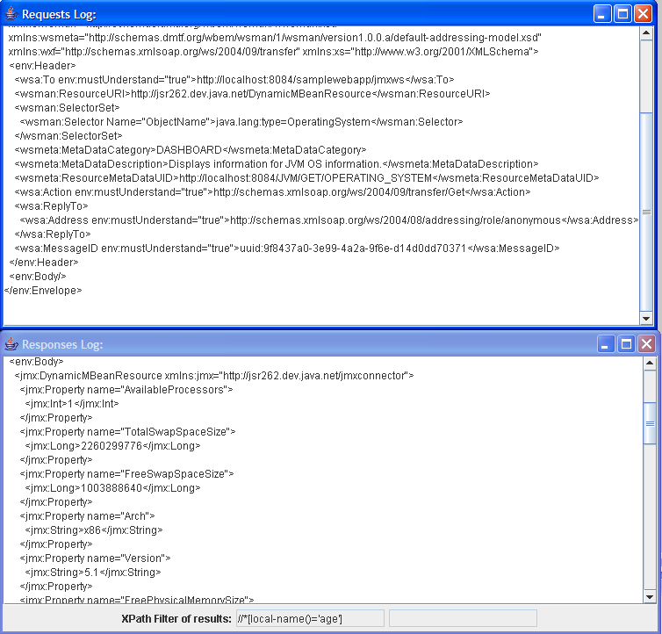
Wiseman Tooling: Resource Accessor
Notes:
Wisema provides tooling around describing and browsing WS-Management metadata/connection information
Respect the Default Addressing Model, experiences learned from successful interoperation with Microsoft, OpenWsman, etc. …
Leverages Java language structure(Annotations) for scalable mechanism to define metadata closest to where it’s defined… i.e. server implementation.
Is an implementation of the public Metadata Exchange WS* standard.

Slide 23
Demo: Graphical Client Access
WS-Management enabled Resources
  Tomcat 5.5.25 instance with JMX connector
  Arbitrary JVM with JMX connector
  Wiseman metadata server
  Windows(Vista) [optional] REMOTE
  Glassfish appserver [optional] REMOTE
  Swing Administrator Dashboard: putting it all together
Notes:
Description

Slide 24
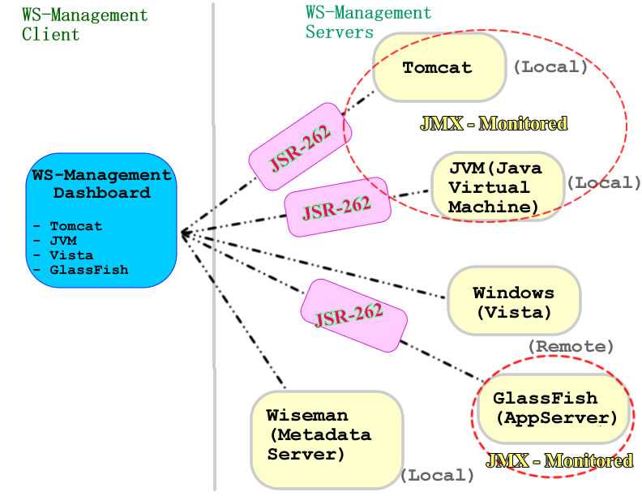
Demo: Graphical Client Access
Notes:
Description

Slide 25
References/Sources?
JMX Info: http://java.sun.com/jmx
Publicly Known JMX Adopters
  http://java.sun.com/javase/technologies/core/mntr-mgmt/javamanagement/jmxadoption.jsp
JMX WS Connector: https://ws-jmx-connector.dev.java.net/
JMX presentation: http://developers.sun.com/learning/javaoneonline/2006/coreplatform/TS-3523.pdf
JMX presentation 2: http://developers.sun.com/learning/javaoneonline/2007/pdf/TS-2656.pdf
Many thanks to the Sun Microsystems JMX team for slide content and images.

Slide 26

Questions?

