Slide 1
SAP’s Strategy of using Industry Standards in the Management Field
Gregor Frey, Miroslav Petrov NetWeaver, Operations Infrastructure

Slide 2
Message
SAP welcomes the emerging interest in industry standards in the field of IT-management.
The new technology-wave of service oriented architecture (SOA) reinforces the need of a unifying platform for system and service management.
Together with its partners SAP wants to drive the development, alignment and adoption of the relevant industry standards, to allow for a plug-and-manage of IT-components.

Slide 3
Standards
Topic | Standard (adopted by SAP) | Standard Body
Information Model | Common Information Model (CIM) | DMTF
Protocol | WS-Management (WS-Man) | DMTF
Instrumentation | Java Management Extensions (JMX) | JCP
CIM, WS-Man, and JMX are orthogonal standards
Together they ensure full interoperability: Plug-and-Manage
CIM
WS-Man
Information
Model
Protocol
Instrumentation
JMX

Slide 4
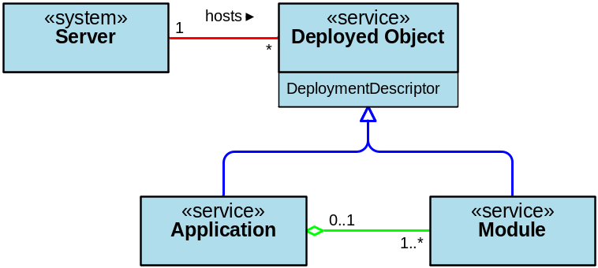
Interconnection of JMX, CIM & WS-M
For a Management Application
a MBeanServer
“looks like”
a lightweight CIM-OM
Management Application
WS-Man
WS-Man
JMX-WSM Adapter
CIM-WSM Adapter
MBeanServer
CIM-OM

Slide 5
NW-Integration Points for SOA-Management Partners
NetWeaver
NWAdmin UI
central
ISV
Tool
WS-Man
NWAdmin Data Provisioning
central
ISV
Resource
WS-Man
NWAdmin Local Agent
local
NW Managed Resource
local

Slide 6
Roadmap
Already done
Ongoing
Still to come
Modeling all managed objects in CIM started
SOAP based management protocol for Java, C/C++, and ABAP agents
Introducing WS-Man for pilot projects
Check interoperability together with partners
  SUN – Integration of management data from SUN-Storage
  MS – Processing of SAP-Incidents in MS-Operations Manager
All managed objects are modeled in CIM
General accessibility of managed objects using WS-Man

