Slide 1



DSP0226: WS-Management
WS-Management is now a DMTF standard
Based on a proposal submitted by Microsoft and Co-Authors in August 2005
Foundation of 1G Effort
Notes:
Get dmtf logo
05/23/06 11:26
© 2005 Microsoft Corporation. All rights reserved.
This presentation is for informational purposes only. Microsoft makes no warranties, express or implied, in this summary.

Slide 2
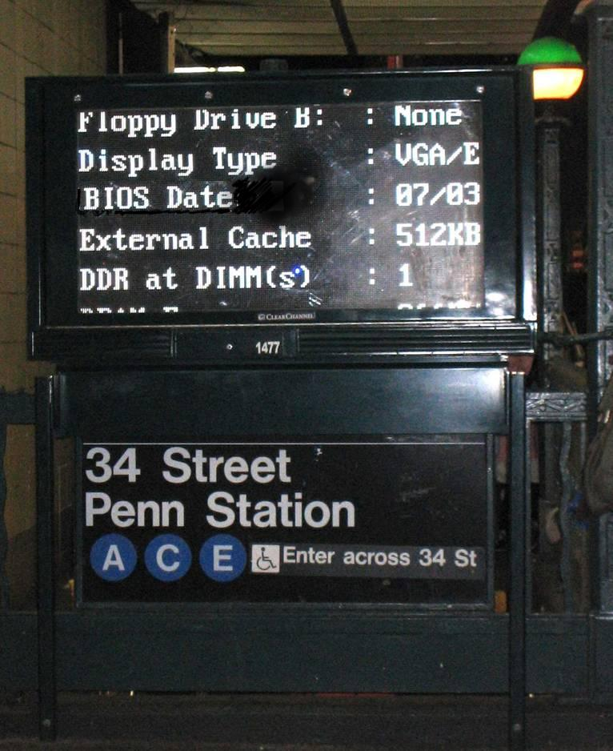
Goals of the Initiative
Web Services Access to CIM/WMI Instrumentation
  Evolve from DCOM and CIM/XML
Expose Hardware Instrumentation
  Web Services in your CPU
  Expose SMASH data

Slide 3
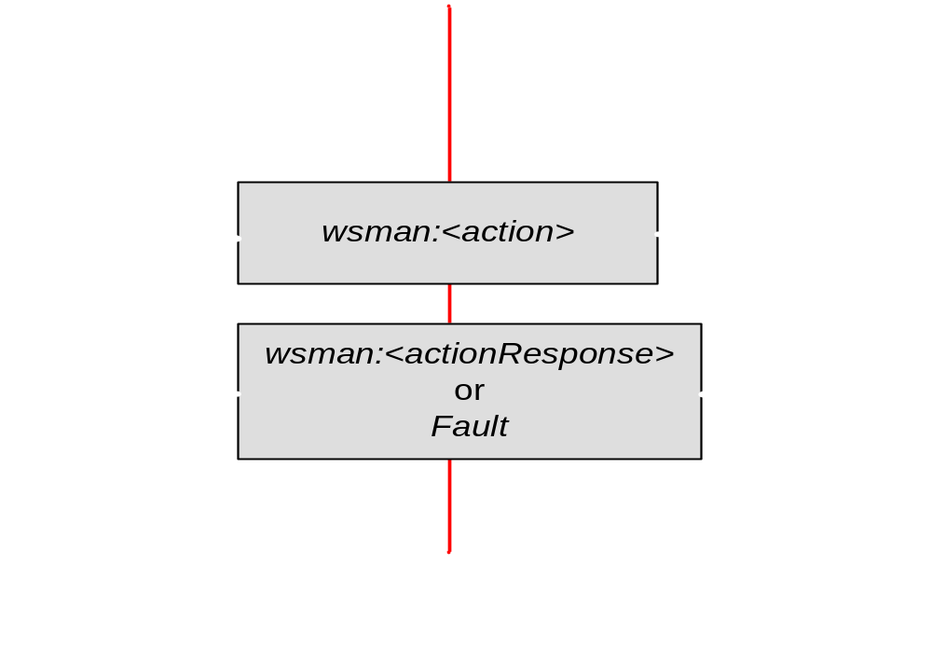
WS-Transfer
Defined by WS-Transfer
  Get
  Put
  Create
  Delete
Defined by WS-Mgmt
  Partial Get
  Partial Put
  Rename

Slide 4
WS-Enumeration: Enumerating Data Sources
Same as base specification
WS-man allows using partial results
Enumerate
EnumerateResponse
(Context)
Pull(3)
PullResponse
Pull(4)
PullResponse
Release
ReleaseResponse
Item Collection
Client
Agent
Notes:
Operation to get an enumeration context
Enumerate starts a new enumeration and returns a new enumeration context
Operation to fetch items from an enumeration
Pull gets one or more items
Operation to abandon an enumeration
Release stops an enumeration in progress
Operations to manage enumeration lifetimes
05/23/06 11:26
© 2005 Microsoft Corporation. All rights reserved.
This presentation is for informational purposes only. Microsoft makes no warranties, express or implied, in this summary.

Slide 5
Resource Addressing Choice
WS-Management “default” addressing
  ResourceURI is additional SOAP header
  Selectors (required only to act as ‘keys’ for multi-instanced resources)
Alternative addressing models are used for integration or where appropriate
<wsa:To>
http://myserver/wsman</wsa:To>
<wsman:ResourceURI>
http://schemas.dmtf.org/cim/2.9/CIM_LogicalDisk
</wsman:ResourceURI>
<wsman:SelectorSet>
<wsman:Selector Name="Drive">c:</wsman:Selector>
</wsman:SelectorSet>
Notes:
Quickly go over the managed resources and URI space to start from
05/23/06 11:26
© 2005 Microsoft Corporation. All rights reserved.
This presentation is for informational purposes only. Microsoft makes no warranties, express or implied, in this summary.

Slide 6

WS-Eventing
Events can be delivered to a log or to a specific subscriber
Delivery modes:
  Push (defined by WS-eventing)
  PushWithAck (new)
  Batched (new)
  Pull (new)
Deliver
Management
Console
Get
Server
Subscribe
Group Policy
Notes:
05/23/06 11:26
© 2005 Microsoft Corporation. All rights reserved.
This presentation is for informational purposes only. Microsoft makes no warranties, express or implied, in this summary.

Slide 7
Protocol Composition
WS-CIM Schema Translation
Integration
WS-MAN WSDL Binding for CIM
Description
WS-Management
Application
Resource
Addressing
Models
WS-Transfer
WS-Enum
WS-Eventing
Data Transfer
Security profiles
Security
XML, SOAP, WS-Addressing
Messaging
HTTPS, TCP
Transports
Notes:
The key point about this picture is to show that the protocol is built upon the existing infrastructure you have already deployed plus a set of standard SOAP protocols that are not specific to management. And only on the very top we introduce mgmt specific extensions. Notice the integration layer on top of the protocol. This shows that we leverage the existing instrumentation infrastructure to without asking to change it or use another model to build instrumentation.
05/23/06 11:26
© 2005 Microsoft Corporation. All rights reserved.
This presentation is for informational purposes only. Microsoft makes no warranties, express or implied, in this summary.

