Slide 1
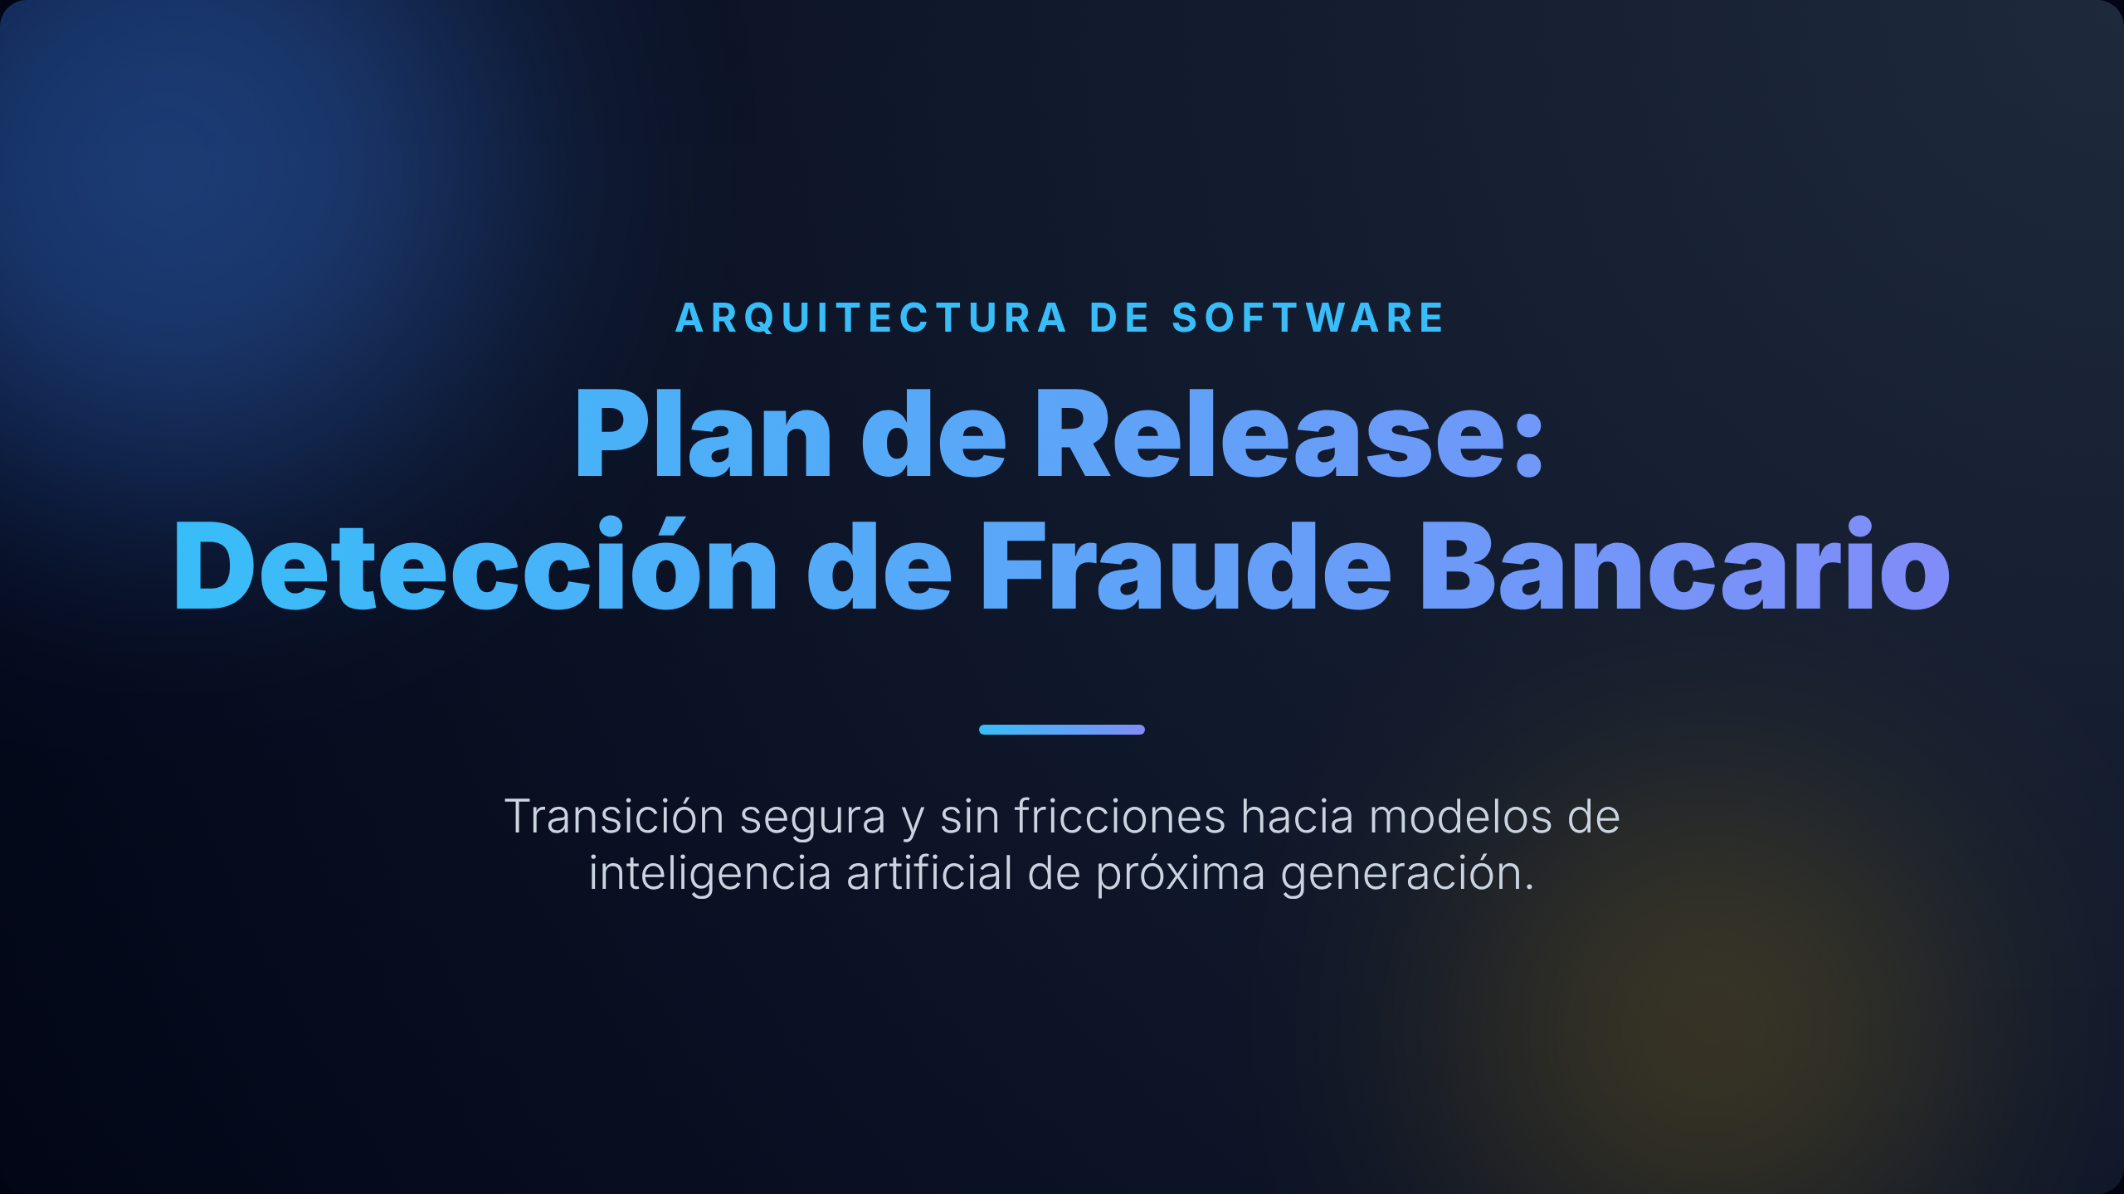

DESPLIEGUE DE SOFTWARE
Universidad Tecnológica Nacional, Facultad Regional Córdoba
Cátedra: Ingeniería y Calidad de Software | Comisión: 4K2 | Profesora: Meles, Judith
Integrantes:
401919 Allasia, Luciano
403938 Bertuzzi, Valentín
402494 Maggi, Gerónimo
401156 Mamud, Savina
400809 Mandrile, Virginia Maria
400483 Piscitello, Tomás
400299 Ritta, Guillermina
400653 Ruiz, Juan Jose
87979 Salguero, Mateo
400430 Suárez, Florencia
400181 Talone, Álvaro
403862 Zancanaro, Isabella

Slide 2
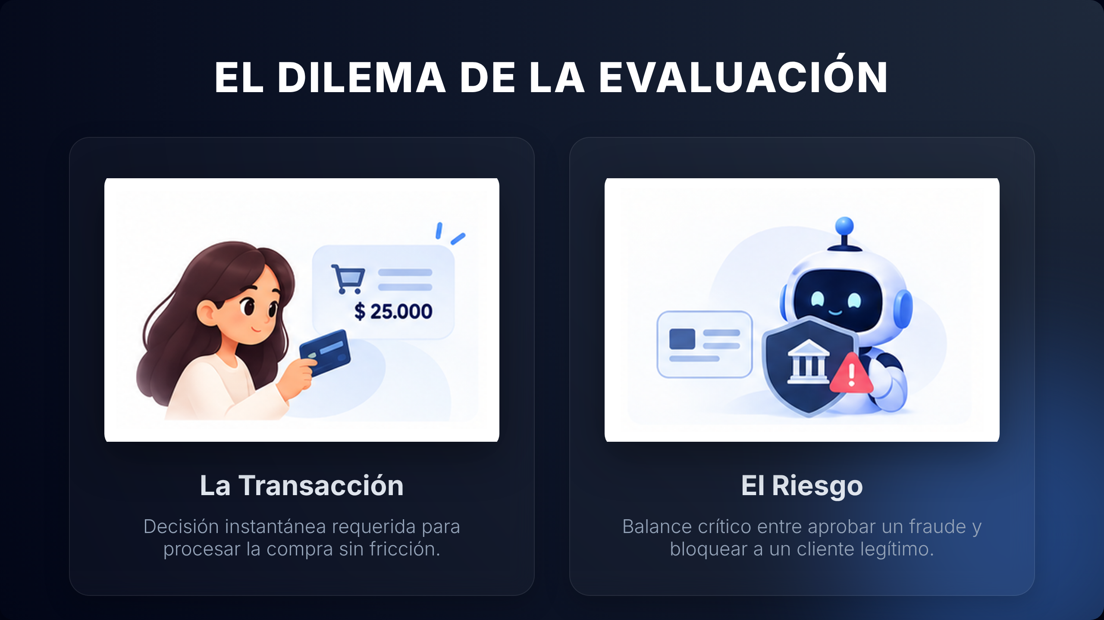


Slide 3
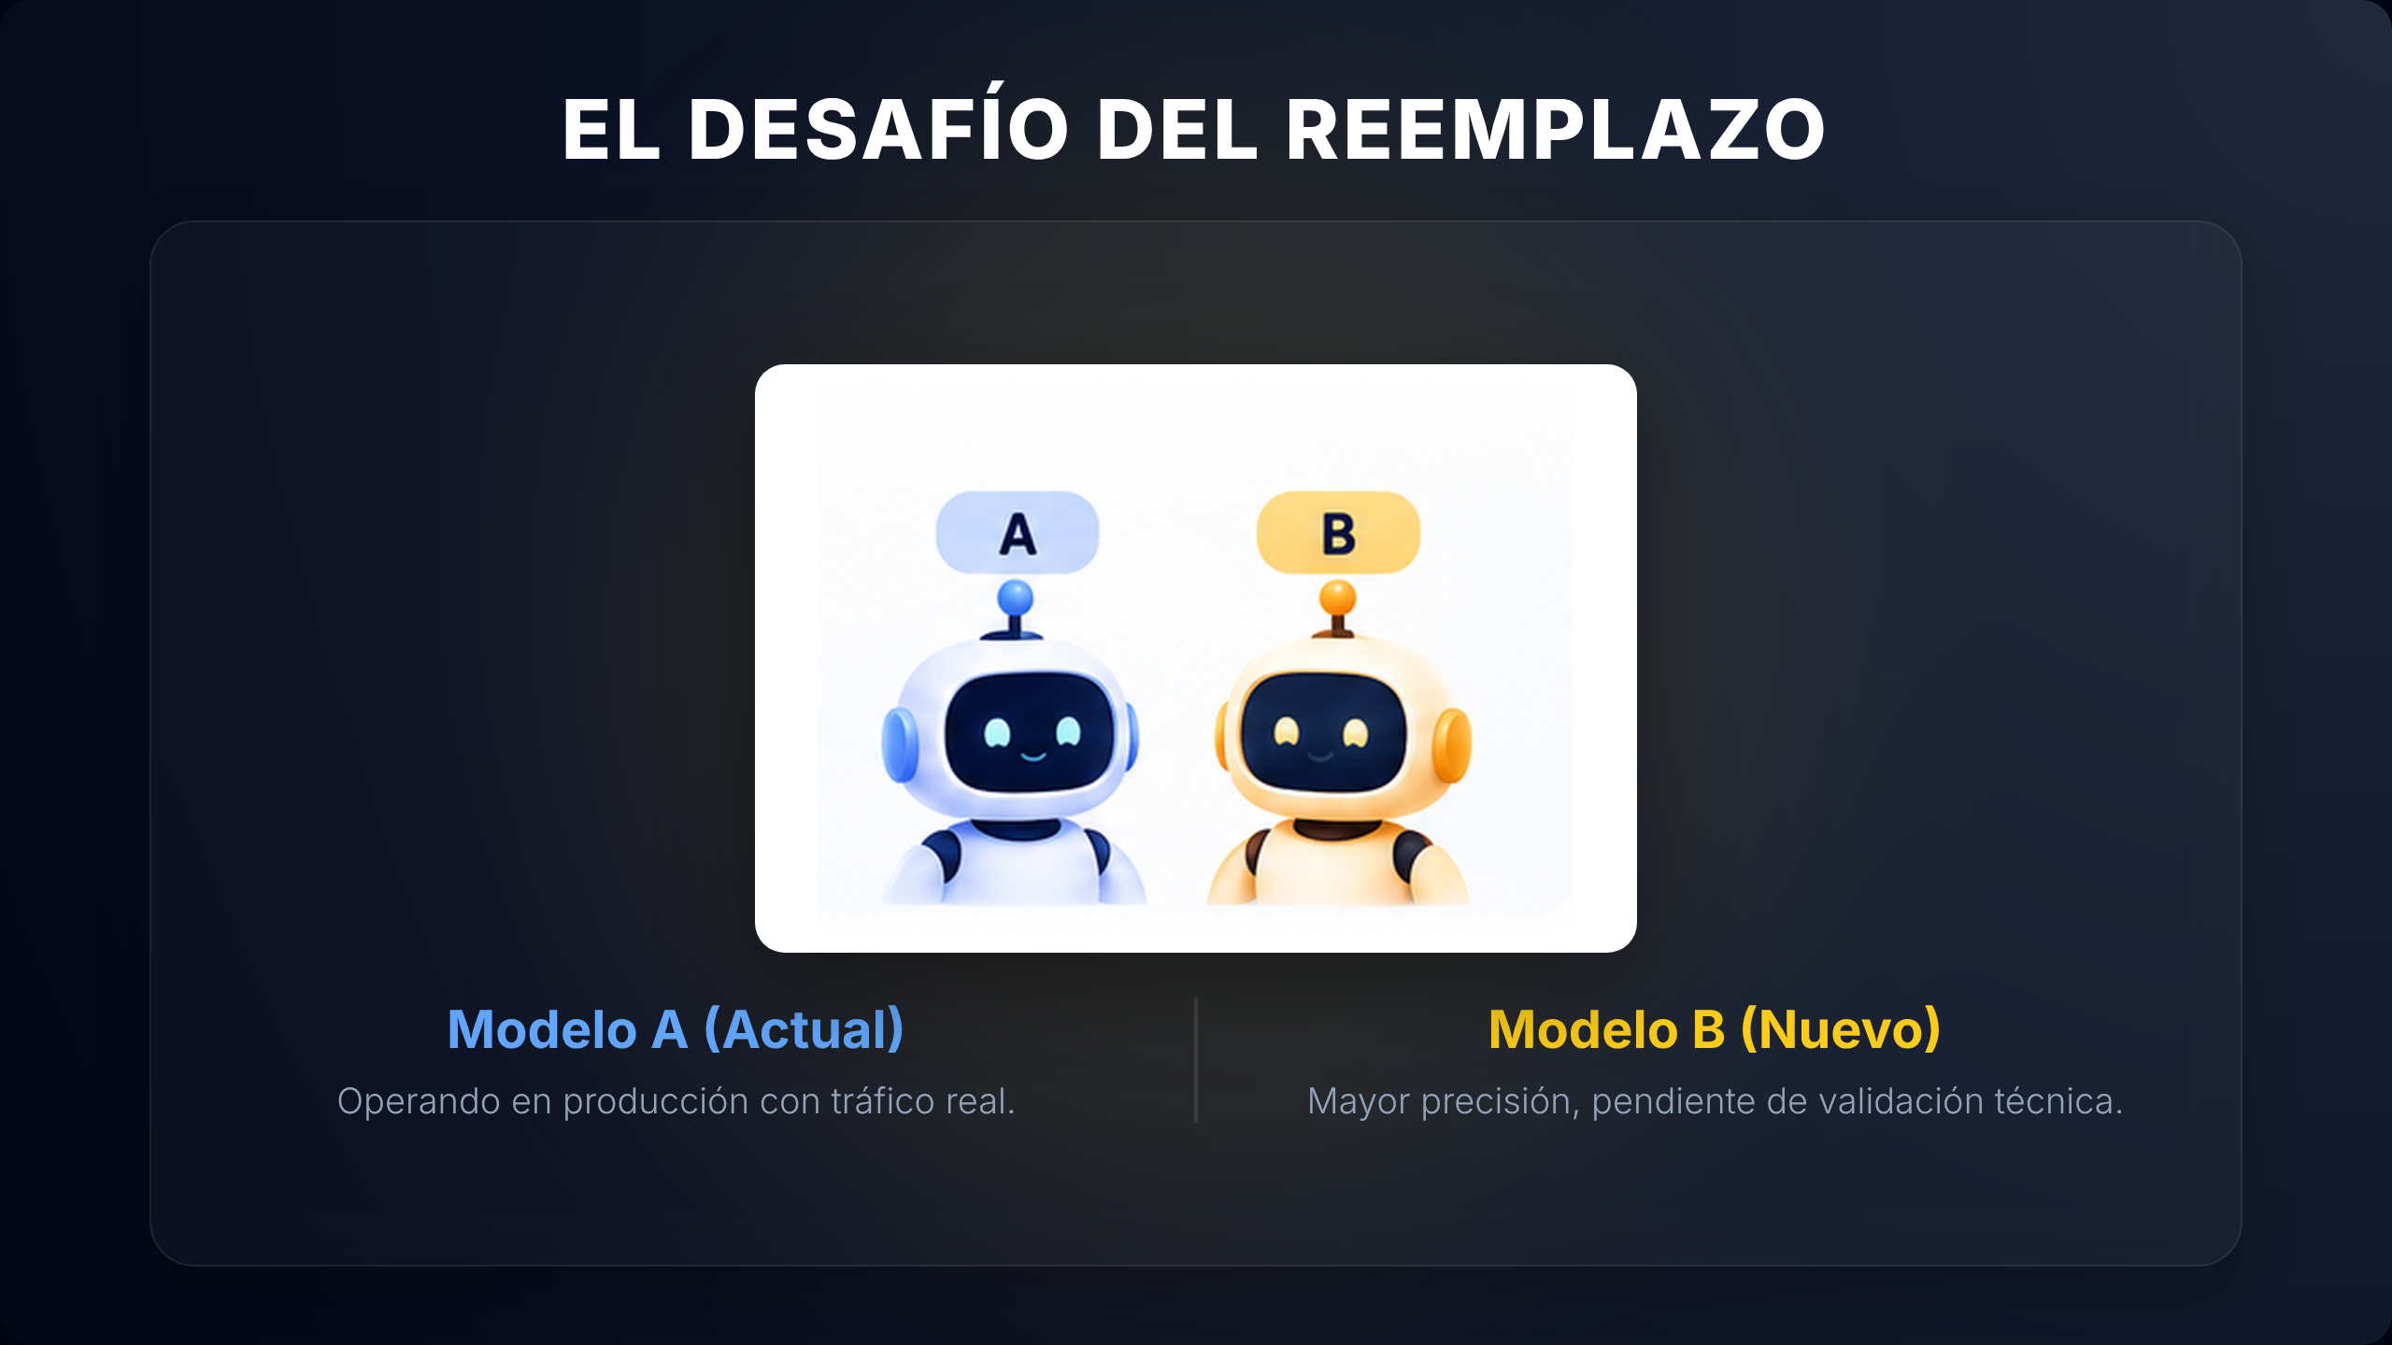

Slide 4
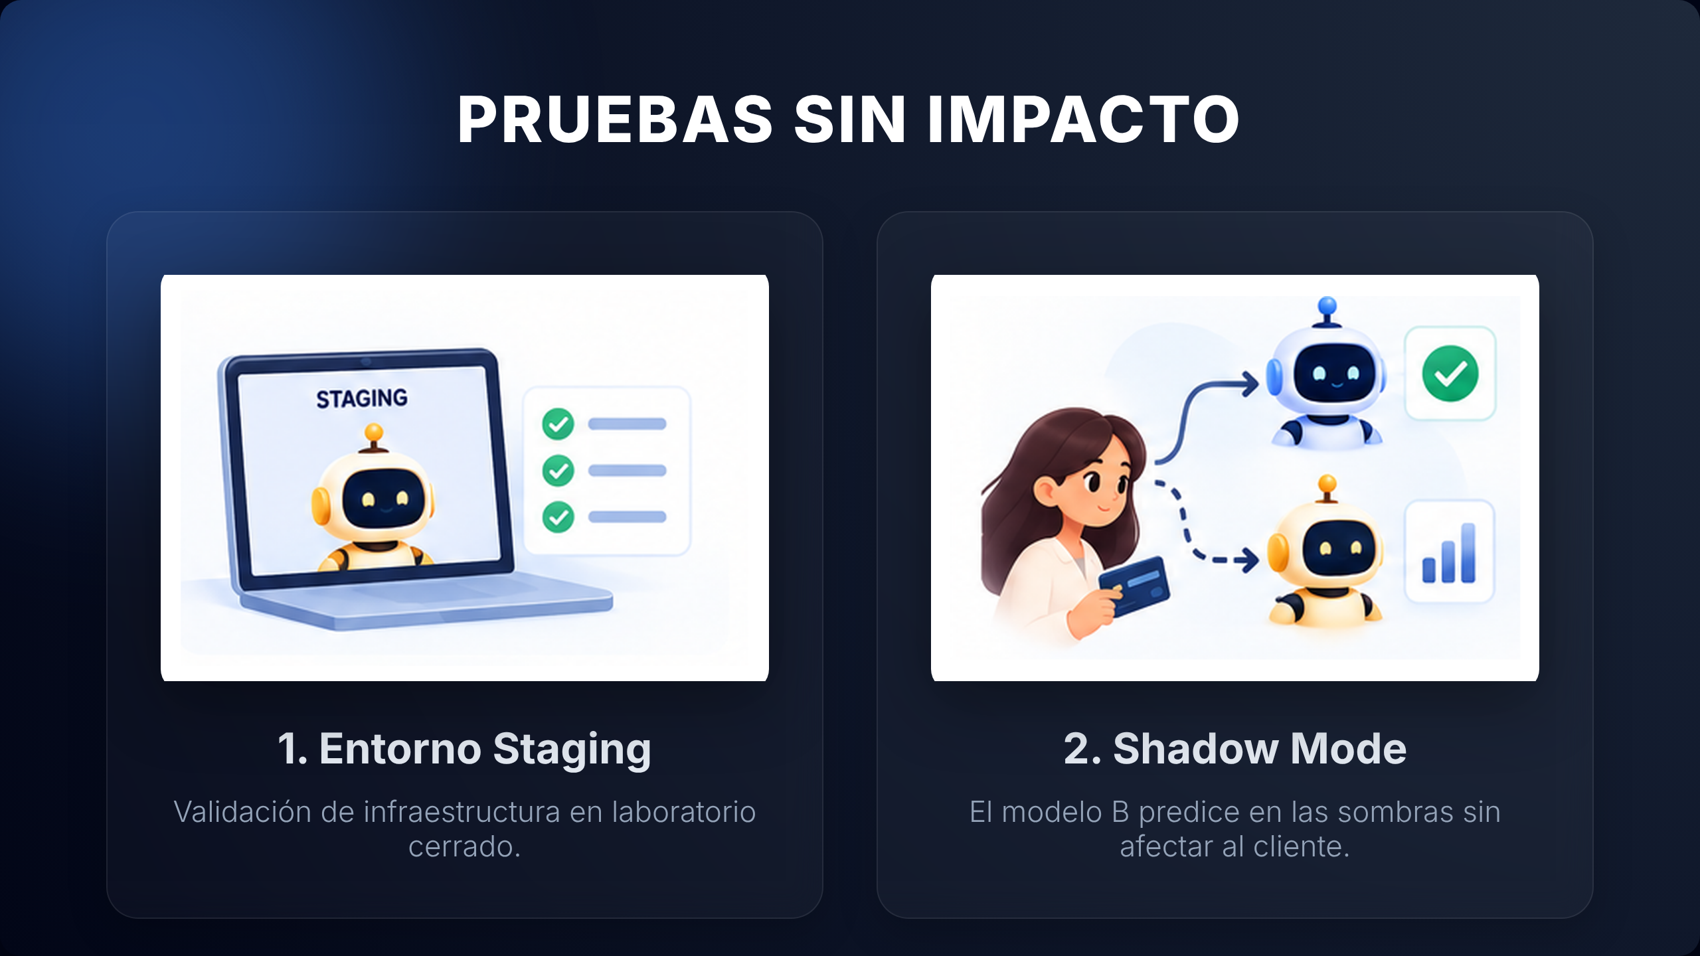

Slide 5
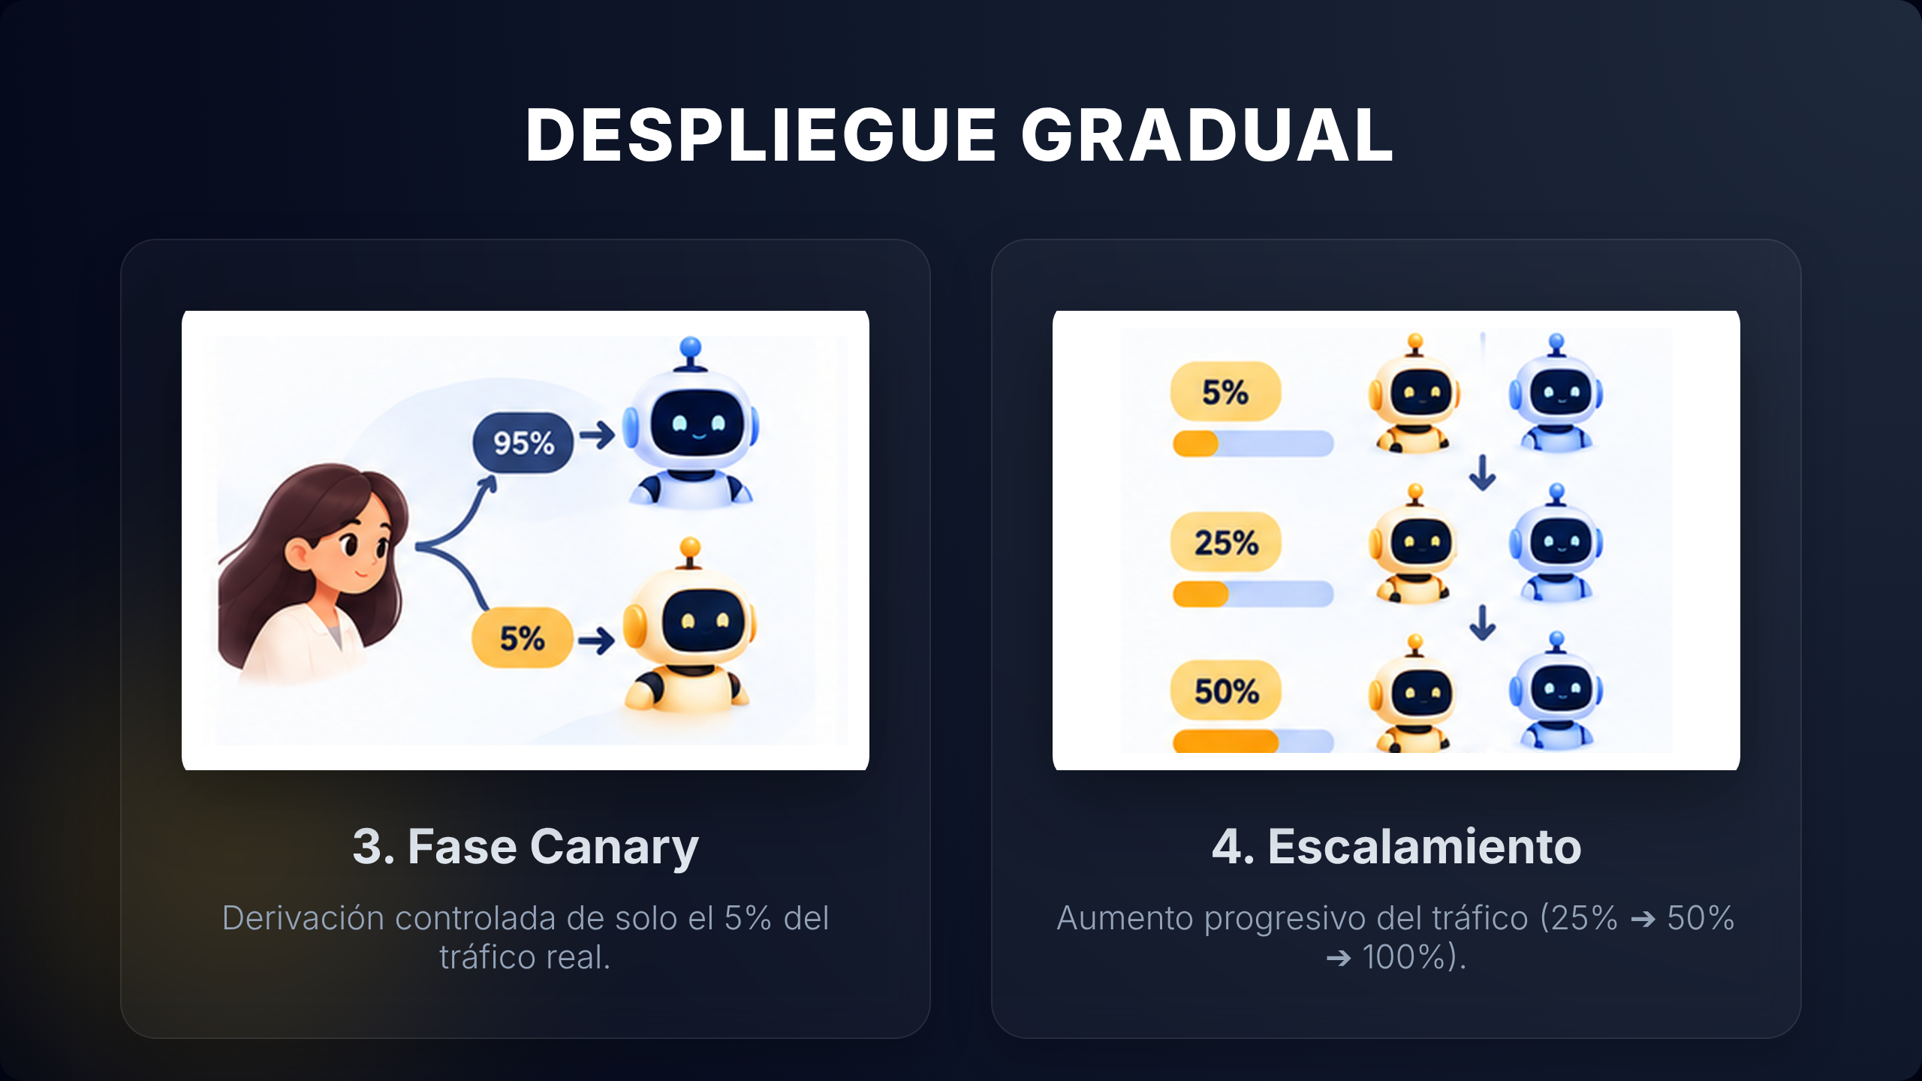

Slide 6
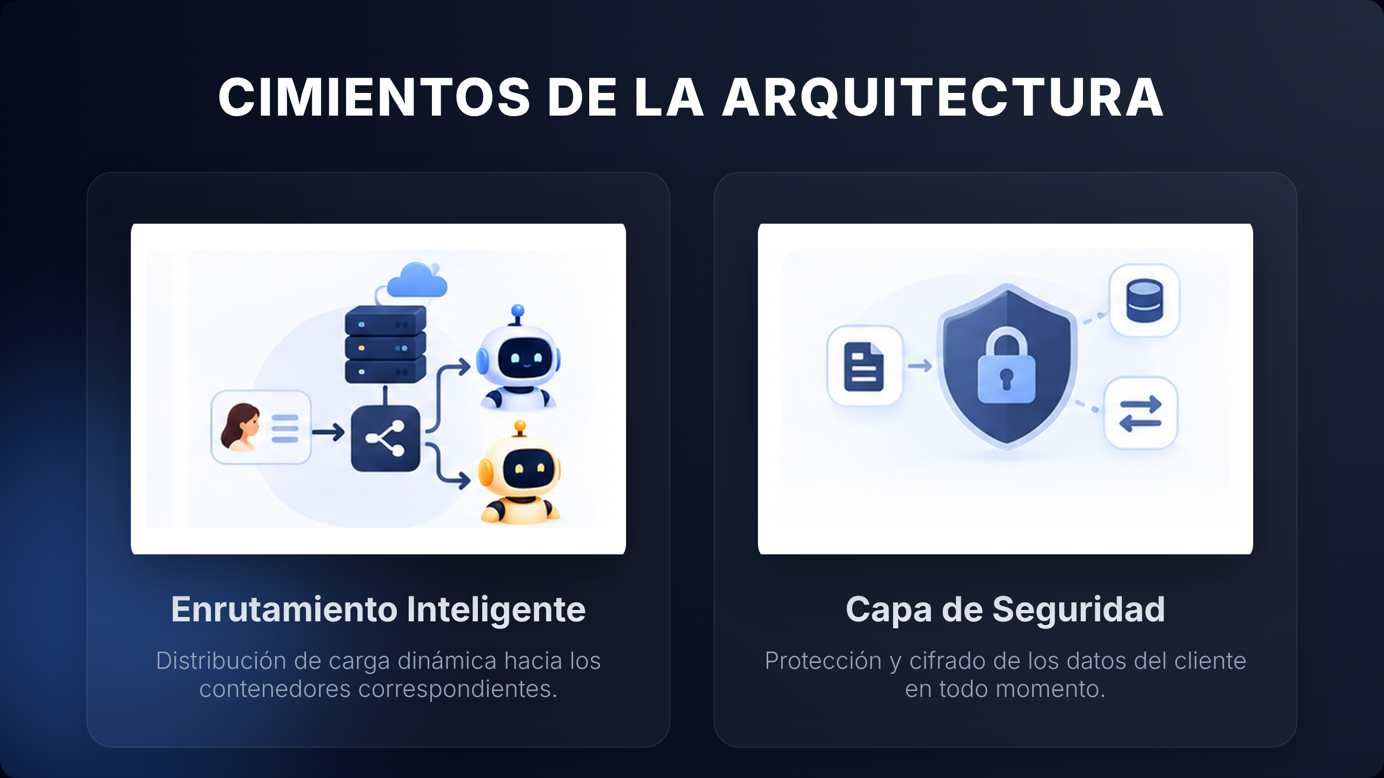

Slide 7
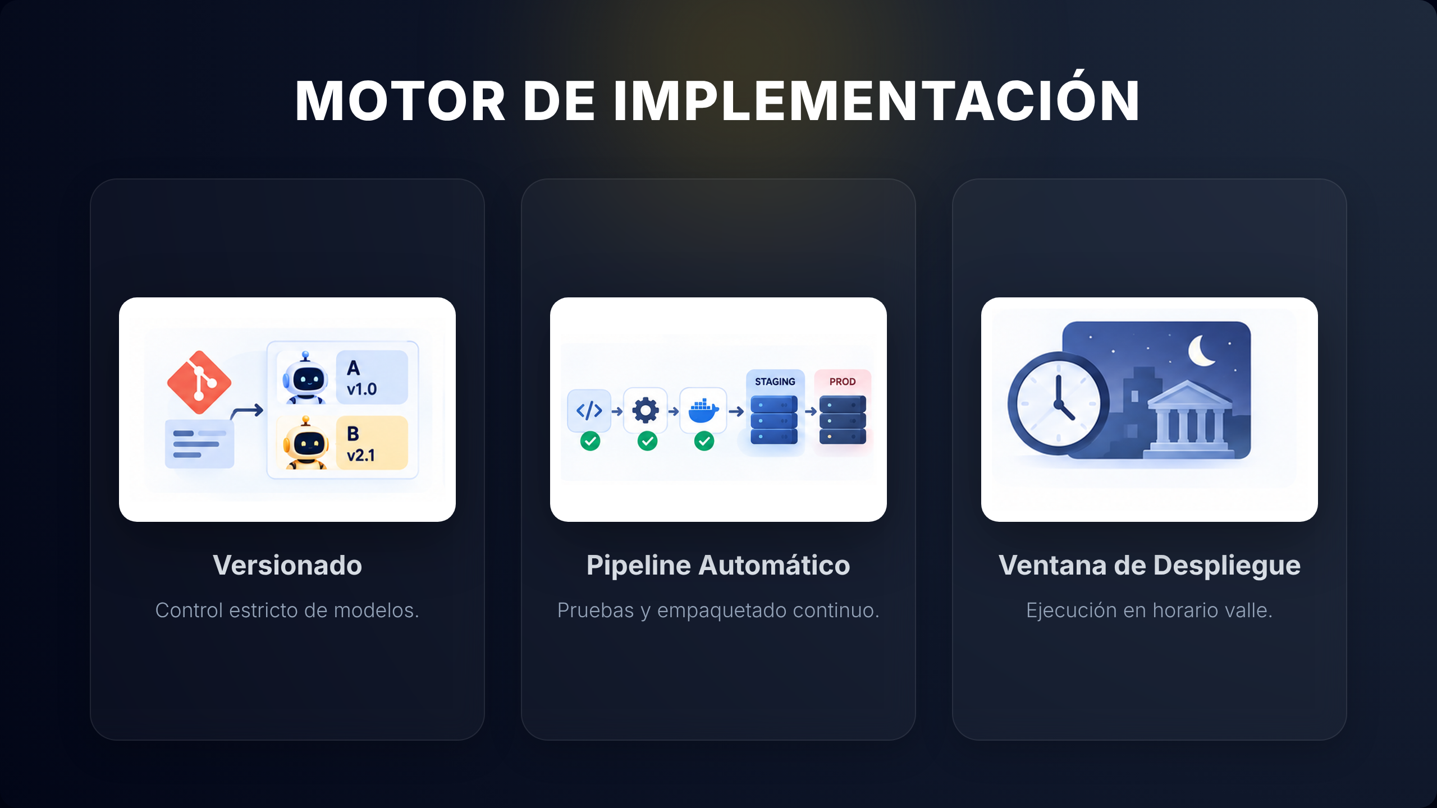

Slide 8
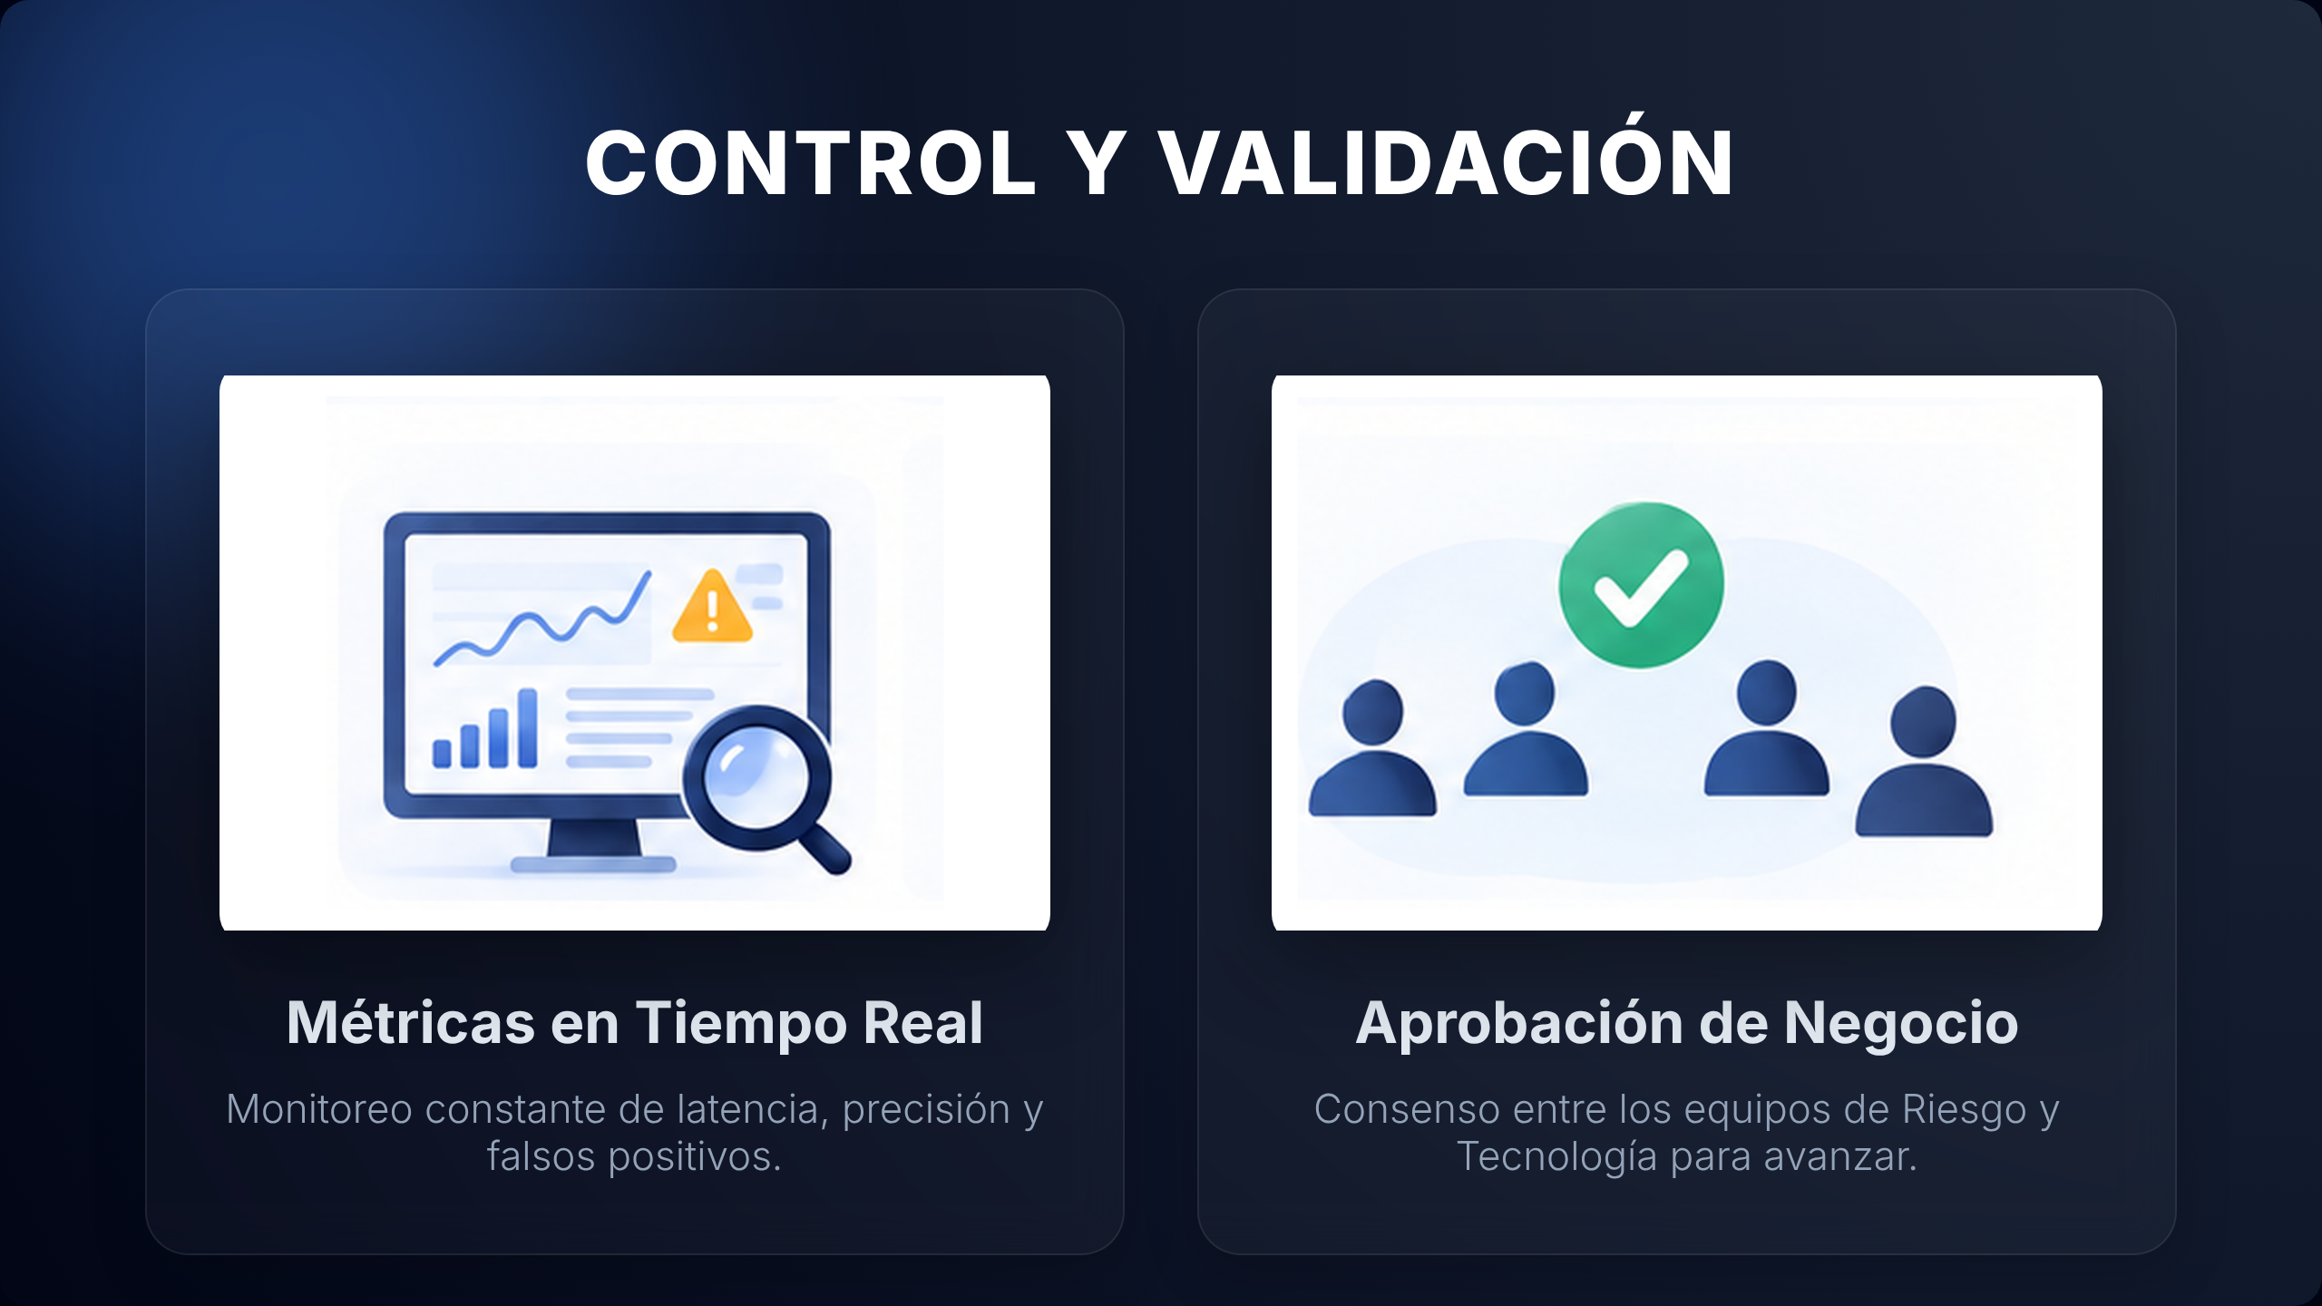
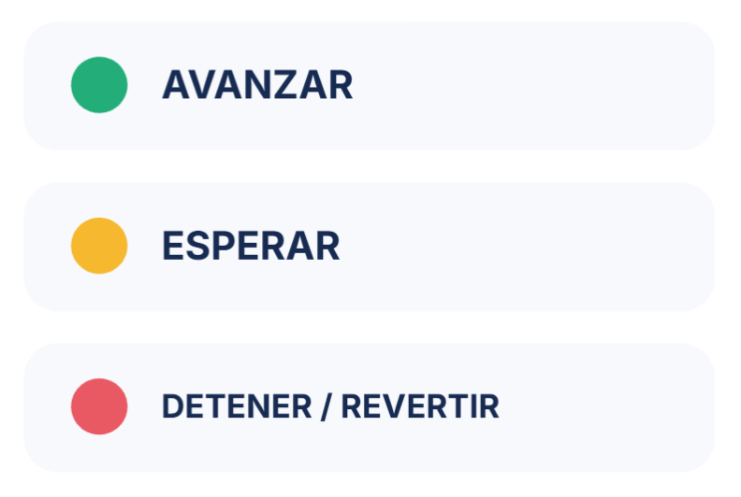

Slide 9
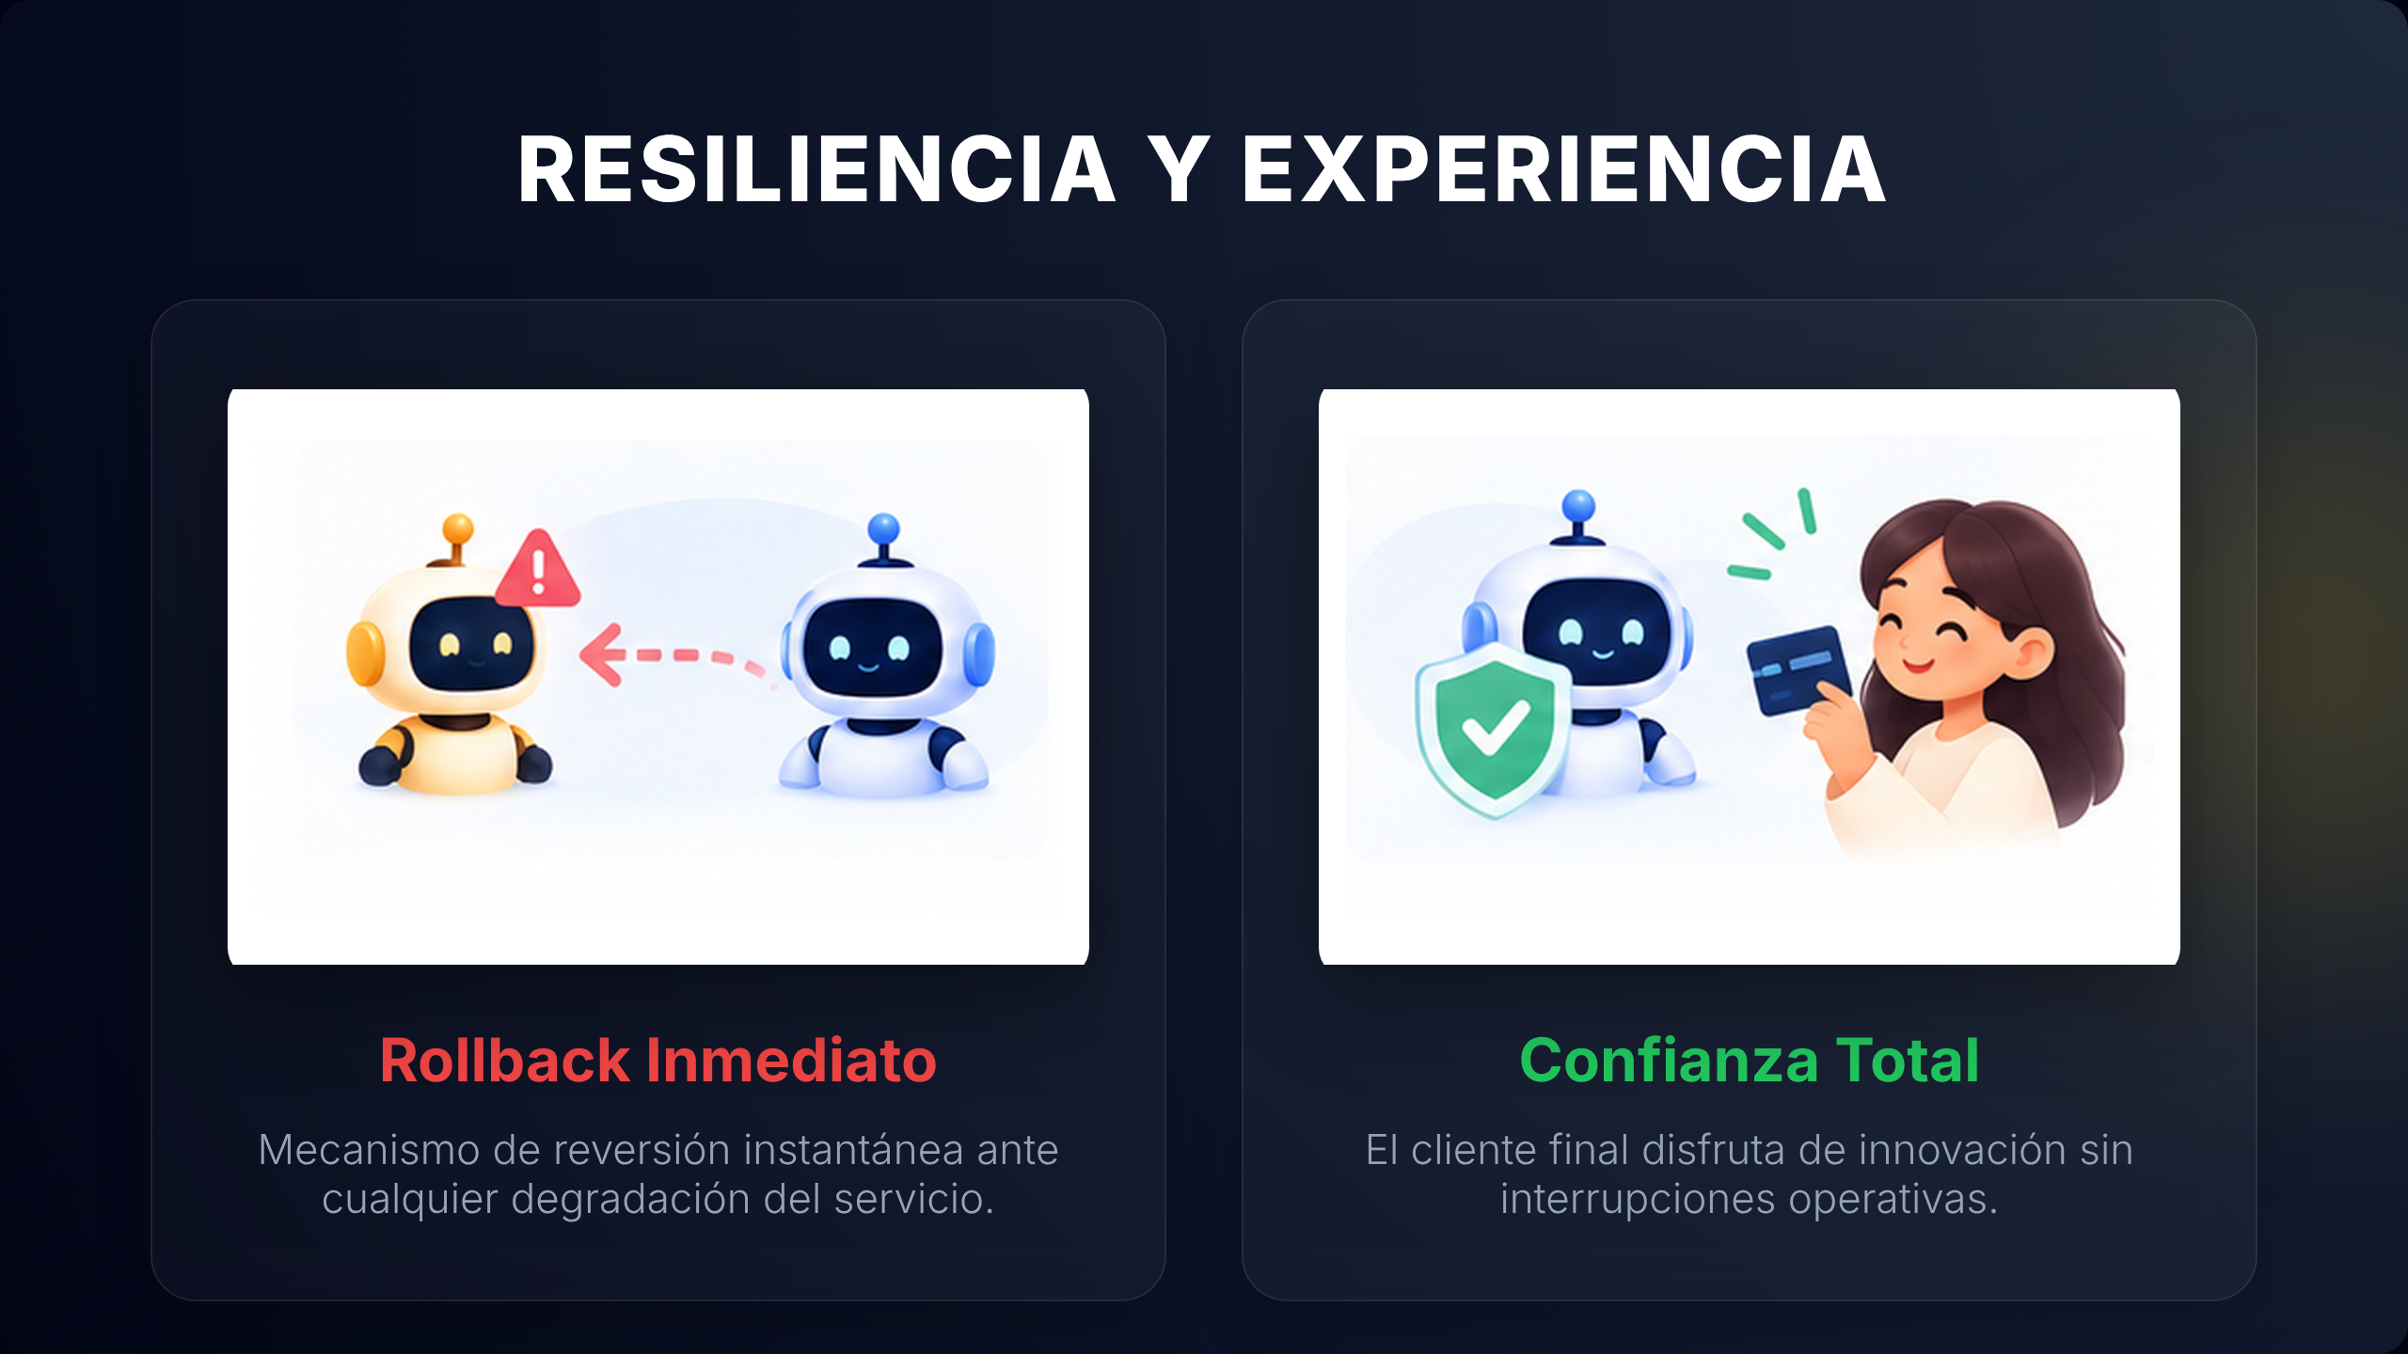
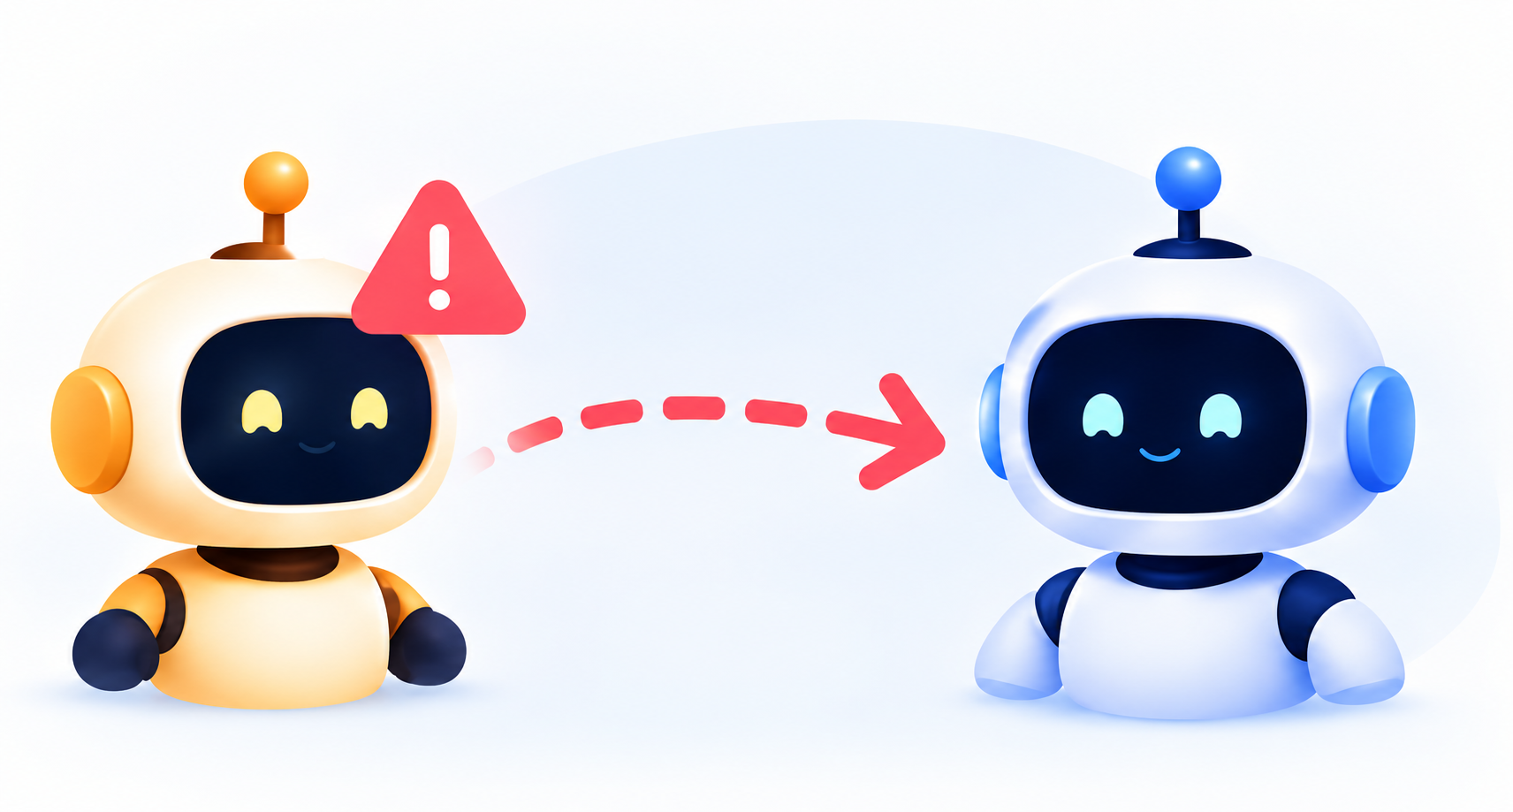

Slide 10
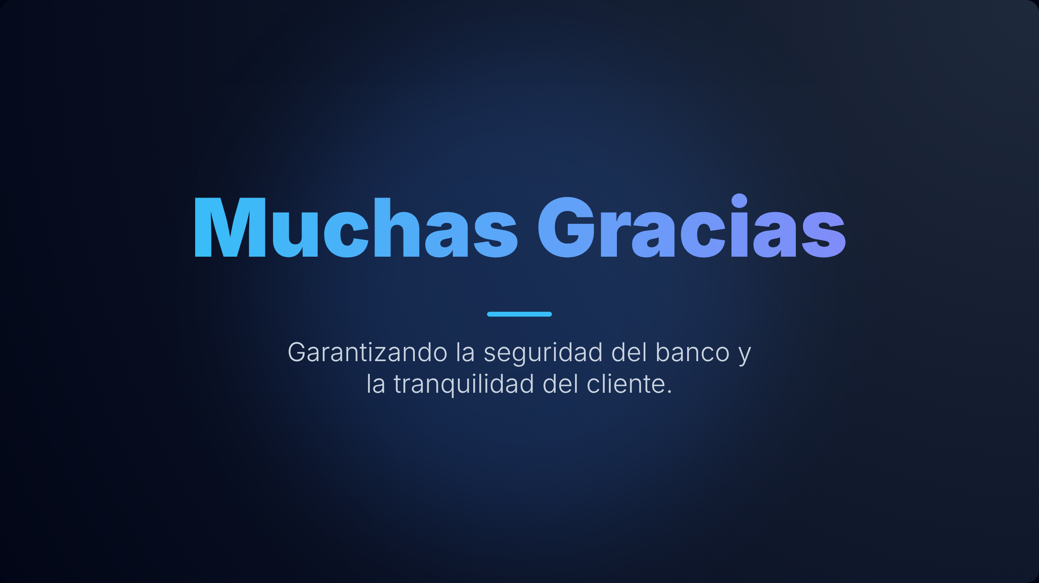

Slide 11

Referencias:
1. Amazon Web Services (AWS). Shadow Tests – Amazon SageMaker AI.
https://docs.aws.amazon.com/sagemaker/latest/dg/shadow-tests.html
2. Warner, A. y Davidovič, Š. (Google SRE). Canarying Releases – The Site Reliability Workbook.
https://sre.google/workbook/canarying-releases/
3. Amazon Web Services (AWS). Deployment Guardrails for Updating Models in Production.
https://docs.aws.amazon.com/sagemaker/latest/dg/deployment-guardrails.html
4. Google Cloud. MLOps: Continuous Delivery and Automation Pipelines in Machine Learning.
https://docs.cloud.google.com/architecture/mlops-continuous-delivery-and-automation-pipelines-in-machine-learning
5. MLflow. ML Model Registry.
https://mlflow.org/docs/latest/ml/model-registry/
6. GitHub. Understanding GitHub Actions.
https://docs.github.com/en/actions/get-started/understand-github-actions
7. Carcillo, F. et al. (2017). SCARFF: A Scalable Framework for Streaming Credit Card Fraud Detection with Spark.
https://arxiv.org/abs/1709.08920
8. NIST. (2022). Secure Software Development Framework (SSDF), SP 800-218.
https://doi.org/10.6028/NIST.SP.800-218
9. Open AI – Chat GPT (2026): apoyo en investigación, síntesis y escritura del guión.

