Slide 1
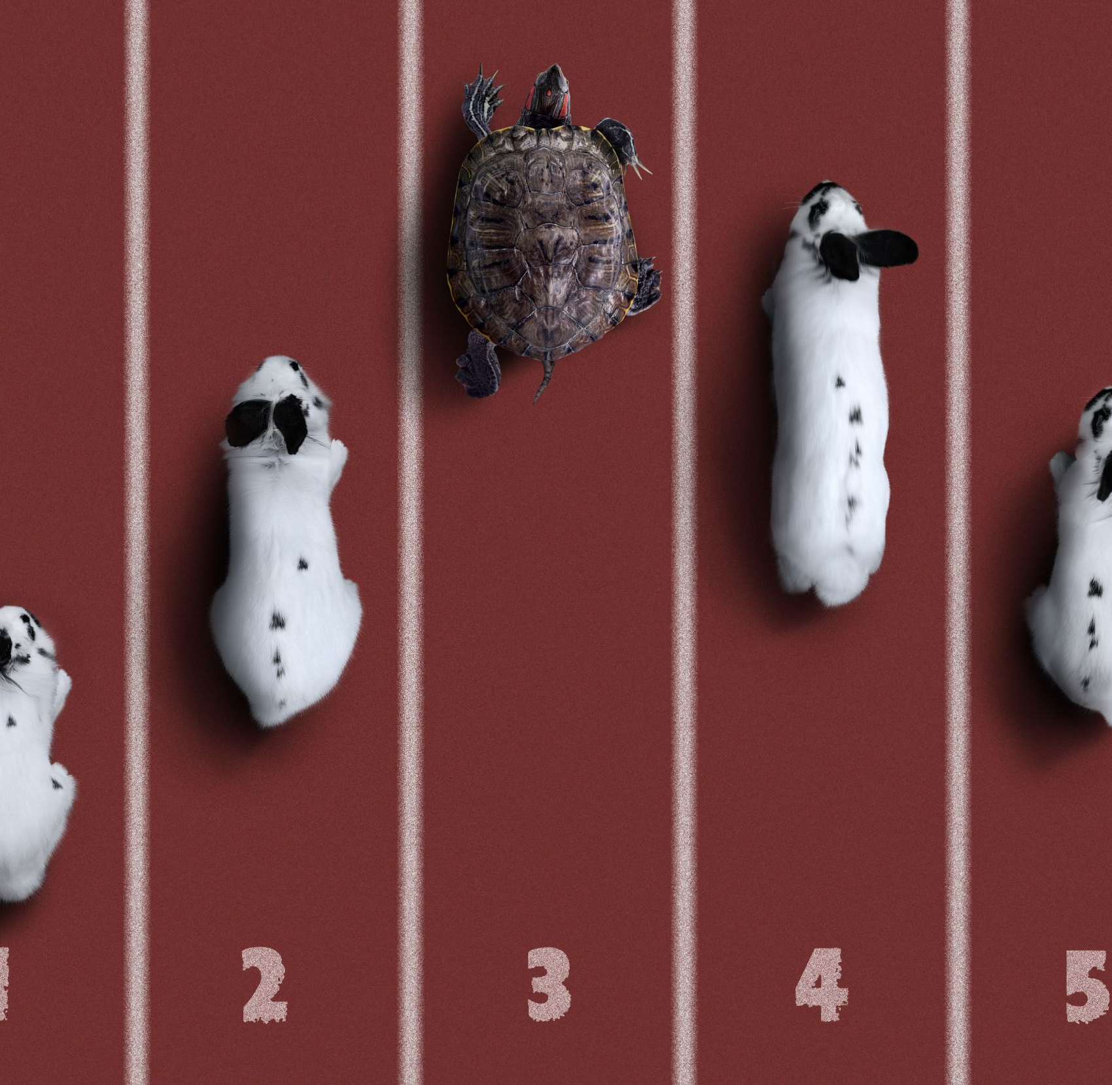
Object Identification — Animals
Tingxuan Zhai, Wei He
Notes:
Paying is one reason

Slide 2
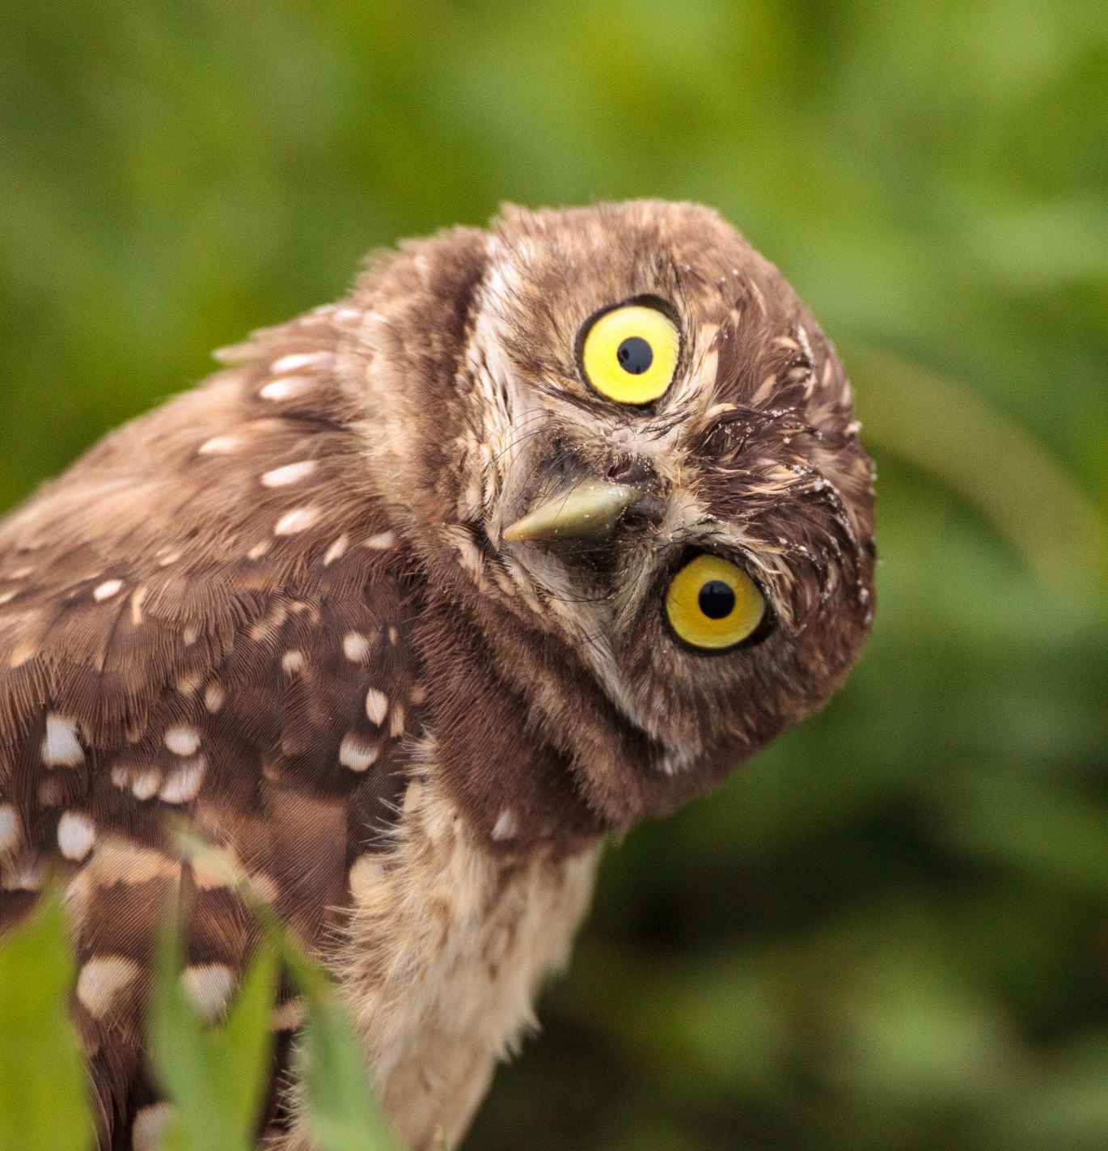
Goals：
An exploration of some basic deep learning techniques for object detection and classification tasks.
Identify the animal in a picture
Add a rectangular to point out the animal in the picture

Slide 3
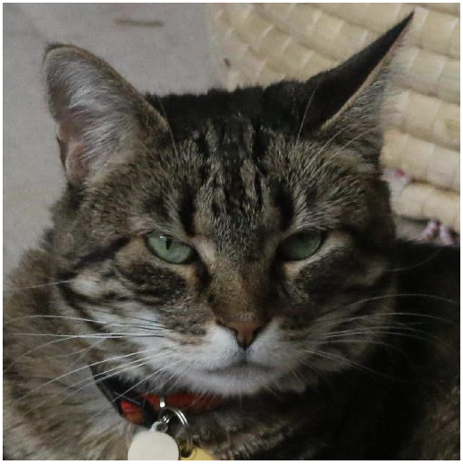
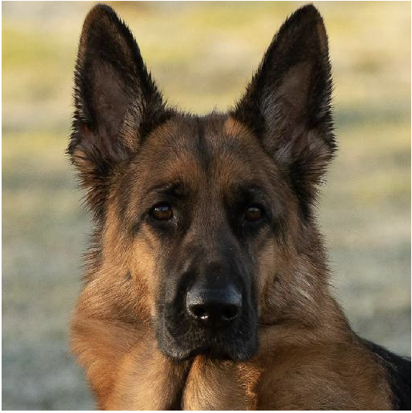
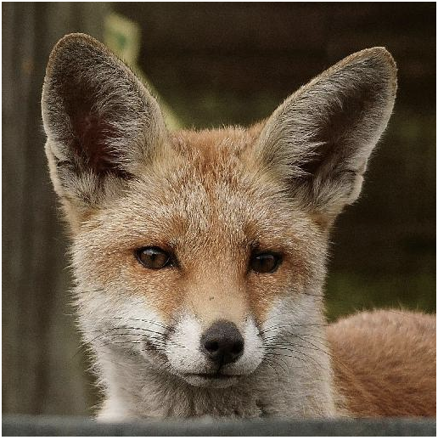
Dataset
3 animal categories: cat, dog, wild-life.
15,000 images for training, and 1,500 images for testing.

Slide 4
What we did
Used CNN to identify the category of the animal in the pictures.
Drawed plots of train loss and validation loss to get more sense of the deep learning process.

Slide 5
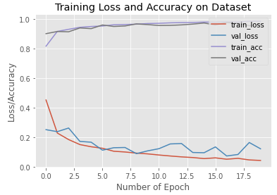

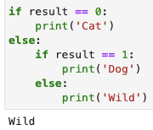
Model Evaluation
After 20 epochs, the accuracy score of the test dataset is 96%.

Slide 6
What went well?
Our model got high accuracy
Used plot to show the train loss and validation loss during the training process

Slide 7
What didn’t go well?
We did not complete the initial attempt of adding rectangular box around the animals (animal image detection).
Our current model may only work on the pictures filled with one animal face.

Slide 8
Conclusion
This has been an overall fun journey. We both enjoyed working with this dataset of cute animal faces. One of the struggles we encountered is getting ourselves familiar with the Tensorflow UI and functionalities, but the experience turned out very rewarding and provided us a chance to pick up this new tool. We are proud that our model can work well with the pictures and rendered satisfying model performances.

Slide 9
Thank you！

