Slide 1

Project: Examining Dementia
Isabelle Sanford

Slide 2
Dementia Characteristics
Over the last few years, have you noticed a change in…
remembering appointments?
remembering dates and times?
dealing with money subjects?
difficulty making decisions?
interest in activities?
repeating stories more?
learning and using tools?
thinking and memory?

Slide 3
Historical Variables
Age, Sex, Region, and Education

Slide 4
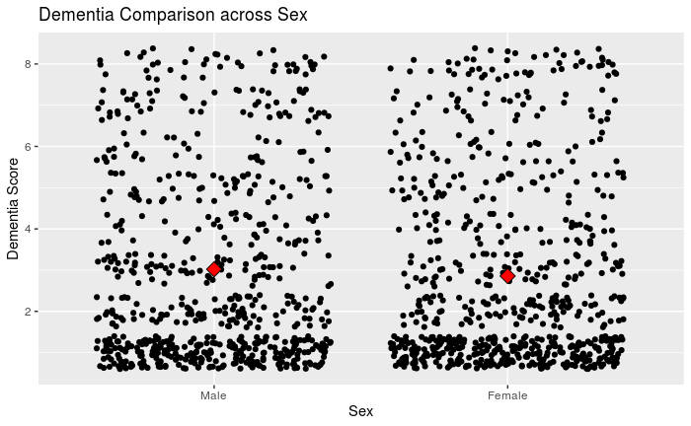
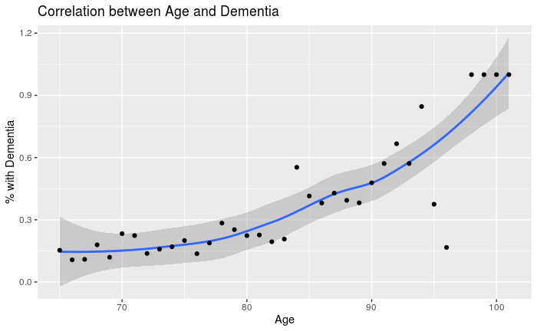
Historical: Age & Sex
r = .82

Slide 5
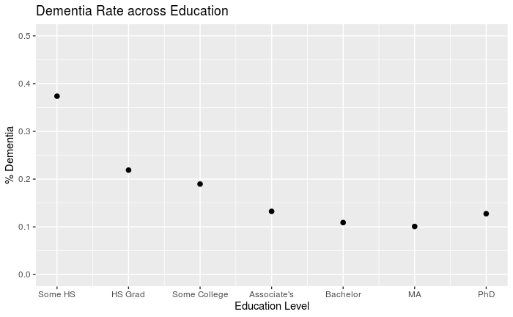
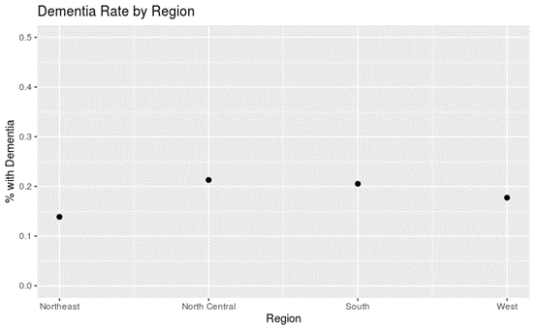
Historical: Region and Education
r = .41
r = -.85

Slide 6
Current Variables
Life satisfaction, mental activity, interaction level, frequency of attending religious services

Slide 7
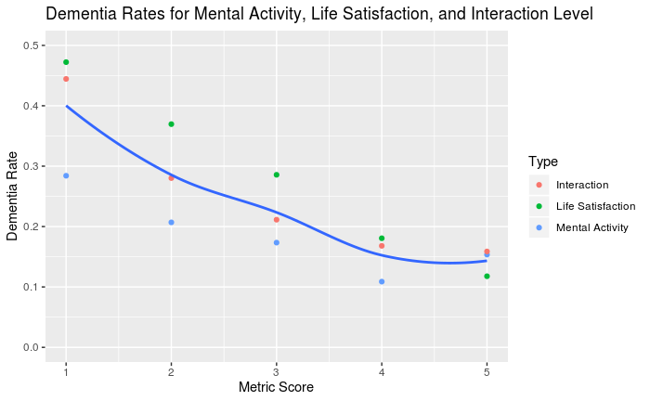
Metrics on Current Life Status
Interaction: r = -.91
Life Satisfaction: r = -.99
Mental Activity: r = -.87

Slide 8
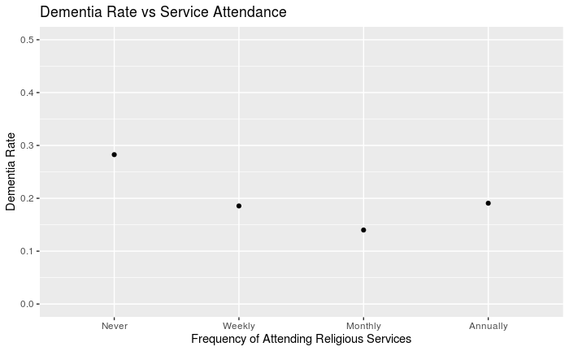
Frequency of Attending Religious Services
Dementia rate among religious: 19%
Among nonreligious: 15%

Slide 9
Source
University of Michigan: Panel Study of Income Dynamics, 2017.

