Slide 1
Slithering Senate salamanders
Project members:
Steven brown, William Enriquez, Michelle Risucci,
isabelle Sanford, kosal sieng

Slide 2
117th United states senate
The breakdown:
50 Republicans
48 Democrats
2 Independents (who tend to vote Democrat)
Vice President Harris with the tie-breaking vote
Why is this significant?
A super-majority or even a simple majority does not guarantee a measure will pass
Senate Majority Leader can prioritize what the Senate will vote on
Can make effective change difficult to achieve

Slide 3
Why we need Senate Reform
“People in overrepresented states are not the same as the people in the underrepresented states. While there are a few small states on the coasts, many more small states are inland and rural. The coasts and their large cities tend to be in larger states. This means that the economic and infrastructure needs of cities get less representation in the Senate.”
-Jonathan M. Ladd, Vox “The Senate is a much bigger problem than the Electoral College”, Apr 9 2019
All votes are not created equal
Combined population of 15 states (approx. 38 million) represented by 30 Republican Senators
California population is approximately 39 million and is represented by 2 Democratic Senators

Slide 4
what are some senate reform proposals?
Grant Statehood¹
Washington DC and Puerto Rico – approximate combined population of 4 million people
Largely black and Hispanic demographic
Senate Seats by Population²
Each state given 1 Senator
Extra Senators allocated by the state’s share of the total US population
Number of seats change every 10 years with Census
¹ John Narcross, Electoral Reform Society “When it comes to fair votes, the US Senate is ripe for reform”, November 2020
² Eric W. Orts, The Atlantic “The Path to Give California 12 Senators, and Vermont Just One”, January 2019
VS. Wyoming:
2 Senators
Population: 580,000
Mostly white demographic²
Based on 2017 Census Estimates:
26 states: 1 Senator each
12 states: 2 Senators each
8 states: 1 - 2 Senators each
California: 12 Senators
Texas: 9 Senators
Florida & New York: 6 Senators each

Slide 5




The data

Slide 6
The coding
Cleaning the data:
Jupyter Notebook
Used Postgres to create SQL database
Moved into Flask - SQLite
Using the data:
app.py returned jsons
Plotly Plots
d3
Chamber Plot Structure
Python Flask-powered API
HTML/CSS
JavaScript
Plotly
SQLite
d3

Slide 7
Data processing using Jupyter notebook and python
Using libraries:
Pandas
Load, transform and create key for the SQL table
sqlalchemy
To push data to SQL
To Query Data
Json
To jsonify
Flask
To host output json

Slide 8
Virtualizing data:
Design in python:
Create to_json.py to load data and jsonify all data
Create app.py to host the json data and rendering html pages
Webdesign
Using HTML and CSS to design the webpage
Create function.js to process json data and output
Create plot.js to plot the output data
Create app.js to output data and plots on the HTML pages
Using library: D3, Plotlty

Slide 9
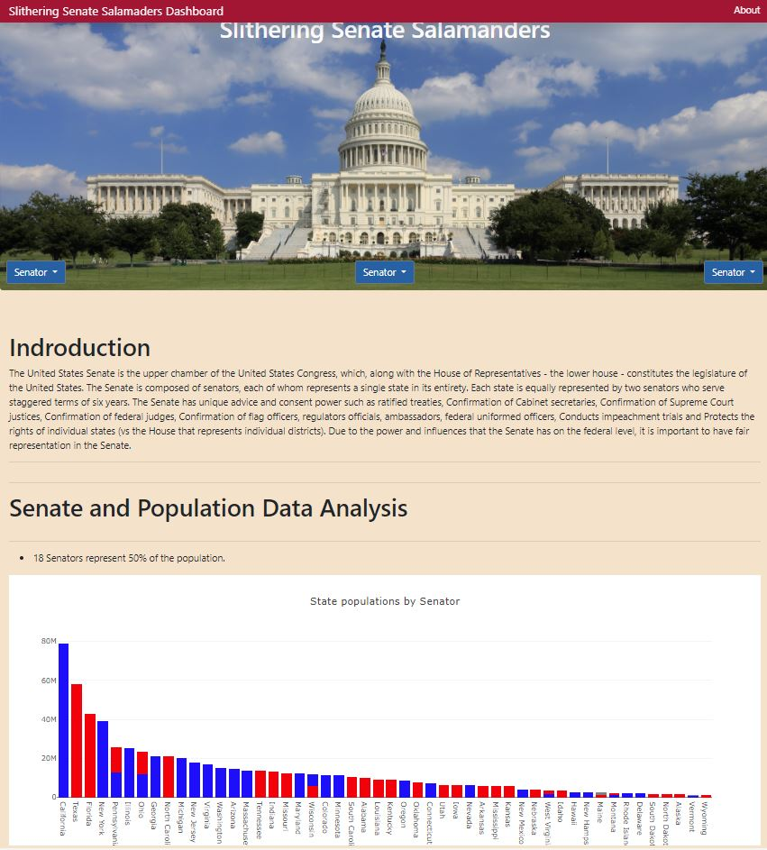
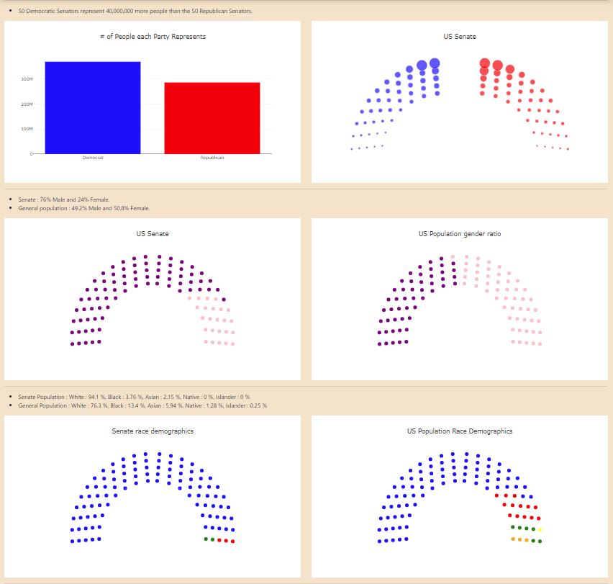
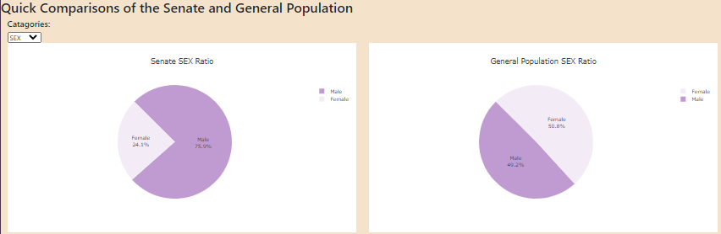
Our dashboard main page

Slide 10
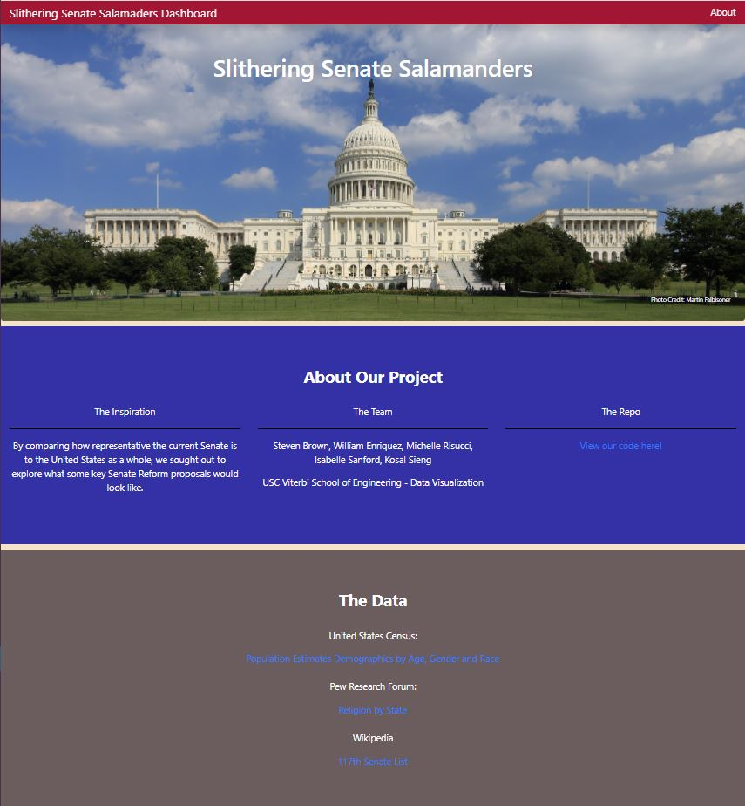
Our dashboard about page

