Slide 1
Homelessness in California
By Maya Fujita and Isabelle Bodner

Slide 2
Our Goal:
Look at patterns in homelessness in California 2017-2023
Trends by:
County
Race
Age
Effect of Covid-19

Slide 3

Data: State of California

Slide 4
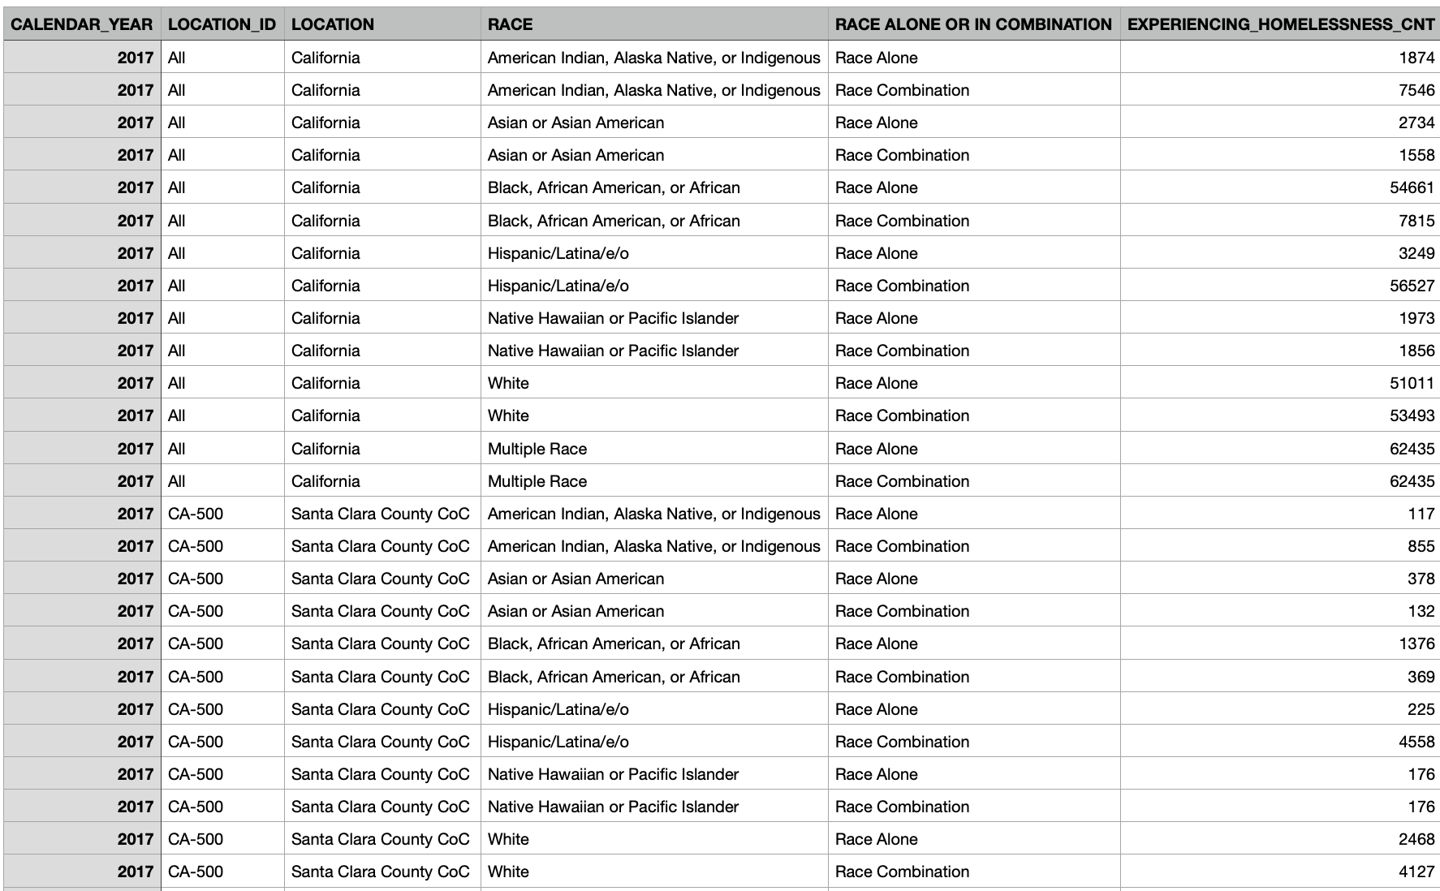
Introduction:
Variables:
Year
County
Race
Mixed?
Number of individuals of that race receiving care
About 16 percent of data missing

Slide 5
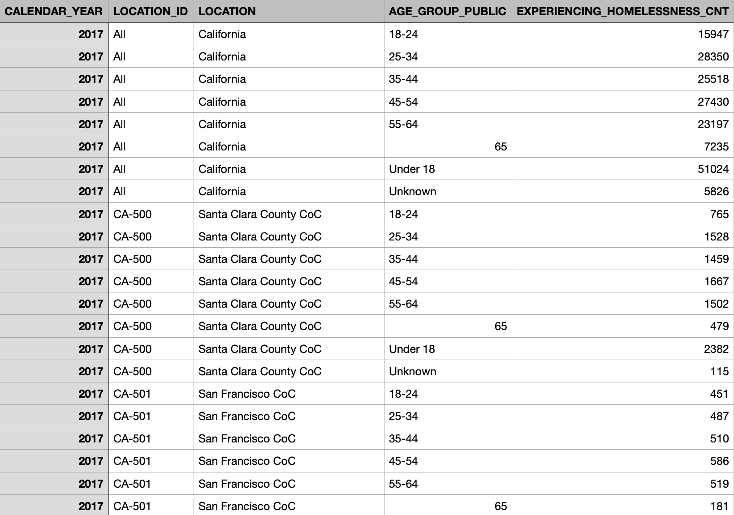
Initial issues with our data:
Numeric and categorical
NAs, *
Inconsistencies in data entry
Can we combine the data sets?

Slide 6
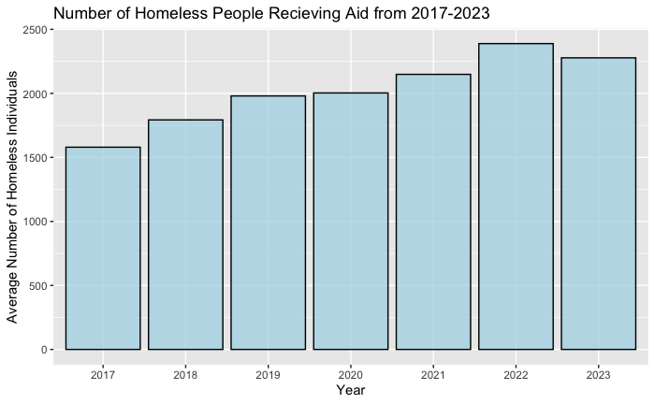
Preliminary Exploration
Pre Covid avg:
1786.808 individuals per year
Covid avg:
2208.124 individuals per year
Difference:
421.32/year

Slide 7
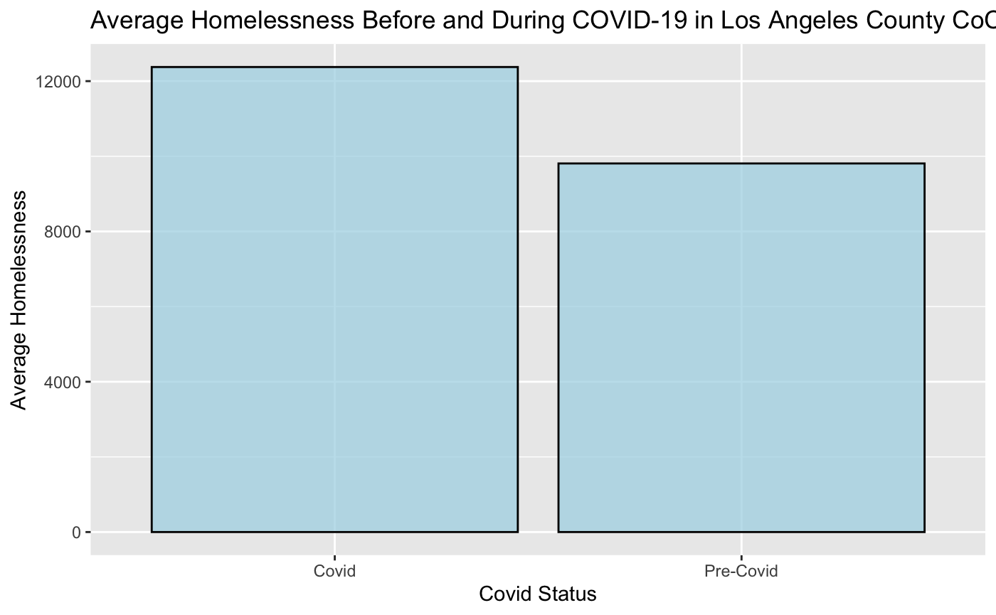
Pre-Covid: 2017-2019
Covid: 2020-2023

Slide 8
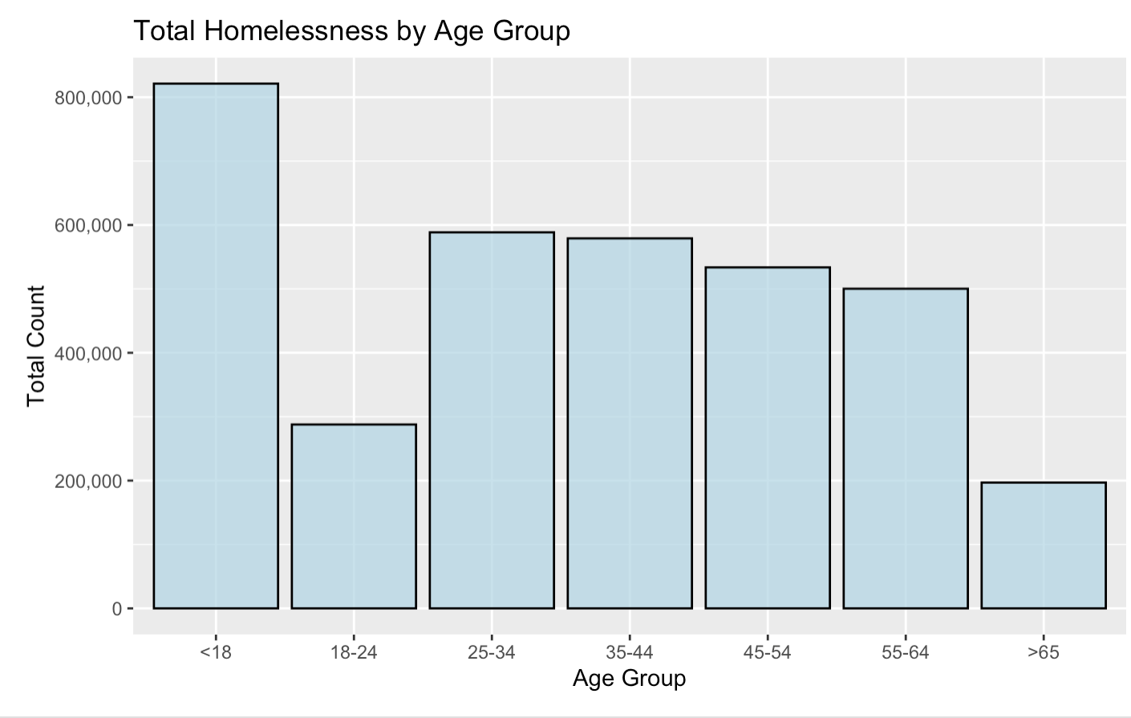
<18 age group is significantly higher than any other age group

Slide 9
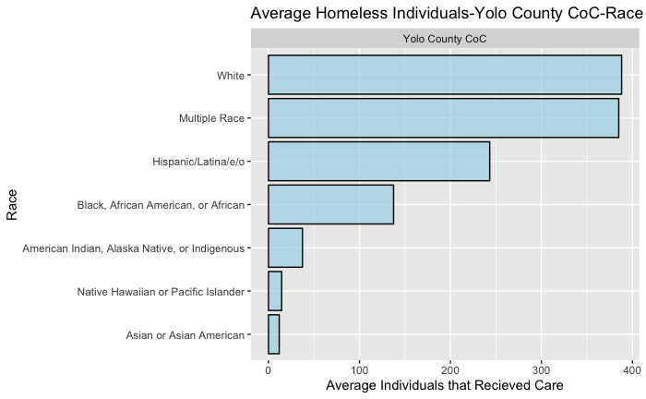
Yolo County

Slide 10
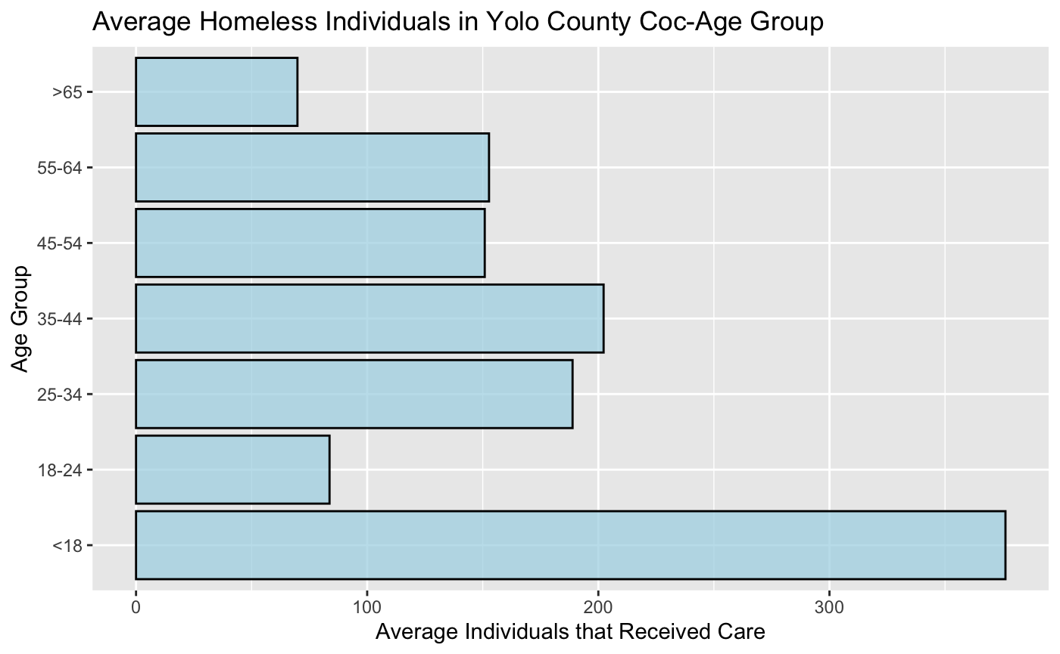

Slide 11
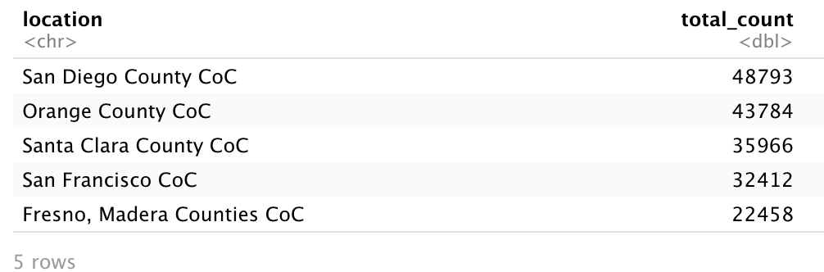
Looking at Race and Location

Slide 12
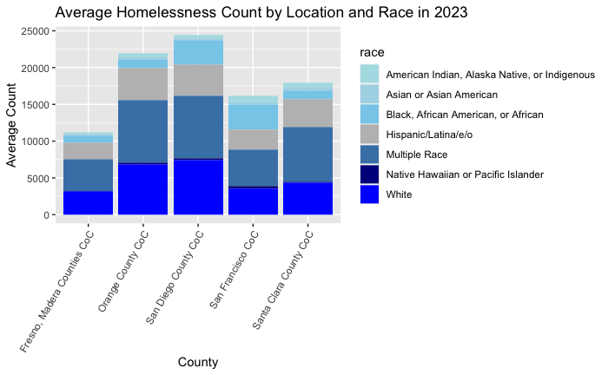

Slide 13
App to make this more clear…

Slide 14
Thank you for listening!

