Slide 1


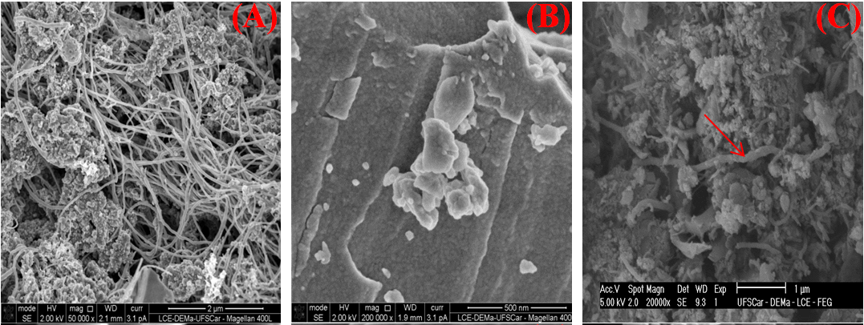
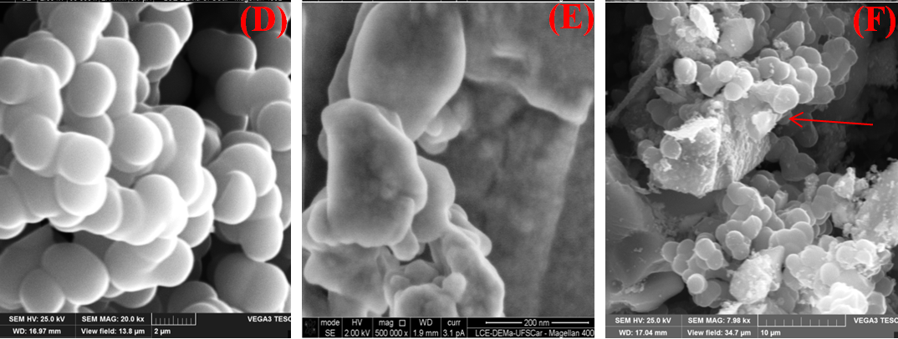
xxx
Estratégia de time de Robôs Very Small Size
Igor Mourão Ribeiro, NomeSegundoautor
Instituto Tecnológico de Aeronáutica - ITA, Brasil
Programa Institucional de Bolsa de Iniciação Cientifica (PIBIC)
XXIII Encontro de Iniciação Cientifica - ENCITA
Resumo (exemplo)
The main objective was to evaluate the nanocomposites formed by TiO₂-CNT and TiO₂-C (resorcinol/formaldehyde) on sonocatalysis. The composites synthesis was performed by sol-gel method using titanium isopropoxide (Ti(OPr)₄), acetic acid and ethylene glycol as dispersing medium. The samples were characterized by SEM and SEM-FEG. Ultrasound was used as the irradiation source and methylene blue was chosen as the model compound. Then a series of degradation experiments was carried out in the presence of each material. Adsorption capacity was also studied on attempt to achieve great ratio degradation-adsorption. The methylene blue concentration during adsorption and sonocatalysis was investigated by UV–vis spectroscopy. The orption process was an important factor to achieve high degradation capacity. However, when adsorption is intense the ultrasound effect was insufficient.
Experimental (exemplo)
Materials and preparation of carbon structure and TiO₂
CNTs were functionalized by acid and amine treatments. The carbon structure was synthetized by the polycondensation of resorcinol (R) and formaldehyde (F) using an initial R:F molar ratio of 1:2. Deionized water (W) was used as the diluent and the R:W molar ratio was 1:170, this structure was identified as C. The synthesis of TiO₂ was accomplish using Titanium isopropoxide (IV) (Ti(OCH(CH₃)₂)₄) (97%), acetic acid (99.7%) and ethylene glycol (99.0%). The mixture was kept at 100 °C for 24 hours until complete gelation, after that the obtained gel was dried at 110°C and then calcined at 400 °C. The molar ratio of alkoxide:acid:glycol was ﬁxed at 1:10:11 - this catalyst was further referred to TiO2-S, TiO2 obtained from Degussa as P25 and methylene blue as organic dye.
Resultados e Discussões
Figura 1 (ac) exibe imagens SEM de CNT, TiO2-S e TiO2-10CNT. Amostras de TiO2-S são formados por partículas secundárias além de 500 partículas primárias nm e aglomerados com cerca de 10 nm. A superfície CNT foi revestido com nanopartículas de TiO2 em compósitos TiO2-10CNT. CNT incorporação ocorreu durante a formação de partículas secundárias. Figura 1 (df) mostra imagens SEM de C, TiO2-S e TiO2-10C. A amostra C apresenta estruturas esféricas de carbono e lamelar, com cerca de 2 m. A incorporação de partículas ocorre por C intercalada crescimento de TiO2 (rutilo fase) e de carbono durante a síntese de sol-gel.
Table 1 and Figure 2 show CNT enhances the degradation efficiency and k_{app} increases greatly and rapidly. The association of TiO₂ with CNTs increased the charge delocalization, reducing the recombination probability. Between 2-10% of CNT added to TiO₂, CNT decreased the degradation rate. Sample TiO₂-2.0AM promote higher dispersion of CNT on TiO₂ matrix which enhances the adsorption and the degradation. The activated carbon (C), due its high surface area, acts as co-adsorbent which can facilitate the sonocatalytic efficiency. The value of k_{app} increases for TiO₂-0.5C, TiO₂-1.0C and TiO₂-2.0C samples, however, reaction rate is smaller than CNT doped composites. Despite the reduced value of k_{app} the amount of catalysts used during the sonodegradation is ten times minor than CNT composites.
Figura 1. SEM images of samples
Tabela 1. Kinetics of adsorption and degradation
Sample | Adsorption |  | Sonodegradation
 | Pseudo-second-order |  | Apparent-first-order
 | k (mg.g⁻¹.min⁻¹) | q_{e} (mg.g⁻¹) | R² | k_{app} (min⁻¹) | R²
TiO₂-S | 0.5363 | 0.1446 | 0.9838 | 0.0030 | 0.9982
P25 | 2.4311 | 0.1992 | 0.9943 | 0.0030 | 0.9891
TiO₂-0.5CNT | 1.4134 | 0.3061 | 0.9981 | 0.0032 | 0.9936
TiO₂-1.0CNT | 0.2124 | 0.3725 | 0.9971 | 0.0037 | 0.9931
TiO₂-2.0CNT | 0.1160 | 0.7794 | 0.9955 | 0.0048 | 0.9673
TiO₂-2.0AC | 0.0500 | 0.7707 | 0.9581 | 0.0047 | 0.9662
TiO₂-2.0AM | 0.0507 | 1.1268 | 0.9845 | 0.0071 | 0.9532
TiO₂-10CNT | - | - | - | 0,0079 | 0.9102
TiO₂-0.5C | 0.00418 | 15.451 | 0.9972 | 0.0026 | 0.9899
TiO₂-1.0C | 0.01291 | 8.8028 | 0.9982 | 0.0030 | 0.9271
TiO₂-2.0C | 0.01634 | 7.8216 | 0.9956 | 0.0033 | 0.9394
References (exemplos)
N. Shimizu, C. Ogino, M. F. Dadjour, and T. Murata, Ultrasonics sonochemistry, 1
4, 2, pp. 184, 2007.
F. Adam, L. Muniandy, and R. Thankappan, Journal of Colloid And Interface Science,
406, pp. 209–216, 2013.
Y. L. Pang and A. Z. Abdullah, Ultrasonics Sonochemistry,
19, 3, pp. 642, 2012.
Y. L. Pang and A. Z. Abdullah, Applied Catalysis B, Environmental,
129, pp. 473–481, 2013.
Figura 2. Kinetic curves of all samples
Agradecimentos: ITA, CNPq, ITAndroids

