Slide 1

Node.js
Isabelle Lynch
10/11/2025

Slide 2

What is JavaScript?
A scripting language
Designed to enhance interactivity and functionality on web pages
Enables developers to control multimedia, create dynamically updating content, animate images and much more
JavaScript code is often packaged into libraries, which can be grouped into larger structures called frameworks
2

Slide 3
What is a JavaScript framework?
A JavaScript Framework is a structured collection of prewritten JavaScript code, typically organized into libraries.
These libraries provide reusable functions and components that streamline development and reduce repetitive coding tasks.
A framework provides a structure for developers to write code, which in turn simplifies the completion of both common and complicated tasks.
3

Slide 4

Node.js
Founded by Ryan Dahl in 2009.
He wanted to achieve greater concurrency at a lower cost than what other programming languages had achieved at the time.
The primary role of Node.js is to provide a JavaScript runtime environment that enables developers to execute JavaScript code outside of a web browser, primarily on the server side, for building fast, efficient, and scalable network applications.
Traditionally, JavaScript was limited to client-side scripting, however, Node.js extends its capabilities to server-side development, allowing for full-stack programming within a single language.

Slide 5
features
Asynchronous architecture
Single threaded
Modular structure
Allows the server to process multiple client requests simultaneously without waiting for any single process to complete
Although Node.js operates on a single thread, it efficiently manages numerous operations through the event loop mechanism, delegating heavy or blocking tasks to background workers. ​
Developers can utilize millions of prebuilt modules and tools to simplify and accelerate application development. ​
​

Slide 6
features
CROSS-PLATFORM
COMPATIBILITY
COMMUNITY SUPPORT
Code can be developed and executed on Windows, macOS, and Linux without modification. This simplifies deployment and ensures consistency across all operating systems
Node.js benefits from an active global developer community that continuously contributes updates, modules, and security patches.

Slide 7
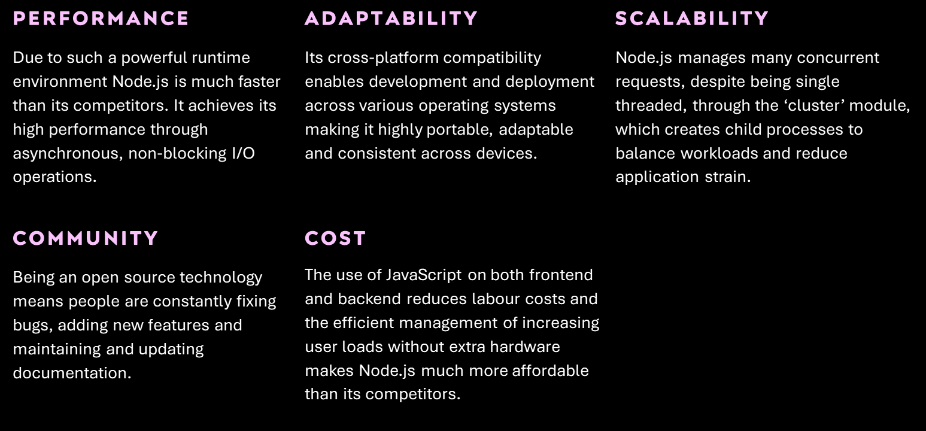
advantages

Slide 8
disadvantages
LIBRARY COMPATIBILITY ISSUES
Callback hell
Although Node.js benefits from a vast ecosystem of third-party libraries available through the Node Package Manager (npm), not all libraries are consistently maintained or compatible with the latest versions of Node.js.
This can lead to compatibility issues, deprecated features, or bugs, which may require developers to seek alternative packages or implement additional debugging and testing.
The asynchronous nature of Node.js, while powerful, can lead to challenges in managing multiple nested callbacks, a situation commonly referred to as ‘callback hell.’
This occurs when callback functions are nested within other callbacks
Single threaded
limitations
Because Node.js runs on a single thread, it struggles with CPU intensive or heavy computational tasks, which can block the event loop and negatively impact performance.

Slide 9
What can node.js do?
Build
Create servers
File system operations
Database interactions
Node.js allows developers to create powerful command-line and build tools that assist in software development and automate repetitive tasks. It is commonly used to build RESTful and GraphQL APIs, enabling communication between client and server.
Node.js is widely used to create fast, scalable network applications and web servers. Its non-blocking, event driven architecture allows it to manage multiple connections simultaneously, making it ideal for real-time applications such as chat servers, streaming platforms and online gaming platforms.
Node.js provides built in modules that allow developers to perform file-related operations such as reading, writing, updating, and deleting files directly on the server.
Node.js supports seamless integration with various databases, both relational and non-relational, including MySQL, PostgreSQL, and MongoDB. It allows developers to efficiently query, update, and manage data within applications.

Slide 10
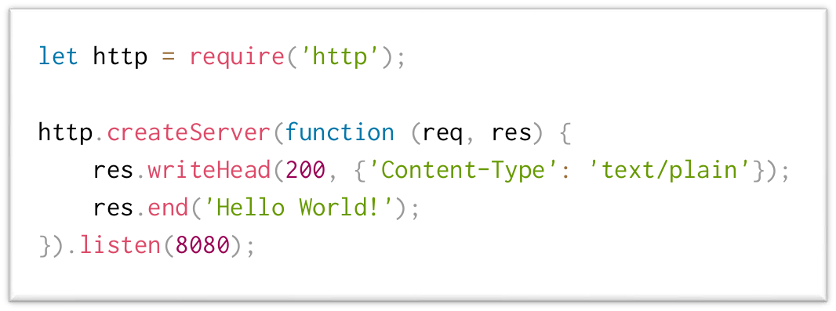
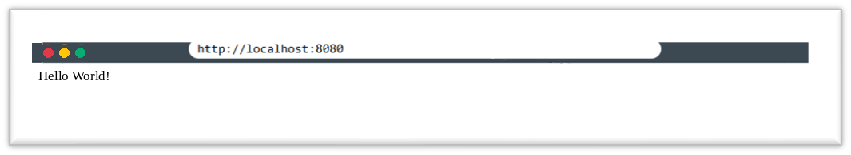
Sample code
An example of a simple program, written on Node.js is shown in Figure 1. This program creates a server and prints out ‘Hello World!’, which is demonstrated in Figure 2.
Figure 1
Figure 2

Slide 11
Sample code
Figure 1
This line imports the built in Node.js http module. This module allows developers to create HTTP servers and handle requests/responses. The ‘require()’ function loads the module and returns it as an object.

Slide 12
Sample code
Figure 1
This section creates the server. The ‘createServer()’ function takes a callback function as an argument. Within the function the ‘req’ refers to the request object which contains details about the client’s request such as the URL, method, headers etc, the ‘res’ refers to the response object which is used to send data back to the client.
‘res.end’ closes the response, indicating that no more data will be sent.
‘.listen(8080);’ tells the server to listen for connections on port number 8080.

Slide 13
What can we conclude?
I believe I have demonstrated that Node.js represents a significant advancement in modern software development, primarily due to its asynchronous, non-blocking I/O model, which enables the efficient handling of multiple concurrent requests and enhances overall performance. I also believe that I have shown that Node.js is a scalable, adaptable, and cost-effective solution for building networked applications across diverse platforms.
13

Slide 14

Certain limitations have been shown, such as the constraints of its single-threaded architecture and potential performance issues when handling CPU-intensive operations. Challenges such as ‘callback hell’ and occasional library compatibility issues were also noted as potential drawbacks that may complicate development and maintenance.
14

Slide 15
Finally…
Overall, despite these minor limitations, I believe Node.js has made a mostly positive impact on the software development industry. Its efficiency, scalability, and strong community support have established it as one of the most valuable tools for developing fast, modern, and reliable web applications. I believe the innovation introduced by Ryan Dahl will continue to shape the future of full-stack JavaScript development and inspire ongoing improvements in server-side technologies.
15

Slide 16
Thank you, for your attention
Any Questions, feel free to ask and I will try my best to answer them.

