Slide 1
Project 0
Isabelle Meredith

Slide 2
Research Questions
Are the subject’s recordings of sampling times biased compared to the times recorded by an electronic monitoring cap?
What proportion of subjects were within 7.5 or 15 minutes of the required sampling times?
How do cortisol and DHEA levels change over time?

Slide 3
Data Overview
- | Overall | 1 | 2 | 3
n | 372 | 93 | 93 | 93
Time Difference (minutes) (mean (SD)) | -7.71 (32.09) | -4.00 (8.75) | -16.05 (35.87) | -6.18 (42.66)
Cortisol (nmol/L) (mean (SD)) | 5.95 (6.95) | 7.38 (6.05) | 9.00 (4.94) | 3.21 (2.29)
DHEA (nmol/L) (mean (SD)) | 0.98 (1.03) | 1.78 (1.27) | 1.11 (0.92) | 0.51 (0.46)

Slide 4
Analysis
Linear mixed effects model with booklet time as a predictor for cap time, with subject ID as a random effect
  Test if intercept = 0
  Test if slope = 1
Quantify the proportion of subjects who were within 7.5 and 15 minutes of the desired sample intervals
Piecewise linear mixed effects model for cortisol and DHEA. Effect of amount of time since the subject woke up on cortisol/DHEA level, with subject ID as a random effect

Slide 5
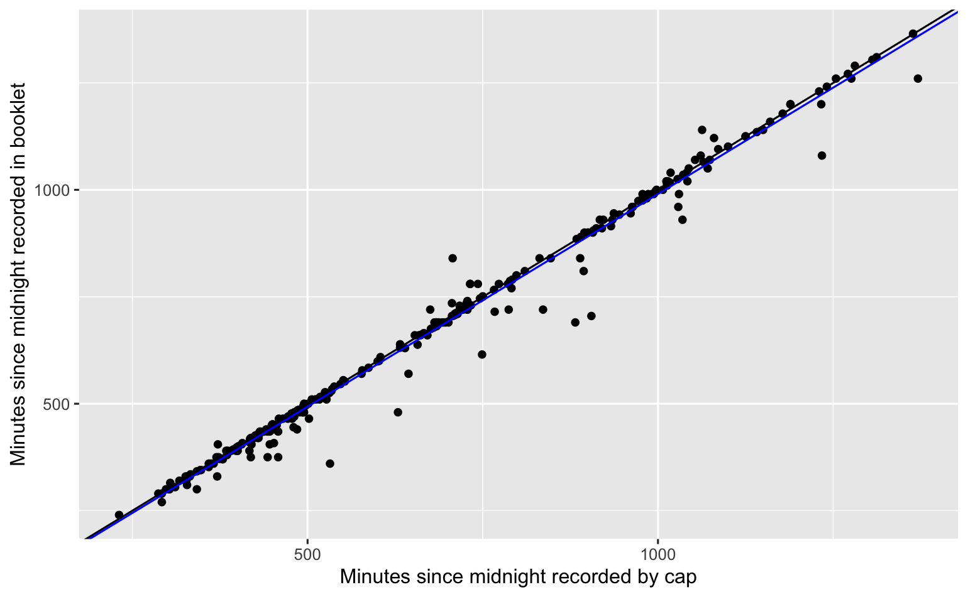
Results
 | Booklet | Cap
Within 15 Minutes | 0.76 | 0.66
Within 7.5 Minutes | 0.62 | 0.50

Slide 6
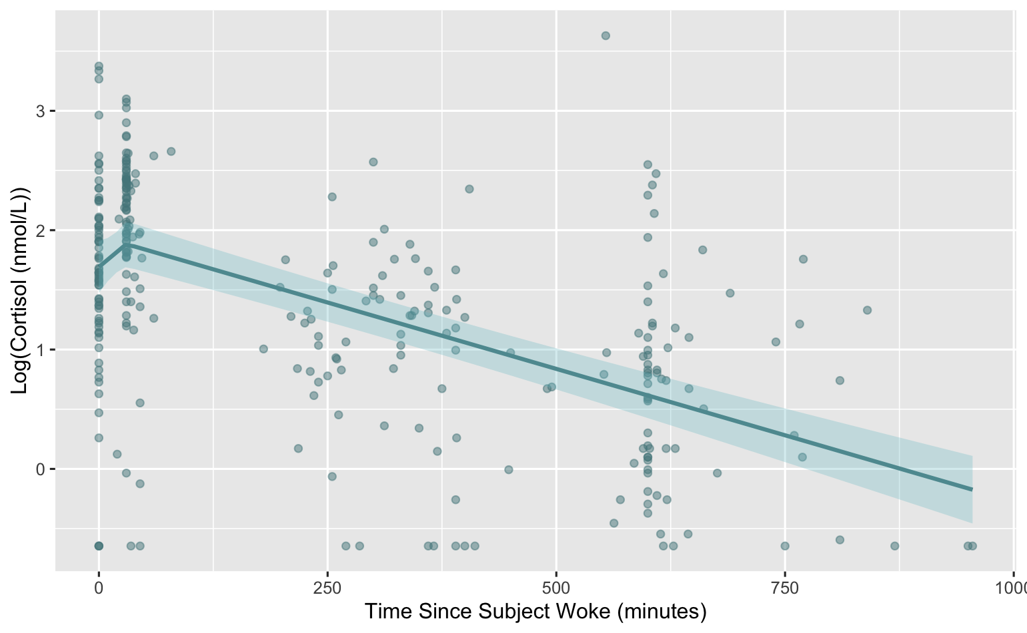
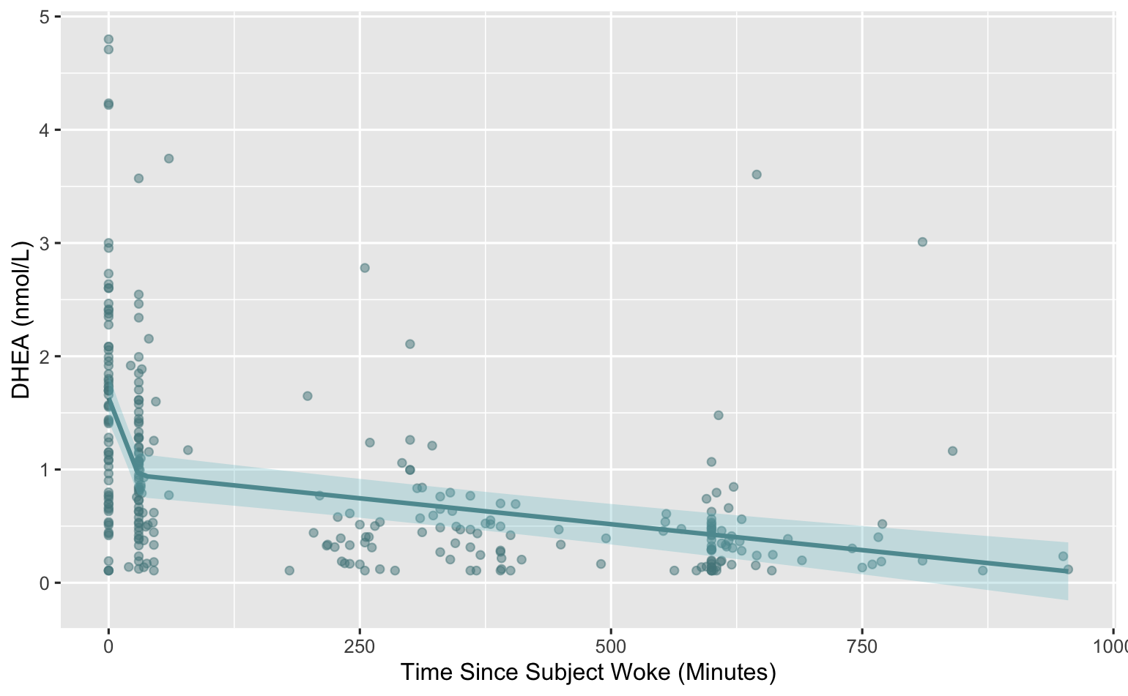
Results

Slide 7
Discussion
Agreement between booklet and cap was generally good
Subjects were not always adhering well to the intended times
Patterns in cortisol and DHEA levels were consistent with past research

