Slide 1
Dynamic Massive Parallel Computation Model for Graph Problems
Isabelle Liu
School of Computer Science
Carleton University, Ottawa, Canada
<isabelleliu@cmail.carleton.ca>

Slide 2
Introduction
What is Massive Parallel Computing and why MPC
  Computations on massive amounts of data
  Traditional models are inadequate
  MPC model captures the needs of computation at a massive scale
  A collection of machines
    communicate through indirect communication channels
  Computation proceeds in synchronous rounds
Limitations of MPC
  Assumes to work on static datasets
  Use of large volumes of resources

Slide 3
Introduction
Dynamic algorithm and its benefits
  Maintain a solution to a given problem throughout a sequence of modifications to the input data
  Efficiently adjust the maintained solution
  Detect whether modifications are needed almost instantly
  Polynomial, and often exponential, speed-up
Objective
  Implement a Dynamic MPC (DMPC) algorithm
  Test on a graph problem, Maximal Independent Set

Slide 4
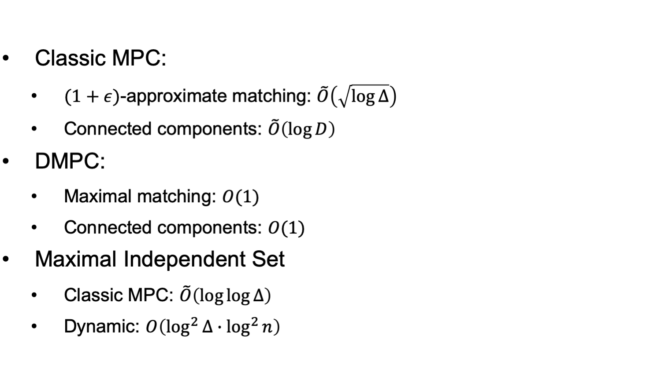
Related Work

Slide 5
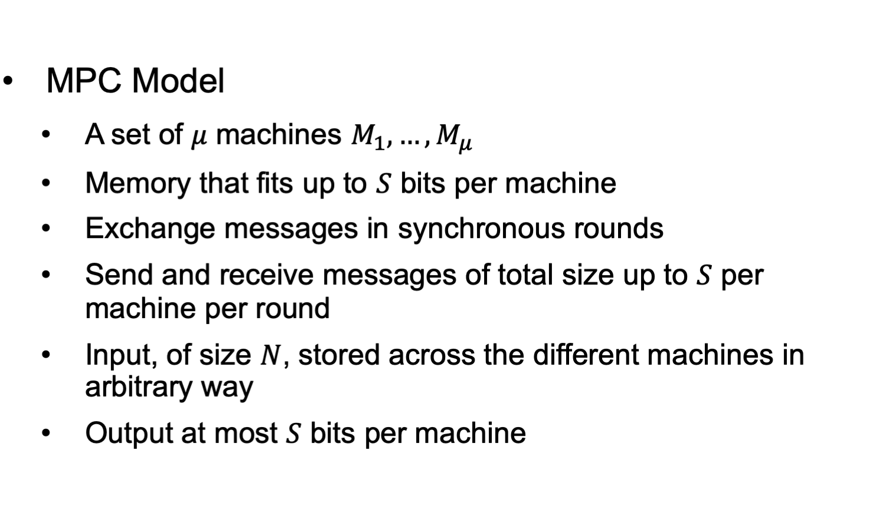
Methodology

Slide 6
Methodology
Dynamic graph algorithm
  Incremental: allow edge insertions only
  Decremental: deletions only
  Fully-dynamic: intermixed sequence of both
Factors that determine the complexity of the dynamic algorithm
  Number of rounds
  Number of active machines per round
  Total amount of communication per round

Slide 7
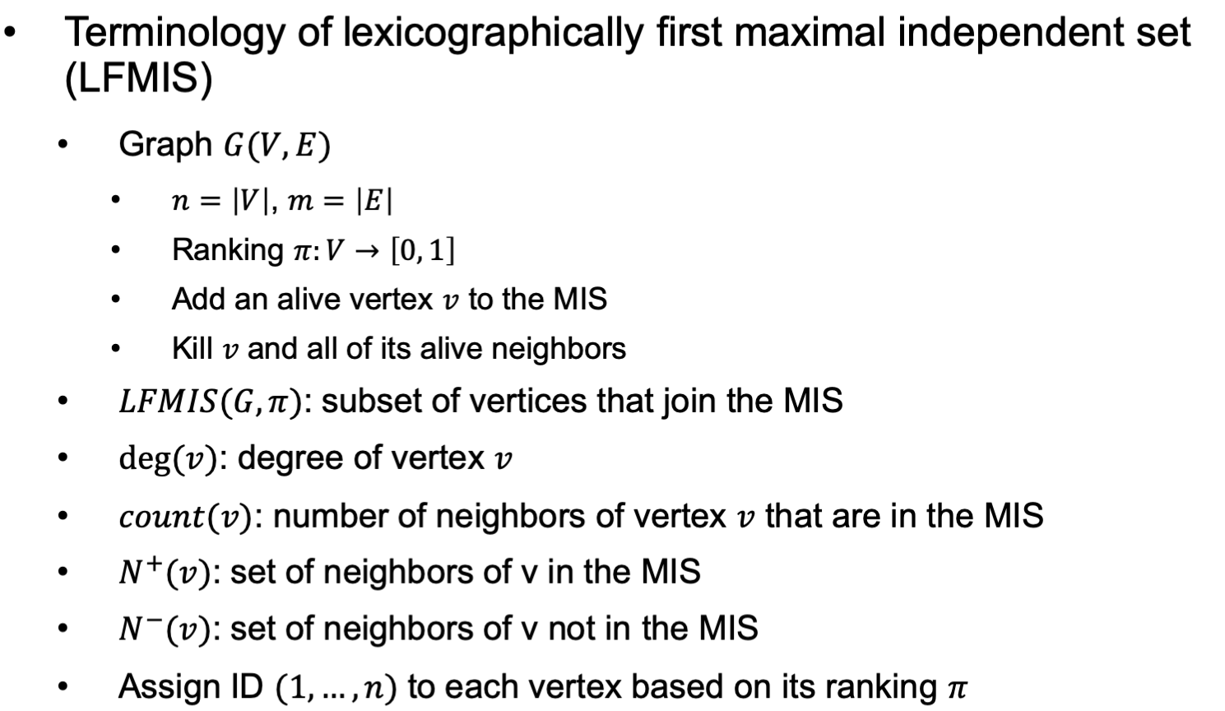
Methodology

Slide 8
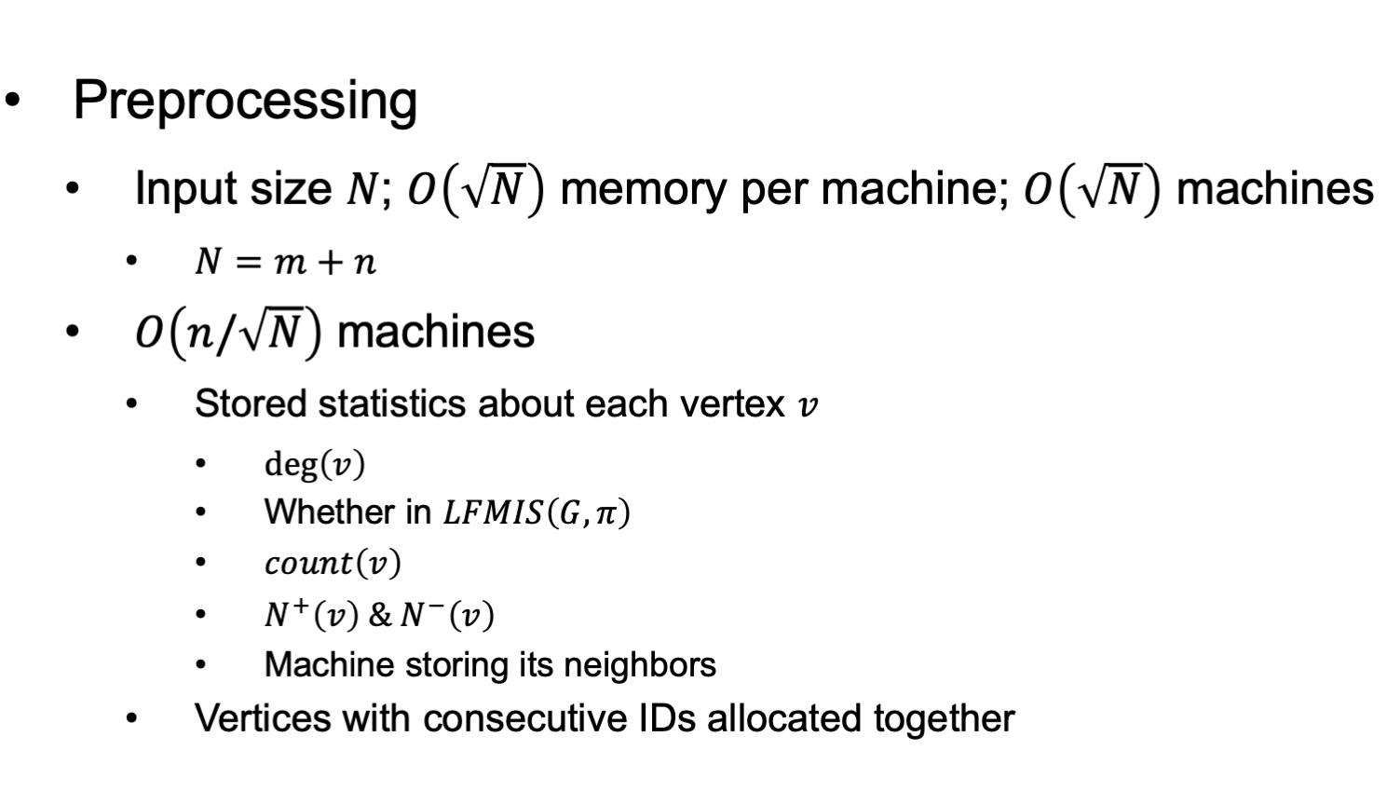
Methodology

Slide 9
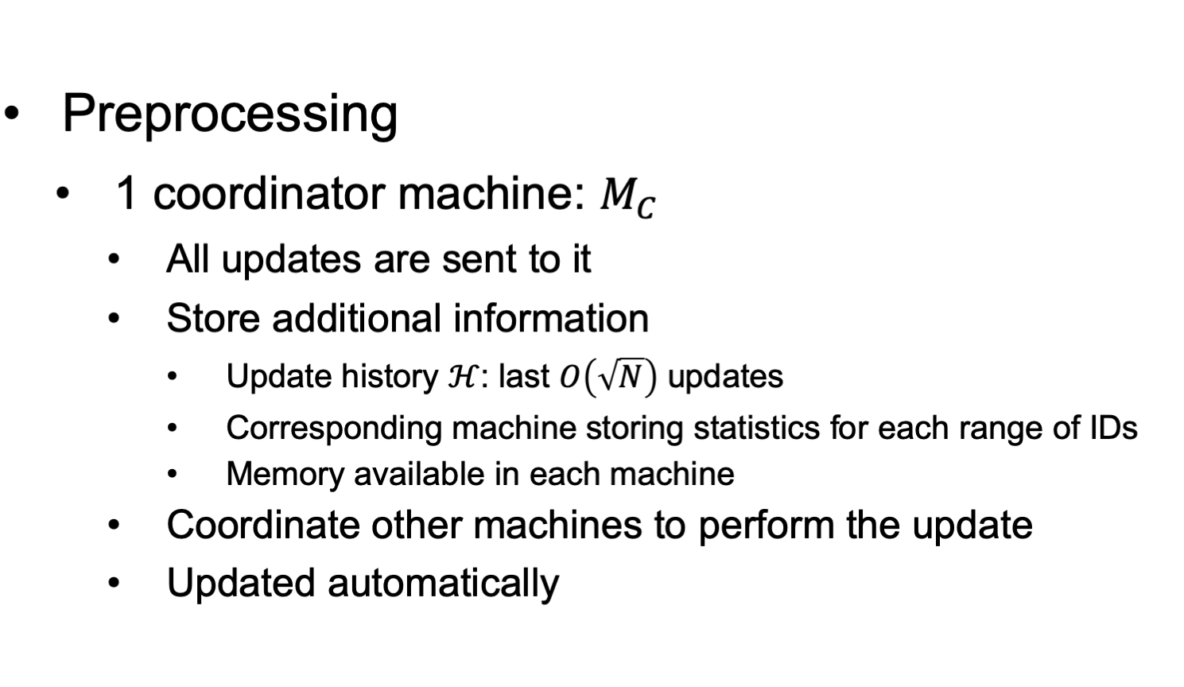
Methodology

Slide 10
Methodology
Insertion
Before
After
a
b
a
b

Slide 11
Methodology
Deletion
Before
After
a
b
a
b

Slide 12
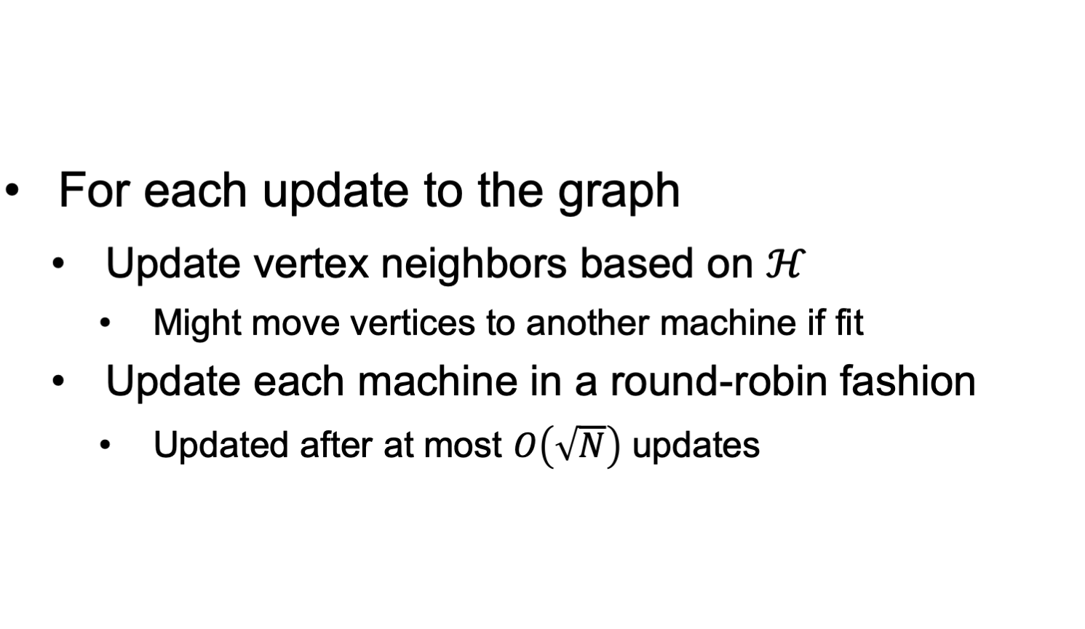
Methodology

Slide 13
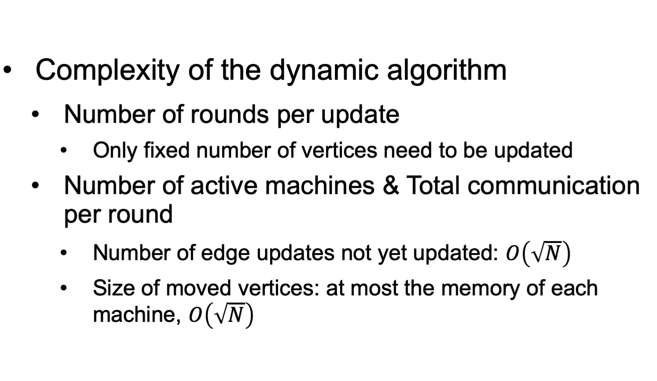
Result

Slide 14
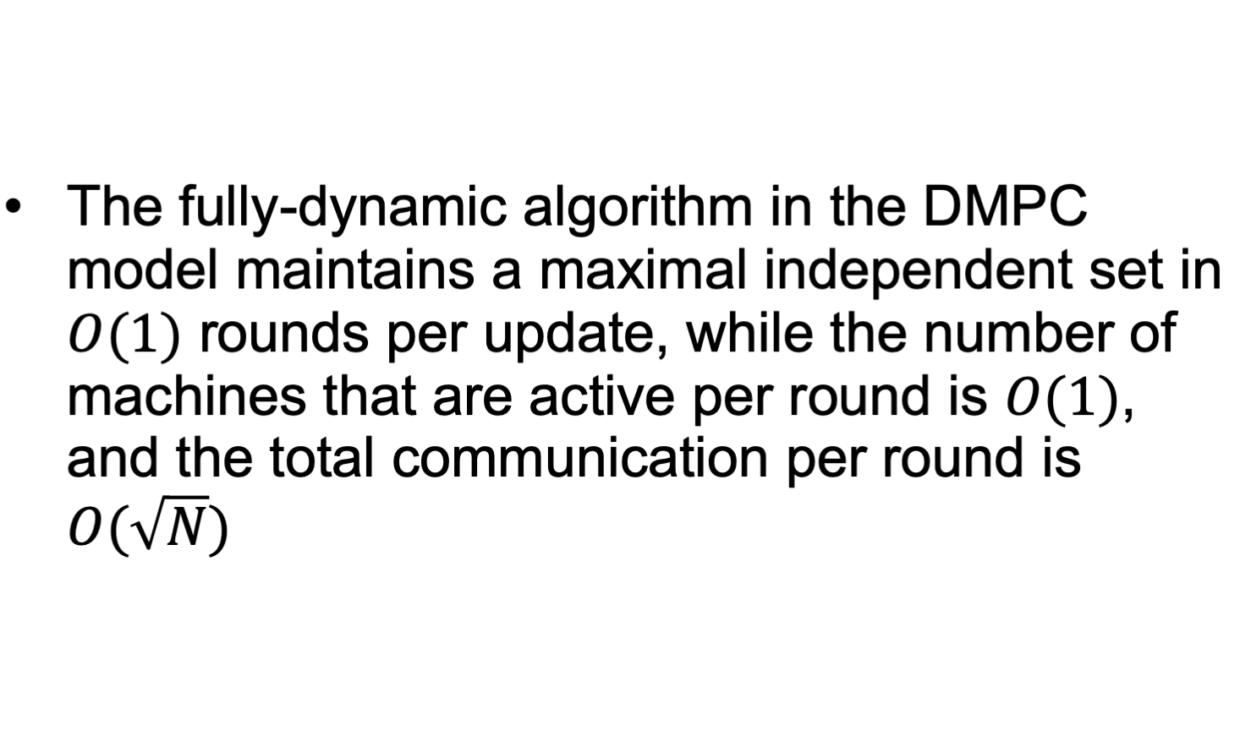
Conclusion

Slide 15
Q & A
What are the benefits of a dynamic algorithm?
What are the restrictions of the DMPC algorithm?
Is the use of a coordinator in the dynamic algorithm to simulate a centralized algorithm?

Slide 16
Thank you!

