Slide 1
EnergyInc:
Predicting Churn
Take Home Exercise AilyLabs

Slide 2
I. Case Study

Slide 3
Business Understanding
Problem Statement: predict the probability of a given household of being poor or not
Type of problem: binary classification
Adjustment method: MLE
Typical loss-function: log-loss (but other metrics might also be useful)
Log Loss equals -1 * the log of the likelihood function
Notes:
- hasta ahora

Slide 4
EDA (I)
In both train / test datasets:
- same number of non-null values in columns Unnamed: 0 (individuals iid) and households id, so that analysis of household’s size becomes irrelevant
- four categorical (nominal) variables represented as object (strings), with missing values (3% approx.)
- four continuous variables represented as float, with missing values (3% approx.)
- target variable “poor” represented as a boolean

Slide 5
EDA (II)
Numeric Features:
- Variables’distribution: (i) evidence of skewness, (ii) presence of outliers
Categoric Features:
- low-dimensional: less than 10 categories
- high-dimensional var (“vwpsxrgk”): around 30 categories

Slide 6
Data Preprocessing (I)
Target imputation: True equals 1, False equals 0
NANs imputation (median strategy)
Numerical vars. Standardization (PowerTransformer: correcting for skewness but for outliers, QuantileTransformer?)
Categorical variables encoding:
- Low-dimensional vars. (uneven frequency among classes): Ordinal Encoding
- High-dimensional var: Target Encoding (LeaveOneOut). Reminder to add some Gaussian noise to decrease overfitting
=> advantage: they both prevent the curse of dimensionality, so no need of dimensionality reduction (PCA)

Slide 7
Data Preprocessing (II)
Numeric variables
(Pipeline)
1. NANs imputation
2. Variable standardization
Low-dimensional
categorical variables
1. Ordinal Encoder
(& NANs imputation)
High-dimensional
categorical variables
1. Target Encoder
(& NANs imputation)
Preprocessor
(Column Transformer)
Classifier
(Pipeline)

Slide 8
Model Building (I)
Hyperparameter tuning (RandomizedSearchCV)
Cross-validation – critical for Target encoding
Fit the model and predict probability with best estimator.
Calculate the metric (log-loss across the board and classification report for the best performing model)

Slide 9
Model Building (II)
Linear model (Baseline): Logistic Regression
Ensembling (non-linear) models:
- Bagging: Random Forest
- (Gradient) Boosting:
  - XG
  - LGB
  - CatBoost
- Stacking
Neural Network
Notes:
- Logistic regression: regression whereby the dependent variable is dichotomous in nature
log(p/1-p) = sum(beta*x(ij))
Model predictions are probability values for each observation, following a binomial distribution
Adjustment method: MLE
- Decision Tree: building block of random forest model. Consists of nodes, containing a high proportion of samples (data points) from a single class by finding values in the features that cleanly divide data into classes.
Each node: (i) question about the data based on a value of a feature (T/F), (ii) gini impurity, (iii) samples, number of observations, (iv) value: number of samples in each class, (v) class: the majority classification for points in the node. In leaf nodes, class is the prediction.
A DT incurs in overfitting: it is a flexible model (high capacity) and memorizes data by fitting closely and has therefore a high variance.
- Ensembling model: aggregates prediction of different models (base/weak learners)
- Random Forest: it aggregates the predictions (majority of rules for classifiers) of bootstrapped (random sampling with replacement) decision trees, which is called bagging
- Gradient Boosting: It learns iteratively from a set of weak models on subsets of the data, weighing each weak prediction according to each weak learner's performance and combining the weighted predictions to obtain a single weighted prediction. Models are fit using any arbitrary differentiable loss function and gradient descent optimization algorithm that allows the loss gradient being minimized with successive iterations.
- XGB: (I) handles missing values, (ii) gains speed and is more efficient in computational terms (split-finding algorithm with quantiles, sparse-aware split finding, parallel computing…), (iii) accuracy gains combining regularization with loss function
- CatBoost: specialises in categorical data and performs better than XGB and LGM
- Stacking: Combines multiple models via a meta-model and improves predictions.

Slide 10
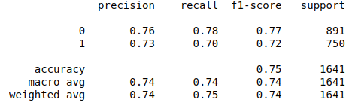
Model Building (III)
Log-loss metrics (CatBoost: 0.4888).
Compared to baseline log-score for balanced classes (0.693), this might be a good metric (?)
However, competition winner yielded 0.1447.
Classifier output quality
the model correctly classifies poor households with a 73% probability and correctly identifies poor households with a 70% probability. Results do not vary much across fitted models.
Results’ interpretation:
- in policy planning, high recall is desirable in order to correctly ascertain poor households as potential programs’ beneficiaries, but also high precision, since you would expect to have good predictions in order to effectively design and implement poverty programs / interventions that decrease the number of poor households

Slide 11
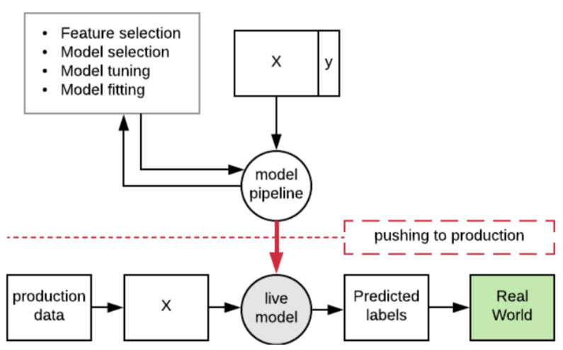
Productivization Plan

Slide 12
II. Pending issues & options

Slide 13
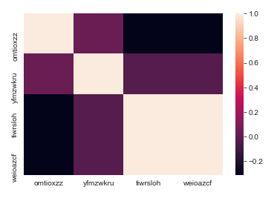
EDA
Check for normality: (i) visually: QQ plot, whisker’s plot, histogram, (ii) measures of central tendency (moments in statistics), (iii) Shapiro-Wilk Test / Jarque Bera
Correlation (one var. dropped to avoid collinearity)

Slide 14
Feature selection
Ideally, we should aim at extracting feature importances,
- eli5: to get variable weights
- shap values: to get the effect of the different feature for a specific prediction
=> Problem: how to get feature importances of a pipeline?

Slide 15
Metrics
AUC / ROC further evaluates classifier output quality (balanced classes)
Precision-recall curves enable to modify thresholds and then affect precision and recall outcomes depending on business objectives.
How to improve metrics?

