Slide 1

Digital Wardrobe
Romano Brentani
University of Bern
Viola Meier
University of Bern
Isabelle Bustamante
University of Fribourg

Slide 2
Goal and Motivation
Goal
Three-stage pipeline for fashion item recognition
Detect items → classify type → predict attributes
Motivation
Manual product tagging is costly and inconsistent
Deep learning enables scalable automated analysis
University of Bern – Deep Learning
1

Slide 3
Challenges and Prior Work
Challenges
Ambiguous categories (e.g. skirt vs. short dress)
Pose and lighting variation across images
Amin et al.: 300k images + 30 experts for attribute labels
Prior Work
Classification, detection, landmark localization
Attribute prediction typically on pre-cropped images
Few works combine all three stages in one pipeline
University of Bern – Deep Learning
2

Slide 4
Method
Stage 1: Object Detection
Faster R-CNN (ResNet50-FPN v2)
COCO pre-trained → fine-tuned on DeepFashion2
Stage 2: Category Classification
EfficientNet-B1, staged fine-tuning, 13 categories
Stage 3: Attribute Prediction
EfficientNet-B0, 6-head multi-head (26 dims)
Weighted cross-entropy for class imbalance
University of Bern – Deep Learning
3

Slide 5
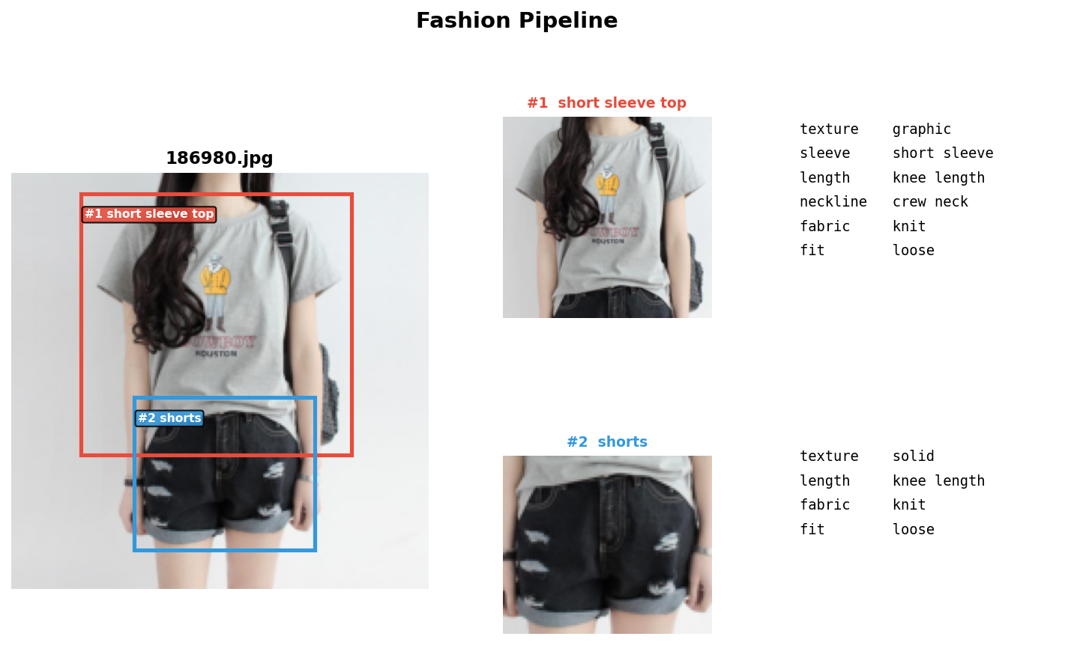
Experiments and Evaluations
Classification (5,000 test images)
Baseline: 21.4% EM 51.2% Cov.
Fine-Tuned: 32.0% EM 68.5% Cov.
FT + DA (best): 33.4% EM 69.6% Cov.
Attributes (5,997 test images)
Mean accuracy 84.4%
Best: Sleeve 94.1%, Length 93.8%
Weakest: Fabric 74.3%
University of Bern – Deep Learning
4

Slide 6
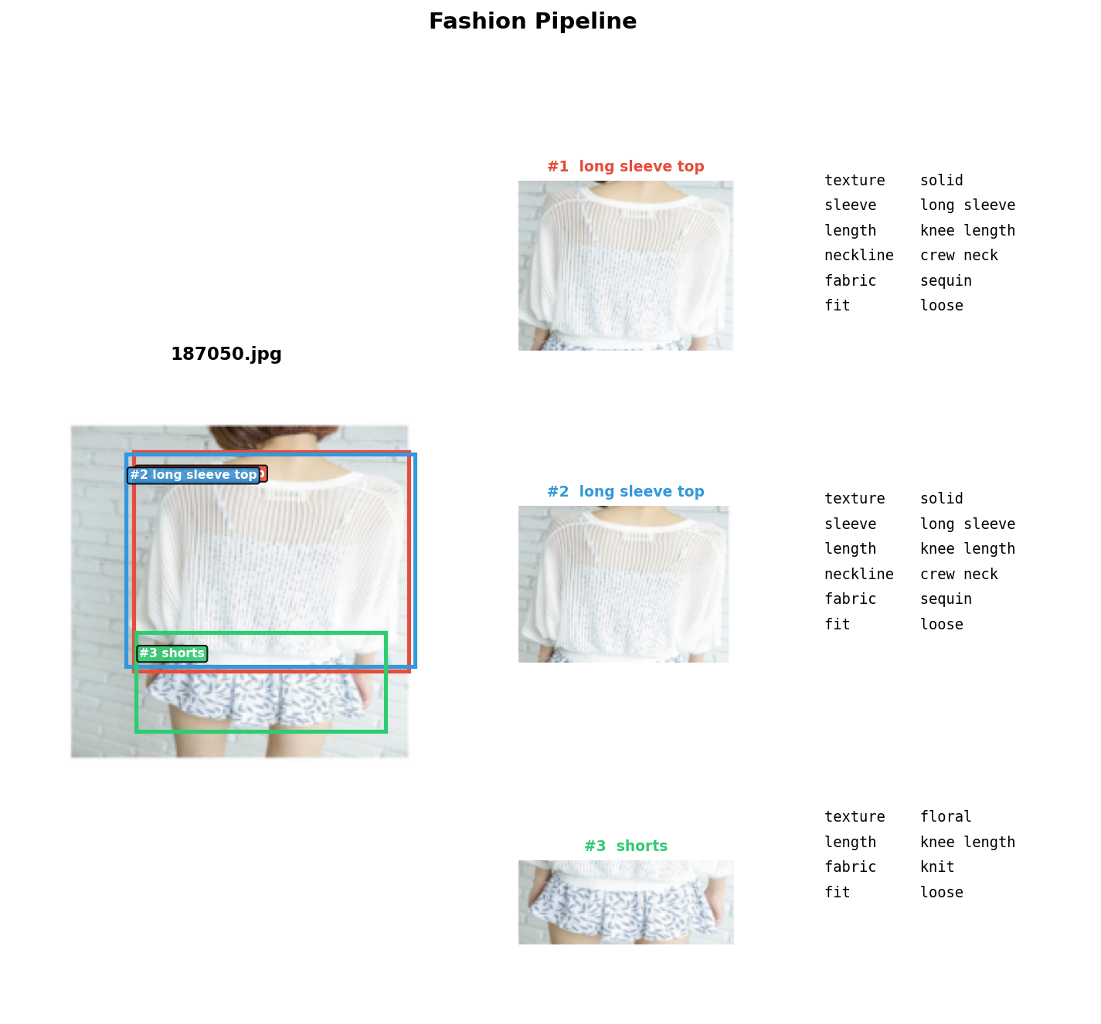
Conclusion and Future Work
Conclusion
Future Work
Evaluate on detector-predicted crops
Reduce duplicate detections
University of Bern – Deep Learning
5

