Slide 1
Missing value imputation
Missing value imputation
Missing value imputation
Missing value imputation
Missing value imputation
Missing value imputation
Missing value imputation
Missing value imputation
Missing value imputation
Missing Value Imputation

Slide 2
Problem - incomplete data
Two cases:
Conscious missing (willingly)
Unconscious missing (unwillingly)

Slide 3
Missing-data mechanisms
Missingness completely at random
Missingness at random
Missingness that depends on unobserved predictors
Missingness that depends on the missing value itself.

Slide 4
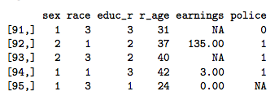
Example - case study
Study population earnings.
Input variables:
sex
race
education
age
earnings
police arrest

Slide 5
Missingness completely at random
Probability of missingness is the same for all units
Example: if each survey respondent randomly decide whether of answer a variable or not (like rolling a dice)
Easiest case, data can we approximated with the mean of existing data.

Slide 6
Missingness at random
Probability of missingness depends on the other OBSERVED variables
Example: white people are more probable to not fill the “earnings” than black people
Missing data can be modeled according to existing data based on a model that account all the observed variables

Slide 7
Missingness that depends on unobserved predictors
Probability of missingness depends on the other UNOBSERVED variables
Example: suppose that people that have children are less likely to reveal their earnings, but having children is not observed.
Missing data is not at random, therefore it must be explicitly modeled, or the reliability of the data will be affected.

Slide 8
Missingness that depends on the missing value itself
Probability of missingness depends on the missing value itself, this is also called censoring.
Example: people with earning greater than 100.000 are less likely to reveal their earnings.
In order to reliably model the missing data, more predictors can be included so the case can fit in the missingness at random case.

Slide 9
Single imputation
Mean imputation
Last observation carried forward
Regression imputation
Matching methods

Slide 10
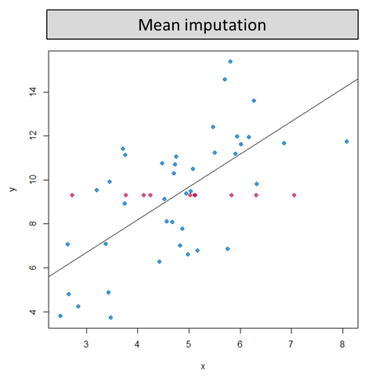
Mean Imputation
It's one of the easiest way to input missing values
Replace each missing value with the mean of the observed values for that variable

Slide 11
Mean Imputation
Downsides:
May lead to distortion in the distribution of the valiable
Underestimates the standard deviation
Advantages:
Very easy to implement
Low computational resources needed
May give good results if data is (almost) missing completely at random

Slide 12
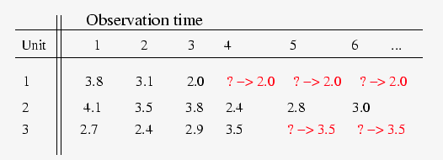
Last Observation Carried Forward (LOCF)
Replaces the missing data with the last available data, which is carried forward
Example:
Clinical drug trial

Slide 13
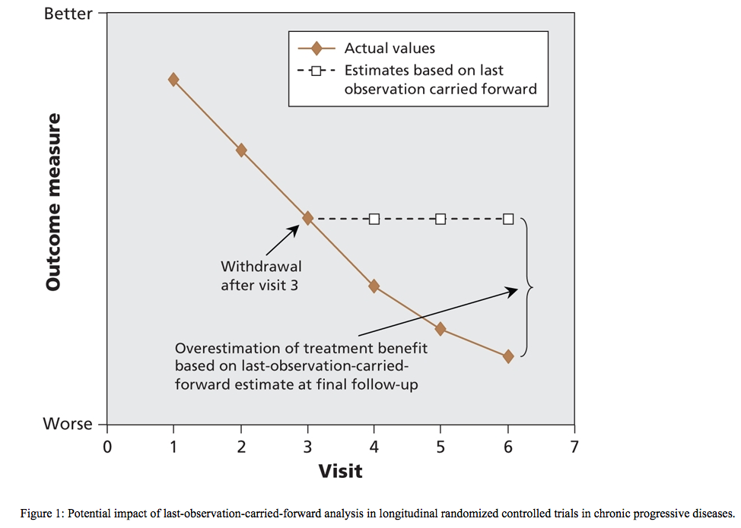
Last Observation Carried Forward (LOCF)

Slide 14
Last Observation Carried Forward (LOCF)
Downsides:
Means and covariance structure are seriously distorted
It does not take into consideration the trend of previous versions
Advantages:
No extra computational power needed
Can perform good if data is missing completely at random

Slide 15
Regression imputation
Complete observations is used to predict missing observations
Use regression predictions to perform
Deterministic imputation
Random imputation
Deterministic imputation (Single regression)
Assumes that imputed values fall on regression line with a non-zero slope
Implies a correlation of 1 between predictors and missing outcome variable
Will overestimate the correlations, the variances and covariances are underestimated

Slide 16
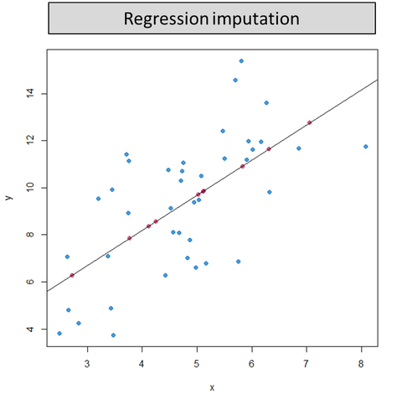
Deterministic imputation

Slide 17
Deterministic imputation
Advantages
It generates a complete data set
Disadvantages
Inputs data with perfectly correlated scores
Overestimate correlation
Bias

Slide 18
Regression imputation
Random imputation (Stochastic regression)
Aims to reduce the bias by an extra step with a residual term
The residual term is normally distributed with a mean of zero
And with a variance equal to the residual variance from the regression of the predictor
The error of the normal distribution is added

Slide 19
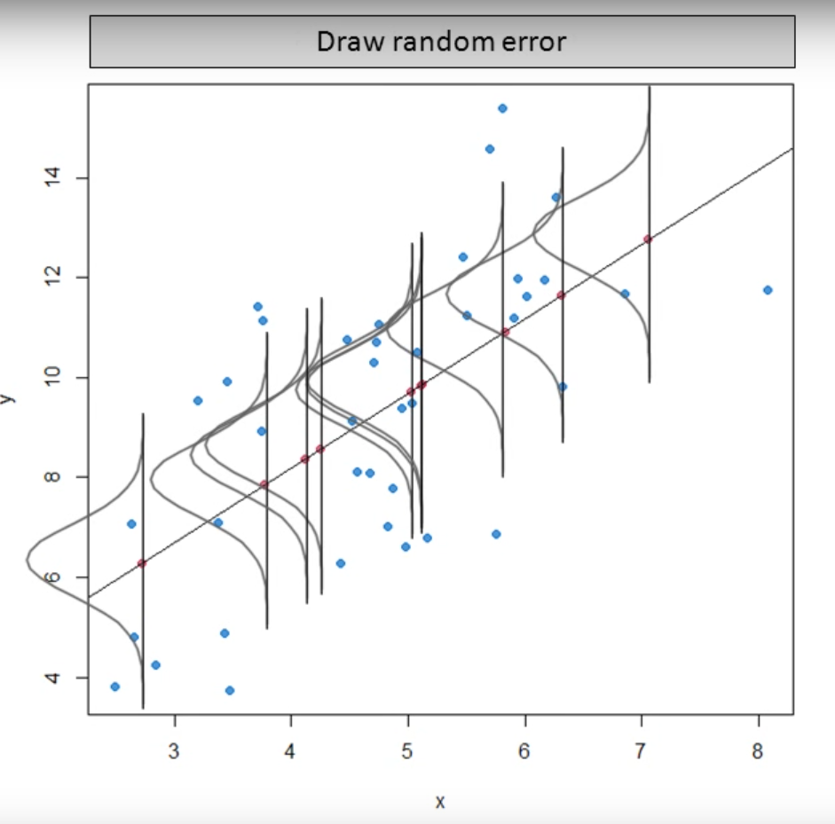
Random imputation

Slide 20
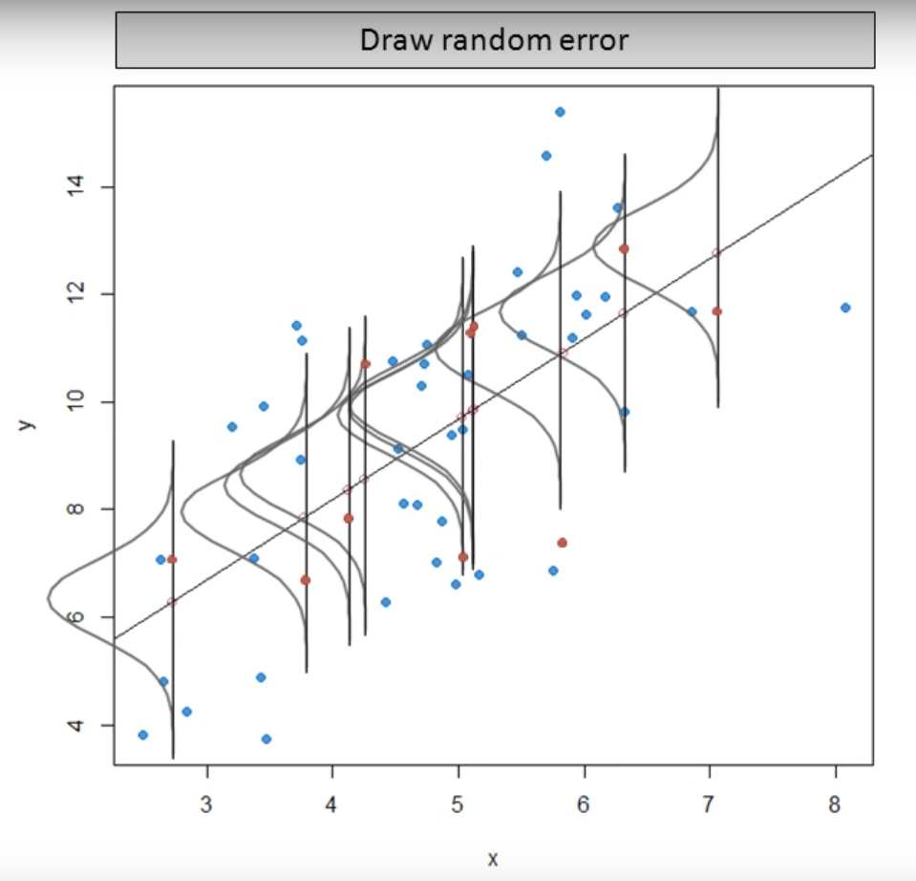
Random imputation

Slide 21
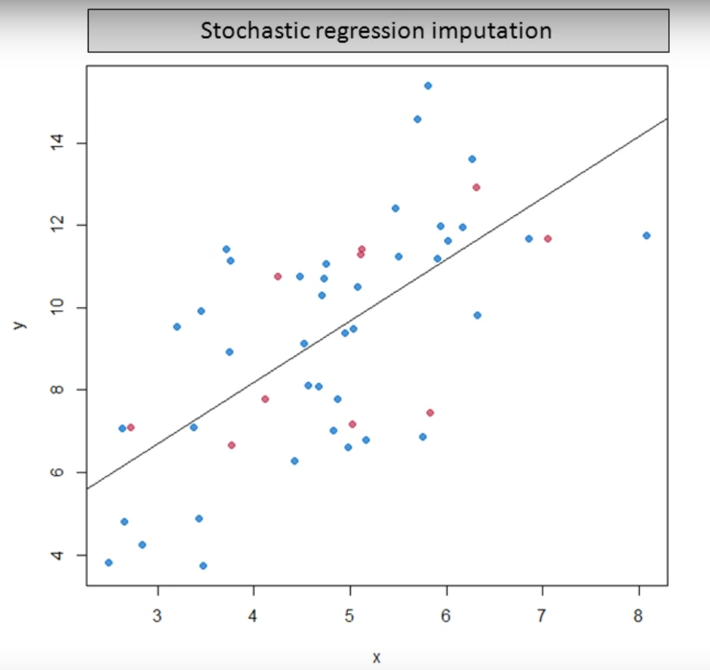
Random imputation
Notes:
This way the variability in the data is preserved and parameter estimates are unbiased with MAR data. However, the standard error tends to be underestimated, because the uncertainty about the imputed values is not included, which increases the risk of type I errors

Slide 22
Random imputation
Advantages
Most appropriate method
Input approximately equal results
It gives unbiased parameter under an MAR data mechanism
Disadvantages
Under estimate standard error

Slide 23
Matching methods (Hot-deck imputation)
Non-respondents are matched to resembling respondents
Two hot-deck approaches are
The distance function approach (Nearest neighbor approach)
The matching pattern method
Hot-deck imputation is especially common in survey research

Slide 24
Matching methods (Hot-deck imputation)
The distance function approach
Imputes the missing value with the case with the smallest squared distance
The matching pattern method
The sample is stratified in separate homogenous groups
Missing values are drawn from cases in the same group

Slide 25
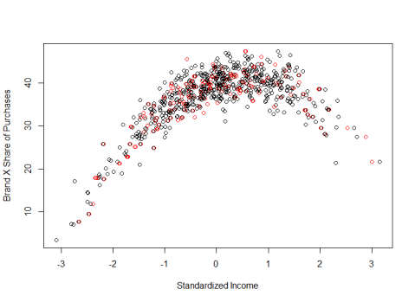
Hot-deck imputation

Slide 26
Matching methods (Hot-deck imputation)
Advantages
It generates a complete data set
Disadvantages
Not well suited for estimating measures of association
Produce substantially biased estimates of correlation and regression coefficients

Slide 27
Multiple imputation
What is multiple imputation ?
A statistical technique for analyzing incomplete data sets for which some entries are missing. Each missing value is replaced by a set of possible values.

Slide 28
Multiple imputation
What is multiple imputation ?
When do we use it?
MI can be used when the data is missing completely at random, missing at random or missing not at random.
When we want more precise results

Slide 29
Multiple imputation
Data set 1
Result 1
Data set with missing values
...
...
Summarized result
Data set n
Result n

Slide 30
Multiple imputation
Steps:
Imputation Phase
Data set 1
Result 1
Data set with missing values
...
...
Summarized result
Data set n
Result n
Notes:
Each imputation method should follow the described steps :
The imputation phase consists of creating a number of copies of the data (i.e. 10) where the only difference is the imputed values of the missing data.
For each copy the missing values are estimated using the mean and the covariance of the dataset.

Slide 31
Multiple imputation
Steps:
Imputation Phase
Analysis
Data set 1
Result 1
Data set with missing values
...
...
Summarized result
Data set n
Result n

Slide 32
Multiple imputation
Steps:
Imputation Phase
Analysis
Pooling
Data set 1
Result 1
Data set with missing values
...
...
Summarized result
Data set n
Result n

Slide 33
Multiple imputation (MICE method)
MICE Method steps :
Perform simple imputation
Set back to missing the imputed values
Perform regression for the missing values
Set the predicted values
Repeat 2-4 for another variable
Repeat 2-4 until convergence

