Slide 1

Efficient Convolutional Neural Networks for Mobile Vision Applications
Mobile Nets
Isac ciobota
Universitatea Politehnica Timisoara

Slide 2
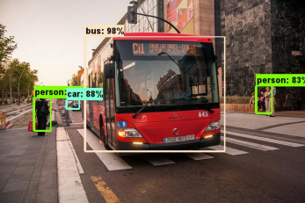
Mobile nets
Efficient models for mobile and embedded vision applications
Uses depthwise separable convolutions to build light weight deep neural networks
Two simple global hyperparameters that efficiently trade off between latency and accuracy

Slide 3
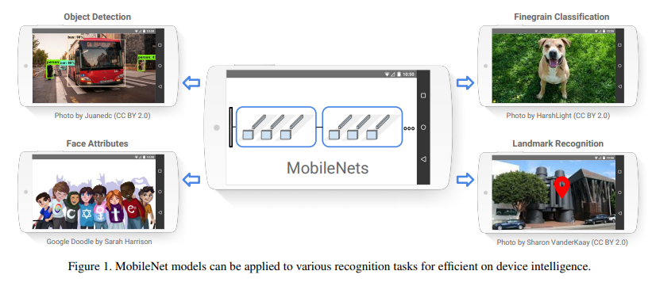
Use cases
Fine Grained Recognition
Large Scale Geolocalization
Face Attributes
Object Detection

Slide 4
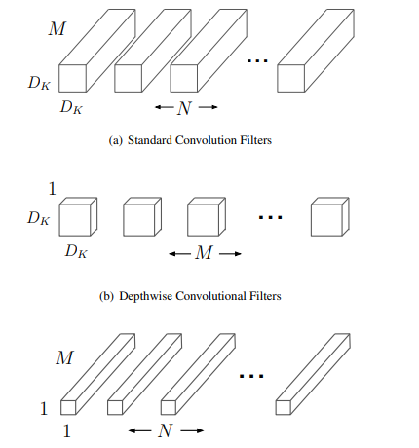
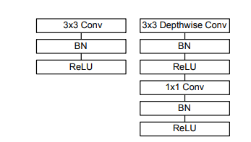
Depthwise Separable Convolutions
It’s a form of factorized convolutions.
Factorizes a standard convolution into:
a depthwise convolution
a 1x1 convolution called a pointwise convolution

Slide 5
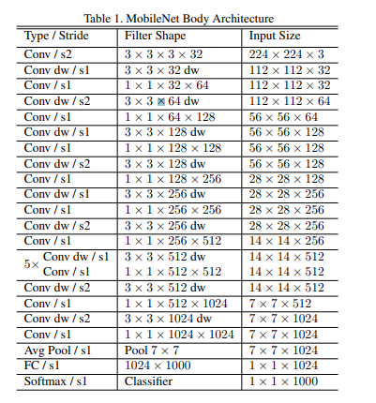
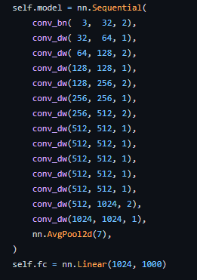
Mobilenet architecture

Slide 6
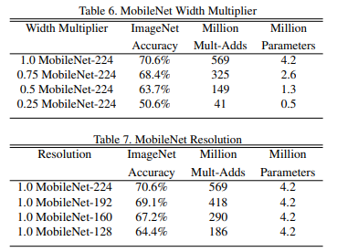


Hyper-parameters
Width Multiplier: Thinner Models
For a given layer and width multiplier α, the number of input channels M becomes αM and the number of output channels N becomes αN, where α ∈ (0, 1]. Computational cost:
Resolution Multiplier: Reduced Representation
We apply this to the input image and the internal representation of every layer is subsequently reduced by the same multiplier. In practice we implicitly set ρ by setting the input resolution, where ρ ∈ (0, 1]. Computational cost:

Slide 7
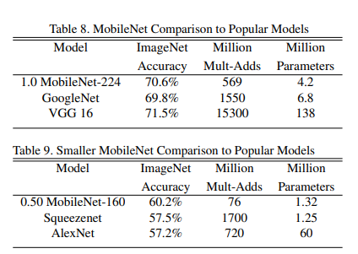
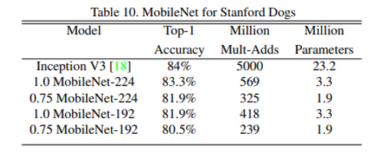
Other models

Slide 8
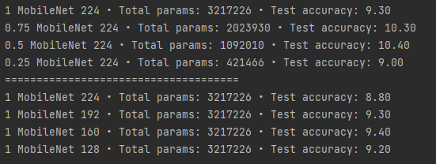
Results on FAKEDATA

Slide 9

netron

Slide 10
THANK YOU

