Slide 1
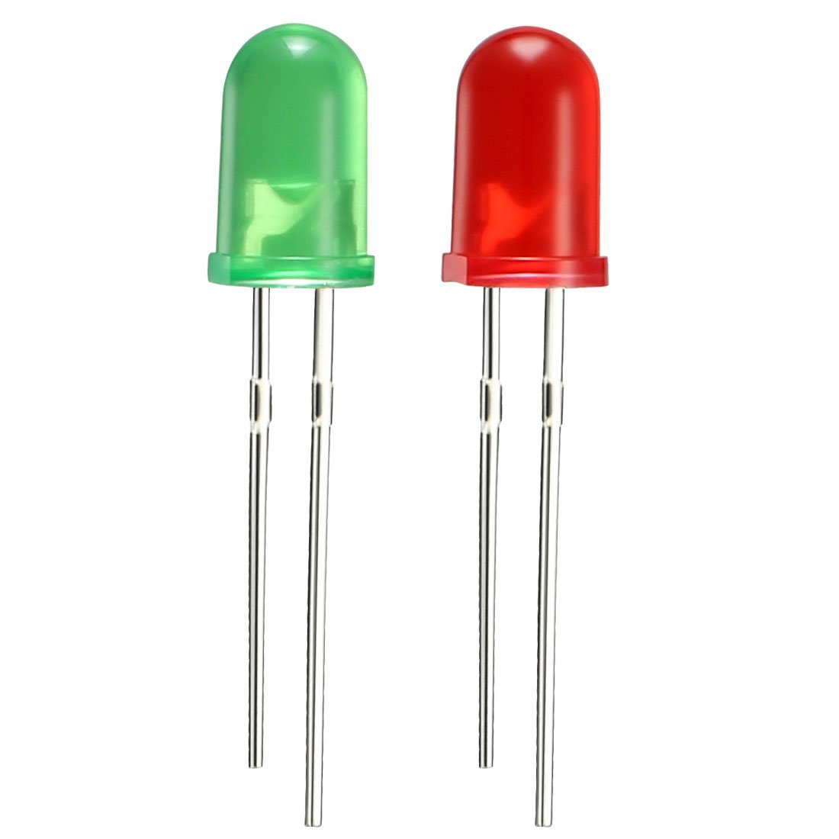
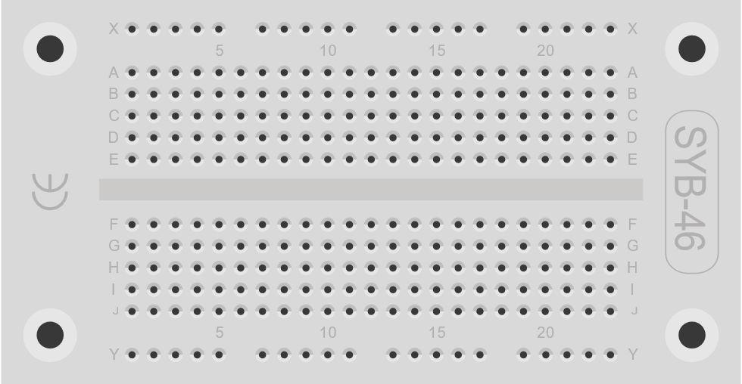
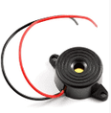
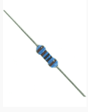
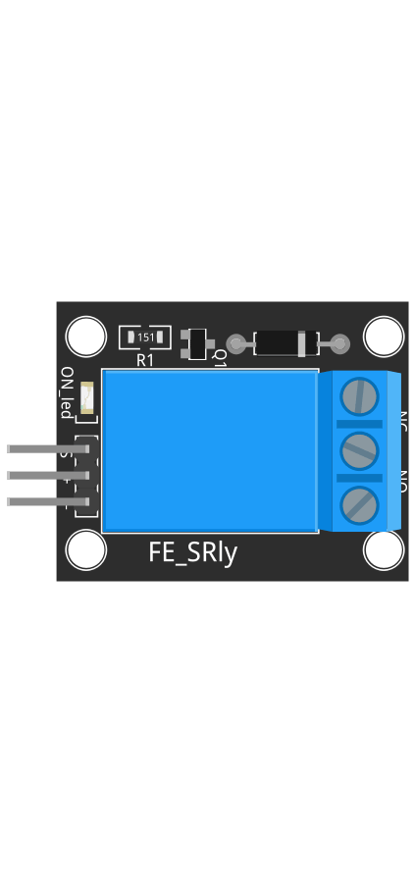

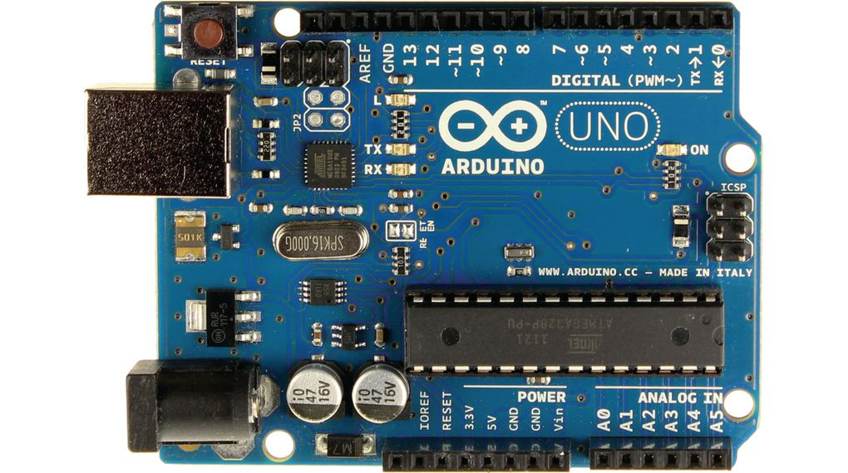

+5V DC
The long pin is the positive. Even if this drawing can confuse, the leds are not connected directly to the Arduino but are placed on breadboard
GND
5V DC Buzzer
+5V
+5V DC
5V DC Relay
12V DC Water pump
12V DC Power Supply

