Slide 1
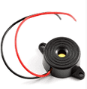
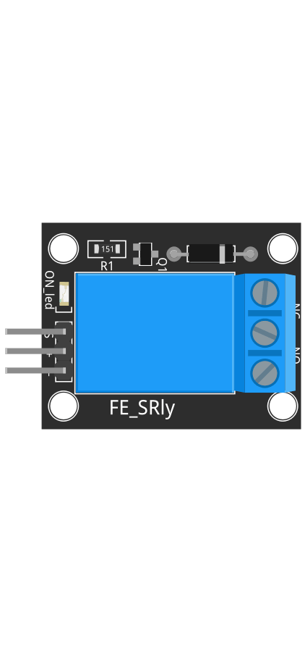

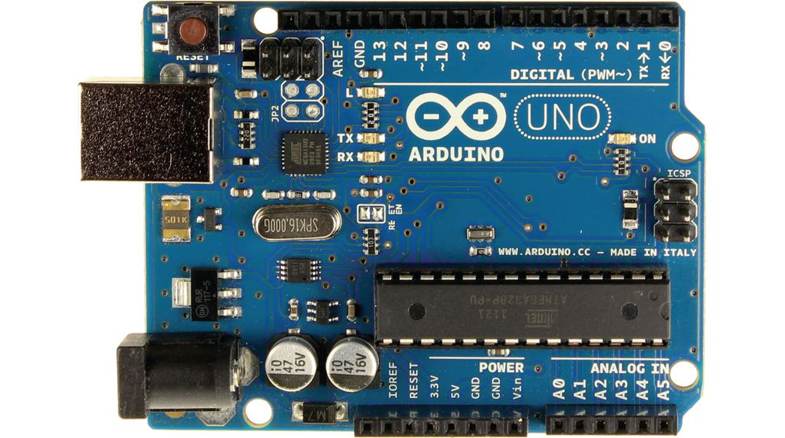

5V DC Buzzer
+5V
+5V DC
5V DC Relay
12V DC Water pump
12V DC Power Supply

