Slide 1

Chrome Internals:
Paint and Composition
by Dzmitry Varabei

Slide 2
Demo

Slide 3
Page Rendering Cycle
Parse HTML and CSS files
Build the DOM

Slide 4
Nodes and the DOM tree
<html>
<body>
<div>
Hello
</div>
</body>
</html>
HTMLDocument
HTMLHTMLElement
HTMLBodyElement
HTMLDivElement
Text("Hello")

Slide 5
Page Rendering Cycle
Parse HTML and CSS files
Build the DOM
Calculate CSS property values
Build the rendering tree

Slide 6
RenderObject Tree
This is a data structure that helps the browser perform layout tasks.
display:none
<head>
<script>
<style>
anonymous line box
:before

Slide 7
Page Rendering Cycle
Parse HTML and CSS files
Build the DOM
Calculate CSS property values
Build the rendering tree
Calculate layout
Paint
Composite
Draw the final screen image onto the screen

Slide 8
Display refresh rate
~ 60Hz
or
~16.6ms to make a frame

Slide 9

Google Chrome Canary
console> chrome.exe
--enable-threaded-compositing
--force-compositing-mode
--enable-impl-side-painting
--enable-skia-benchmarking
--allow-webui-compositing

Slide 10
Trace Event Profiling Tool
about://tracing/
Read more: http://dev.chromium.org/developers/how-tos/trace-event-profiling-tool

Slide 11
Demo – CSS Paint Order

Slide 12
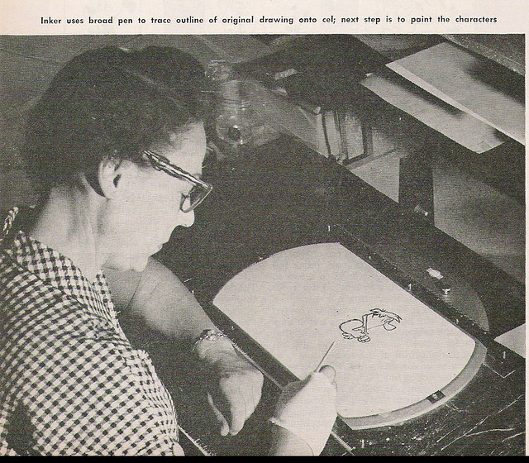
Paint
The phase of rendering where RenderObjects make calls into the GraphicsContext API to make a visual representation of themselves

Slide 13
Skia Graphics Engine
Skia is the open source C++ graphics library for drawing Text, Geometries, and Images.
https://code.google.com/p/skia/

Slide 14




Skia is currently used in
Google Chrome | Mozilla Firefox | Chrome OS | Android | Sublime Text 3

Slide 15
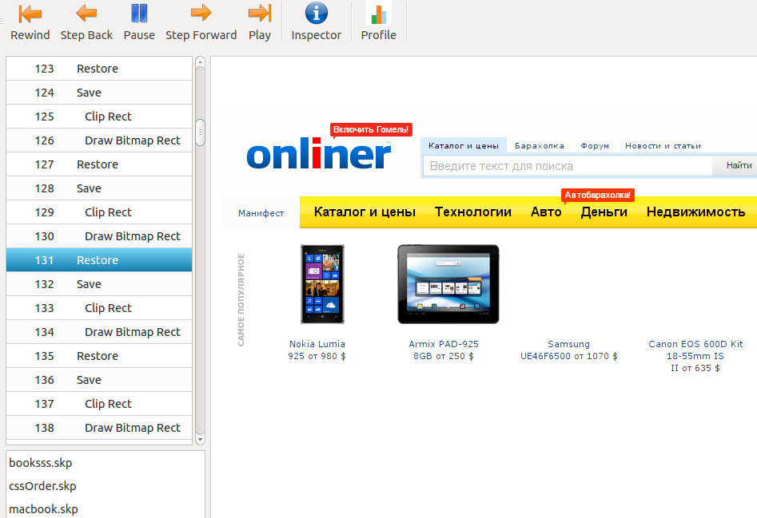
Skia Debugger
- Demo

Slide 16
How to save .skp files from Chromium?
http://www.chromium.org/developers/how-tos/trace-event-profiling-tool/saving-skp-s-from-chromium

Slide 17
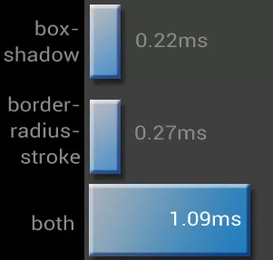
What cause complex painting?
image decodes/resizes
box-shadow (essentially
improved over
the past 2 years)
border-radius
border-radius + box-shadow
Read more: CSS Paint Times and Page Render Weight

Slide 18
Software mode VS Accelerated compositing mode

Slide 19
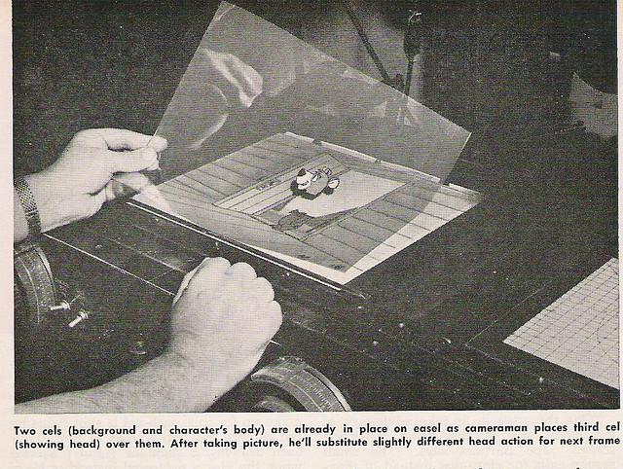
Composition

Slide 20
Accelerated compositing mode
Layer bitmaps are transferred to the GPU, combined ("composited"), and drawn on the screen.

Slide 21
Layer
Layer: section of the page, subtree of the DOM. Painted independently, composited on the GPU, and can stretch, move, and fade without repainting.

Slide 22
Which elements have their own layer?
Root page object
Canvas
Video element
plugins (flash and etc)
Elements with CSS properties: TranslateZ, Translate3d, Opacity, ScaleZ, RotateZ...
2D Transforms do not create layer

Slide 23
The cost of too many layers:
Additional GPU and memory usage

Slide 24
Render profiling tools
Show FPS
Show paint rectangles
Continuous page repainting
Show composited layer borders
Timeline -> Frames

Slide 25
Questions?

Slide 26
Resources
How Browsers Work
http://jankfree.org/
Jank Free: Chrome Rendering Performance
Compositing in Blink and WebKit
Trace Event Profiling Tool (about:tracing)
GPU Accelerated Compositing in Chrome
CSS Paint Times and Page Render Weight
http://dev.chromium.org/developers/tech-talk-videos

Slide 27
Thanks!
Dzmitry.Varabei@gmail.com

