Slide 1
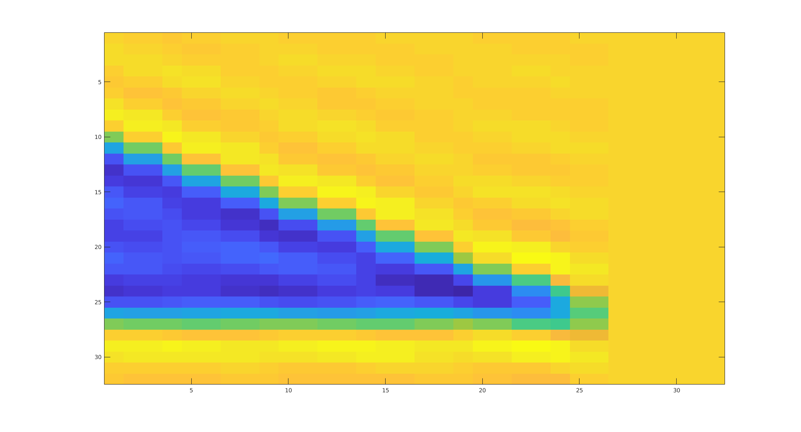
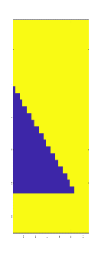
Fully Connected Layer
Regression Layer
Convolution
Max pooling
ReLu
Convolution
Max pooling
ReLu

