Slide 1

Big Data Analytics
14 September, 2022
Students
Grade
Prediction
Neuron Solutions, Islamabad
Kamyab Jawan Program 2022 | Batch–3

Slide 2

Presented By
Sadia Iqbal
Rabbia Sajid
Sidra Sajjad
Adeeba Zahra
Presented To
Mr. Fahad Shah

Slide 3
Project Overview
In the world of open education systems, students have flexibility to learn anything with ease as the learning content is easily available. But this facility can make students complacent. Therefore, it becomes difficult to predict the student’s performance in advance. In this project, an attempt is made to help the student to know his performance in advance.
Dataset Reference:
https://www.kaggle.com/datasets/dipam7/student-grade-prediction

Slide 4
Project Objective
The main objective of this Python project is to Analysis & Prediction the final grade of secondary students. These data reflect the performance of secondary school students in two Portuguese schools. There are two sets of indicators for two different subjects: mathematics (math) and Portuguese (por). The target attribute Grade 3 (final grade) has a strong correlation with the Grade 2 and Grade1 attributes.

Slide 5
Machine learning Algorithm
Linear Regression is one of machine learning algorithm. Linear regression performs the task to predict a dependent variable value based on a given independent variable. In student grade dataset, final grade G3 dependent on so many independent aspects . We use this algorithm to predict student grade due to two reasons;
Simple Procedure
It makes the estimation procedure simple
1
Easy Implementation
Easier to implement, interpret and efficient to train
2

Slide 6
Tools & Technologies
Visual Studio Code
* For implementation of dataset analysis and machine learning algorithm
PyCharm
* For connection of ML model with website/ flask, app files
Notepad
*For creating html, css files or web interface required files

Slide 7
Overview Of All Files Involved In This Project

Slide 8
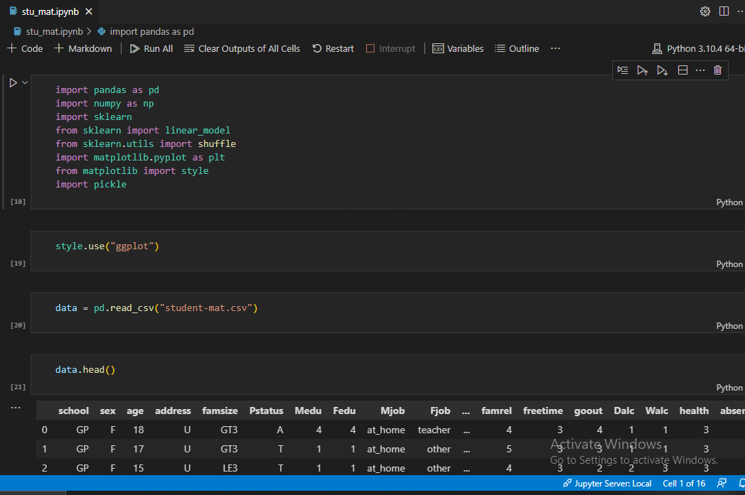
1
stu_mat.ipynb
Data
Cleaning &
Analysis

Slide 9
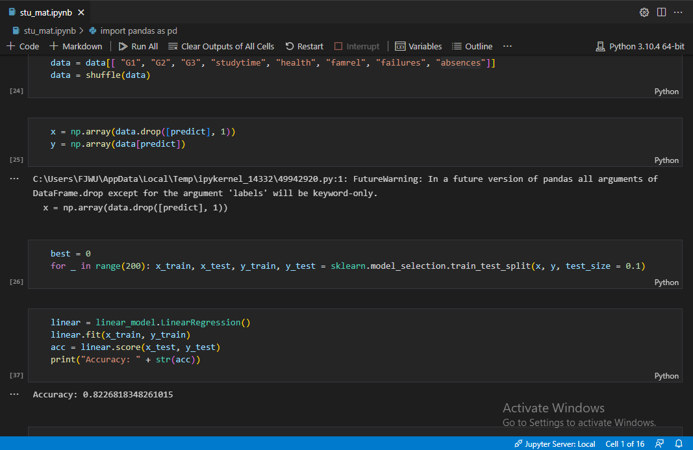
1
stu_mat.ipynb
Training Model of Linear
Regression

Slide 10
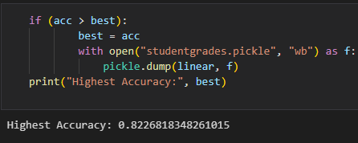
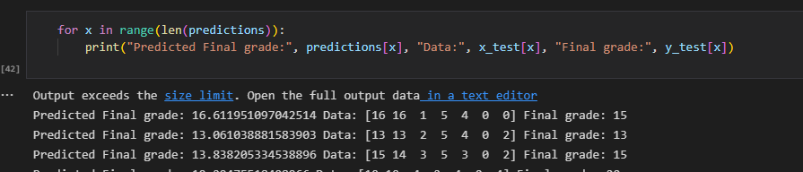
1
stu_mat.ipynb
Output

Slide 11
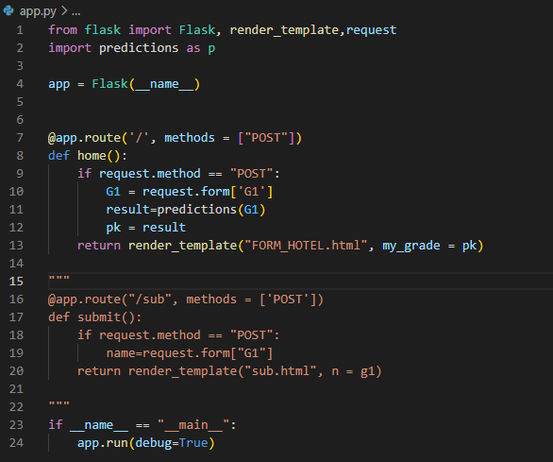
2
app.py

Slide 12
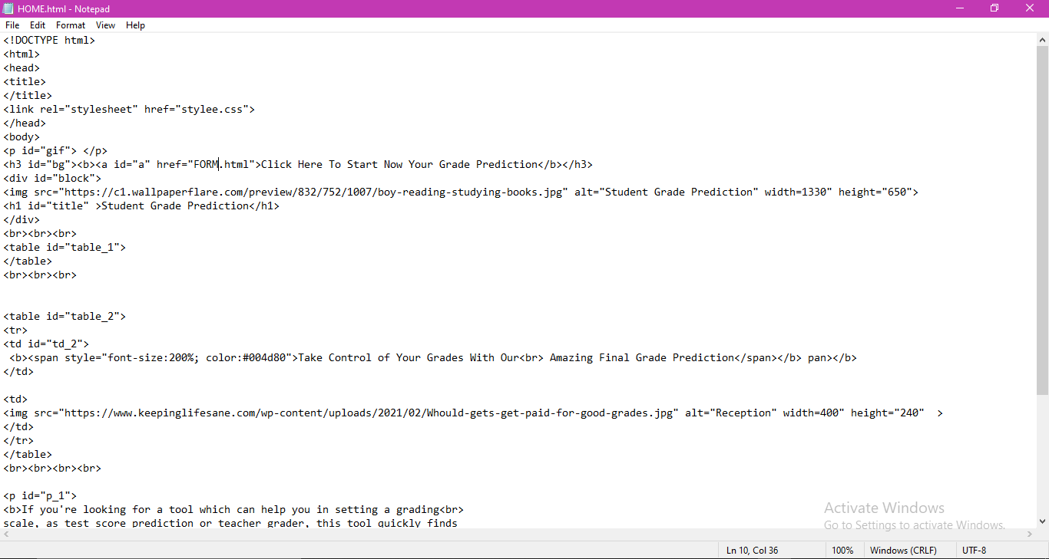
3
HOME.html

Slide 13
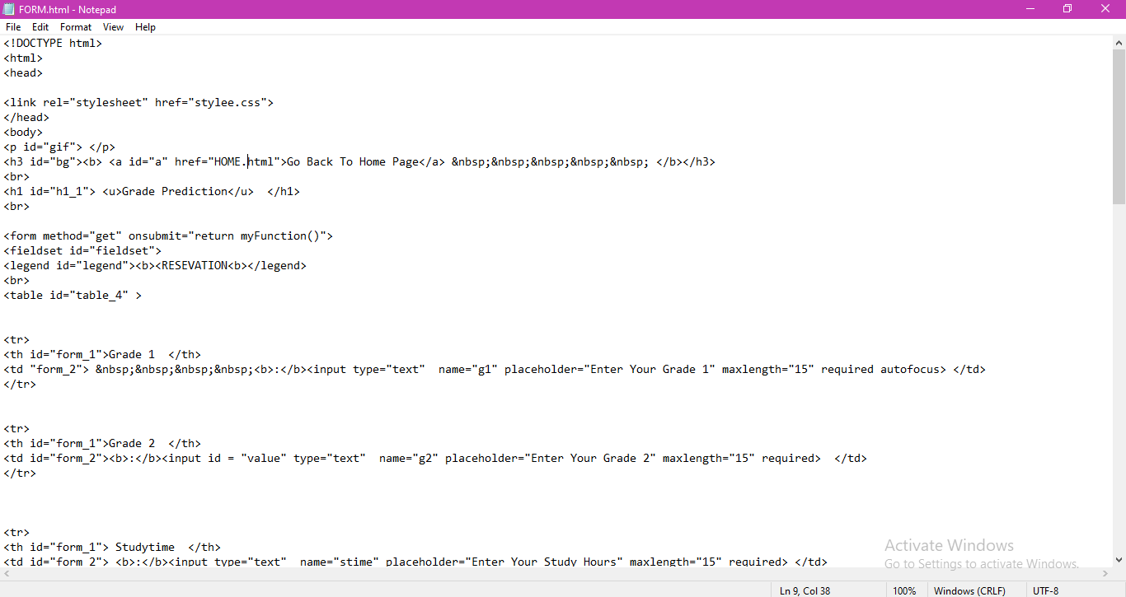
4
FORM.html

Slide 14
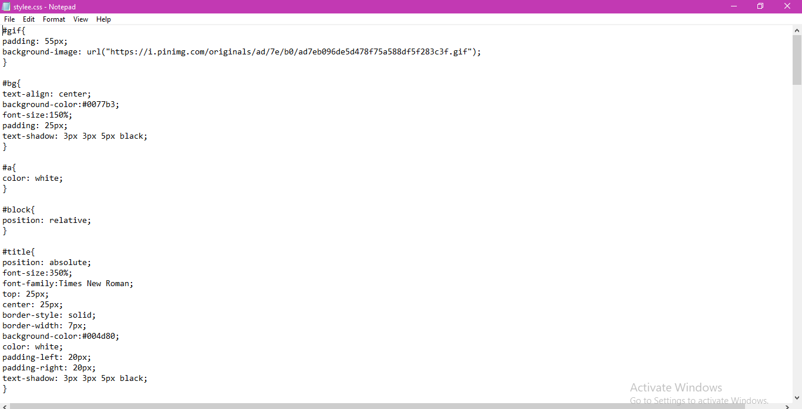
5
stylee.css

Slide 15
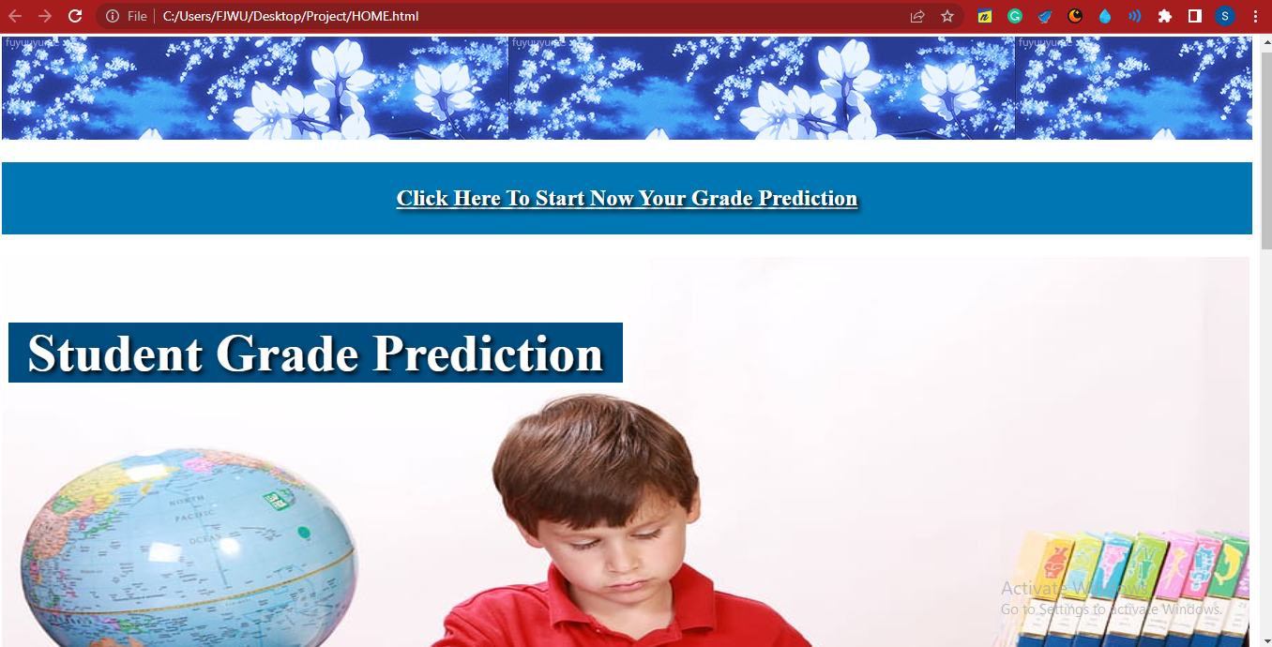
6
Website Home Page Interface

Slide 16
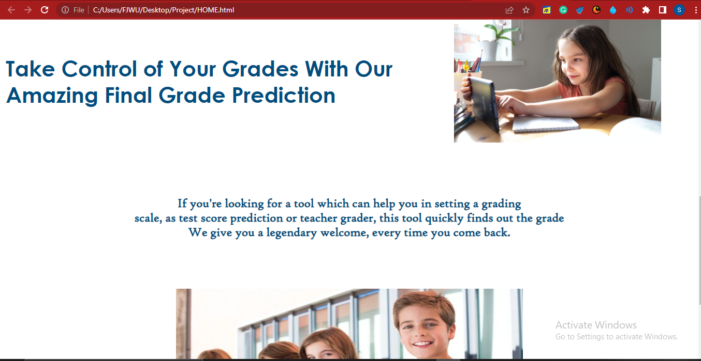
6
Website Home Page Interface

Slide 17
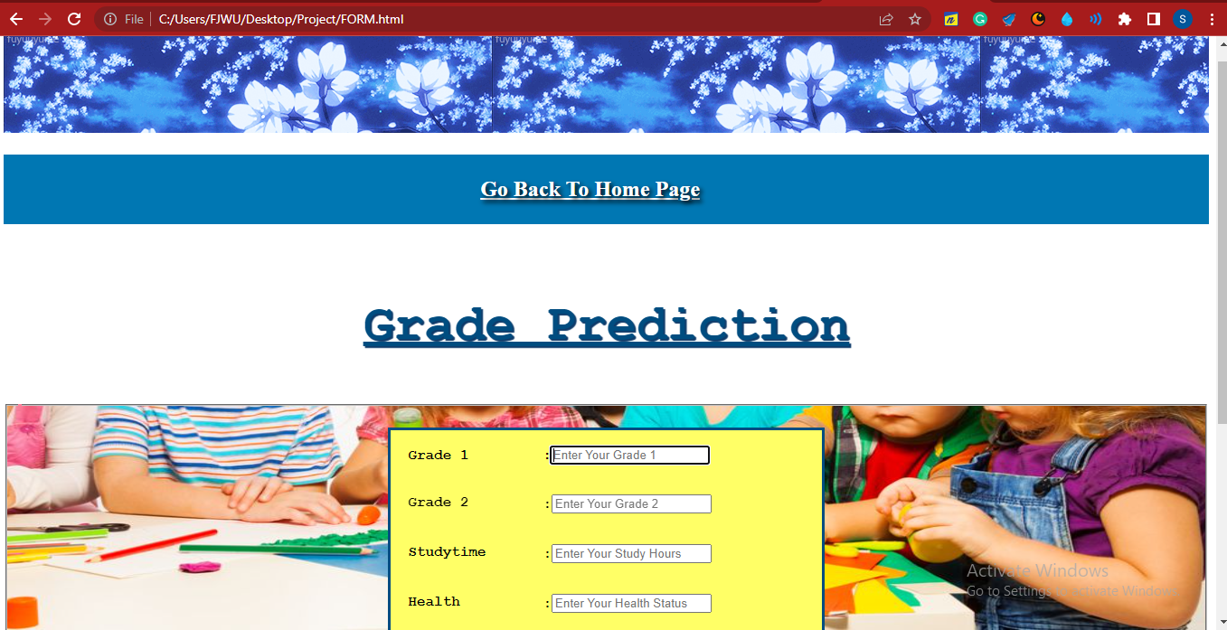
6
Website Form Page Interface

Slide 18
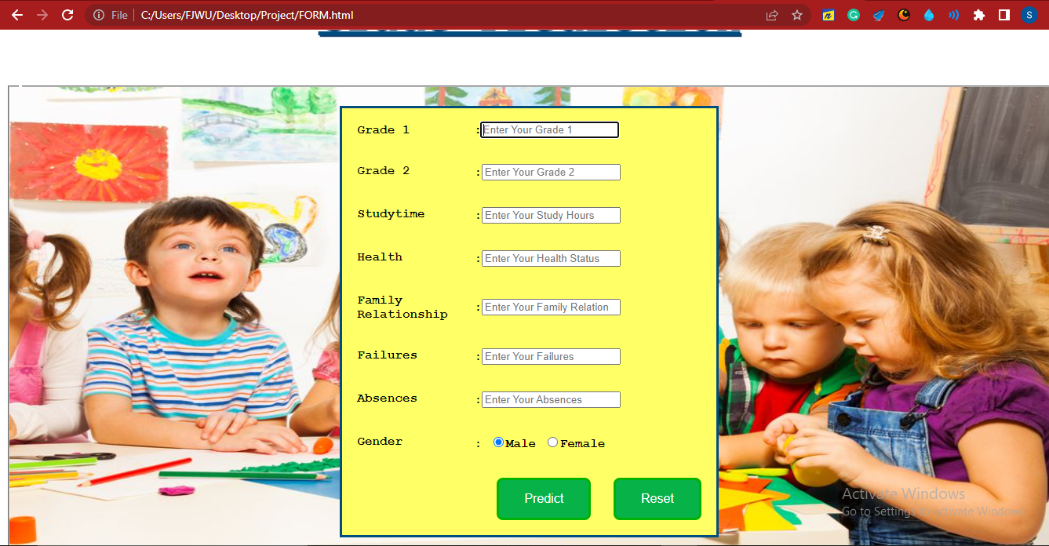
6
Website Form Page Interface

Slide 19
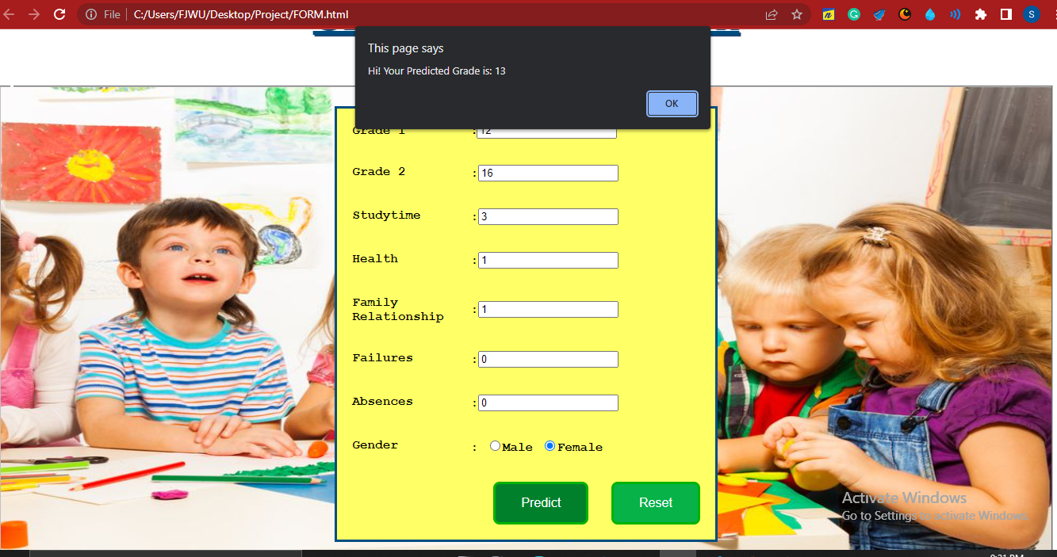
7
Output

Slide 20
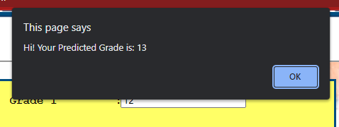
7
Output

Slide 21
Conclusion
In this project, we did a deep analysis of what could be a possible factor in whether a student is likely to get a high grade or a low grade. The data does not contain that much information but still, we were able to predict a pretty precise Linear Regression algorithm that predicts what score a student will get in the foreseen feature by analyzing the features.

Slide 22
YouTube Link
https://youtu.be/YAKxP162g8g
GitHub Link
https://github.com/isadia005/STUDENT-GRADE-ANALYSIS-PREDICTION.git

Slide 23
THANK YOU!
Have a great day ahead.

