Slide 1



Apple store
Visualizing of an interesting data set using Tableu that covers information about apps available on the
Apple Store

Slide 2
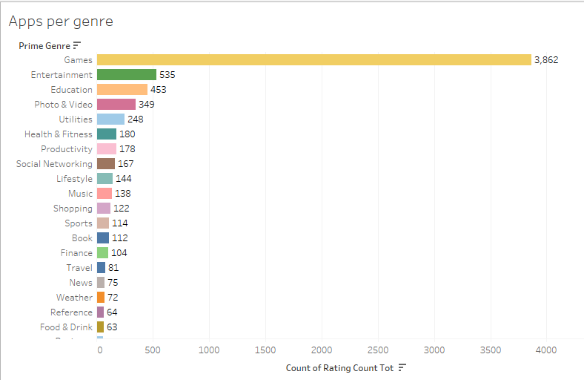
The number of apps per genre
& more …

Slide 3
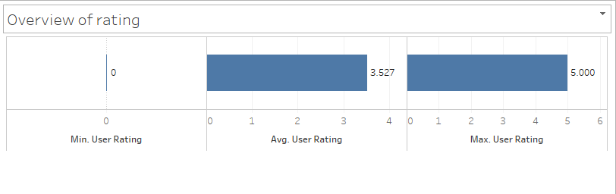
An overview of ratings

Slide 4
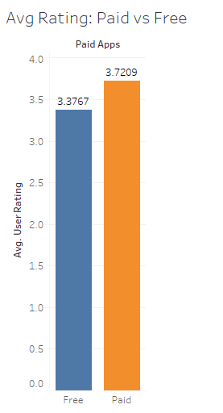
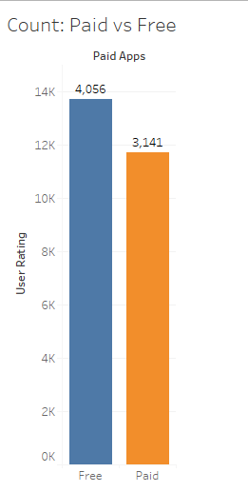
Paid apps VS Free apps

Slide 5
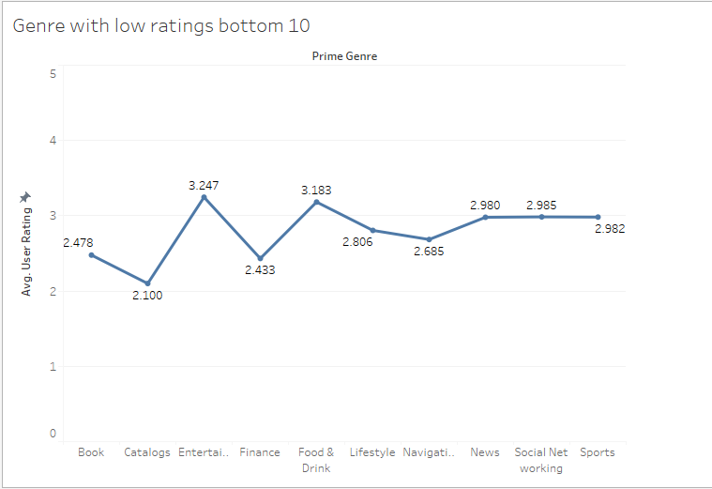
Genre with lower ratings

Slide 6
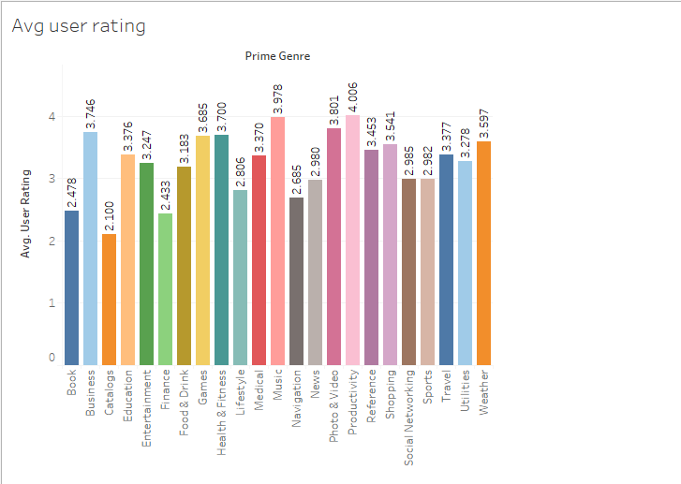
Average user per genre

Slide 7
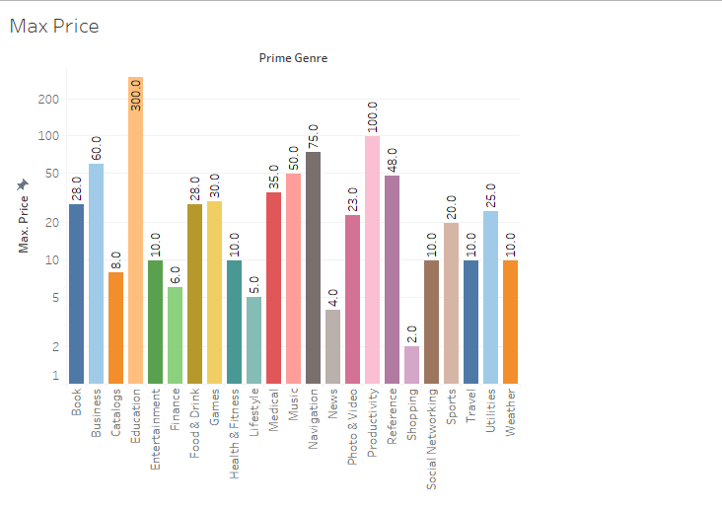
Max price in each genre

Slide 8
Key outcomes of the analysis
Paid apps have better ratings
Finance and Catalogs apps have low ratings
The most and least expensive app is in Education and Shopping genre
A new app should aim for an average rating above 3.5
Games genre have highest competition

