Slide 1
Active Directory Migration Project

Slide 2
The Four major components of Active Directory
Forest – this is the highest level of organization within Active Directory. this is the highest level of organization within Active Directory. It also acts as the centralized mechanism for managing as well as controlling authentication and authorization across the organization
Domain – or Active Directory Domain is typically a collection of all objects within an AD DS network. This is grouped in a tree structure. AD Domains are identified by a DNS name. For CCI, this is “ldhenergy.net”
Tree – is a collection of domains within AD DS. The main reason why it is called a tree is because each domain has exactly one parent which leads to a hierarchical tree structure. A domain tree typically starts from a single parent or root and then branches out into different child domains
Object – it refers to the single element contained in Active Directory domain such as a user account, custom recipient, security group, distribution group, organization unit, computer account…….Objects are also referred to as resources or security principals.

Slide 3
Issue we are trying to address in this project
Primary issue / goal:
Change the Active Directory domain name:
The new domain will be named cci.local. This will allow the users to login to this domain instead of ldhenergy.net once the AD accounts have been migrated to the new domain. The new name will align with the firm’s current name (Platform Services Team)
Clean up legacy objects such GPOs, Scripts, Accounts……. (Platform Services Team)
Related goals / projects:
Implement Windows Hello For Business (Client Services Team)
Implement modern security policies, such as Zero Trust (Security Team)

Slide 4
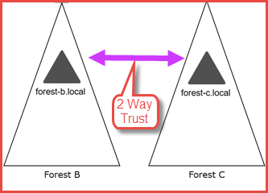

Slide 5
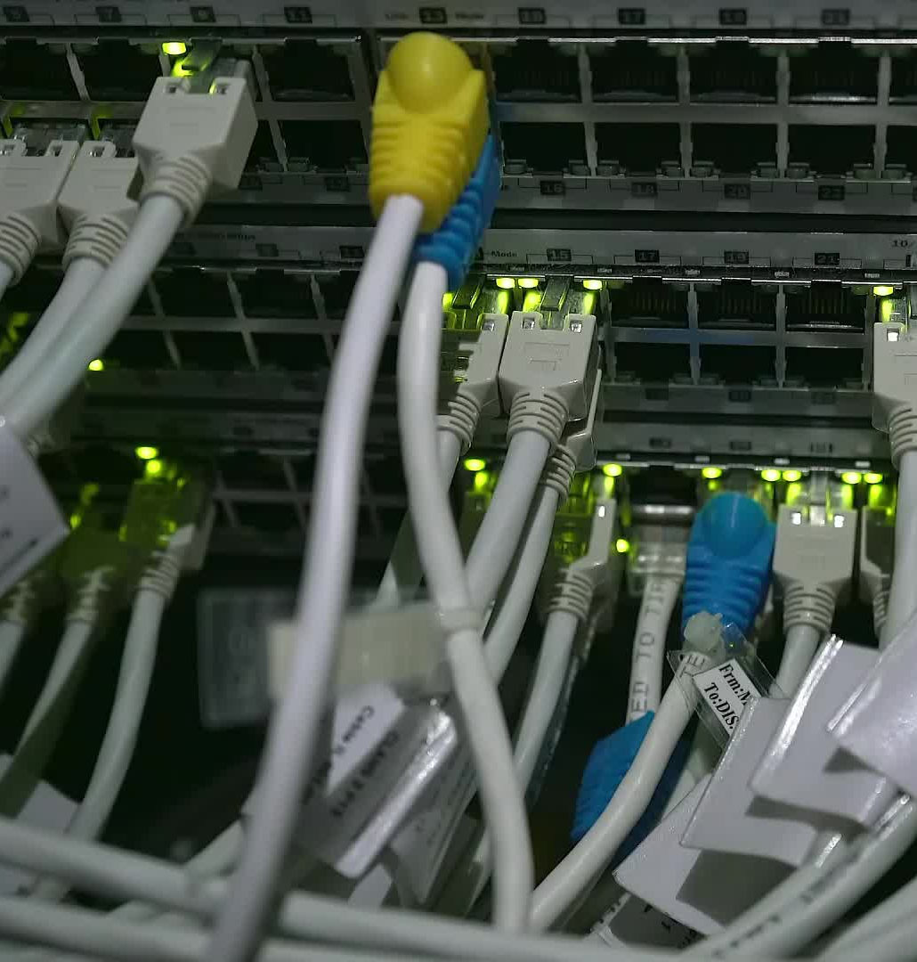
Migrating User and Computer Accounts Between Active Directory Forests
Steps for seamless migration of accounts and resources
Notes:
AI-generated content may be incorrect. --- This presentation provides a comprehensive guide on how to effectively migrate user and computer accounts between Active Directory forests. We will cover preparation, trust relationships, migration processes, and post-migration tasks to ensure a smooth transition.

Slide 6

Agenda Items
Interviewing Microsoft Partners
Selecting a Microsoft Partner
Preparation and Planning
Setting Up Trust Relationships
Migrating User Accounts
Using Quest AD Migration for Active Directory Forests
Migrating Computer Accounts
Post-Migration Tasks
Notes:
We will begin by discussing the importance of preparation and planning for migration, including evaluating the current environment and defining objectives. Next, we will cover the setup of trust relationships necessary for migration. The presentation will then detail the actual migration of user and computer accounts, utilizing various tools. Finally, we will address post-migration tasks to ensure success.

Slide 7
Interviewing and Selecting a Microsoft Partner
Notes:
Thorough preparation and planning are crucial for successful migration. Understanding your current environment and having clear objectives can significantly reduce complications during the process.

Slide 8
List of Microsoft Partners we have discussed the project with
Softchoice
SpruceTech / BlueSky
Interlink

Slide 9
The Microsoft Partner we have decided to partner with
TBD

Slide 10
Preparation and Planning
Notes:
Thorough preparation and planning are crucial for successful migration. Understanding your current environment and having clear objectives can significantly reduce complications during the process.

Slide 11
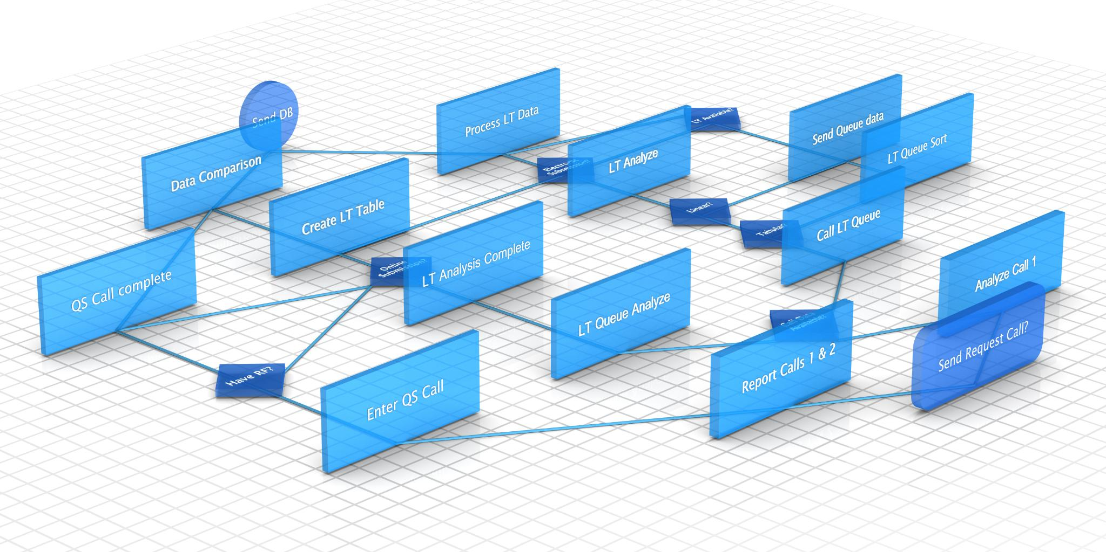
Assessing the Current Environment
Current Active Directory Status
Begin your assessment by evaluating the current Active Directory environment and its components. CCI infrastructure team has already conducted its own AD and Azure AD assessments. Additional assessments will be conducted with the MS partner once selected.
Identifying Domains
Identify the existing domains within the environment, which will be crucial for migration planning.
Trust Relationships
Assess trust relationships between domains to understand how they interact during migration.
Dependencies Assessment
Identify any dependencies that may impact the migration process and strategy development.
Notes:
Begin by assessing the current Active Directory environment. Identify existing domains, trust relationships, and any dependencies that could affect the migration. This assessment will inform your migration strategy and planning.

Slide 12
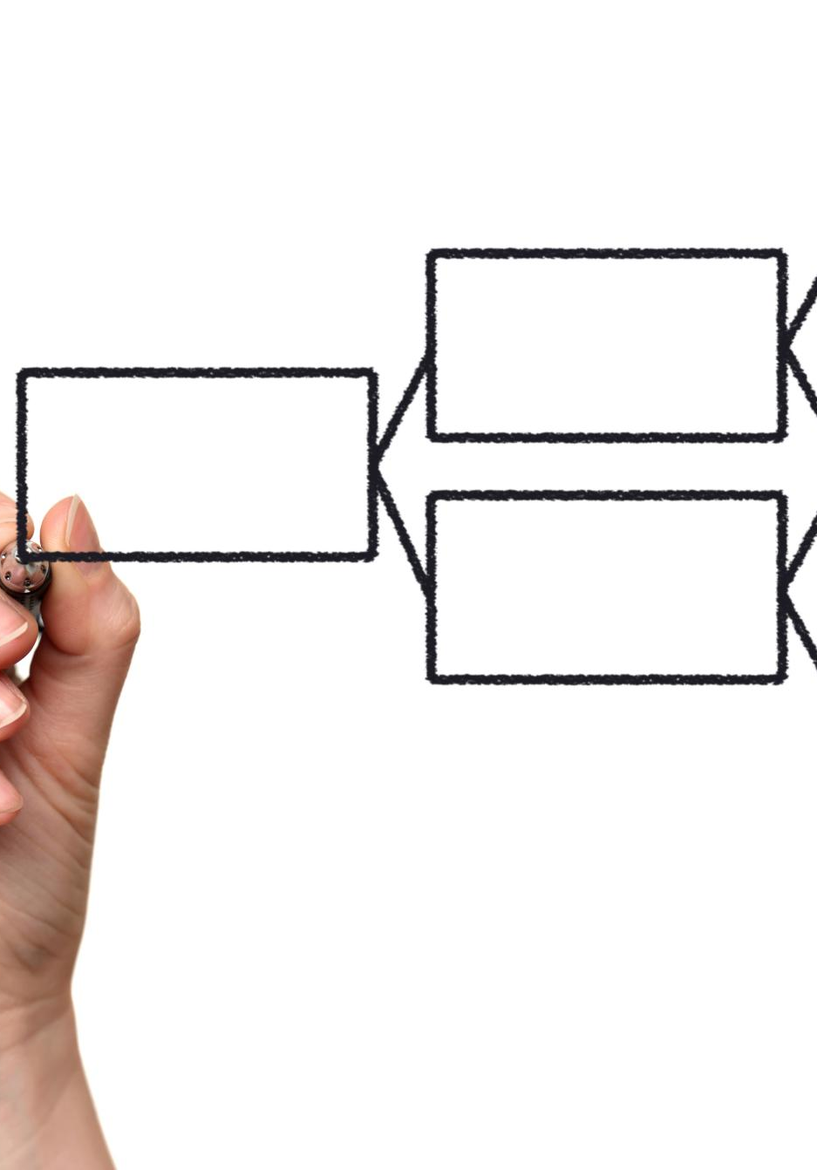
Defining Migration Objectives and Scope
Establish Migration Objectives
Defining clear objectives for the migration process helps ensure a smooth transition and successful outcomes (listed in slide 3)
Identify Essential Accounts
It's important to identify which user and computer accounts are critical for migration to avoid data loss.
Set Timelines
Establishing timelines for the migration ensures all steps are planned and executed efficiently.
Notes:
Clearly define the objectives of the migration and the scope of what will be moved. This includes identifying which user and computer accounts are essential for migration and setting timelines.

Slide 13

Creating a Detailed Migration Plan
Outline Steps for Migration
Clearly define the steps that need to be taken to ensure a successful migration process. This includes planning, execution, and evaluation phases.
Identify Tools Required
List the tools and technologies that will be necessary to facilitate the migration. This includes software, hardware, and support services.
Assign Responsibilities
Clearly assign roles and responsibilities to team members to ensure accountability and effectiveness throughout the migration process.
Notes:
A comprehensive migration plan should outline the steps to be taken, the tools to be used, and responsibilities assigned to team members. This plan will serve as a roadmap for the migration process.

Slide 14
Setting Up Trust Relationships
Notes:
Trust relationships between the source and destination forests are necessary for successful migrations. Understanding different trust types will enable you to configure them appropriately.

Slide 15

Establishing One-Way and Two-Way Trusts
Understanding One-Way Trusts
One-way trusts enable one forest to access resources in another, enhancing resource utilization effectively.
Understanding Two-Way Trusts
Two-way trusts facilitate mutual access between forests, promoting collaboration and shared resources.
Benefits of Trust Establishment
Establishing trusts broadens collaboration and resource sharing, optimizing operational efficiencies.
Notes:
Learn how to establish one-way and two-way trusts between forests. One-way trusts allow one forest to access resources in another, while two-way trusts allow mutual access, broadening collaboration.

Slide 16

Verifying and Troubleshooting Trust Relationships
Verifying Trust Functionality
Ensure that established trusts are functioning correctly by performing regular checks and validations.
Common Issues in Trusts
Identify and understand common issues that can disrupt trust relationships to effectively troubleshoot them.
Smooth Migration Process
By addressing trust issues promptly, you can ensure a smooth migration process without major disruptions.
Notes:
Once trusts are established, it's crucial to verify their functionality. Learn how to troubleshoot common issues that may arise with trust relationships to ensure a smooth migration.

Slide 17
Using Quest AD Migration for Active Directory Forests
Notes:
Quest AD Migration provides advanced features that simplify the migration process. Understanding its capabilities can help streamline migrations between forests.

Slide 18

Overview and Features of Quest AD Migration
Automated Migrations
Quest AD Migration provides automated migration capabilities to streamline the process and reduce manual errors.
Comprehensive Reporting
The tool includes comprehensive reporting features to help track migration progress and identify potential issues.
Support for Complex Environments
Quest AD Migration supports complex environments, allowing for seamless transitions across various configurations and infrastructures.
Notes:
Quest AD Migration offers features such as automated migrations, reporting, and support for complex environments. Familiarizing yourself with these features can enhance your migration strategy.

Slide 19

Setting Up Quest AD Migration
Installation Steps
Understand the necessary installation protocols for Quest AD Migration to ensure a smooth setup process in your environment.
Initial Configurations
Learn about the initial configurations required to prepare the environment for a successful Quest AD Migration.
Migration Preparation Steps
Explore the key steps needed to prepare our environment for the AD migration process, ensuring efficient execution.
Notes:
Learn how to set up Quest AD Migration for your environment, including installation protocols and initial configurations to prepare for the migration.

Slide 20

Executing Migration with Quest AD Migration
Running Migration Jobs
Executing migration jobs is crucial for transferring data effectively across systems during the migration process.
Monitoring the Process
It is essential to monitor the migration process continuously to identify and resolve any issues that may arise.
Ensuring Completion
Confirming the successful completion of the migration ensures that all data is accurately transferred and accessible.
Notes:
Once set up, executing the migration with Quest AD Migration involves running the migration jobs. Monitor the process for any issues and ensure successful completion.

Slide 21
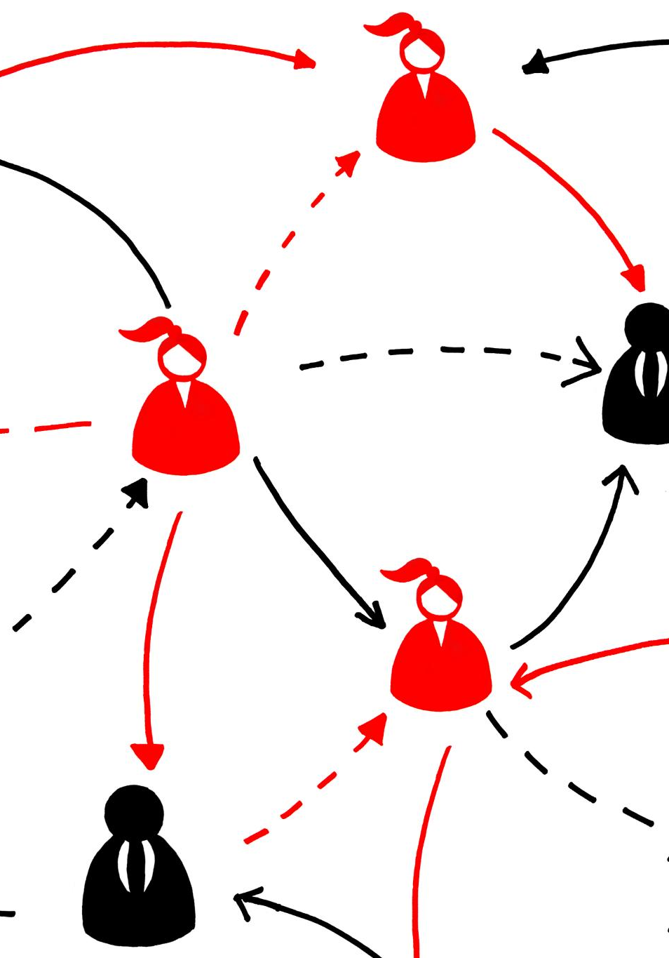
Troubleshooting and Best Practices
Common Pitfalls
Identifying common pitfalls in the migration process will help us to avoid significant issues and delays.
Troubleshooting Strategies
Having effective troubleshooting strategies in place will enable us to quickly address and resolve issues that arise, and they will.
Best Practices
Implementing best practices to ensure a smoother migration experience and helps minimize potential setbacks.
Notes:
Understanding common pitfalls and having troubleshooting strategies in place will help navigate issues that may arise during the migration process. Best practices ensure a smoother experience.

Slide 22
Migrating User Accounts
Notes:
The migration of user accounts requires careful preparation and execution. Proper tools can streamline this process and ensure data integrity.

Slide 23

Preparing User Data for Migration
Data Cleanliness
Ensuring data cleanliness is crucial before migration to avoid complications during transfer.
Removing Duplicates
Identifying and removing duplicate accounts helps maintain a streamlined user database.
Verifying Attributes
Verify user attributes to ensure all necessary information is accurate and complete.
Preparing User Groups
Organize user groups to facilitate smooth migration and access rights management.
Notes:
Prior to migration, ensure that user data is clean and ready for transfer. This includes removing duplicate accounts, verifying attributes, and preparing groups.

Slide 24

Validating and Synchronizing User Accounts
Migration:
Test migrating a small batch of user accounts to the target domain. Assess the results and decide on how to proceed
Post-Migration Validation
After migration, it is essential to validate that all user accounts have been correctly migrated to ensure proper access.
Synchronization Check
Synchronization with the destination forest must be confirmed to guarantee functionality and access consistency for users.
Ensuring Access and Functionality
This validation step is crucial for ensuring that users retain access and all functionalities post-migration.
Notes:
After migration, validate that all user accounts have been correctly migrated and synchronized with the destination forest. This step is crucial for ensuring continued access and functionality.

Slide 25
Migrating Computer Accounts
Notes:
Migrating computer accounts requires a slightly different approach than user accounts. Ensure that all dependencies are accounted for.

Slide 26

Preparing Computer Data for Migration
Documentation of Accounts
Proper documentation of computer accounts is essential to track data efficiently during migration.
Verification of Attributes
Verifying necessary attributes of accounts ensures that all data is ready for a seamless migration process.
Seamless Transition
Preparing data thoroughly is crucial for a seamless transition, reducing potential errors during the migration.
Notes:
Prepare the computer accounts for migration by ensuring that they are properly documented and any necessary attributes are verified. This preparation is crucial for a seamless transition.

Slide 27
Validating and Synchronizing Computer Accounts
Migration:
Test migrating a small batch of computer accounts to the target domain. Assess the results and decide on how to proceed
Post-Migration Validation
After migration, it is essential to validate that all computer accounts have been correctly migrated to ensure proper access.
Synchronization Check
Synchronization with the destination forest must be confirmed to guarantee functionality and access consistency for users.
Ensuring Access and Functionality
This validation step is crucial for ensuring that computers retain access and all functionalities post-migration.
Notes:
After migration, validate that all user accounts have been correctly migrated and synchronized with the destination forest. This step is crucial for ensuring continued access and functionality.

Slide 28

Ensuring Proper Connectivity and Functionality
Network Verification
After migration, ensure all computer accounts are properly connected to the network and operational.
Service Testing
Conduct thorough testing to confirm that all services are functioning as expected post-migration.
Notes:
After migration, verify that all computer accounts are connected to the network and functioning as expected. Testing is essential to ensure that all services are operational.

Slide 29
Post-Migration Tasks
Notes:
Post-migration tasks are as critical as the migration itself. They include validation, problem resolution, and documentation of the migration process.

Slide 30

Monitoring and Validating the Migration
Importance of Monitoring
Continuous monitoring after migration ensures that the environment remains stable and functional, preventing potential issues.
Validation of Services
Validating accounts and services post-migration is essential to ensure everything operates correctly and efficiently.
Avoiding Future Issues
Proper monitoring and validation help identify and rectify issues early, ensuring a smooth migration experience.
Notes:
After migration, monitoring the environment is vital. Validate that all accounts and services are functioning correctly to avoid any future issues.

Slide 31

Resolving Issues and Conflicts
Post-Migration Preparedness
Being well-prepared for potential conflicts after migration ensures a smoother transition and effective resolution.
Troubleshooting Plans
Developing a comprehensive troubleshooting plan can greatly reduce disruptions during the migration process.
Minimizing Disruption
Having proactive measures in place helps to minimize disruption and maintain productivity during conflicts.
Notes:
Be prepared to address any conflicts or issues that arise post-migration. Having a plan in place for troubleshooting can minimize disruption.

Slide 32

Documenting the Process and Updating Policies
Comprehensive Documentation
Thorough documentation of the migration process is essential for understanding each step and ensuring clarity for future reference.
Policy Updates
Updating policies to reflect the changes made during migration helps maintain organizational compliance and operational efficiency.
Future Migration Readiness
Maintaining accurate documentation prepares the organization for any future migrations, ensuring smooth transitions.
Notes:
Finally, document the entire migration process and update any relevant policies to reflect changes. This documentation is invaluable for future migrations.

Slide 33
Conclusion
Careful Planning
Effective migration begins with meticulous planning to identify necessary resources and steps involved in the process.
Execution Process
The execution phase involves implementing the migration plan, ensuring that user and computer accounts are migrated smoothly.
Post-Migration Tasks
Post-migration tasks are crucial for verifying the success of the migration and addressing any potential issues.
Following Best Practices
Adhering to best practices can minimize risks and help achieve a smooth and successful migration experience.
Notes:
In conclusion, migrating user and computer accounts between Active Directory forests requires careful planning, execution, and post-migration tasks. Following best practices will help ensure a successful migration and minimize risks.

