Slide 1
Where to open a Chinese food restaurant in New York City?
Applied Data Science Capstone, Coursera
April 4, 2020

Slide 2
Content
Introduction
Data
Methodology
Results
Conclusion

Slide 3
Introduction
New York City is the most populous city in the Unites States with an estimated (2018) population of 8,4 million. The city is a vibrant metropolis with immigrants from all over the world living and working in the city, and also bringing some of their culture with them.
We will take a look at Chinese restaurants. In particular we will conduct an analysis trying to discover the following:
how many Chinese restaurants are there in the NYC in the city?
where are these restaurants located?
using heat-map check which borough has the lowest density of Chinese restaurants?
what neighbourhoods have the lowest number of Chinese restaurants?
would these neighbourhoods be interesting locations to open a Chinese restaurant?

Slide 4
Data
To conduct the analysis and solve the business problem different sources of data will be analysed and used:
New York City open data website: https://opendata.cityofnewyork.us/
Data which contains a list of NYC boroughs, along with their longitude, latitude boundaries available at: https://data.cityofnewyork.us/City-Government/Borough-Boundaries/tqmj-j8zm and
oursquare list of Chinese restaurants. By using this API I will get all venues in every neighbourhood and further explore which of these are Chinese restaurants

Slide 5
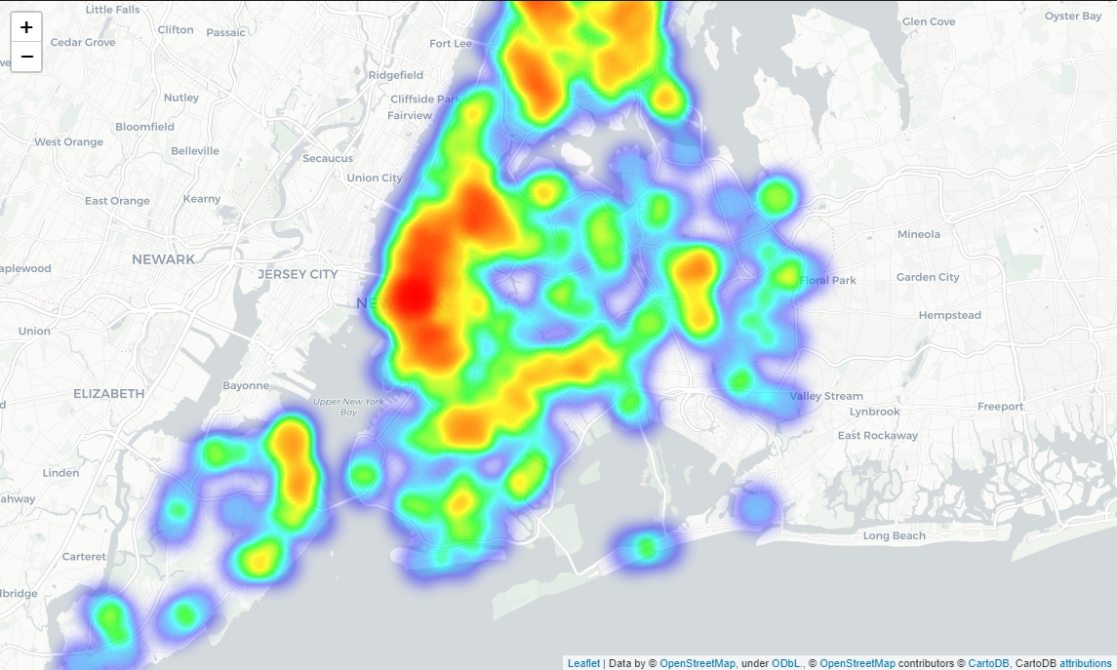
Methodology
The heatmap was created in order to detect ‘pockets’ with lower concentration of Chinese restaurants in the NYC. The results are shown in the Picture 2 below.

Slide 6
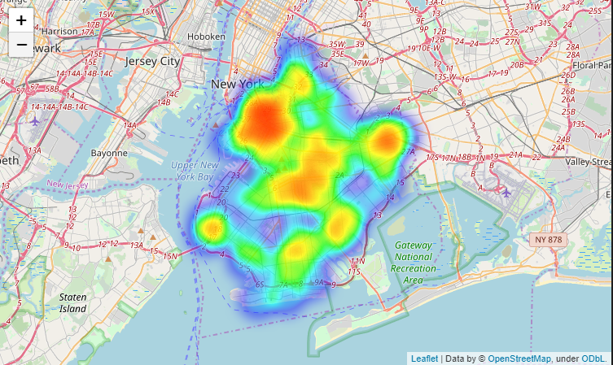
Methodology
Taking a look at the heat-map of Chinese restaurants in the Picture 3 below, it seems that the highest concentration of Chinese restaurants is close to Manhattan, near Manhattan Bridge and Brooklyn Bridge.

Slide 7
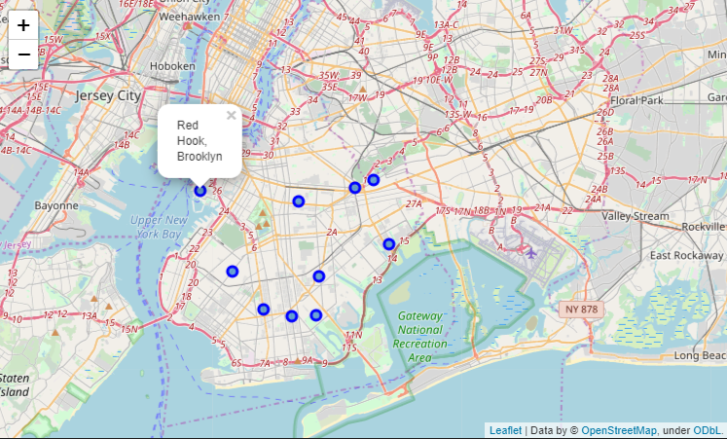
Results
Based on the previous analyses it would be worth considering Red Hook neighbourhood as a potential restaurant location, as it is close to Manhattan and has only one Chinese restaurant

Slide 8
Conclusion
To sum up, it seems that New York City has a high number of Chinese restaurants (1247 Chinese restaurants). With such competition in the business, when opening a new Chinese food restaurant it would be of vital importance to consider the location and competition in the area where you plan to open.
Considering all of the data presented above it would be reasonable to consider Brooklyn for a potential location, especially the neighbourhood Red Hook where there is only one Chinese restaurant and it is close to Manhattan.

