Slide 1
[STATIONCODE_STATIONNAME]
Appendix B – RF Predictions
3D MODEL IMAGE
Document Reference | Revision | Description of Changes | Date | Author | Checked | Approved
TCP01-BAI-COM-[STATION CODE]_0-SPE-DM-000<P> | P02 | Updated Design | <<DATE>> | <<AUTHOR>> | <<CHECKED>> | <<APPROVED>>

Slide 2
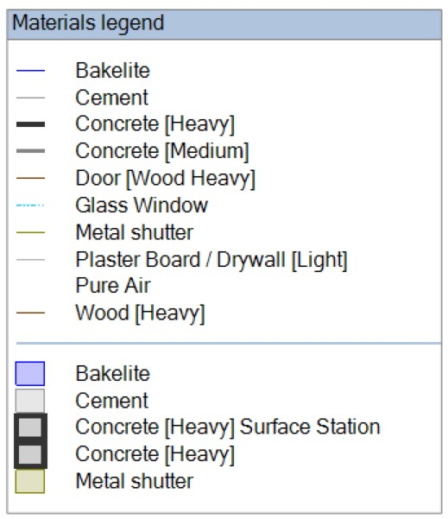
EXECUTIVE SUMMARY
This document to be read in conjunction with STATION-NAME detailed design document. This document contains RF predictions for the proposed system at STATION-NAME Station. Predictions have been carried out using industry’s renown in-building coverage prediction tool, i.e. iBwave. The plots include coverage predictions for OPERATOR-NAME across their relevant GSM / LTE / 5GNR bands. The results are presented with technology specific legends as defined within the JOTS.
The building has been concisely modelled up in iBwave for accurate production of the results. The following materials have been utilised to model up the building.

Slide 3
<<logo>>

Slide 4
<<BUILDING>>

Slide 5
<<BUILDING>>

Slide 6
<<BUILDING>>

Slide 7
<<BUILDING>>

Slide 8
<<BUILDING>>

Slide 9
<<BUILDING>>

Slide 10
<<BUILDING>>

Slide 11
<<BUILDING>>

Slide 12
<<BUILDING>>

Slide 13
<<BUILDING>>

Slide 14
<<BUILDING>>

Slide 15
<<BUILDING>>

Slide 16
<<BUILDING>>

Slide 17
<<BUILDING>>

Slide 18

<<BUILDING>>

