Slide 1
Make or Buy Model: Replacement Part Kits
Nicole Lockwood Nina Wroniak
19 October 2022
BQOM 2521

Slide 2
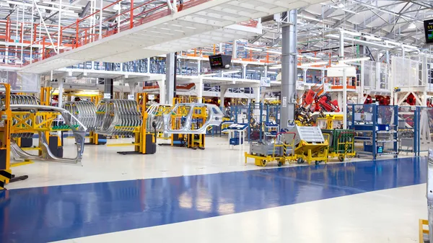
Established manufacturer builds, sells , and services medical devices globally
Replacement Part Kits are developed less than one year after product is released to field
Kits enable service centers to fix most common repairs quickly
Majority of kits are manufactured in-house with some at 3rd party vendor
Delay in release allows for time to gather information on top failures
Company is currently facing scrutiny due to recent quality issues in products
Core competencies are being reevaluated to allow for reprioritization
Other commitments for kitting operations to support company quality issues are causing compromises to be made on new kits
Projects that were delayed over past year are now high priority

Slide 3
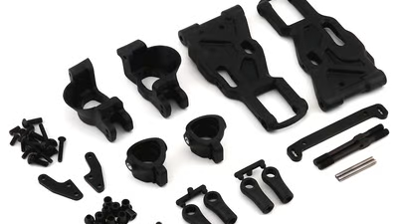
Problem Statement
Product X has released to the market for over two years, and the company must make a swift decision on the method for supplying the Replacement Part Kits

Slide 4
Several stakeholders are impacted by supply plan but only 3 have decision making power…
Procurement Strategy Engineers (PSE)
Other Stakeholders
After Market Support Production Team (AMS)
Project Manager (PM)
Operation Material Management (OMM)
Manufacturing Engineering Team (ME)
Global Product Manager (GPM)
Decision Makers
Service (SERV)

Slide 5
Criteria with influence over supply plan were considered with different scales established for each criteria…
Risk
Overall risk including quality and supply chain considerations.
Timeline
Leadtime for production startup
Flexibility
Ability to change production quota or kit contents
Demand
Ability to meet production needs for kit
Impact
Impact on production needs for other kits
Low
Medium
High
Short
Medium
Long
Improve
Same
Worsen
High
Medium
Low
No
Yes
Definition
Scales

Slide 6
Alternatives considered for kit supply plan include existing and new options…
Produce In-House
Full quality control (low risk)
Outsource to New Vendor
Protect core competencies
Outsource to Existing Vendor
Protect core competencies
Improved flexibility for changes
Production constraints due to other commitments
Reputation for good quality
Existing supply chain and channels
Shortest implementation timeline
Limited experience with contract manufacturing
Current vendor for several kitting operations
Medium implementation timeline
Longest implementation timeline
History of poor quality
Little to no existing channels

Slide 7
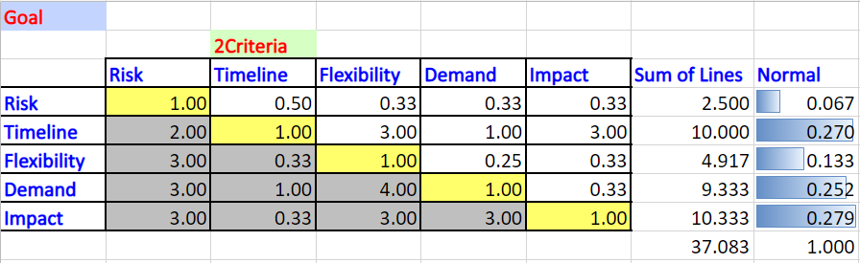
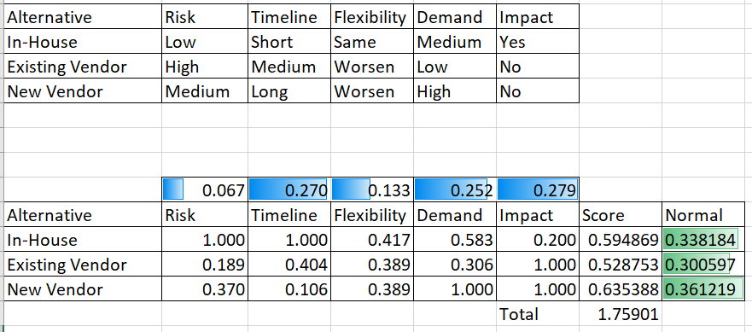
Criteria ratings output shows highest weight given to impact and implementation timeline Model output shows all alternatives closely scored with the New Vendor as the best fit

Slide 8
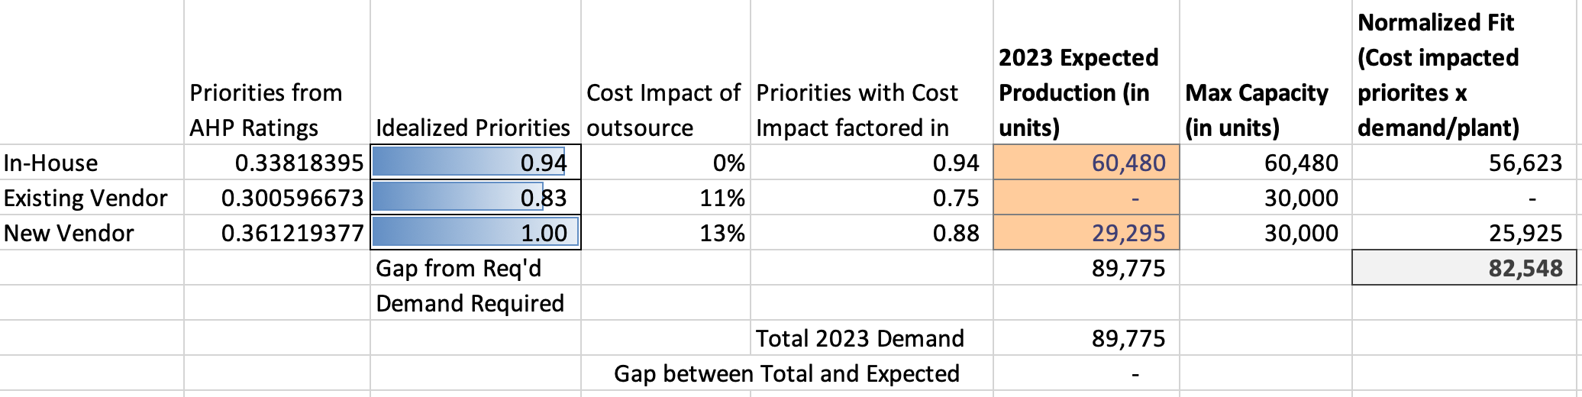
Resource Allocation model was developed using inputs from AHP, cost of alternatives, and production constraints
Idealized priorities from AHP model were adjusted to account for the cost impact of outsourcing against the in-house option*
Demand forecast for 2023 and known production capacity from 2022 used to determine optimal mix between in house/outsource
In-house option received majority of demand, impacted by the lower cost currently being pushed by the business
Additional capacity allocated to new vendor
Existing vendor to receive no additional demand (aligns with supply strategy)
*Based on average of all SKUs releasing

Slide 9
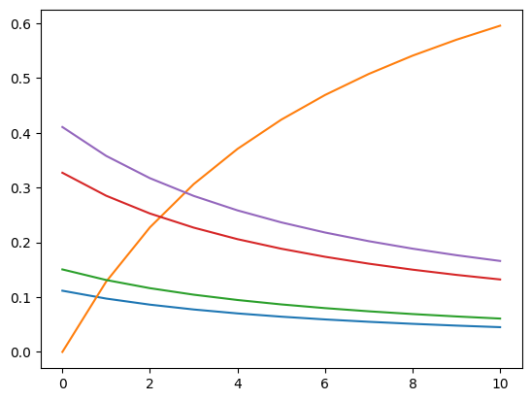
Sensitivity Analysis
cdf_calc.sensitivityCellSupermatrixPlot (super,2,"2Criteria",kitmodel)
Looks at sensitivity of risk against other decision factors

Slide 10
Thank you!
Questions?

Slide 11
Appendix

Slide 12
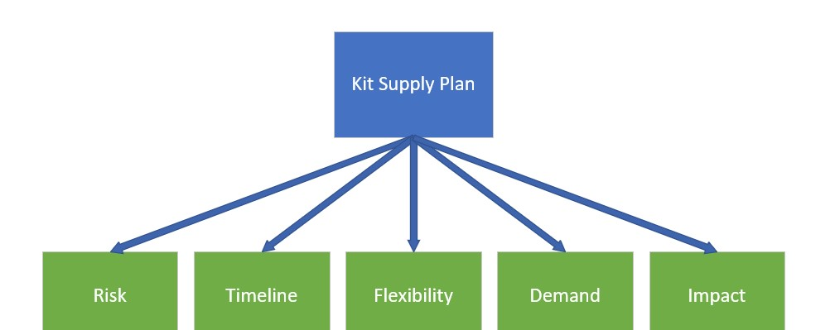
Model Diagram

Slide 13
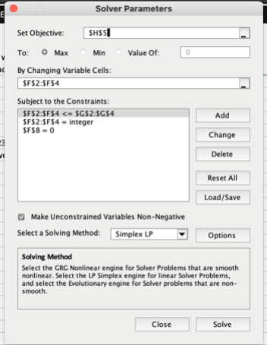
Excel Solver Inputs

Slide 14
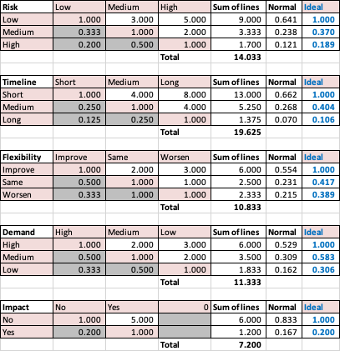
Scales for criteria

