Slide 1
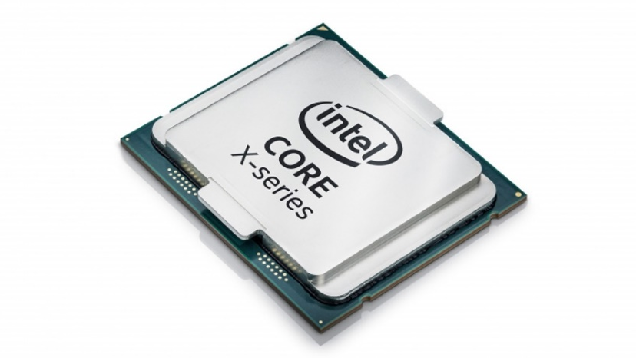
X86 memory
coherency

Slide 2

Background/Motivation

Slide 3
Virtual machines are just C/C++ programs running on real Machines like X86

Slide 4
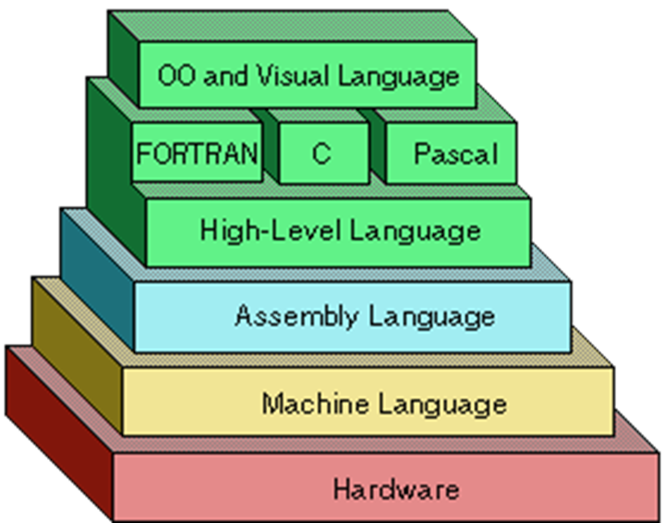
Understand from bottom up perspective (Why)
Initially out of interest and curiosity
But turned out to be useful in day job too

Slide 5
Multiprocessors reorder memory operations in unintuitive ways
This behaviour is necessary for performance but affects correctness too!
We only need to care about what we can observe in software

Slide 6
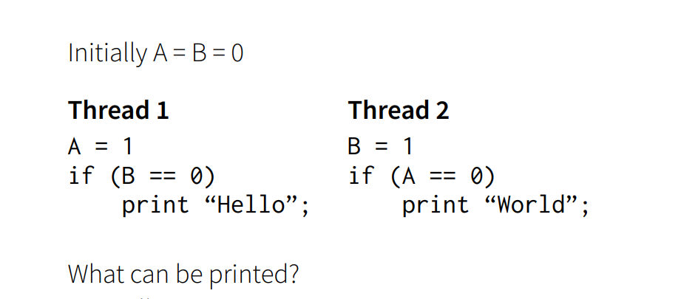
Learning through experiments

Slide 7
Single writer for each location in memory Single reader for different location can it print hello world ?

Slide 8
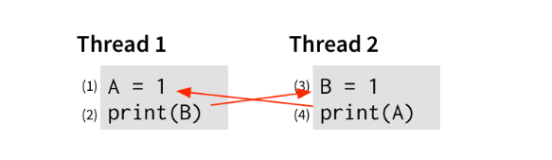
For line 2 to print 0
Print B must happen before B = 1 on Thread-2
For line 4 to print 0
Print A must happen before A = 1 on Threa-1

Slide 9
For line 2 to print 0
Print B must happen before B = 1
For line 4 to print 0
Print A must happen before A = 1

Slide 10
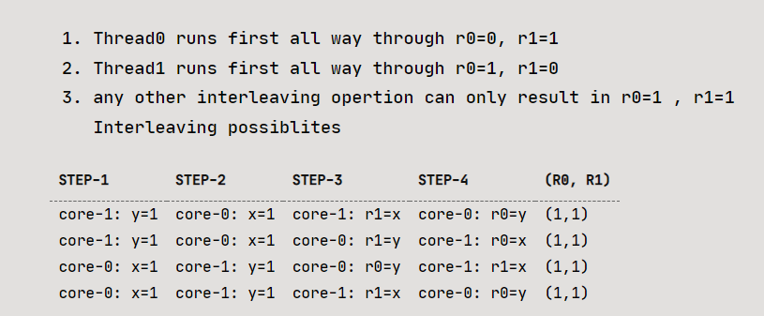
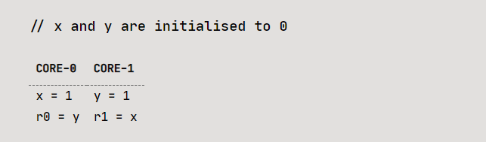
How can r0 and r1 == 0
A re-order happen

Slide 11
Who is Re-Ordering
Is it compiler ?
Is it hardware ?
Or Both

Slide 12
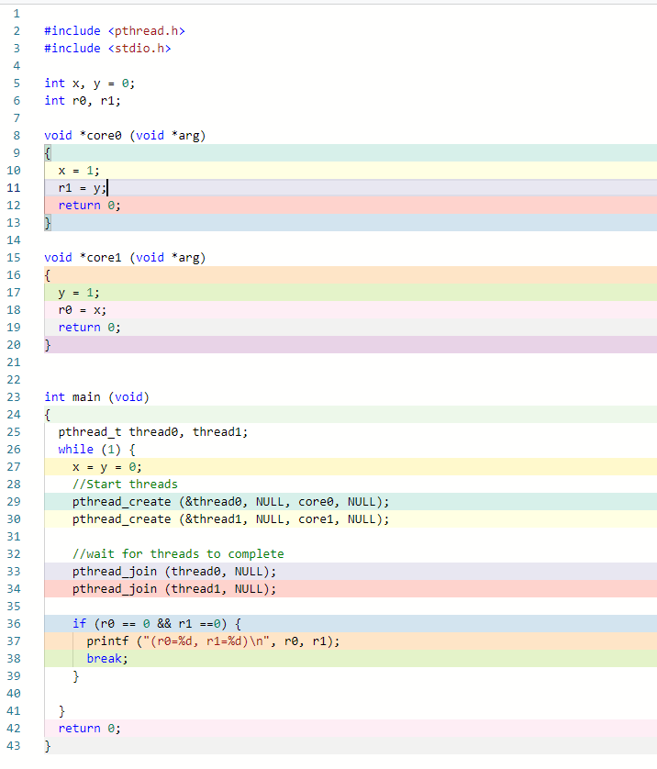
C is simple and easier to reason
So good starting point
Should only terminate if r0 and r1 equal to zero
A re-order happen

Slide 13
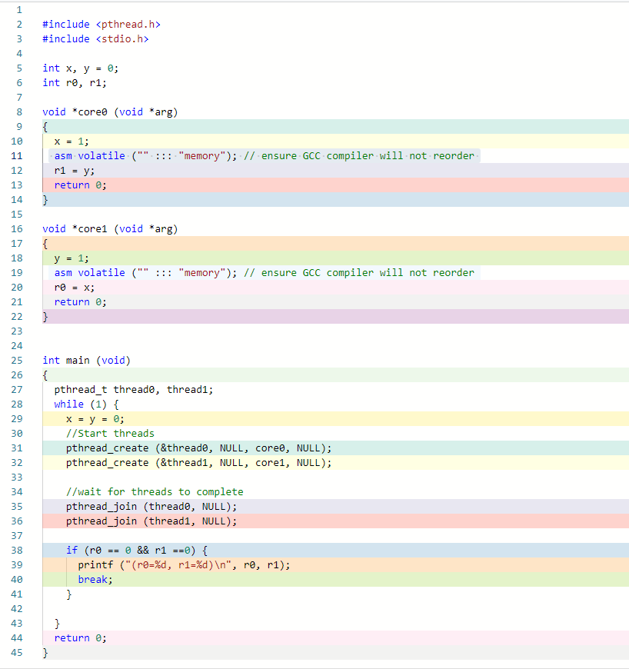
Lets rule out compiler Re-ordering
Small hack to stop GCC compiler from re-ordering
Program still terminates
Meaning a Re-order happen !

Slide 14
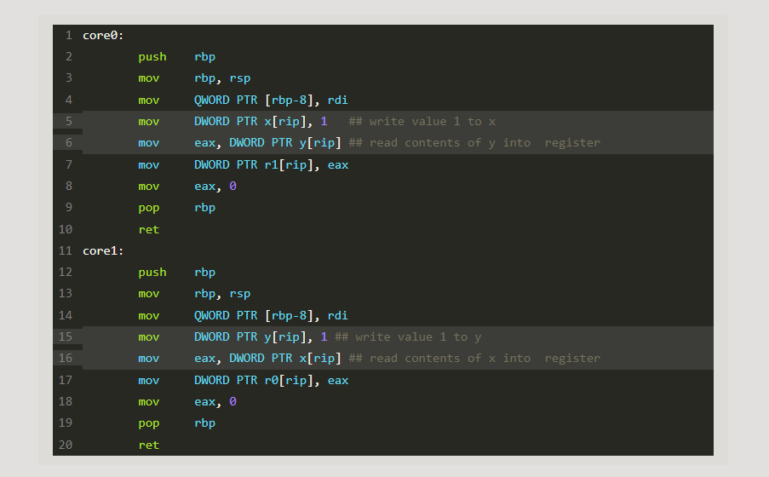
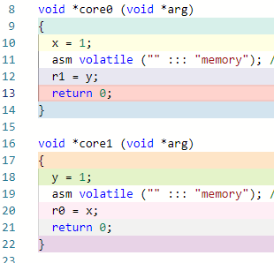
Looking at one level lower just to be sure

Slide 15
Has to be at hardware level
Writes to memory even slower than reads as more book keeping required to keep caches coherent

Slide 16
Has to be at hardware level
Remember this from last week memory is super slow
Writes to memory even slower as more book keeping required to keep caches coherent

Slide 17
Coherent Memory
Coherent memory (L1/L2/L3 caches and RAM)
Caches in CPU cores are coherent so if one CPU writes to its L1 cache, x86 hardware guarantees other CPUs will observe the change too. As software devs we don’t need to worry about coherency here

Slide 18
Non Coherent Memory
Non coherent memory (Store buffers, Load buffers, TLB, maybe more )
Store buffers (visible effect and we need to handle this)
Load Buffer (no visible effect on software on x86)
TLB (visible effect especially in mem mapped files (another presentation maybe)
Maybe others I don’t know yet but they don’t affect our software

Slide 19
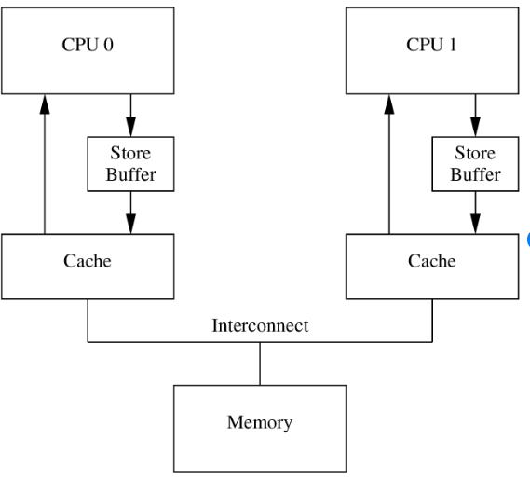
Store Buffer
Unlike Cache this affects correctness
Non-Coherent part of x86 memory

Slide 20
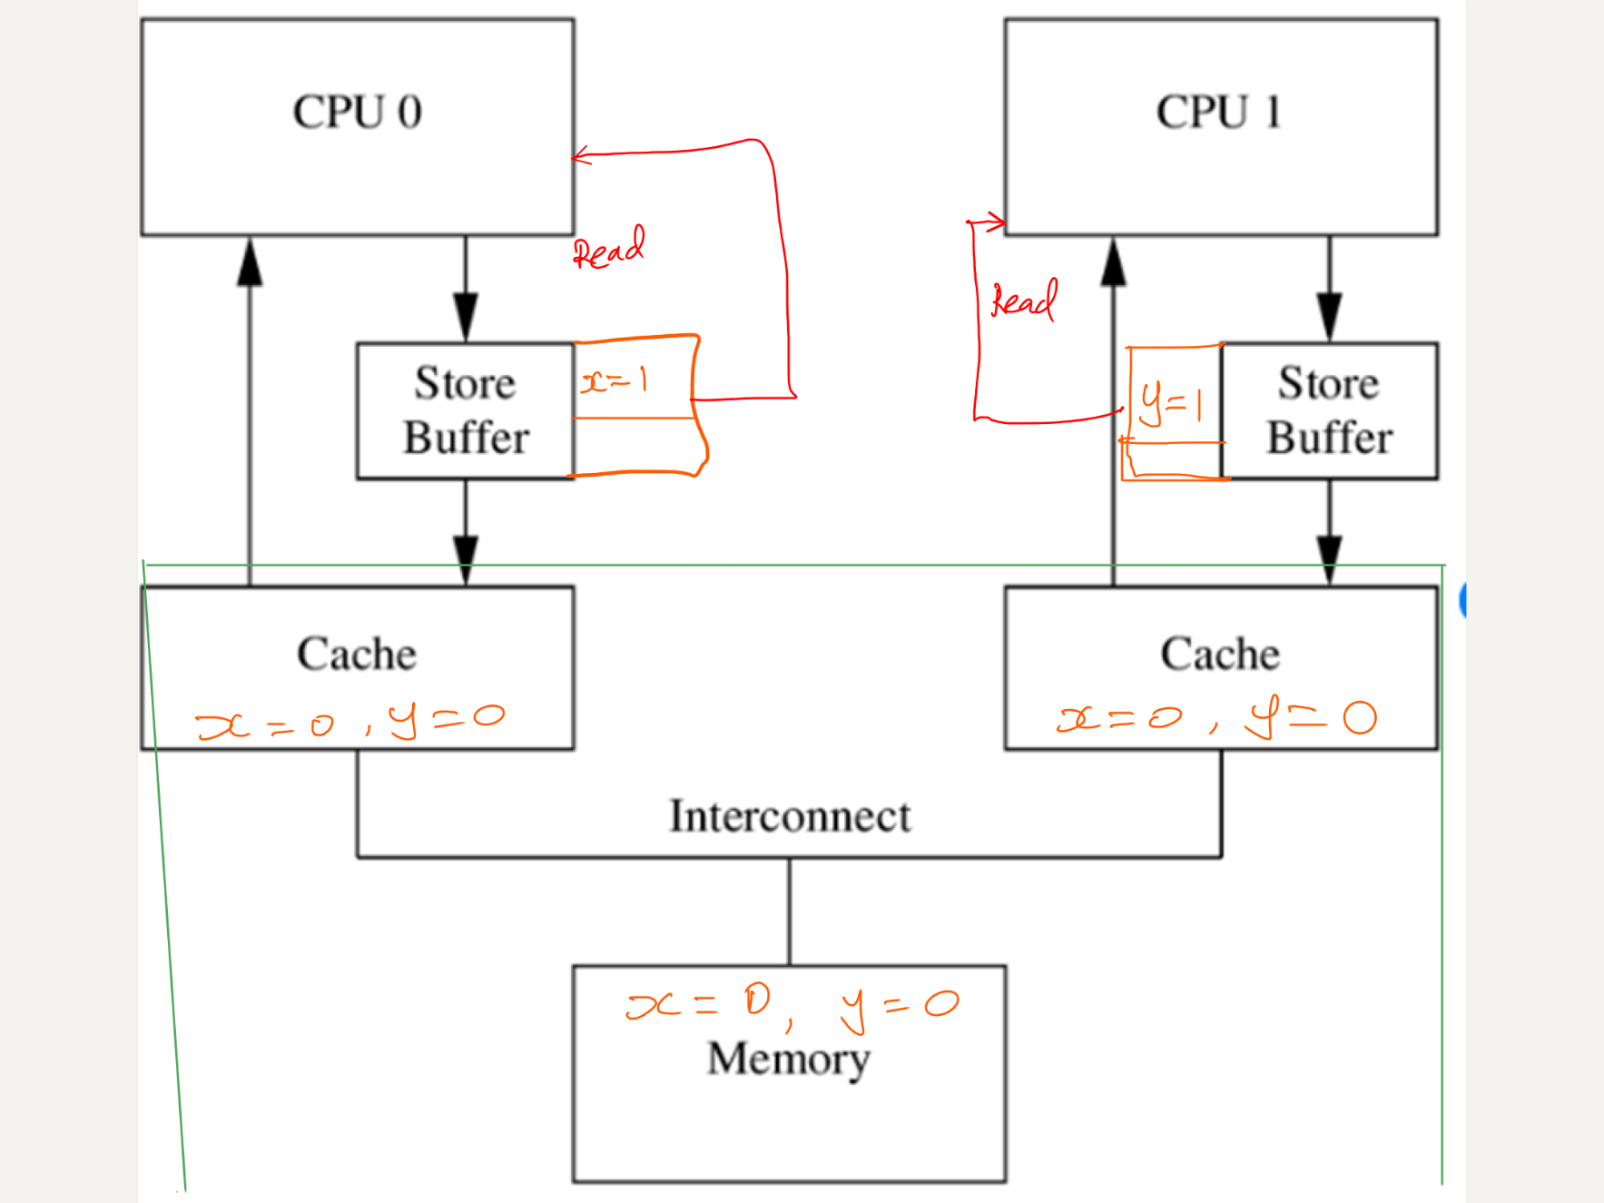
Store Buffer
Write is in Store buffer
Non-Coherent part of x86 memory
Other core cannot observer the writes

Slide 21
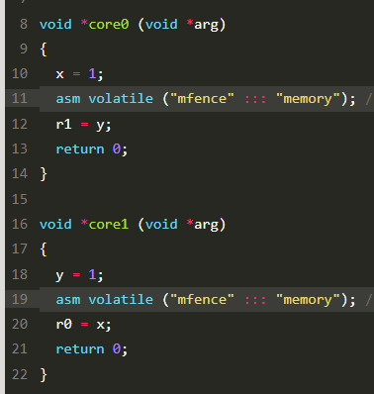
Memory Barriers
Flush Store buffer to coherent memory
CPU will stall until this is done
X86 MFENCE instruction
X86 LOCK prefix has same effect

Slide 22
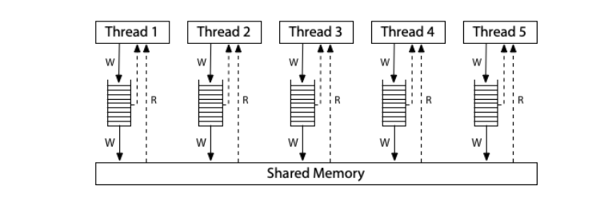
Memory Barriers
X86 is one of the easiest architectures to understand
Only Write and Read can be re-ordered
Write and Write don’t get re-ordered or we cannot observe from software
Read followed by Write is not Reordered
Read followed by Read is also not reordered
Simple model on right is enough

Slide 23
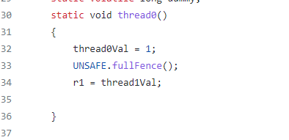
Moving up Stack to JAVA
Flush Store buffer to coherent memory
CPU will stall until this is done
X86 MFENCE instruction
X86 LOCK prefix has same effect

Slide 24
X86 is one of the easiest architectures to understand
ARM and other are bit more complex, more possible re-ordering possible

