Slide 1
Nintendo DS Family
Isaiah Solomon
icsolomo
October 5, 2016

Slide 2
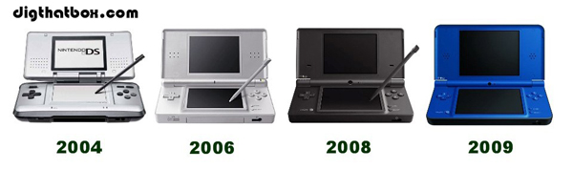
This image displays the many different types of Nintendo DS’s made throughout the years. You can see each model becoming more compact, yet more powerful than the previous models.
Click for more history

Slide 3
Chart of Different Models
This chart signifies my enjoyment of each specific model. I really enjoyed the original model; however, I learned to also enjoy the later models as well.

Slide 4
Pros and Cons for each Model
Nintendo DS
  Original
Nintendo DS Lite
  Lighter
  Cheaper and more durable than original
Nintendo Dsi
  New Software
  More expensive
Nintendo Dsi XL
  Better specs
  Even more expensive

