Slide 1
Flight Delay Analysis and Prediction Using Machine Learning
Exploring Causes and Predicting Delays in the Aviation Industry
Presented by: Isaiah Heyward

Slide 2
Problem Statement
Flight delays impact passengers and airlines, costing billions annually. Delays stem from multiple causes:
- Air carrier inefficiencies
- Late-arriving aircraft
- National aviation system issues
- Security procedures
Objective: Analyze delay causes and predict total delays using machine learning.

Slide 3
Dataset Overview
Sourced from the Bureau of Transportation Statistics, the dataset contains aggregated annual data from 2010–2022, including:
- Air Carrier Delay
- Aircraft Arriving Late
- National Aviation System Delay
- Security Delay
- Total Delay (target variable)
Challenges: Small size and lack of flight-level granularity.

Slide 4
Data Cleaning and Preprocessing
1. Removed unnecessary columns.
2. Handled missing values using the median.
3. Standardized features for clustering analysis.
4. Simulated SQL-like workflows in Python for preprocessing.

Slide 5
Exploratory Data Analysis
Statistical summaries revealed averages for delay causes.
Visualizations provided insights into:
- Trends in delays over time
- Relationships between delay causes
Highlighted patterns in the data for further analysis.

Slide 6
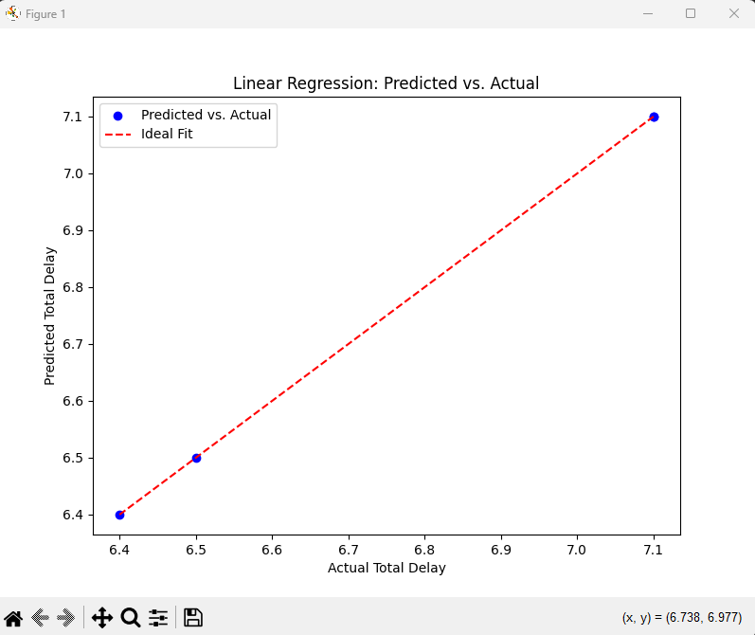
Linear Regression Results

Slide 7
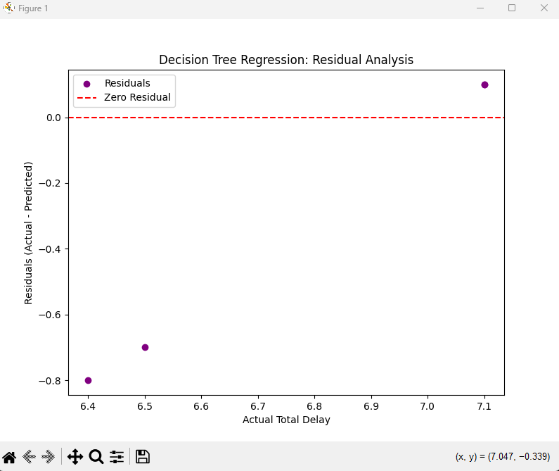
Decision Tree Regression Results

Slide 8
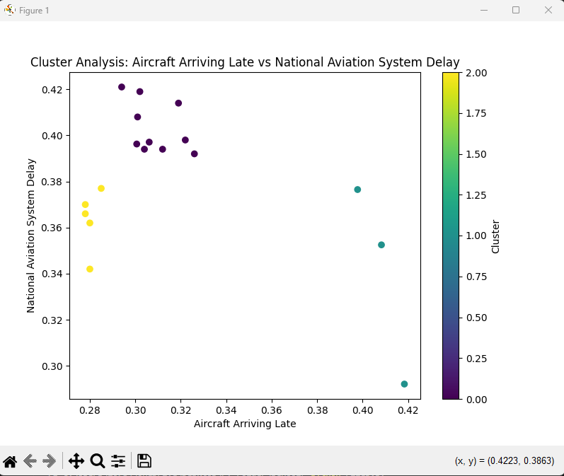
Clustering Analysis Results

Slide 9
Challenges
1. Small dataset size limited model performance.
2. Lack of flight-level granularity restricted insights.

Slide 10
Conclusions
Conclusions:
- Machine learning effectively analyzed and predicted delays.
- Linear Regression performed well; Clustering uncovered delay patterns.
- Decision Tree highlighted dataset limitations.

