Slide 1
Book3_tableau
File created on: 4/11/21 12:44:13 AM EDT

Slide 2
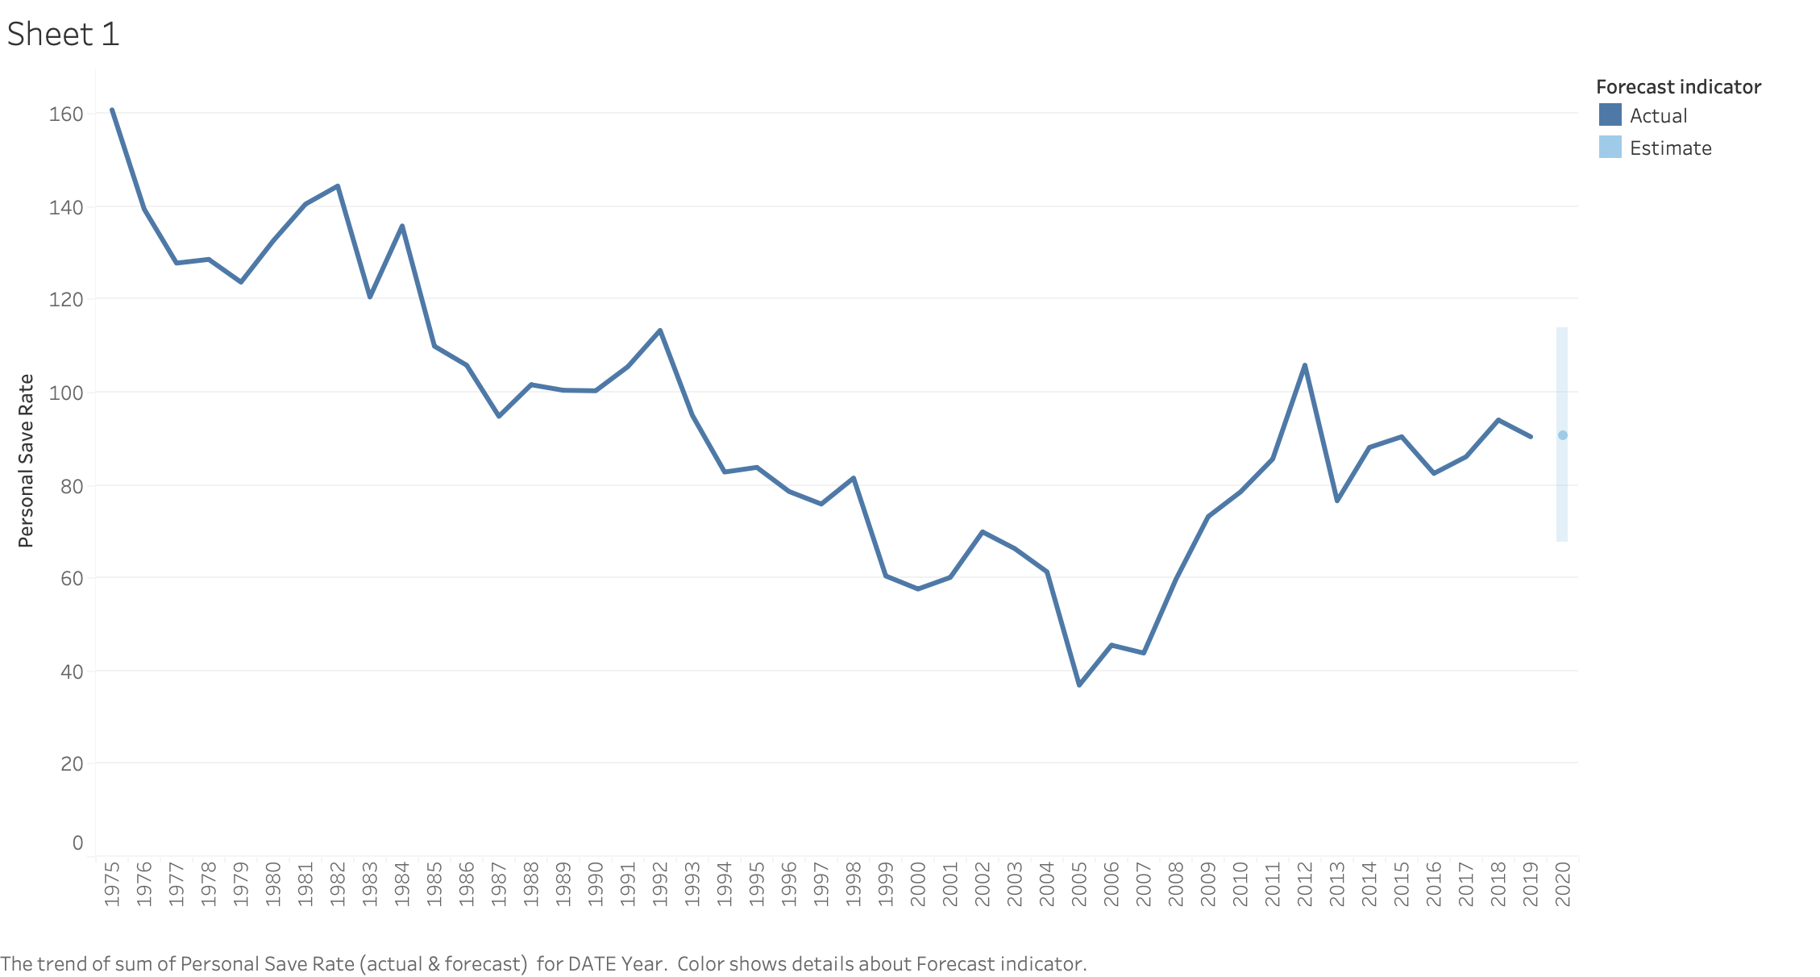

Slide 3
