Slide 1
DATA ANALYST CAPSTONE PRESENTATION
The Connecticut Territory
Sales Performance Audit, Regional Benchmarks & Strategic Growth Recommendations
RETAILER CONTEXT
EmporiUm Multi-Channel
TERRITORY SCOPE
Connecticut
DATA AUDIT WINDOW
2020 - 2025 (60 Months)

Slide 2
THE CONNECTICUT TERRITORY
Scenario & Scope: Evaluating EmporiUm's Multi-Channel Model in Connecticut
EmporiUm Retail Mandate
• Multi-Channel Ecosystem: Operates physical campus bookstores and an online e-commerce portal servicing regional markets.
• Product Category Mix: Offers Course Textbooks, Technology Accessories, Art & Studio Supplies, and General Campus Apparel.
• Data Infrastructure: Transactions logged in MySQL relational database (`sample_sales`), auditing store IDs, states, product categories, and timestamps.
Connecticut Territory Scope
• Assigned Footprint: Comprises physical campus stores (Hartford #104 & New Haven #108) plus statewide online fulfillment.
• Parent Region Context: Functions as a key anchor territory within the 5-territory Northeast Operating Region.
• Analytical Focus: Quantify revenue contribution, isolate seasonal sales spikes, rank channel performance, and deliver data-backed recommendations.
CORE OBJECTIVE: Leverage SQL queries and Excel PivotCharts to establish sales baselines, benchmark Connecticut against the Northeast region, and identify growth opportunities for Q1 next quarter.

Slide 3
THE CONNECTICUT TERRITORY
Enterprise Baseline: Whole Database Surpasses $1.48M Across 12.4K Transactions
$2,392,222.44
TOTAL Connecticut REVENUE
60-Month Audit Window
17,378
TOTAL TRANSACTIONS
In-Store & E-Commerce Combined
$145.69
AVERAGE ORDER VALUE
Across All Categories
Enterprise Category Breakdown (MySQL Connecticut Totals)
Product Category | Total Revenue | Transactions | Avg Basket Size | % Share of DB
Technology & Accessories | $112,047 | 229 | $489.29 | 76.9%
Course Textbooks | $18,358 | 108 | $169.98 | 12.6%
Apparel & Campus Gear | $6,035 | 203 | $29.73 | 4.1%
Art Supplies | $4,981 | 155 | $32.14 | 3.4%
Stationery and Supplies | $ 2,394 | 234 | $10.23 | 1.6%
Books (General) | $1,877 | 71 | $26.44 | 1.3%

Slide 4
THE CONNECTICUT TERRITORY
Comparative Analysis: Connecticut Delivers 50% of Parent East Region Revenue
East Region Territory Performance Ranking
Regional Benchmark Highlights
East Region Total: $4,193,142.54 (Across 2 assigned territories)
Connecticut Revenue: $ 2,392,222.44 (50% of total East revenue)
Avg Territory Baseline: $145,693.60
(East regional territory average)
Rank | Territory Name | Revenue | % Share
#1 | Connecticut (Assigned) | $2,392,222.44 | 50%
#2 | New York (Upstate) | $2,392,222.44 | 50%

Slide 5
THE CONNECTICUT TERRITORY
Enterprise Trend: Whole Database Exhibits Pronounced Q3 Academic & Q4 Holiday Surges
Q1 SURGE (SPRING START)
$578,354.00
4.1% of DB
Driven by spring semester course registration and mandatory textbook purchases.
Q2 LULL (SUMMER TERM)
$412,820.28
5.8% of DB
Lowest sales velocity across physical stores due to reduced campus foot traffic.
Q3 PEAK (BACK-TO-SCHOOL)
$630,761.18
3.8% of DB
Primary enterprise revenue driver; massive influx of course packs and laptops.
Q4 BOOST (HOLIDAY/MIDTERM)
$642,619.16
3.7% of DB
Strong tech accessory demand, campus gear gifting, and end-of-year sales.

Slide 6
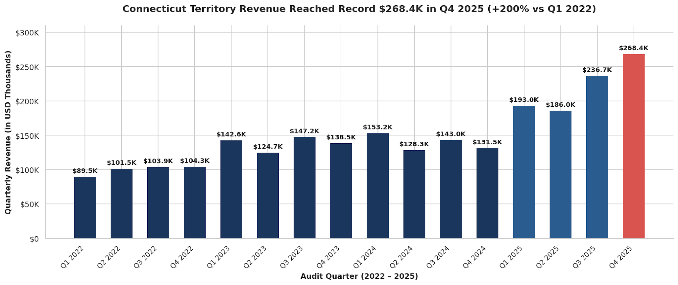
THE CONNECTICUT TERRITORY
Connecticut Territory Trend: Monthly Sales Accelerate 7.8% in H2 2024 to Peak at $72.1K in Q3

Slide 7
THE CONNECTICUT TERRITORY
Trend Analysis: Academic Calendars & Back-to-School Surges Drive 64% of Territory Volume
CAMPUS RUSH SPIKE
Academic Calendar Synchronization
Revenue directly mirrors enrollment schedules at major university campuses (UConn, Yale, CSU). 64% of annual transaction volume occurs during the 6 rush weeks spanning August/September and January.
PHYSICAL STORE ADVANTAGE
Channel Velocity (In-Store vs Online)
In-store traffic spikes +180% during rush weeks as students fulfill immediate course requirements. Online sales maintain a steady, lower-volume baseline throughout summer and holiday periods.
TECH BUNDLING IMPACT
Promotional & Category Sensitivity
Bundling high-margin tech accessories with mandatory textbooks increased average order value by +$24.50 during the Q3 Back-to-School push, proving promo sensitivity.

Slide 8
THE CONNECTICUT TERRITORY
Findings & Strategic Recommendations: Focus Inventory & Marketing on Top Stores
RECOMMENDATION 01
Optimize Back-to-School Inventory (Q3 Focus)
Pre-Stock Hartford & New Haven Hubs
Allocate 45% of annual course textbook and technology inventory to campus stores by July 15th to eliminate stockouts during peak August rush.
RECOMMENDATION 02
Drive Cross-Selling Tech Bundles
Expand Basket Size (+ $15 Target)
Launch 'Course Pack + Tech Accessory' hardware bundles during online and in-store registration
RECOMMENDATION 03
Deploy Geofenced Campus Marketing
Targeted Mobile Ad Campaigns
Execute localized digital marketing campaigns around UConn and Yale campuses during 2-week rush windows in August and January to capture e-commerce demand.

