Slide 1
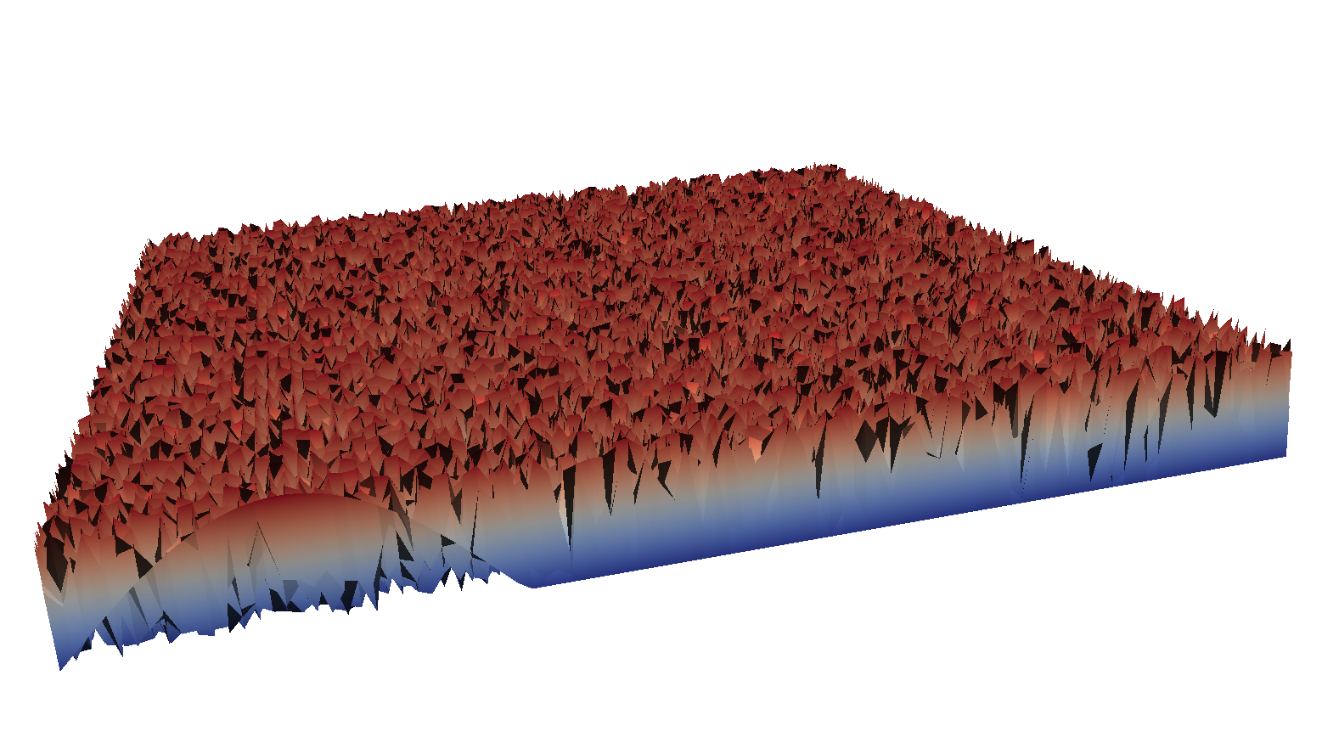
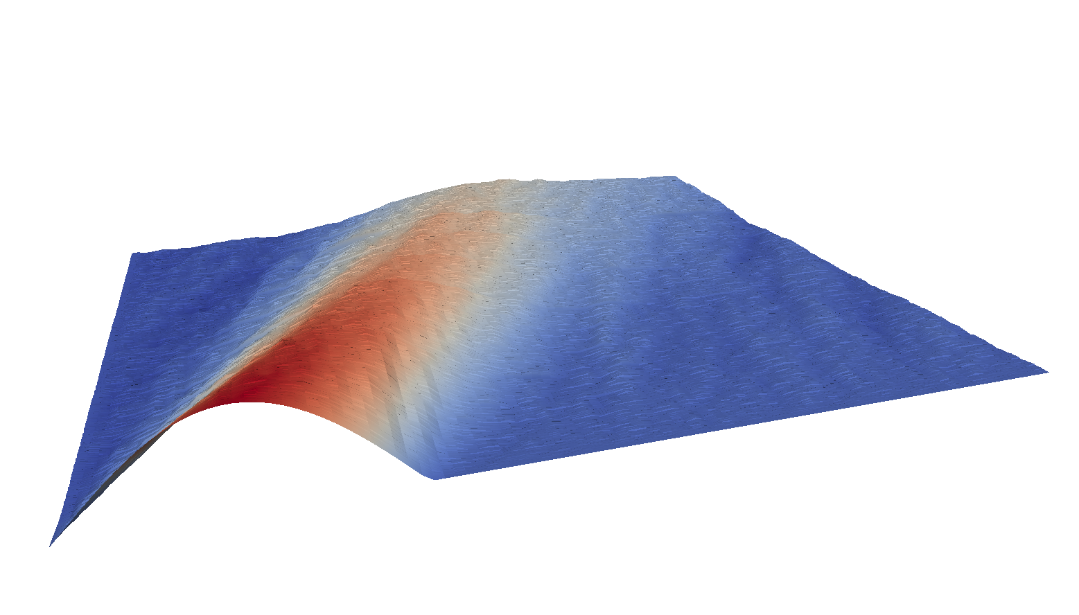
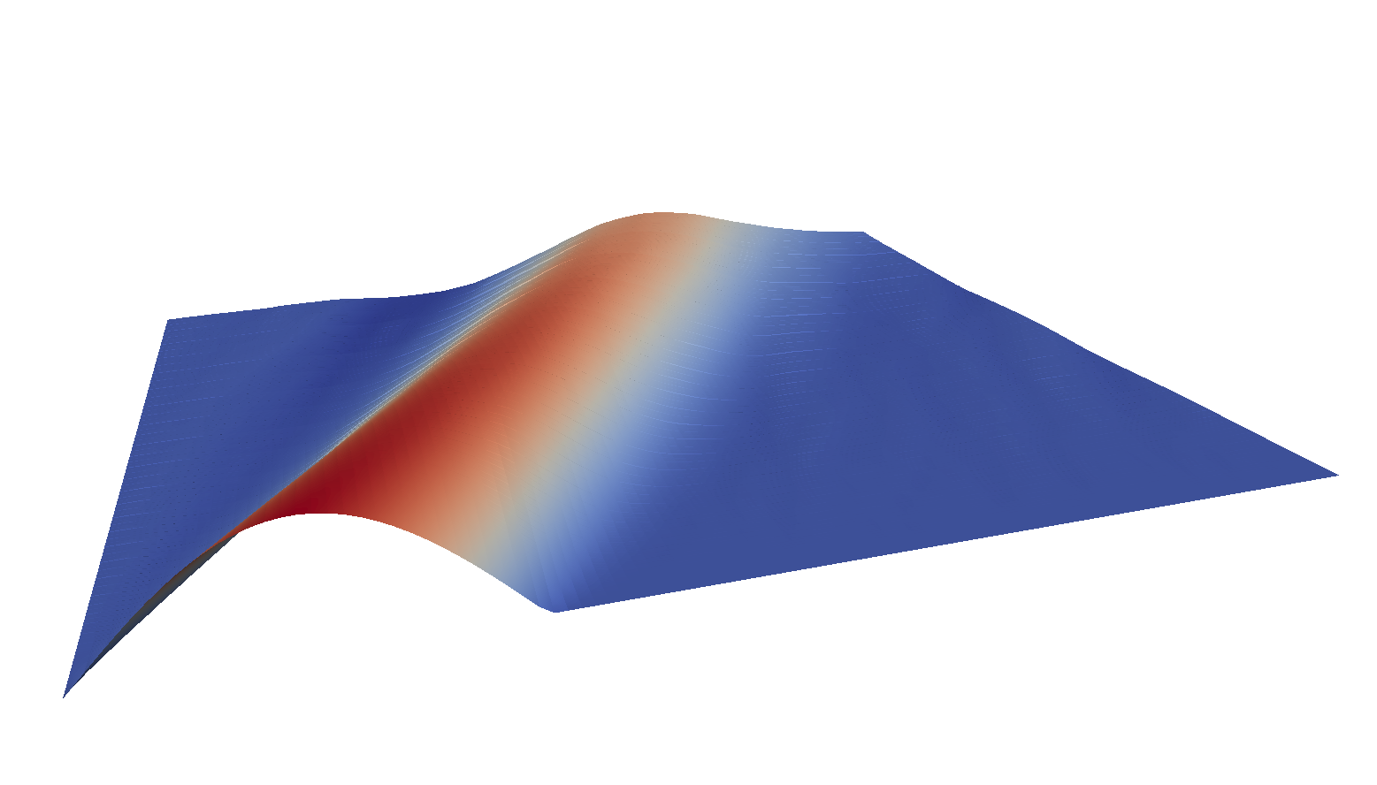
Initial Space-Time Guess
Iterate
Converge
Time
Space
Time
Space
Time
Space

Slide 2
Initial Space-Time Guess
Iterate
Converge
Time
Space
Time
Space
Time
Space

Slide 3
Logo brainstorming to hand off to TID.
Braid
t
Braid
Time-Braid: Multigrid in Time Solvers
Notes:
1.\quad & x\mbox{Braid} & \quad \mbox{A math font x in front of Braid}\\
2.\quad & \chi\mbox{Braid} & \quad \mbox{A chi in front of Braid}\\
3.\quad & \mbox{xBraid} & \quad \mbox{A regular font x in front of Braid}\\
4.\quad & \mbox{XBraid} & \quad \mbox{A regular font X in front of Braid} \\

