Slide 1
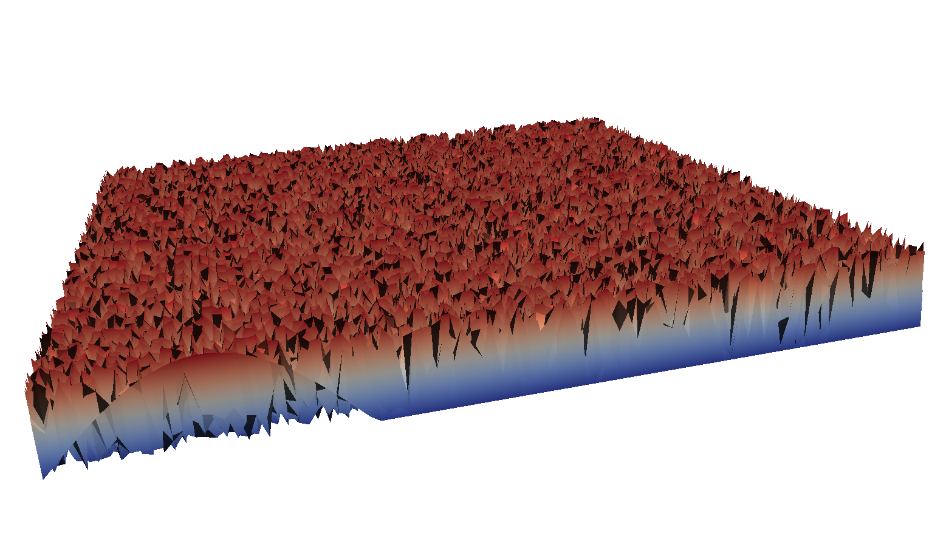
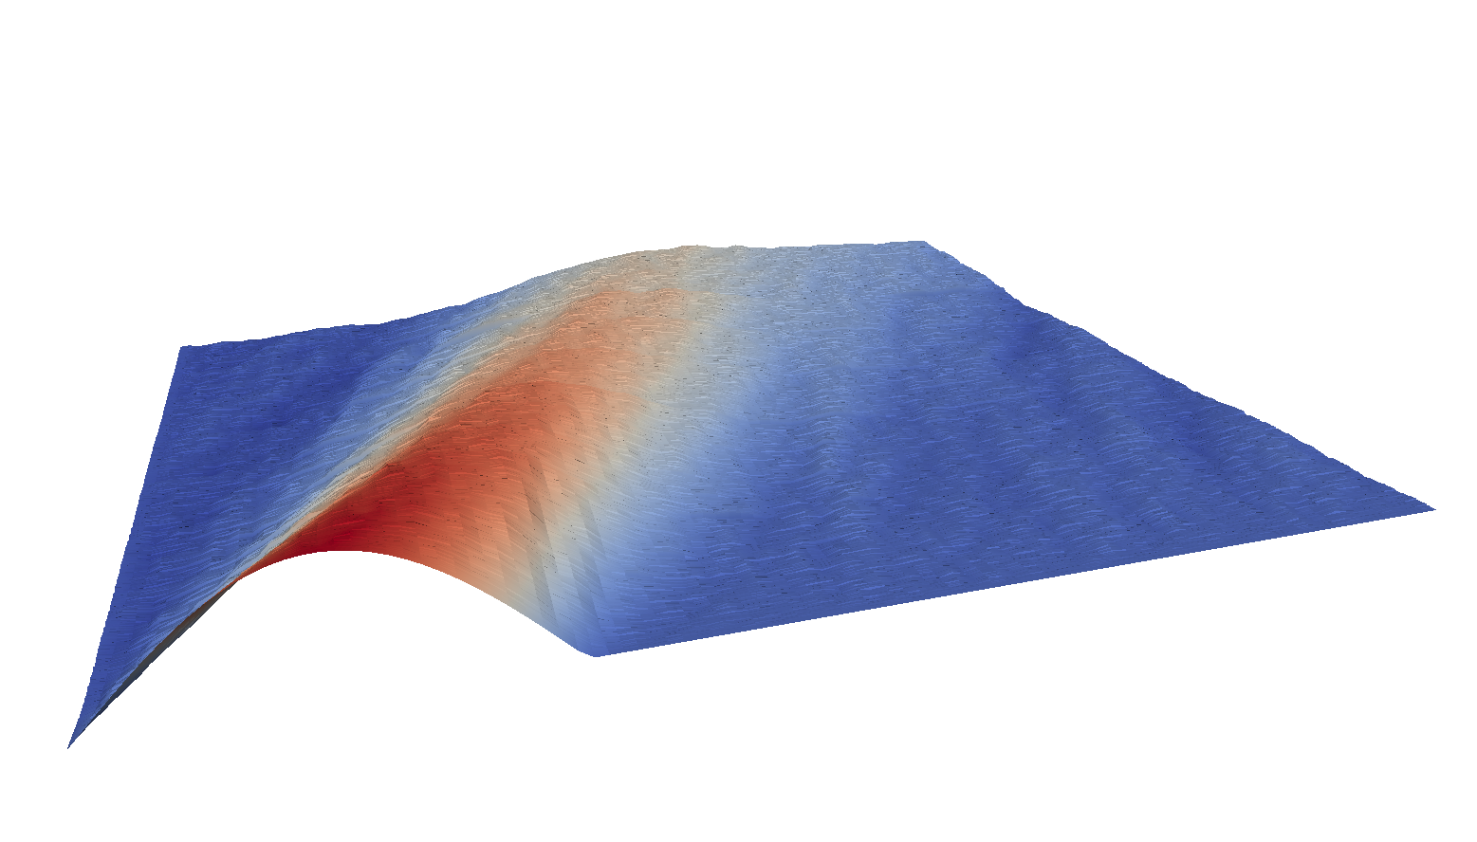
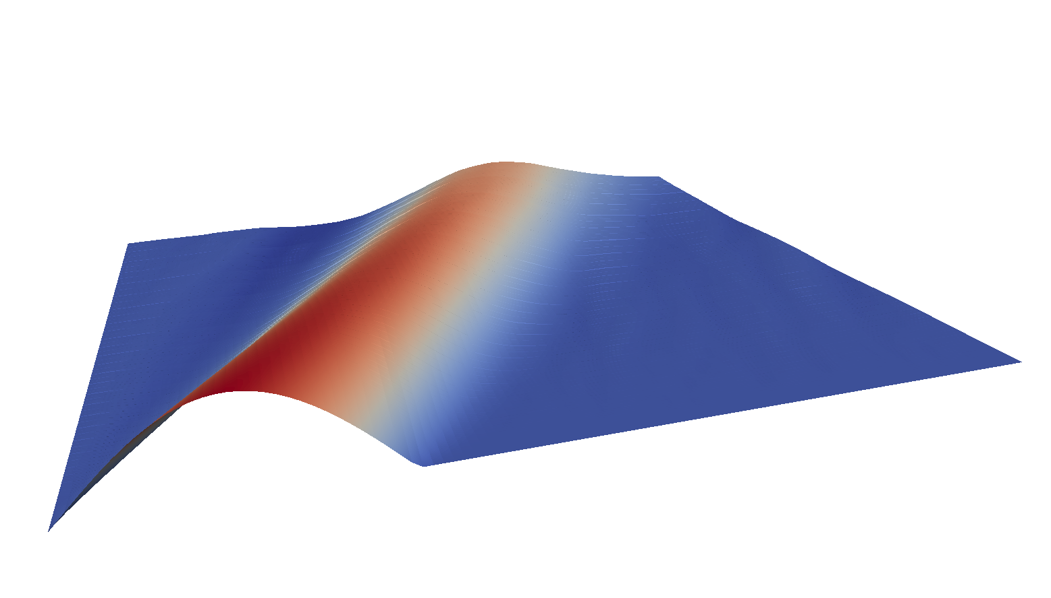
Iteration 0
Iteration 1
Iteration 2
Time
prolongation
(interpolation)
Time
prolongation
(interpolation)
Time
prolongation
(interpolation)
Space
Space
Space
Relaxation on fine time grid
restriction
Relaxation on fine time grid
restriction
Relaxation on fine time grid
restriction
Note: smaller grid
with fewer time values
Note: smaller grid
with fewer time values
Note: smaller grid
with fewer time values
Relaxation on first coarse grid
Relaxation on first coarse grid
Relaxation on first coarse grid

Slide 2
Iteration 0
Iteration 1
Iteration 2
Time
prolongation
(interpolation)
Time
Time
Space
Space
Space
Relaxation on fine time grid
restriction
Note: smaller grid
with fewer time values
Relaxation on first coarse grid

