Slide 1
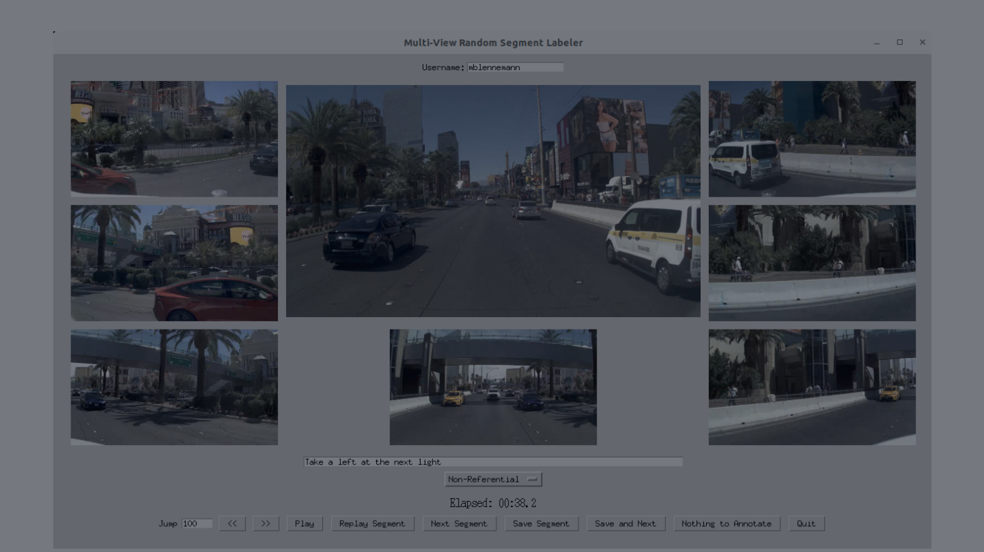
doPlan
Annotating Long-Horizon
Driving Instructions
Summer Research Oral Presentation
Isaiah Ramirez • Mi³ Lab • Dr. Ross Greer
Natural language × autonomous driving
Annotation perspective
Notes:
Open by framing the talk as your summer research contribution. Say: This summer I worked with the Mi3 lab on doPlan, a dataset for teaching autonomous driving systems to understand passenger-style driving instructions. My role was annotation, so this talk focuses on what the dataset is, why it matters, and what I learned by helping create labels.

Slide 2
MOTIVATION
Why language matters in driving
Imagine riding in a self-driving taxi.
Core question
Passenger says:
Autonomous vehicle must connect:
How do we train AVs to understand instructions the way a human driver would?
“Turn left at the light.”
language
road context
“Go around that truck.”
traffic agents
“Drop me off near the entrance.”
planning over time
doPlan addresses this through passenger-centered annotation.
Notes:
Use this slide as the hook. The point is not just commands like turn left. The hard part is combining language with the scene and with planning over time. Mention that the paper motivates doPlan around passenger intent and long-horizon interaction.

Slide 3
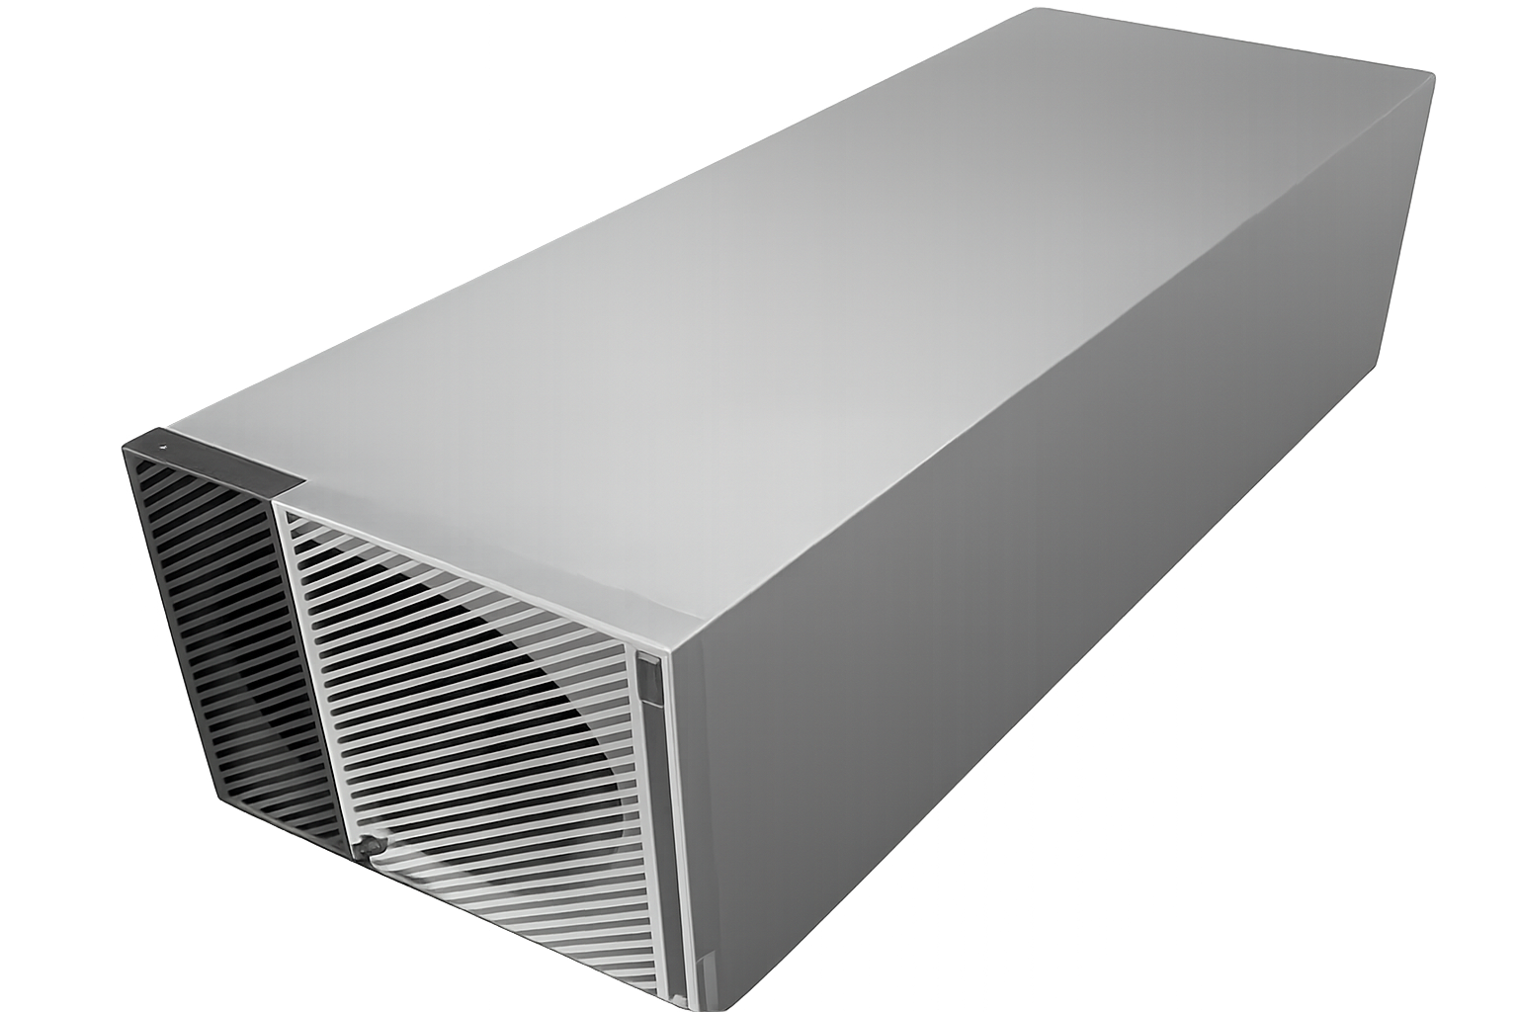
WHY NOW
New hardware makes language-guided driving practical
From annotation to an autonomous vehicle
doPlan labels
Training data
VLA model
AV
human passenger instructions
examples for future models
language + vision + action
real-time decisions
Dataset side
Hardware side
Engineering connection
doPlan helps teach what a passenger means over time.
Platforms like DRIVE AGX Thor are designed run advanced AI in vehicles.
The dataset only matters if future models can run on real vehicle hardware.
‹#›

Slide 4
DATASET LANDSCAPE
Where doPlan fits
KITTI
Perception
object detection, depth
nuScenes
Scene understanding
multi-sensor urban data
Waymo
Prediction
large-scale motion data
nuPlan
Planning
long-horizon trajectories
doScenes
Language + scenes
shorter scene instructions
doPlan
Passenger instructions
long-horizon language-guided planning
doPlan builds on nuPlan, but adds human-written passenger instructions over variable-length driving segments.
Notes:
Explain this quickly. The main point is that many autonomous driving datasets are very useful, but they are not primarily about natural language instruction following. doPlan is complementary: it builds on nuPlan and adds language annotations.

Slide 5
PROJECT OVERVIEW
What is doPlan?
A dataset that pairs driving scenes with passenger-style instructions.
nuPlan
Random
segment
Annotator
doPlan
driving data
10s+ windows
passenger view
instruction + tag
Built on nuPlan driving data
Uses variable-length clips
Captures intent, not scene captions
Adds referential tags
Goal
Support future models that can connect language, perception, and planning over time.
Notes:
This is the plain English description. A dataset is not just a folder of videos. doPlan is the process of taking driving clips, having people write instructions, and creating data that can train and evaluate future models.

Slide 6
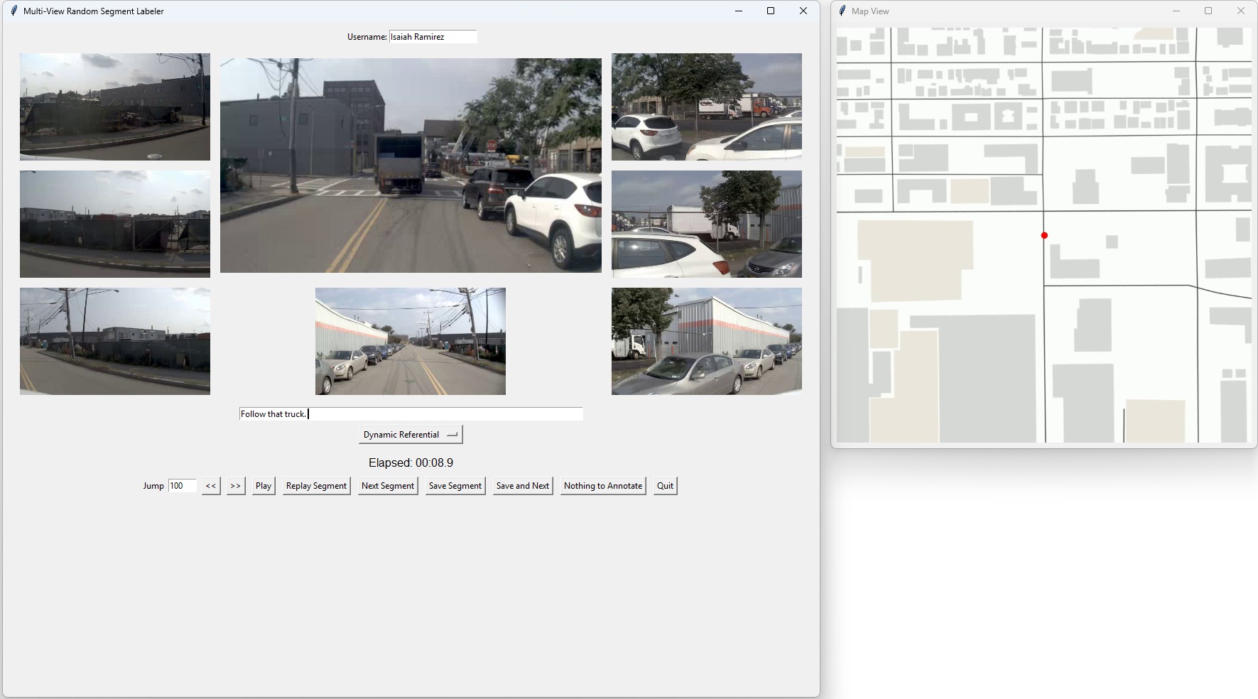
WHAT I USED
The annotation interface
Multi-view camera context
front, side, rear views
Map context
route position + landmarks
Instruction box
what would you tell the driver?
Referential class
non-referential, static, dynamic, combined
Prompt: “If you were being driven by a taxi driver, what instruction would you give?”
Notes:
Show what you actually used. Mention that the interface gives camera views and map context, but it does not give bounding boxes or machine-labeled objects. You had to reason like a human passenger.

Slide 7
MY ROLE
My annotation workflow
1
2
3
4
Watch the clip
Think like a passenger
Write the instruction
Assign a tag
Observe the full driving segment
What would I say to the driver?
Using natural language
Choose the referential class
Notes:
This slide centers your actual contribution. Say that your job was to generate labels that could later be used as training examples. You can say: I had to avoid describing what happened and instead write what I would tell a driver to cause that behavior.

Slide 8
ANNOTATION PHILOSOPHY
Instruction, not description
The output should sound like something a passenger would say.
Descriptions
Instructions
✕
The car turns left.
✓
Turn left.
✕
The vehicle slows down.
✓
Slow down.
✕
The SUV changes lanes.
✓
Merge into the left lane.
Notes:
Use your own examples. Emphasize that the difference is subtle but important. A description says what the car did. An instruction says what you would tell the driver. This is the central mindset for doPlan annotation.

Slide 9
TAGS
Referential classes
Each instruction also gets a lightweight tag describing what it refers to.
Non-referential
Static
↱
⌂
“Turn left.”
“Turn at the stop sign.”
No specific object or landmark
Fixed road feature or landmark
Dynamic
Combined
▣
⌂+
“Go around the truck.”
“Merge behind the bus near the intersection.”
Vehicle, pedestrian, cyclist, etc.
Static + dynamic references
Notes:
Explain the categories simply. Do not spend too long here. The most useful examples are ones you encountered: Turn left is non-referential, turn left at the light is static, go around the fire truck is dynamic.

Slide 10
ANNOTATION IS HARDER THAN IT LOOKS
Challenges I ran into
Unknown destination
High-level vs. turn-by-turn
Sometimes a clip shows several turns, but the final goal is not obvious.
If the intent is clear, use one high-level instruction. If not, stay grounded in the visible clip.
Natural language variation
Consistency
Two annotators can describe the same behavior differently.
Small wording differences affect the dataset labels.
For very long clips, try to generate a high-level instruction that captures the overall intent.
Notes:
This is a good place to show that you learned from the annotation process. Mention the Slack discussion: for very long clips, Marcus suggested generating a high-level instruction if possible, such as go to the park or wherever the final destination is. If the destination is not visible, do not invent it.

Slide 11
CURRENT PROGRESS
Dataset building is a human process
A dataset like doPlan grows through many small annotation decisions.
~1.6k
~15
~2 min
labels so far
annotators involved
per annotation
Long-term target scale
1.6k
10k+ annotated segments
There is a long-term target of 10,000–100,000 annotated instruction segments.
Notes:
This slide helps the audience understand the labor behind the dataset. You can say the exact current number may change, but around the time of the lab discussion there were about 1,100 labels. The paper’s longer term target is much larger.

Slide 12
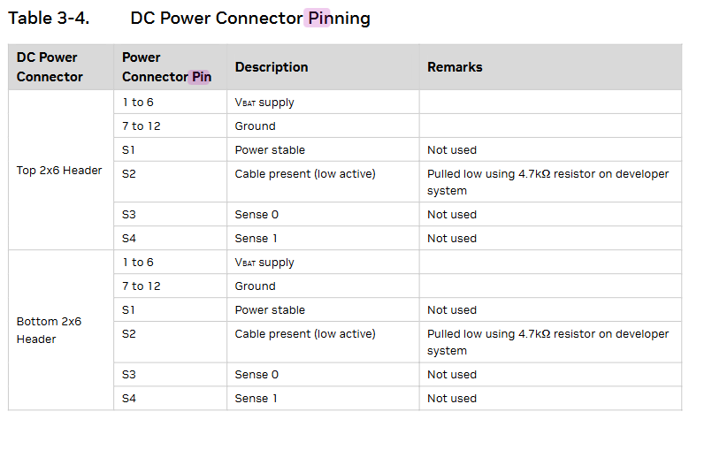
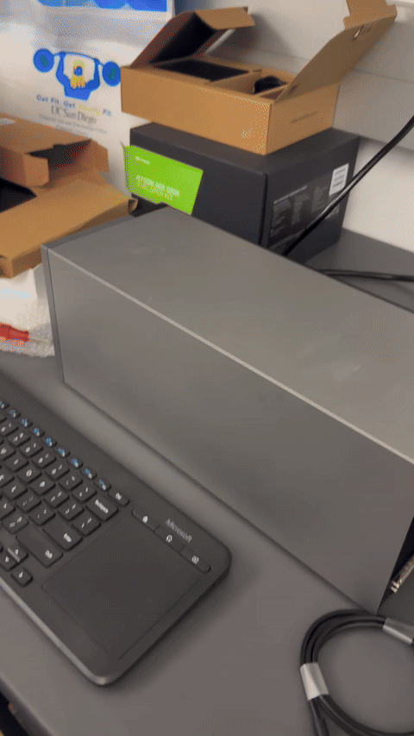
HARDWARE SIDE
My Thor work: building a bench power harness
Besides annotation, I also helped engineer a custom bench power setup for the in-vehicle Thor system.
Harness concept
Power-on test
12V supply
Mean Well lab supply
Fuse
protect the power lead
Power pinout found in the guide
Pins 1–6 are VBAT and pins 7–12 are Ground. That confirmed the cable needs to split power across multiple contacts.
Split harness
12 AWG trunk to 6×16 AWG
Thor connector
6 VBAT + 6 GND pins
Result: powers up and boots.
Result: the custom fused harness successfully powered the DRIVE AGX Thor developer system.

Slide 13
TAKEAWAYS
What I learned
“ ”
UI
HW
Language is ambiguous
Interfaces shape data
Software meets hardware
The same driving behavior can have multiple reasonable instructions.
Map view, camera views, and even compass cues affect annotation quality.
doPlan showed me the data side, while Thor showed me the embedded systems side of autonomous driving.
This summer helped me see how natural language datasets and vehicle hardware come together in autonomous driving research.
Notes:
This is a reflection slide. Emphasize that your contribution was annotation, but that annotation is not trivial. It taught you about natural language ambiguity, research datasets, and how data collection decisions affect future models.

Slide 14
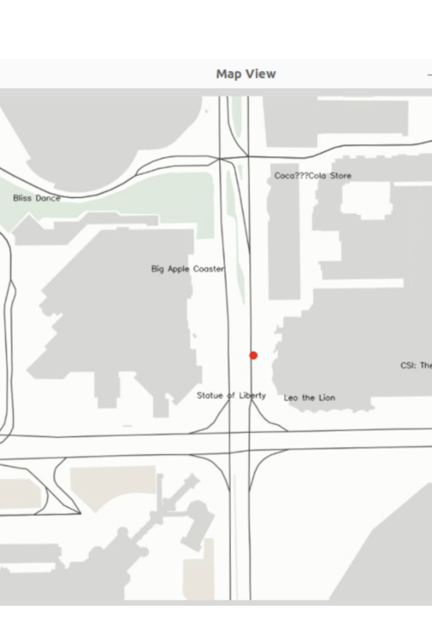
Thank you
Questions?
Annotating Long-Horizon Driving Instructions for Autonomous Vehicles
Isaiah Ramirez • Mi³ Lab • UC Merced
Notes:
End cleanly. Thank the audience and invite questions. If asked what you personally did, return to the workflow: watched clips, wrote passenger instructions, assigned referential classes, and learned how the dataset is being built.

