Slide 1
CSCI-P 532 Object Oriented Software Development Assignment 4
Luddy School of Informatics, Computing, and Engineering
Group 3: Isaiah Sherfick, Snehal Patare, Satin Jain, Raghunadham G
INDIANA UNIVERSITY BLOOMINGTON

Slide 2
Demo

Slide 3
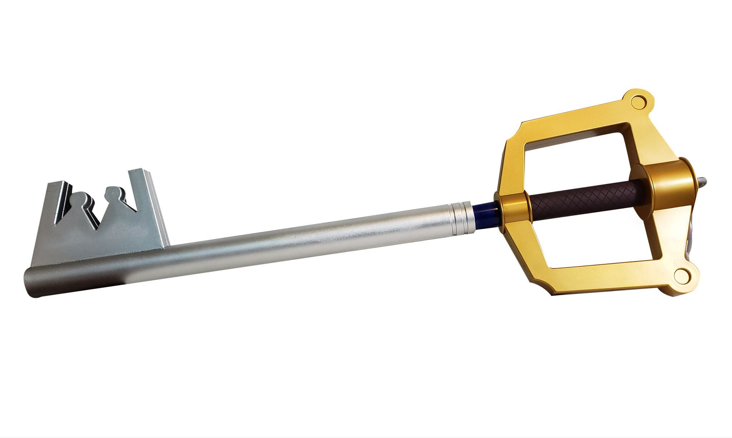
Key Components
Two separate MVC contexts for creating and playing games
Versatile and extensible Sprite class which encapsulates all game objects
GIMP-inspired multi-window view for game creation
Multi-window view for game playing with metabuttons in a separate window
Subscene for strategy buttons with animation.
Game design more realistic.
Combinable EventStrategies which can be chained for each Sprite, allowing for significantly more complex behaviors with each additional EventStrategy class added to the system
Custom CollisionStrategies for each sprite which can be altered for every individual sprite in the game

Slide 4
Architecture
Create Game Context
Model
SaveAndLoadManager
SpriteMaster
ArrayList<View> views;
Controller
CommandInvoker
add(Sprite) -> command
remove(Sprite) -> command
View
Layable - add , remove
Location
Layout Manager
Layable class for each objects
r/w
r/w
read-only

Slide 5
Architecture
Play Game Context
Model
SpriteMaster
ArrayList<View> views;
Controller
GameClock
CollisionDetector
CommandInvoker
EventHandler
View
Meta-buttons
GameCanvas
KeyListener -> notifies Controller.eventHandler
MouseListener
r/w
r/w
read-only

Slide 6

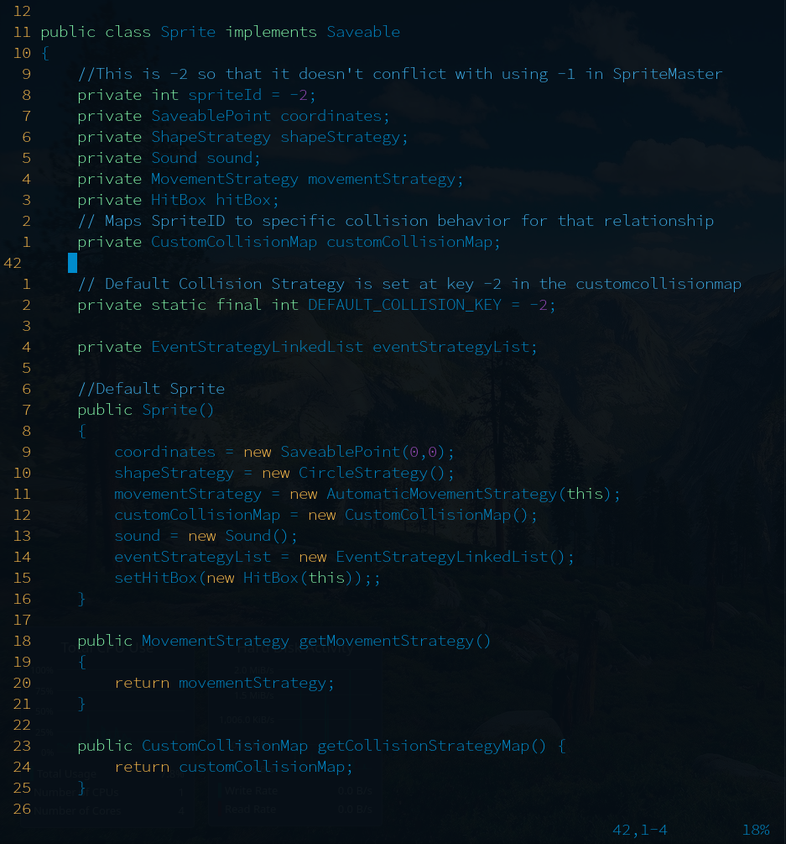

Architecture
The Almighty Sprite
Key to our design: the Sprite class
EVERYTHING in the user’s game is a Sprite
Sprites have the following member variables:
int spriteId - used for restoring relationships between sprites
ShapeStrategy - encapsulates sprite’s graphical representation
Sound - can store a sound in the sprite for explosions
HitBox - used for collision
EventStrategyLinkedList -- more shortly
CustomCollisionMap -- more shortly
As you can see, Sprites are comprised of many different strategies and data structures
This allows Sprite to be an extremely powerful class that is capable of representing whatever game objects the user wants

Slide 7
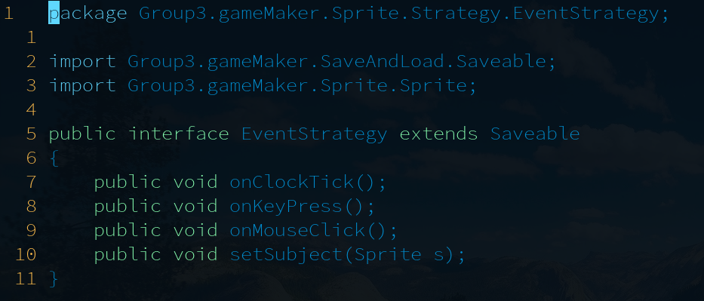

Architecture
The Almighty Sprite: Event Strategies
Event Strategies are how our sprites are able to behave in different, increasingly complex ways.
Each Sprite contains a linked list of EventStrategies which orders EventStrategies in the order they will be processed.
This allows for compounded behaviors such as Pac-Man’s movement, but also leaves room for simple behaviors like a Pong paddle or a ball.
The true beauty of our system is that most simple games can be made possible through the addition of only a handful of specialized EventStrategies.
While we have provided a handful of general EventStrategies with the base game maker package, the user can simply inject any number of custom EventStrategy classes to our system and accomplish arbitrarily complex behaviors in an infinitely scalable capacity.

Slide 8

Architecture
The Almighty Sprite: Custom Collisions
Custom Collisions allow our Sprites to have customizable collision behaviors for each and every other Sprite in the user’s game -- not restricted to “classes” of Sprites
Accomplished with a HashMap between spriteIds and CollisionStrategies
On a collision, the detected sprites each are passed each other’s spriteId, and they check their collision rules to see if they have a custom collision for that sprite. Ex: Bowling
If no special rule is present, the sprite’s default collision behavior is employed. By default, this is the NoCollisionStrategy behavior (Null Object).
But wait… How are these relationships preserved through saves and loads?

Slide 9

Architecture
The Almighty Sprite:
The SpriteMaster
The SpriteMaster is the key to preserving relationships between sprites between saves and loads
The SpriteMaster is really just a fancy HashMap for Sprites
Each Sprite is instantiated with a spriteId = -2.
The SpriteMaster is instantiated with largestSpriteId = -1.
On SpriteMaster.add(Sprite), if the Sprite’s Id is less than the largestSpriteId, then both are incremented and the new value is inserted.
If the Sprite’s Id is larger than what is already in the SpriteMaster, then we must be loading, and we simply insert the Sprite with its current Id and update the SpriteMaster’s largestSpriteId if it’s larger.
This allows relationships to be preserved by having Sprites only contain the SpriteId they’re interested in, rather than an actual reference of type Sprite which would be lost on save/load.

Slide 10

Teamwork
Week 1: research MVC, discuss architecture, begin work on create game context, save/load
Week 2: Isaiah->model/strategies/save+load, Raghu->controller/commands, Satin->PlayView, Snehal->CreateView
Work where we can during the week, but midterms and work obligations leave little time for serious progress
LayoutManager monolith, Raghu lends aid on increasingly demanding frontend, Isaiah finishes backend
Other roadblocks go here
30 hour weekend marathon -> ship the final product

Slide 11
Thank you!
Questions?
Comments?

