Slide 1
CSCI-P 532 Object Oriented Software Development
Assignment 2: Implementation of the Composite Pattern
Abhishek Tiwari Isaiah Sherfick Snehal Patare
Luddy School of Informatics, Computing, and Engineering
INDIANA UNIVERSITY BLOOMINGTON
Notes:
The main goal of my thesis is to find the applicability of high performance computing principles and algorithms in modern end to end deep learning solutions.
With adoptation of deep learning in many areas it is important to have highy efficient frameworks that handle both data processing and deep learning

Slide 2
Demo
To Eclipse!
Notes:
Performance for both data processing and deep learning
ease of use is as important as performance if any framework is to be adopted by the community

Slide 3
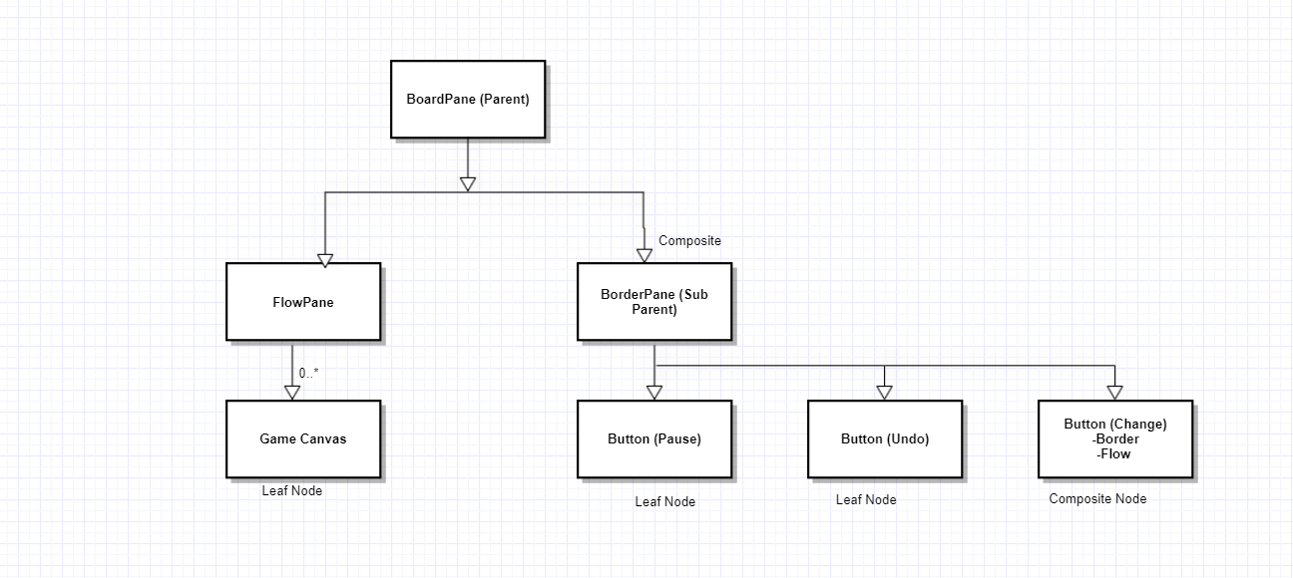
Architecture: Composite Design Pattern
Group 1 Week 2’s codebase was our starting point.
PausableGameEngine:
Class has BorderPane and FlowPane as a Base Layouts.
Default Layout - FlowPane.
Custom Layout:
CustomLayout is a GridPane
Multiple GridPane for Buttons:
Pause, Undo, Replay, FastForward, Rewind, Change (Flow/Border).
Implementation:
Change Button changes the layout architecture of the Base Pane from FlowPane to BorderPane and viseversa.
Notes:
Performance for both data processing and deep learning
ease of use is as important as performance if any framework is to be adopted by the community

Slide 4
Architecture: Save and Load
SaveAndLoadManager:
Saving and Loading Files and its location.
Stores JSON Objects in ArrayList.
Write in JSON file.
Saveable Interface
save(), load()
Functions for Point2D, Color as the Objects are not Saveable.
Notes:
Performance for both data processing and deep learning
ease of use is as important as performance if any framework is to be adopted by the community

Slide 5
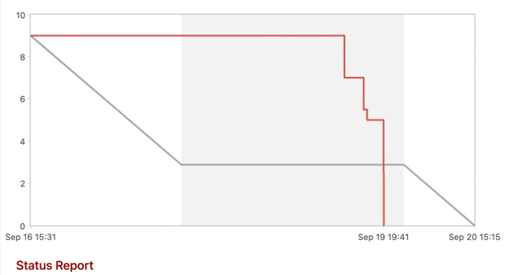
Teamwork
9/15 Wednesday
Save and Load assigned to Isaiah.
Composite Layout assigned to Snehal.
Scrum Master and extra features assigned to Abhishek.
9/17 Friday
Abhishek took over the Composite Pattern
Snehal moved to save and load functionality.
9/18 Saturday
Isaiah and Snehal paired program on Save and Load button. (Completed till saving and loading GameManager Data).
Abhishek pulled the all-nighter for Composite Pattern.
9/19 Sunday
Merged, E2E testing and Documentation.
Figure: Sprint Report
Notes:
Performance for both data processing and deep learning
ease of use is as important as performance if any framework is to be adopted by the community

Slide 6
Thank you!
Questions?
Comments?
Notes:
Performance for both data processing and deep learning
ease of use is as important as performance if any framework is to be adopted by the community

