Slide 1


Battle of Neighborhoods Gyms vs Crimes
An IBM Project by Isaias Hernandez

Slide 2
Business Problem
Las Vegas locals are looking at a 25% of valley residents being obese. This obesity is higher than being overweight. Of the residents in the valley, 40% of adults have high cholesterol levels.
Gyms can be a solution if spread out more.
Gym owners should be aware of the crimes that are happening in the valley as this can affect the amount of people that show up to work out.
Crimes in Las Vegas can have a negative impact on how businesses operate, and gyms are no exception.

Slide 3
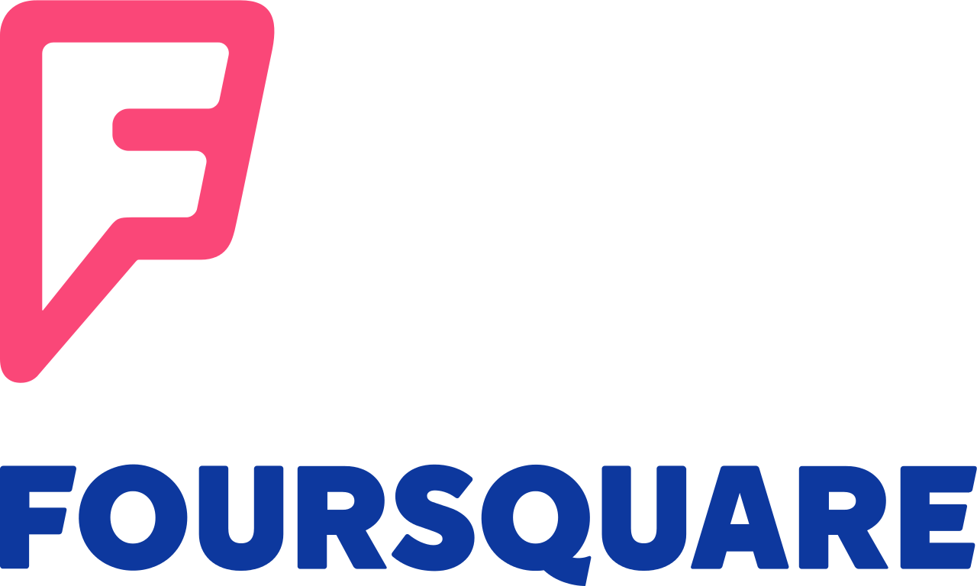
Data
Data that will be used for crime is that of data.world*. https://data.world/lasvegasnevada/las-vegas-metropolitan-police-calls-for-service
In this dataset there are 171427 rows and 10 columns we will limit the rows to only 1000.
The gym data will be gathered and wrangled from Foursquare.

Slide 4
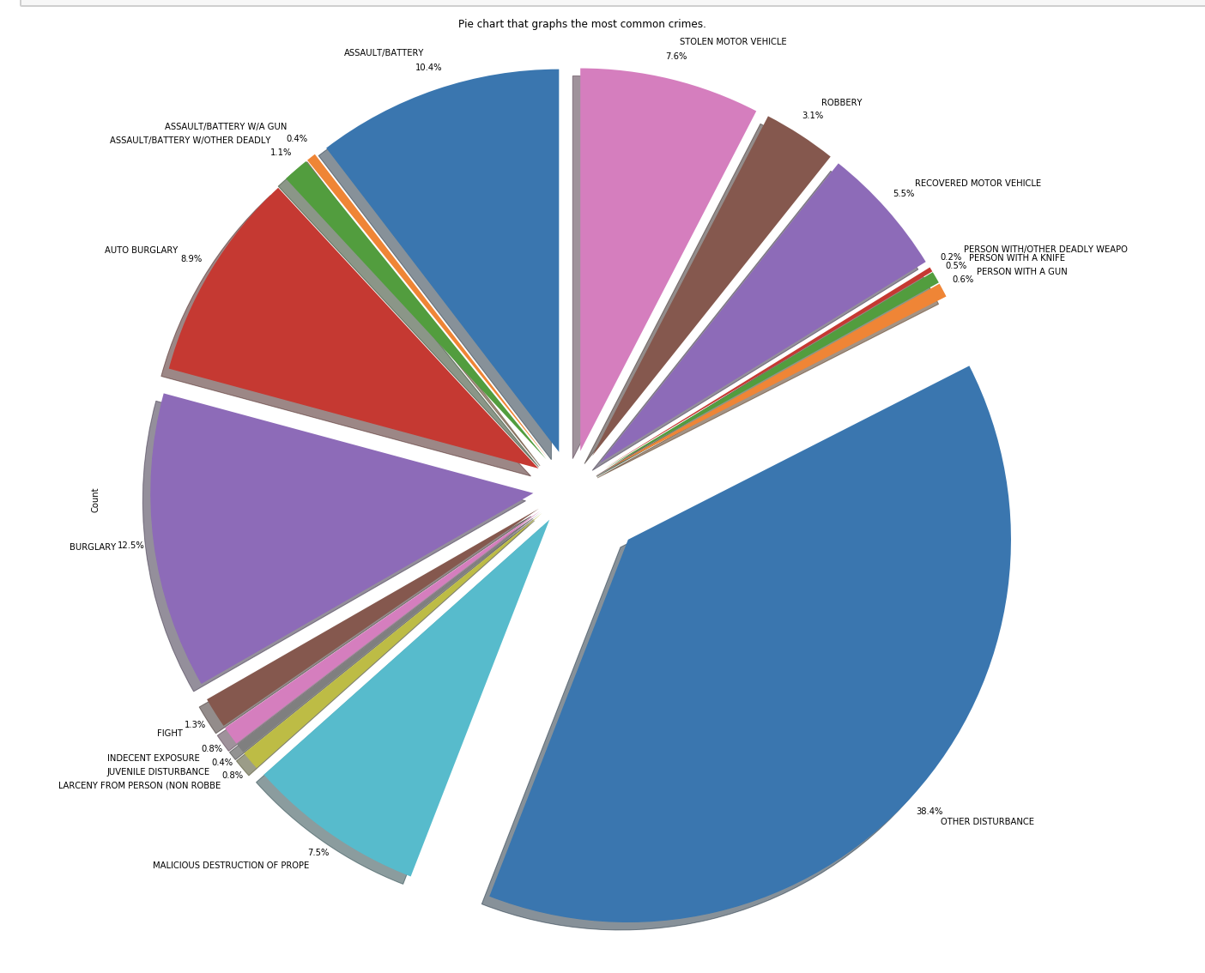
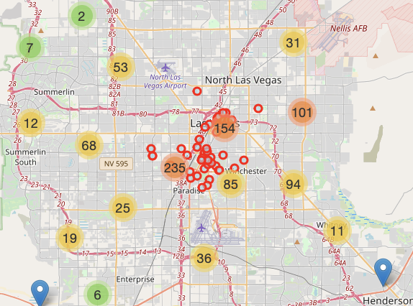
Analysis

Slide 5
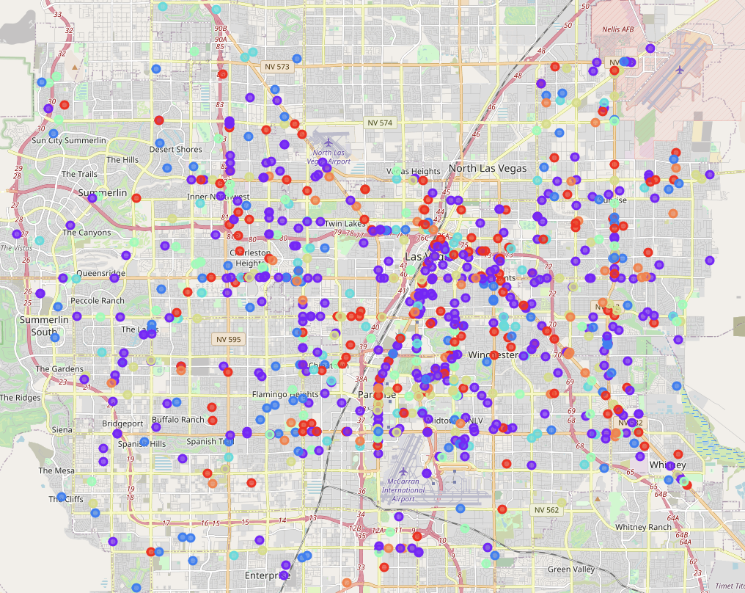
Machine Learning
The machine learning algorithm that is used is Kmeans with k = 7. This data allows us to view how the crimes are related. The purple is around .384 of the whole. It is above 1/3rd of criminal activities.

