Slide 1
AlaToo GPT
Intelligent Academic Advisor for Career and Program Selection
Student: Isa Kasymbek uulu
Supervisor: Dr.Tauheed Khan

Slide 2
Problems
Uncertainty in Choosing a Major and Faculty
Frequent Transfers Between Faculties
Graduates Not Working in Their Field of Study

Slide 3
Solution
Career Orientation Tests (RIASEC)
Personalized Training Program Recommendations Based on Test Results
Focus on Ala-Too University Programs

Slide 4
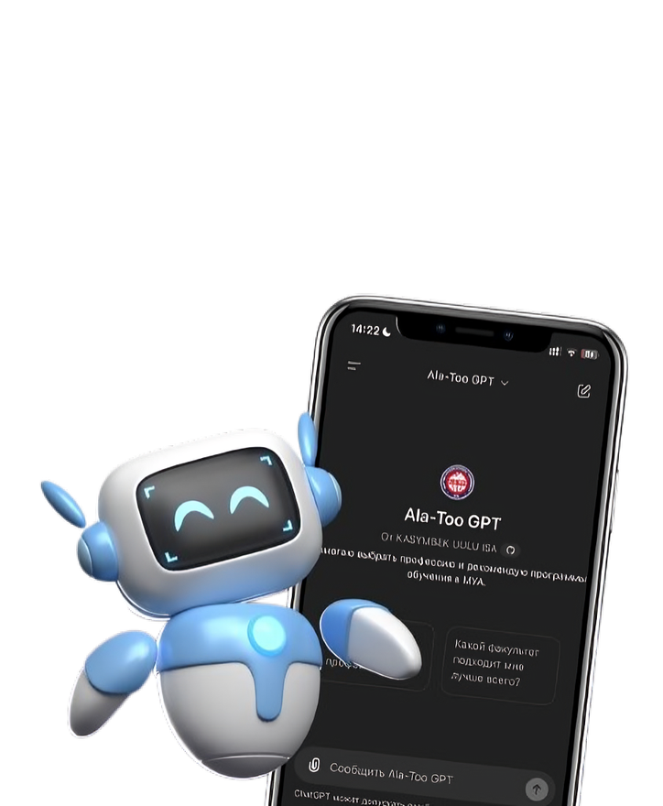
Project Goal
Help applicants choose the right major
Simplify the decision-making process
Provide accessible online consultation

Slide 5
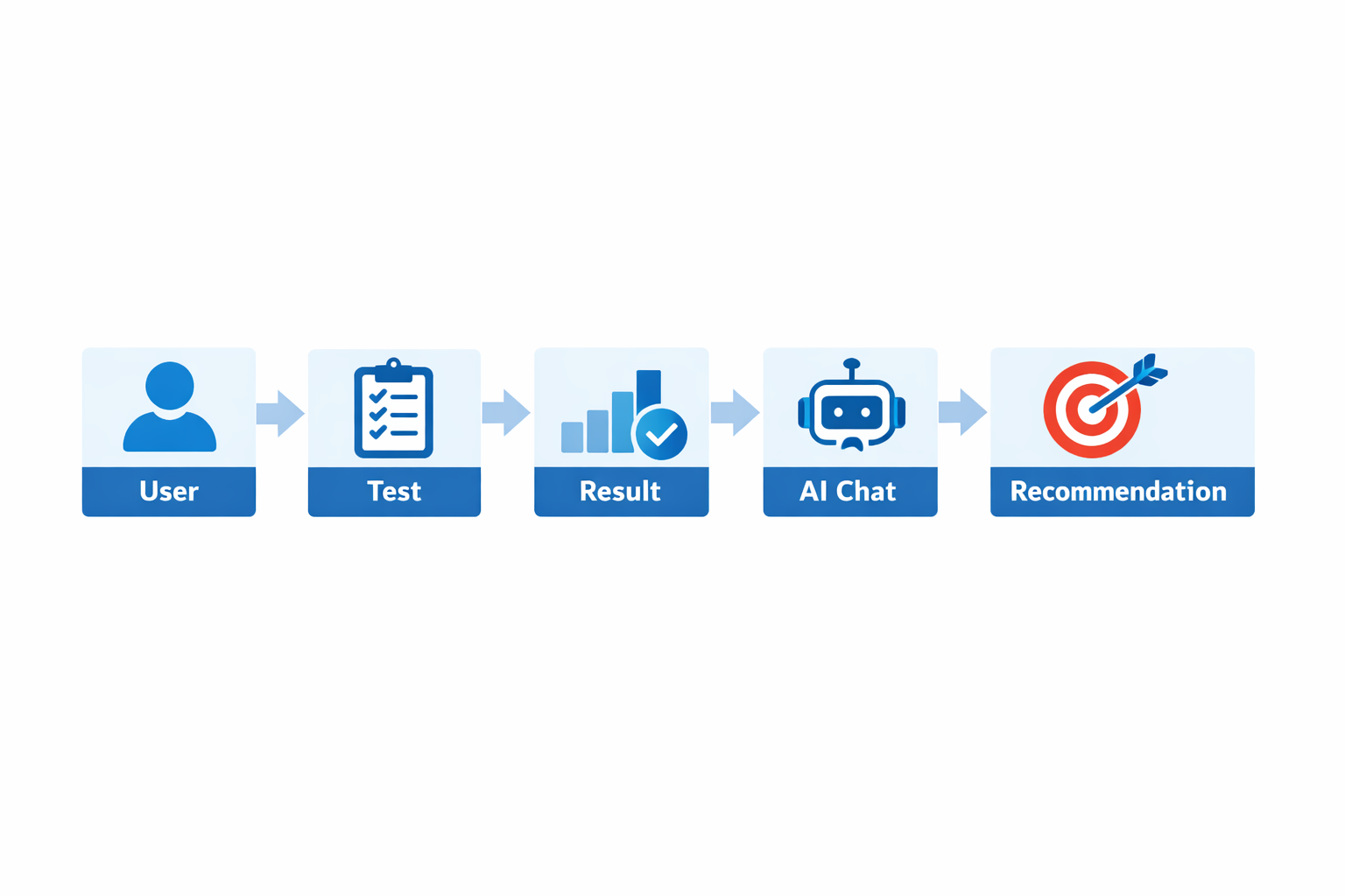
System Flow

Slide 6

Career Test
(RIASEC)
Based on Holland Code model
Identifies personality types:
Realistic, Investigative, Artistic
Social, Enterprising, Conventional
Used to guide major selection

Slide 7

AI Chat Assistant
Answers user questions
Explains recommended majors
Provides guidance about admission
Login: guest@gmail.com
Password: guest

Slide 8
Tech stack
Frontend
Data & Retrieval
Backend
RAG
Qdrant
Embeddings
Python
API integration (LLM APIs)
OpenWebUI
HTML/CSS

Slide 9
Next work
Improve recommendation accuracy
Add machine learning models
Add voice interaction

Slide 10
Future opportunities
Private accounts
Memory
Personalization
Academic data (schedule, rooms)
AI tools for teachers

Slide 11
Local AI System
Local LLM (on-premise)
No external API
Secure data integration
Full privacy

Slide 12


Thank you!

