Slide 1
Embedded systems Plant-Health
A concept for keeping track of your plants health.

Slide 2
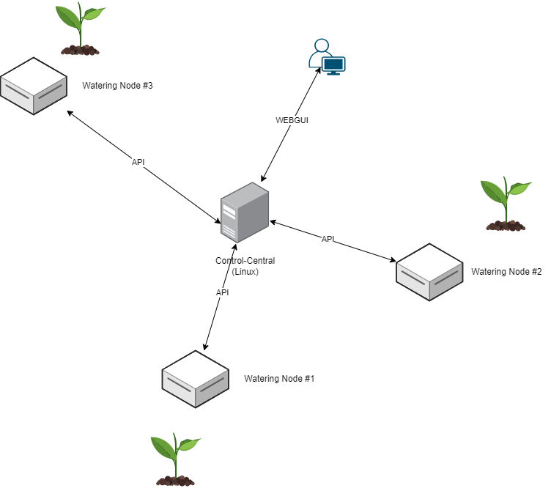
The Concept
Automatic watering of plants
One or more Watering nodes
Statistics-server

Slide 3
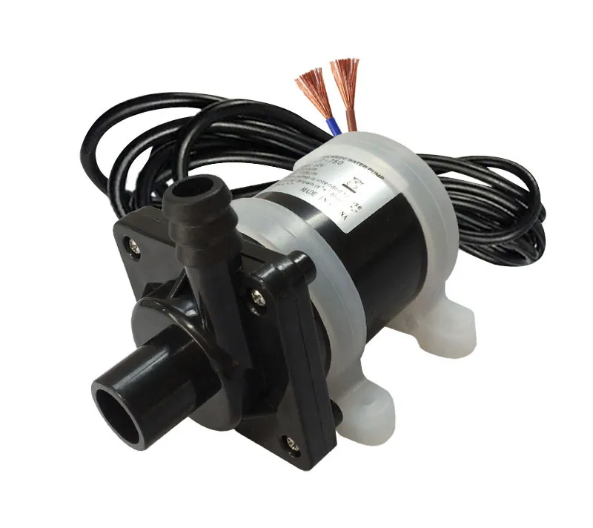
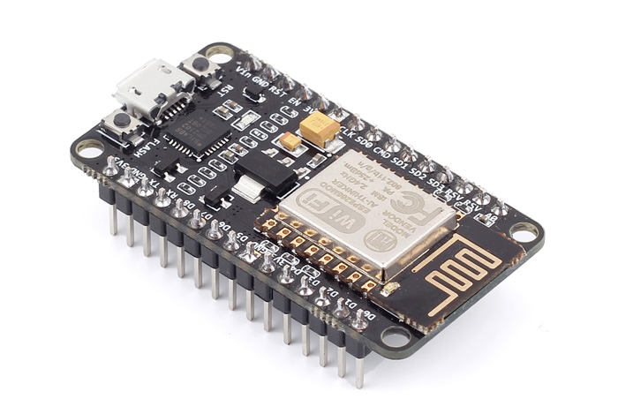

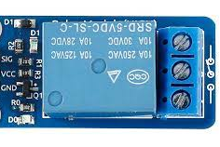
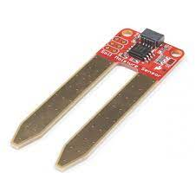
Core components:
Arduino ESP 8266 (Wi-Fi)
Arduino Relay module (single or multi, depending on setup)
Water pump (12v)
Linux Server
Wifi Router/Access point
Humidity Sensor

Slide 4

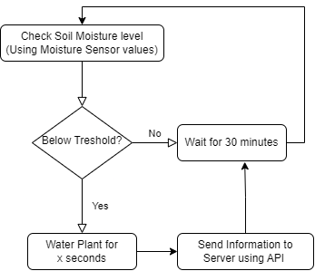
The Watering Node:
Controls watering plants via GPIO pins
Standard timer: (Water every x hour for y amount of seconds)
Moisture-level: (Define treshold in webgui for each given node)

Slide 5

The Server
Keeps statistics on each watering node (Time of watering, amount, Soil Moisture)
Edit watering node configuration (Watering mode, duration, tresholds etc)
Centralizes data for end user.

Slide 6


Watering Node Technologies:
Runs on arduino
Connected to LAN over Wi-fi
Communicates with API over aREST Module

Slide 7


Server Technologies
Hosts REST API server (Flask)
Stores watering events etc. in MySQL database
Flask Webserver

