Slide 1



Utilizing GPU Acceleration for Numerical Integration in the DES Experiment
Ioannis Sakiotis (isaki001@odu.edu), Kamesh Arumugam, Marc Paterno, Desh Ranjan, Balsa Terzic, Mohammad Zubair

Slide 2
INTRODUCTION
Applications: parameter estimation, simulation of mean dynamics, risk management, ray-tracing
PAGANI & m-Cubes
Demonstrated significant performance gains
Goal: use at scale

Slide 3
Outline
Brief description of integration algorithms
Pre-internship status of integration implementations
Summer internship work

Slide 4
Parallel numerical integration
Parallelize existing methods
VEGAS
Cuhre
Parallel GPU methods
m-Cubes
PAGANI
Mathematics identical
Algorithmic changes
Non-identical results

Slide 5
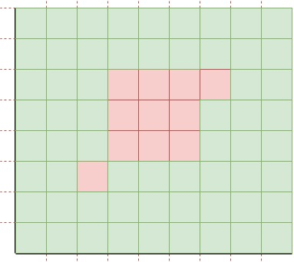
PAGANI
y
x

Slide 6
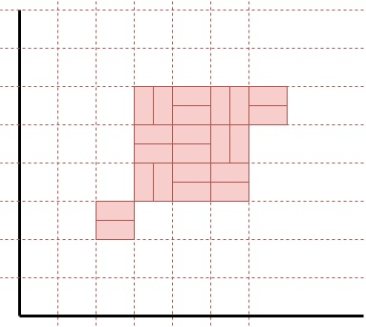
PAGANI
y
x

Slide 7
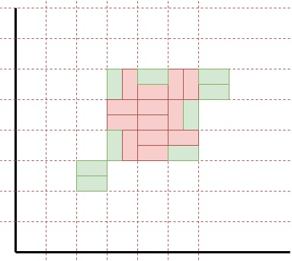
PAGANI
y
x

Slide 8
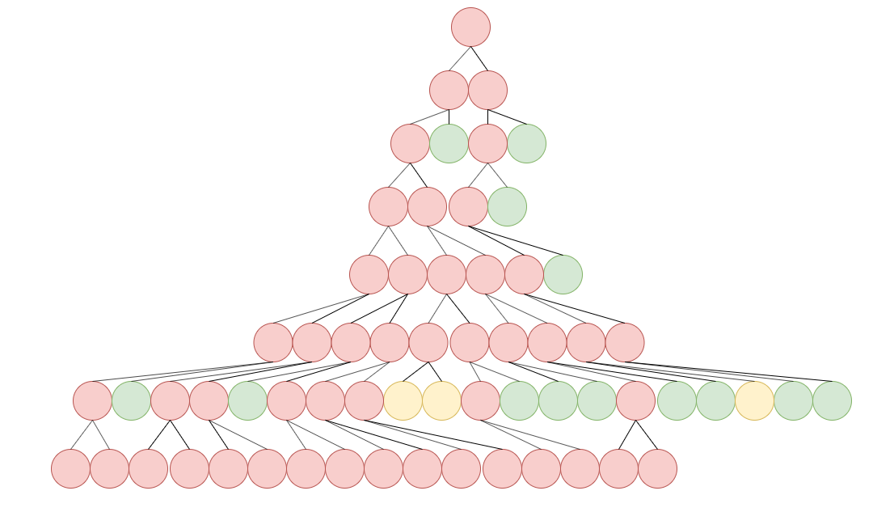
PAGANI
Quadrature rules
Error-estimate
Iterative algorithm
Generate regions within integration space
Sub-divide regions (nodes)
Classify regions
Green/yellow = accurate enough
Red = needs sub-division

Slide 9
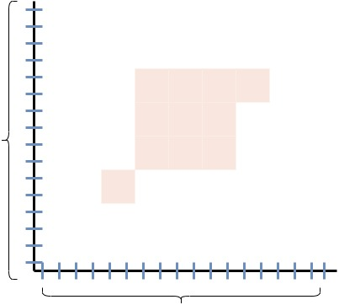
m-Cubes
y-axis bins
x-axis bins

Slide 10
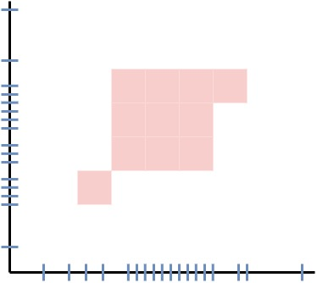
m-Cubes
y-axis bins
x-axis bins

Slide 11
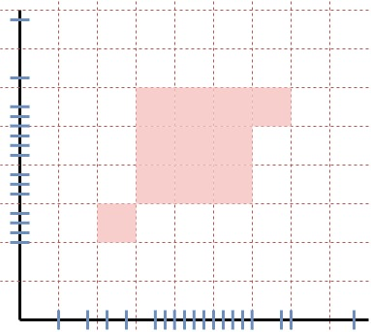
m-Cubes
y-axis bins
x-axis bins

Slide 12
Interface
class Gaussian {
public:
__device__ __host__
double
operator()(double x, double y, double z, double w)
{
double beta = .5;
return exp(-1.0 *
(pow(25., 2.) * (pow(x - beta, 2) + pow(y - beta, 2) + pow(z - beta, 2) + pow(w - beta, 2) )));
}
};
C++ object
Function arguments
Integrand
Relative/absolute error tolerances
Integration-space bounds
Template arguments
Integrand type
Dimensionality
Gaussian integrand;
integrate<Gaussian, ndim>(integrand, epsrel, epsabs, nsamples);

Slide 13
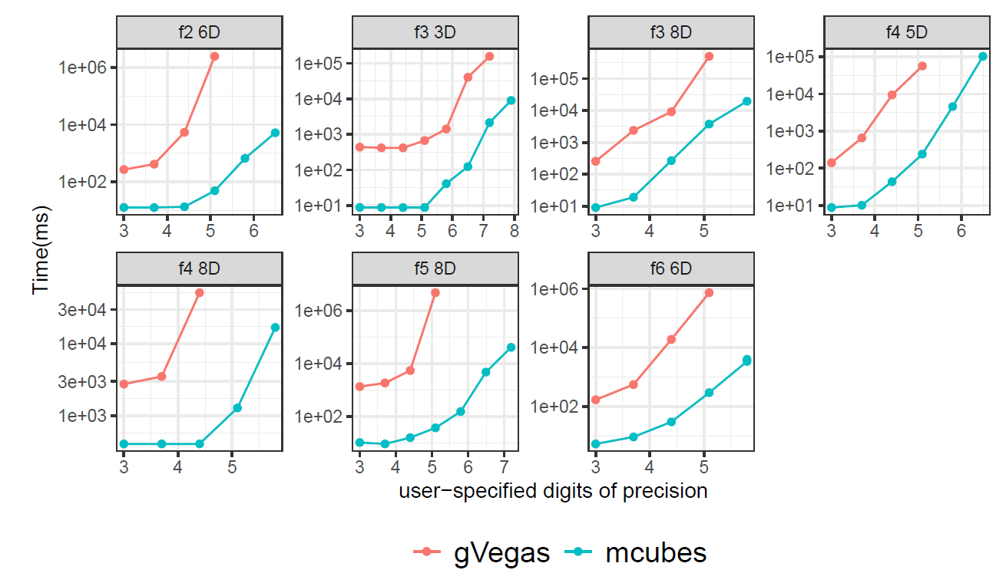
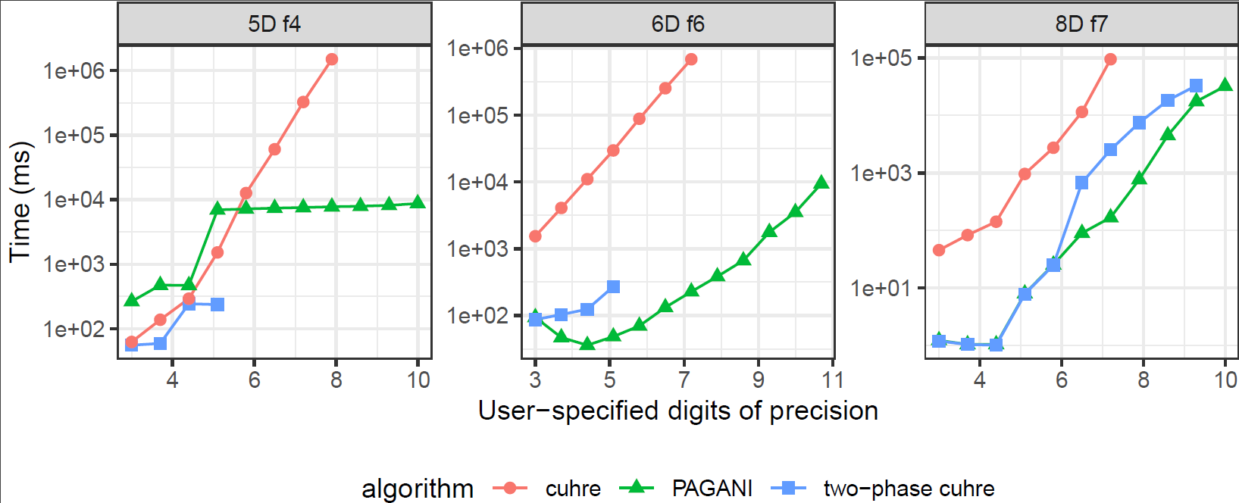
Performance

Slide 14
Scaling
Perlmutter
256 MPI ranks
1 GPU/rank
Hundreds samples
4 integrands
4 volumes
69 grid-points = 69 integrations

Slide 15
Scaling
Perlmutter
256 MPI ranks
1 GPU/rank
Hundreds samples
4 integrands
4 volumes
69 grid-points
Error: Unknown error
Failure mode triggered after hundreds of integrations

Slide 16
The crash
Reverted to 1 MPI rank
Identical crash but took longer to fail
Allocation in copy-constructor
Object for 2D interpolation
Data must be on GPU memory

Slide 17
Detecting memory misuse
“Compute sanitizer” reported no leaks
cudaMemGetInfo: returns available GPU memory in bytes
Recorded free memory within copy constructor
Needed higher resolution memory tracking

Slide 18
Data collection
void execute(){
MemTrackSentry mem_sentry(
ofstream_var,
“integrand_label”,
"module");
do_integrations();
}
MemTrackSentry class
Record free GPU memory upon construction/deletion
“Leaked” = construction – deletion bytes
Module execution to generate sample

Slide 19
Data collection
void do_integrations(){
for(auto& volume: volumes) {
MemTrackSentry mem_sentry(
ofstream_var
“integrand_label”,
“volume");
for(auto& point: grid_points) {
MemTrackSentry mem_sentry(…, “integration”)
integrate(…)
}
}
}
MemTrackSentry class
Record free GPU memory upon construction/deletion
“Leaked” = construction – destruction bytes
Module execution to generate sample
Volume
Call to integration routine

Slide 20
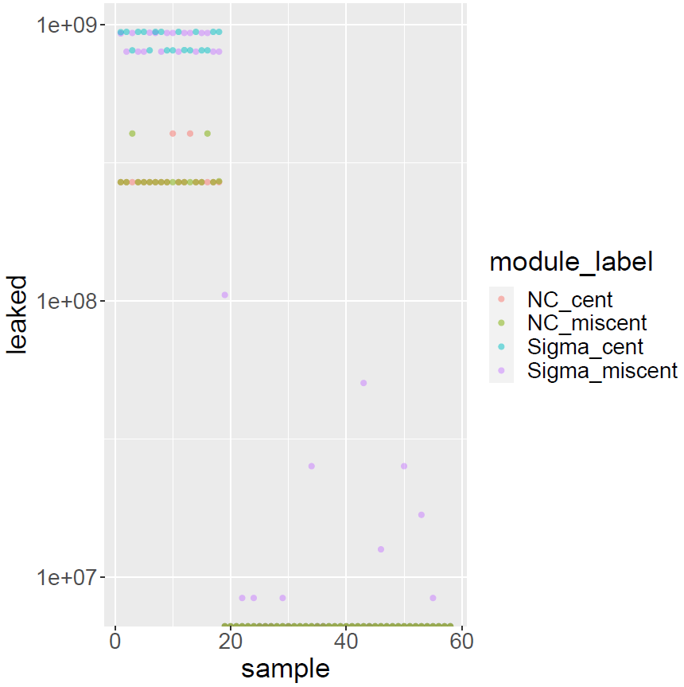
Sample level
Many leaks
Validated our hypothesis
Leaks of different sizes
Caused by module, integration, integrands?

Slide 21
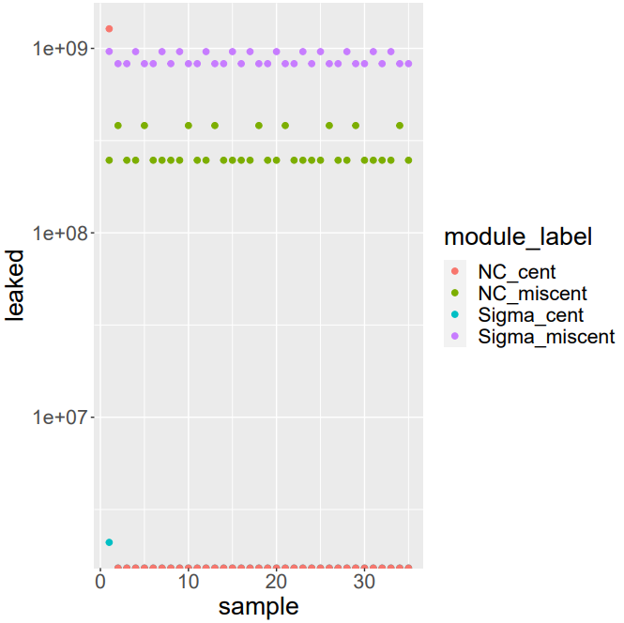
No managed memory
Crash sooner
Patterns within modules
Large initial leak
No consistency across modules
NC_cent and Sigma_cent leaked once

Slide 22
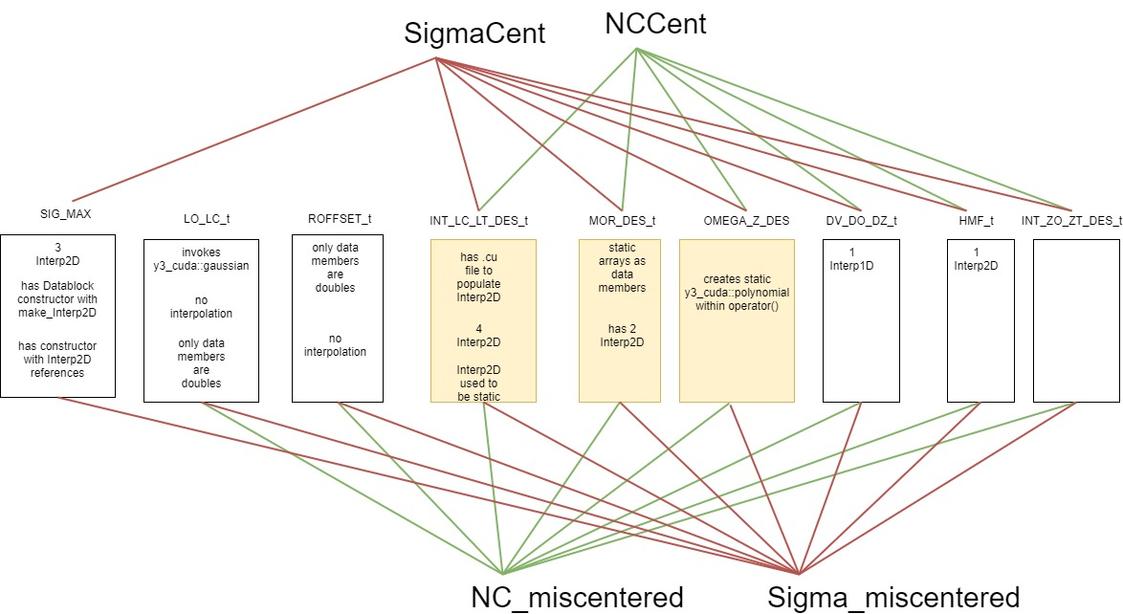
Similarity of integrands

Slide 23
Users of GPU Memory
PAGANI
Quadrature rules
Sub-region boundaries
Sub-region metadata
mCUBES
Bin boundaries
Bin contributions
Integrands
Tabular data
Constructed on the CPU
Copied to the GPU
Execute samples
4 integrands/sample
4 volumes per integrand
69 integrations per volume

Slide 24
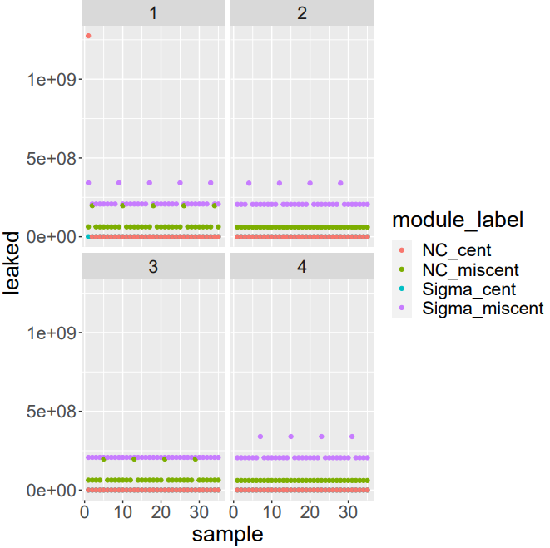
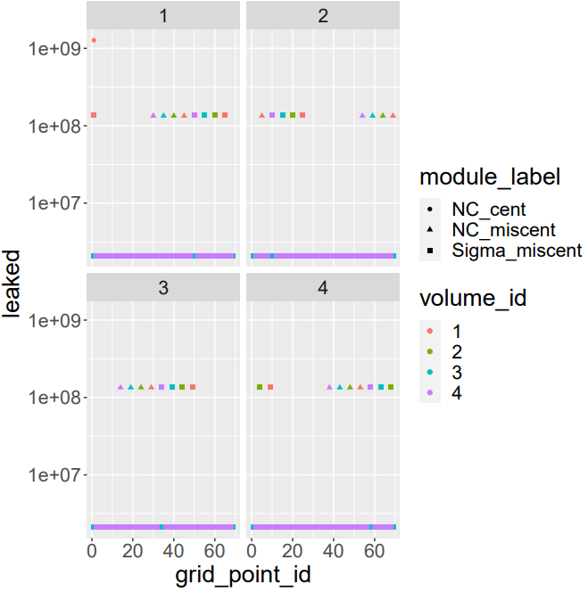
Volumes
Grid-points

Slide 25
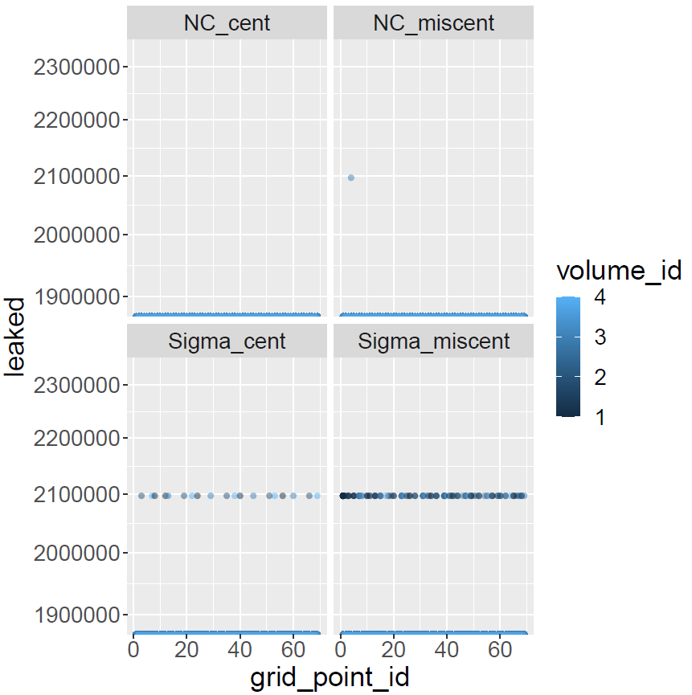
Pipeline without invoking integrate
No crash
Smaller leaks
Integration has a leak
Additional leak
Toy program with only integrand copying to gpu memory

Slide 26
Identifying the issue
template <typename F>
cuhreResult<T>
integrate(F& integrand, ...){
F* d_integrand = quad::cuda_copy_to_managed(integrand);
gpu_integrate(d_integrand, ...);
cudaFree(d_integrand);
}
template <class T>
T*
cuda_copy_to_managed(T const& integrand_on_host){
T* buffer = cuda_malloc_managed<T>();
new (buffer) T(integrand_on_host);
return buffer;
}

Slide 27
Identifying the issue
template <typename F>
cuhreResult<T>
integrate(F& integrand, ...){
F* d_integrand = quad::cuda_copy_to_managed(integrand);
integrate(d_integrand, ...);
d_integrand->~F();
cudaFree(d_integrand);
}

Slide 28
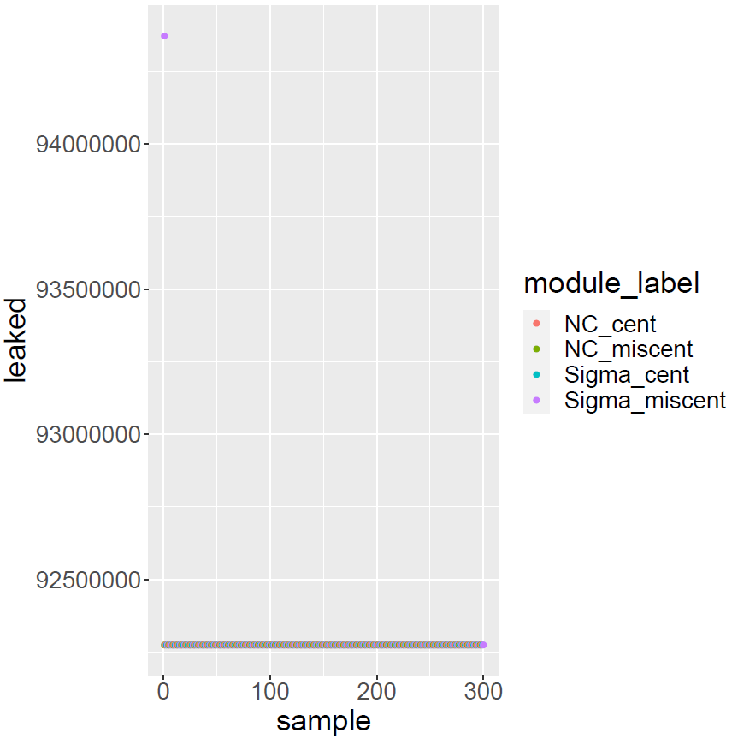
Not realizing the issue is fixed
Repeatedly edited integrands and tested for memory impact
Executed only PAGANI/m-Cubes
Amount of reported leaking would exhaust memory

Slide 29
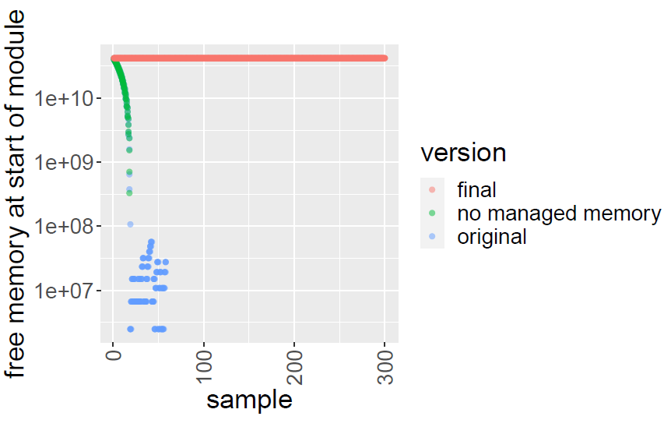
Looking at cudaMemGetInfo at the start

Slide 30
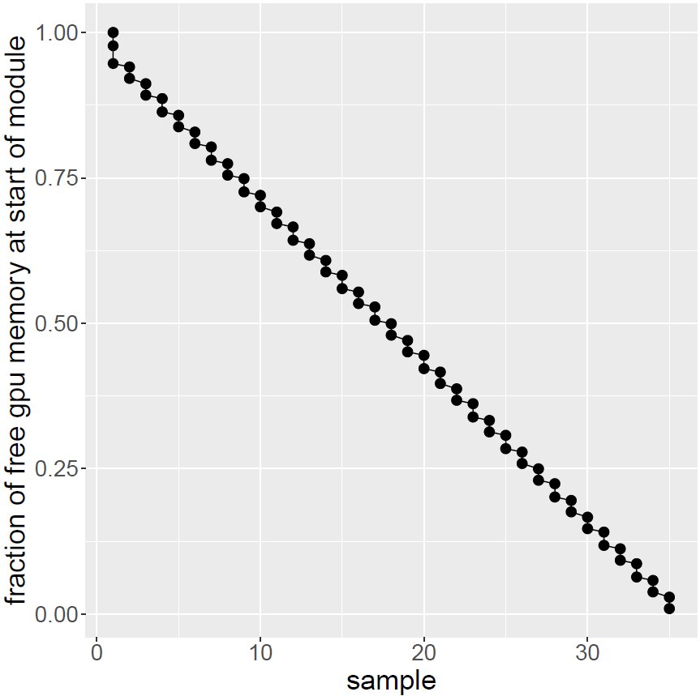
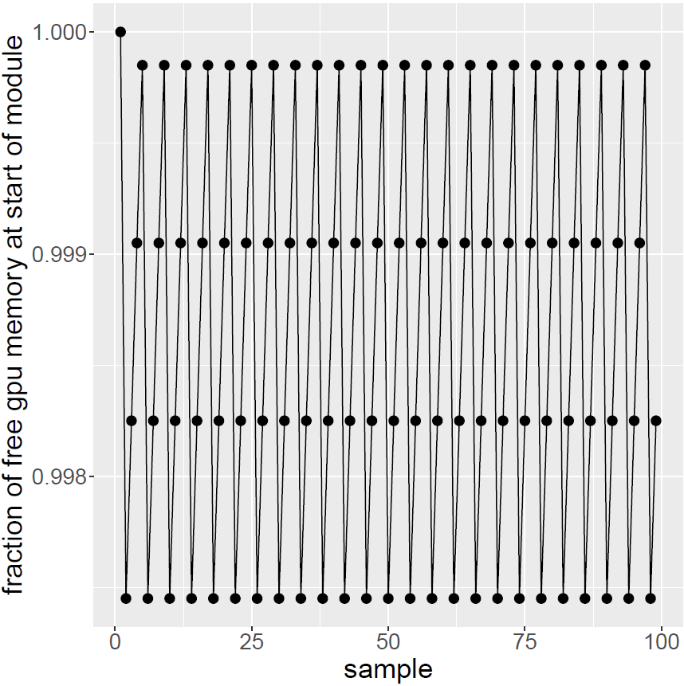
Before and after

Slide 31
Conclusion
Insight on cudaMemGetInfo
Fixed integrands
Removed unneeded managed memory
Fixed memory leak
Successful run with 256 MPI-ranks

Slide 32
QUESTIONS

Slide 33
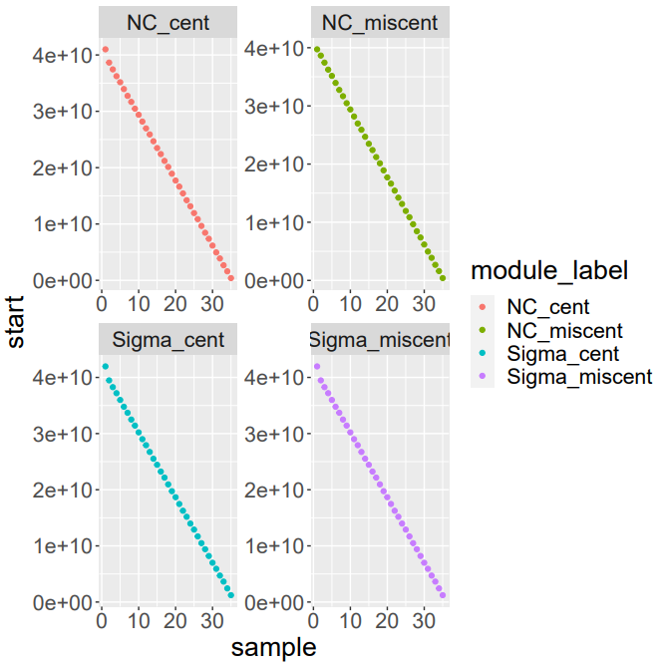
Free memory at module start

Slide 34
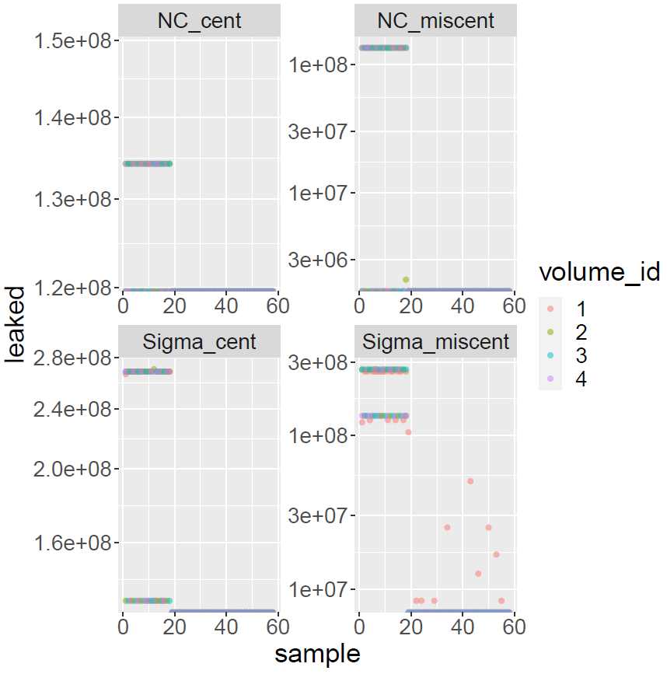
Managed-Volume level
Plot not identical to module level
Volume has no impact on integrand-related allocations

Slide 35
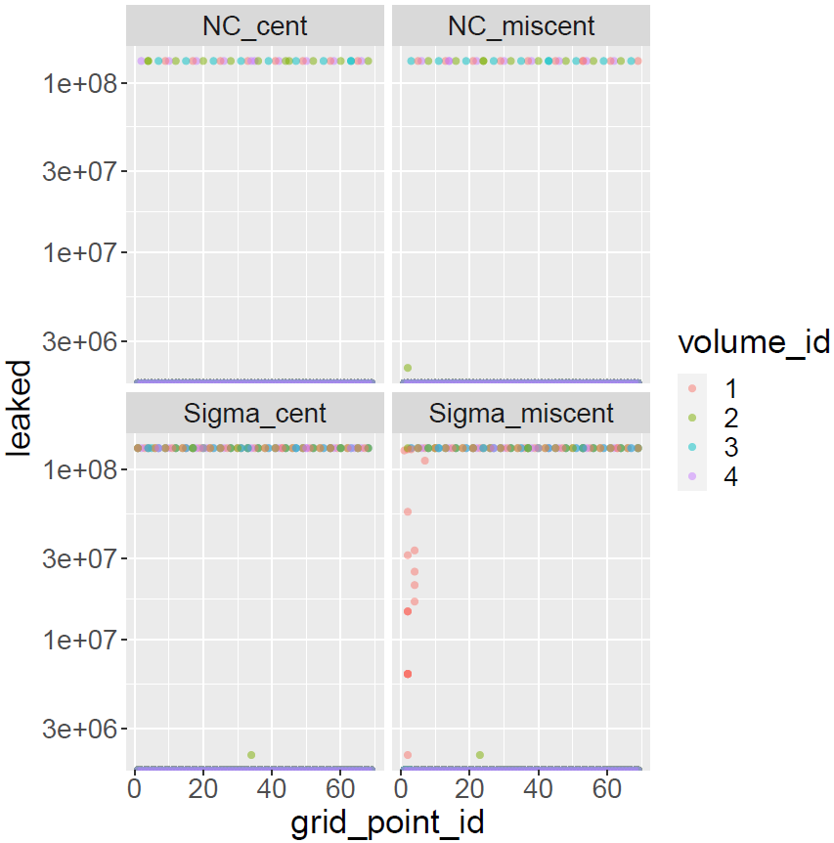
Managed Grid-point level
Integration level
Single integration calls
Multiple leaks?
Integration must have a leak
Why not all grid-points?

