Slide 1


Slide 2

Porting numerical integration codes from CUDA to oneAPI: a case study
Ioannis Sakiotis (isaki001@odu.edu)
Dr. Kamesh Arumugam
Dr. Marc Paterno
Dr. Desh Ranjan
Dr. Balsa Terzic
Dr. Mohammad Zubair

Slide 3
Outline
Motivation
Use-case
Code migration
Performance issues
Observations

Slide 4

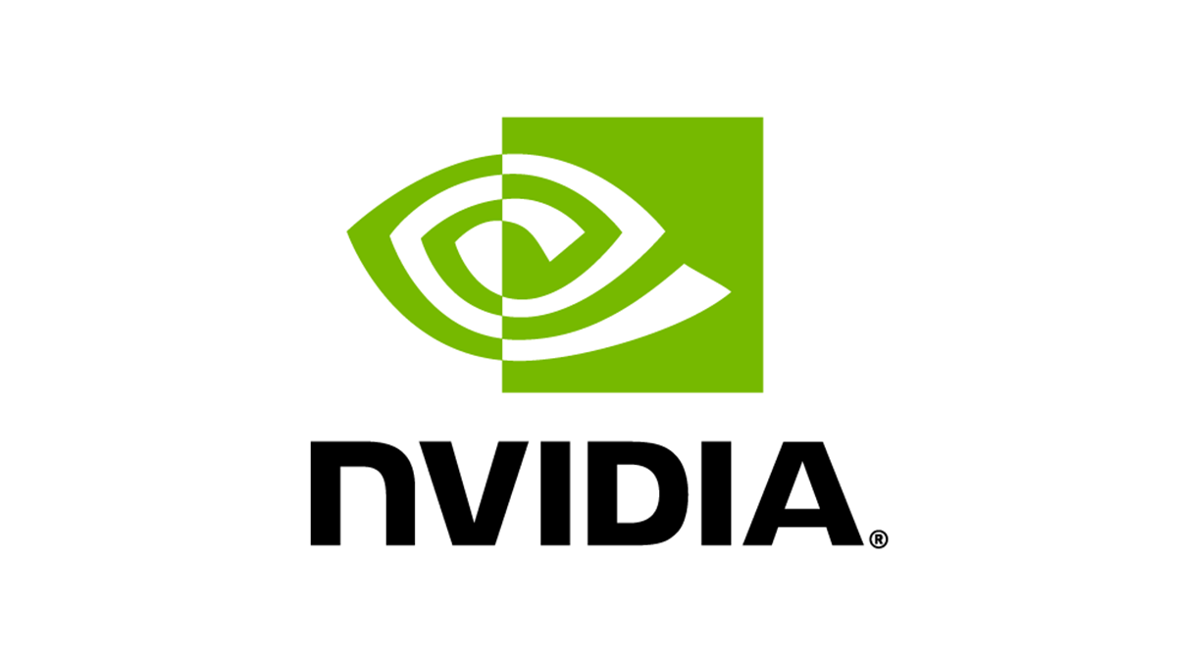







Execution Platform Portability
Devices with different architectures
No widely-adopted common standards
Multiple implementations to target multiple architectures
Notes:
NVIDIA: CUDA AMD: HIP

Slide 5
Platform Agnostic Programming Models
Historically most popular: NVIDIA GPUs
Aurora: Intel GPUs
Frontier: AMD GPUs
Kokkos, Raja, SYCL

Slide 6

Execution Platform Portability
oneAPI platform towards portability
DPC++: conformant to C++ and SYCL standards
Growing oneAPI ecosystem
Intel DPC++ Compatibility Tool
NVIDIA GPUs through the CUDA backend for SYCL
Wide range of performance penalties
https://sycl.tech/assets/files/Michel_Migdal_Codeplay_Porting_Tips_CDUA_To_SYCL.pdf

Slide 7
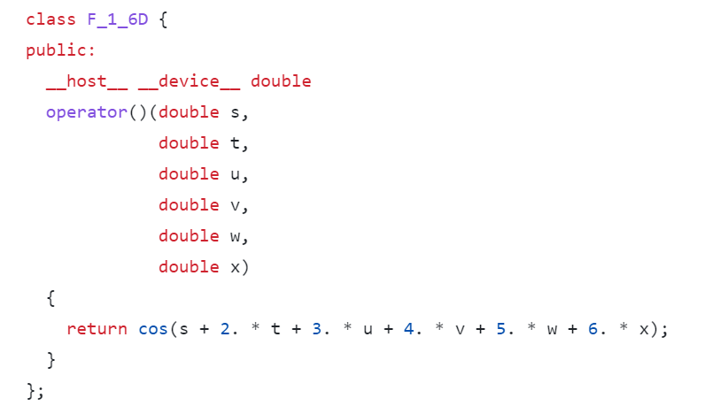
Numerical Integration in Scientific Computing
Multi-dimensional non-smooth integrands
GPU accelerated libraries
PAGANI: deterministic quadrature
m-Cubes: Monte Carlo quadrature
Optimized in CUDA for NVIDIA V100
Execute on upcoming clusters
Not all problems justify overhead of GPU execution

Slide 8
Parallel Integration Algorithms
PAGANI
Big kernel computing integral
Small kernels for post-processing
NVIDIA Thrust library
Used C++ Classes for device-data
C++ classes for initialization on the host & execution on the device
m-Cubes
Two big kernels
Serial post-processing on host

Slide 9
CODE MIGRATION

Slide 10
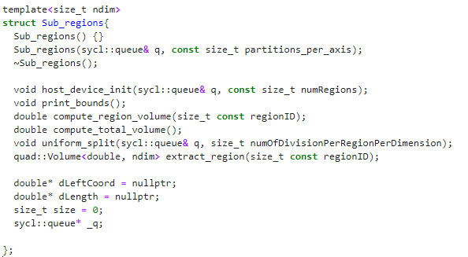
Two Stage Porting Process
Manual
Intel Developer Cloud
Straightforward kernel conversion
Processing library options was difficult
Only small kernel example in sample codes
Intel DPC++ Compatibility Tool
Easy on Intel Developer Cloud
Difficult on CUDA-backend
Notes:
- sycl::stream was error-prone
- Use std::exclusive_scan with a parallel policy or dpl::experimental::exclusive_scan_async
- DPCT introduced functions in the dpct namespace
- Test for reduction returned right results but printing showed wrong results
DPCT answer many of my concernes, don’t pass sycl::queue references and use default queue instead, use accessor’s get_pointer() method to pass shared memory around kernels

Slide 11
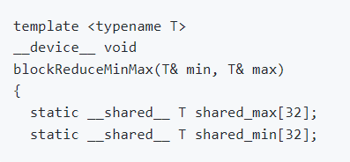
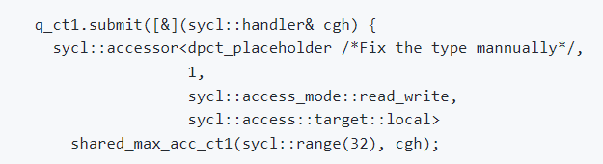
Code Migration Issues
The type of accessors for shared memory

Slide 12
Code Migration Issues
CUDA: atomicAdd
Didn’t work: dpct::atomic_fetch_add
ptxas fatal : Unresolved extern function
Worked: sycl::atomic_ref

Slide 13
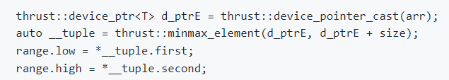
Code Migration Issues
NVIDIA Thrust min_max function
Intel DPC++ Compatibility tool did not support migration

Slide 14
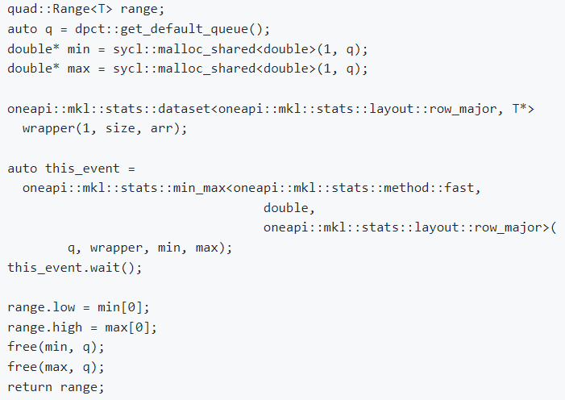
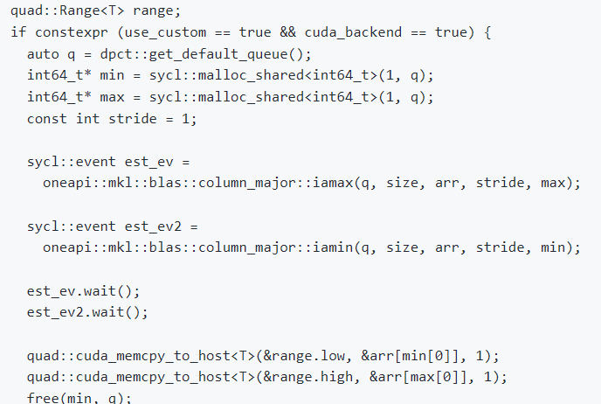
Code Migration Issues
Undefined reference on CUDA backend
worked

Slide 15
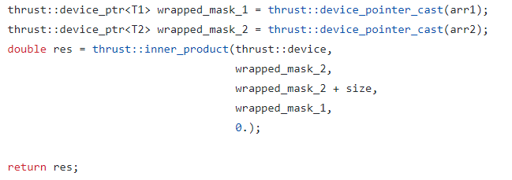
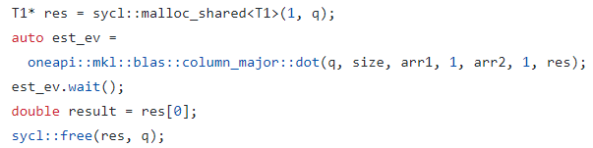
Code Migration Issues
No matching call for call to ‘dpct::inner_product’
Remove use of different types T1 and T2
Oneapi::mkl::blas::column_major_dot

Slide 16
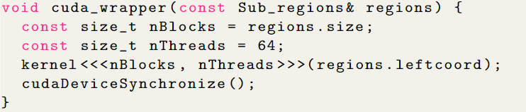
Code Migration Issues: Passing arguments to kernels
CUDA: Encapsulate device arrays in objects
Sub_regions allocates and deallocates device-data
Sub_regions is not trivially copyable
In SYCL kernel is replaced by a lambda expression
SYCL error when lambda captures regions

Slide 17
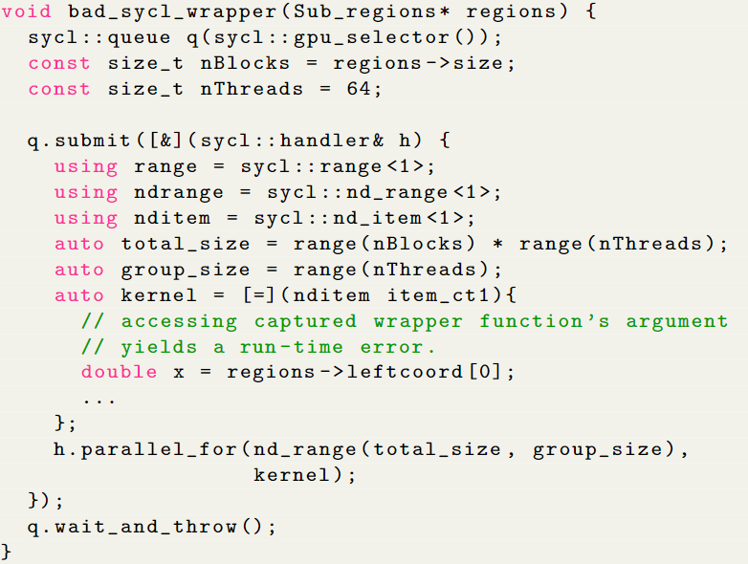
Code Migration Issues
Can pass pointer
regions is allocated host
cannot access pointer on device

Slide 18
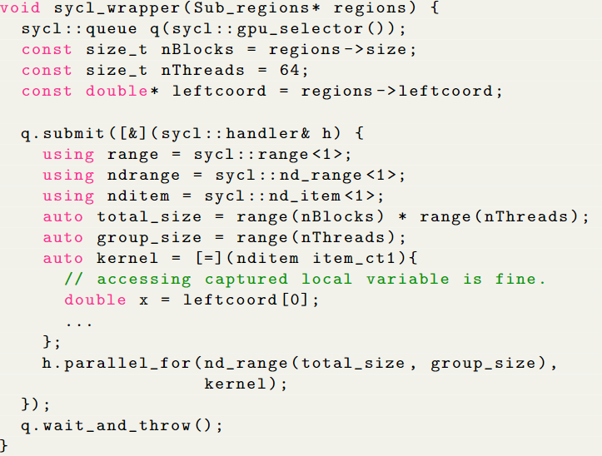
Code Migration Issues
Create local variable and access that instead of pointer
Suggestion: place parallel code in wrapper function

Slide 19
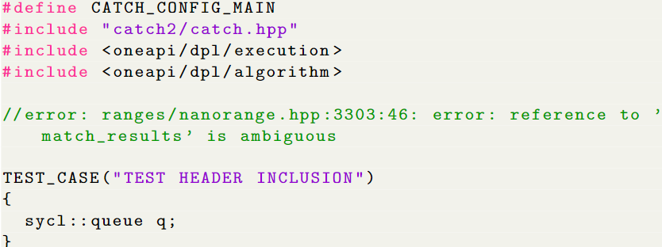
Code Migration Issues
Catch2 testing framework
Compilation errors on test code
DPL and Catch2 headers
Intel DPC++ Conversion Tool placed dpct/dpl_utils.hpp header causing the same error

Slide 20
Code Migration Issues
CMake to build tests and demos
Manual compilation: OK
CMake configuration on Intel Developer Cloud: OK
CMake configuration on CUDA backend: Challenging
Initially, separate build for CUDA backend
Needed one CMake configuration for the repository

Slide 21
Code Migration Issues
Specify architecture for CUDA and oneAPI with different strings
Pass CMake variable to signal usage of CUDA backend
set(CMAKE_CXX_COMPILER clang++)
set(CMAKE_CXX_FLAGS "${CMAKE_CXX_FLAGS} -fsycl -fsycl-targets=nvptx64-nvidia-cuda -Xsycl-target-backend --cuda-gpu-arch=${ONEAPI_TARGET_ARCH}")
target_compile_options(exec PRIVATE "-lonemkl" "-mllvm" "-inline-threshold=10000")

Slide 22
PERFORMANCE

Slide 23
Performance Issues
Compared CUDA and SYCL on V100
Initial PAGANI performance: ~5x slower
Initial m-Cubes performance:~80 times slower

Slide 24
Methodology
Execute main kernels with different integrands
Vary computational intensity
Export detailed metrics through nvprof –print-gpu-trace
Use .csv files in R script to compute statistical data and visualize metrics
Manual inspection of Nsight Compute reports

Slide 25
Experimentation
Combined shared memory accessors
Removed templates
Manually set loop-unrolling
Kernels to invoke integrands on the device hundreds of times
Experimented with simpler integrands
Different execution times with mathematical functions (pow, trigonometric functions)

Slide 26
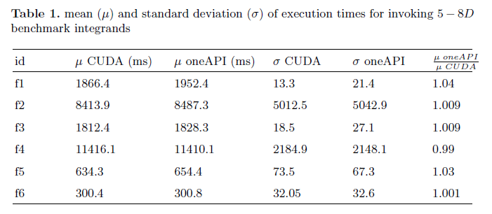
Compare integrand invocations
5 – 8 dimensions
Generate 1 million points
Mean of 10 kernel executions
cos, pow, exp
No fast-math flags
Worse: case 4% slowdown

Slide 27
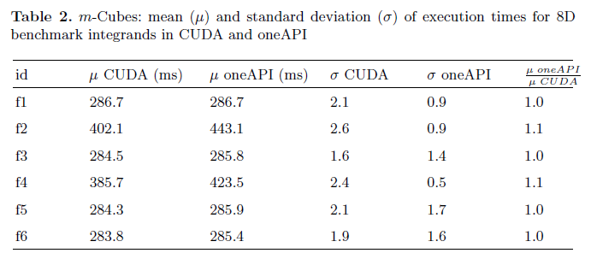
m-Cubes: main kernel execution
Various thread block configurations
100 million to 1 billion samples
Mean of 100 calls per kernel
10% penalty on f2 and f4

Slide 28
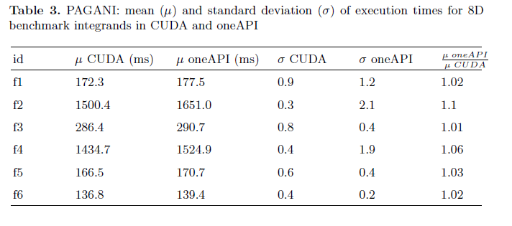

PAGANI: main kernel execution
Various thread block configurations
1 block per region
Different number of regions
Different resolution splits on the unit hypercube ${(0,1)}^{d}$
Mean of 100 calls per kernel
Highest penalties: f2 and f4

Slide 29
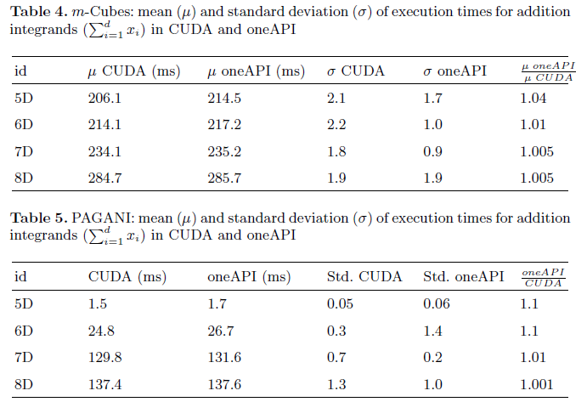
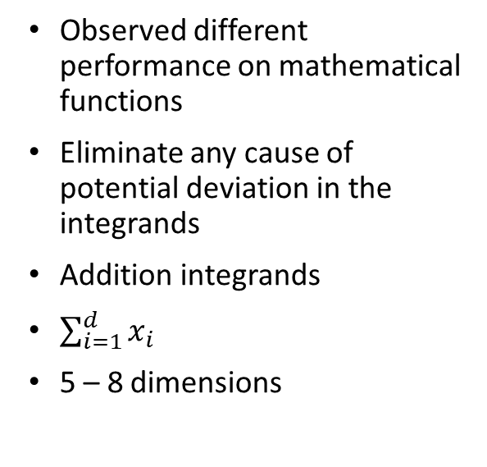
Compare simple integrands
Observed different performance on mathematical functions
Eliminate any cause of potential deviation in the integrands
Addition integrands
$\sum_{i=1}^{d}{x_{i}}$
5 – 8 dimensions

Slide 30
Observations
Bad performance of atomics due to not including device architecture flag
Setting inline-threshold to 10,000 allowed us to achieve the 10% slowdown
Using nd_item<1> yielded slight improvement over nd_item<3>
Reduce_over_group was sensitive to inline threshold
Register count difference

Slide 31
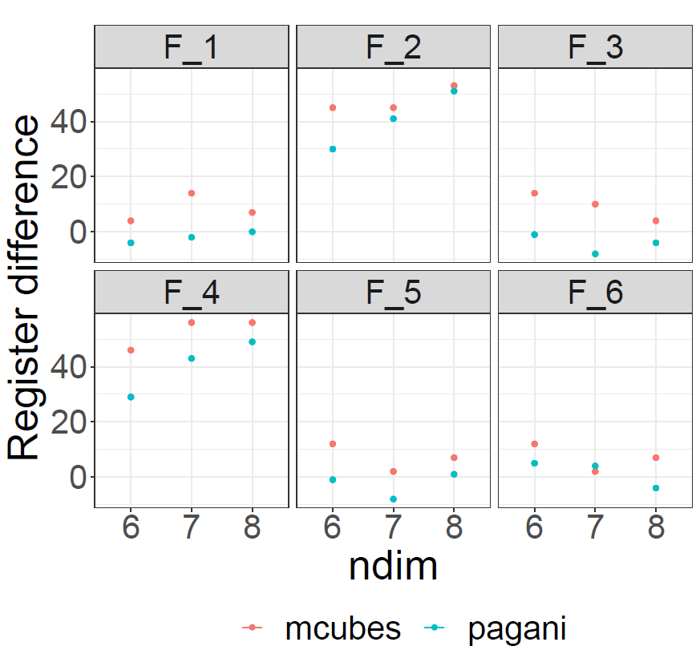
Achieved Performance with oneAPI
Numerous performance tests
CUDA -> oneAPI: 10% performance penalty
Variance in performance penalty
Increased register usage

Slide 32
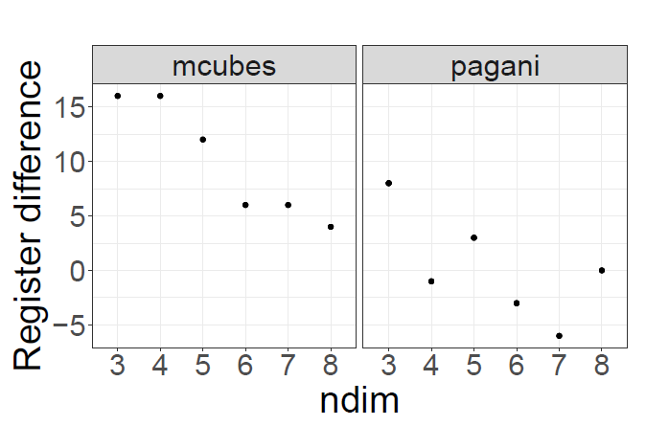
Achieved Performance with oneAPI
Numerous performance tests
CUDA -> oneAPI: 10% performance penalty
Variance in performance penalty
Increased register usage

Slide 33
Conclusion
Intel DPC++ Compatibility tool is great
Mapping library calls may be challenging
Clang and NVCC optimizations
Loop-unrolling and inline-thresholds are critical
Register usage can degrade performance
0-10% performance penalty on NVIDIA GPUs

