Slide 1




Pagani & Mcubes: Parallel Adaptive GPU Algorithms for Numerical Integration
Ioannis Sakiotis (isaki001@odu.edu), Kamesh Arumugam, Marc Paterno, Desh Ranjan, Balsa Terzic, Mohammad Zubair

Slide 2
Introduction
Applications: parameter estimation, simulation of beam dynamics, risk management, ray-tracing
Probabilistic, deterministic
Monte Carlo , Quadrature
No algorithm guarantees the accuracy of its estimated results
Specify desired accuracy (relative error tolerance, digits of precision, etc.)
Goal: Bring efficient adaptive quadrature and Monte Carlo to GPUs

Slide 3
outline
Two integration algorithms
PAGANI
mCubes
Performance
Interface/ease of use
Execution platform portability
Kokkos, intel oneAPI
Algorithm details
Parallelization approach

Slide 4
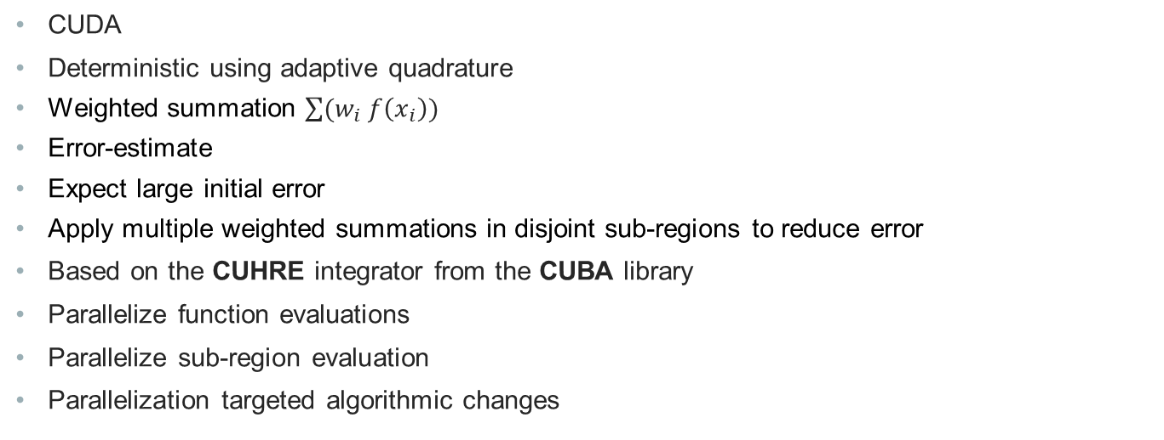
PAGANI
CUDA
Deterministic using adaptive quadrature
Weighted summation $\sum{(w_{i} f\left(x_{i}\right))}$
Error-estimate
Expect large initial error
Apply multiple weighted summations in disjoint sub-regions to reduce error
Based on the CUHRE integrator from the CUBA library
Parallelize function evaluations
Parallelize sub-region evaluation
Parallelization targeted algorithmic changes

Slide 5
mCubes
CUDA
Probabilistic using Monte Carlo integration
Evaluate the integrand at random points
Based on VEGAS integrator from the CUBA library
Accelerate converge through importance and stratified sampling
Parallelize function evaluations, random generation
Algorithm is very parallelizable
Targeted batching of operations

Slide 6
Experiments
Evaluate on various precision levels
maximum relative error tolerance: 1.0e-3
GPU: v100
CUDA 11
m-Cubes: plot averages from 100 runs per experiment

Slide 7
performance
Limited libraries for parallel multi-dimensional numerical integration
Cuba library for single threaded execution on CPU
Parallelization yields orders of magnitude speedup
One order of magnitude faster than existing GPU methods

Slide 8
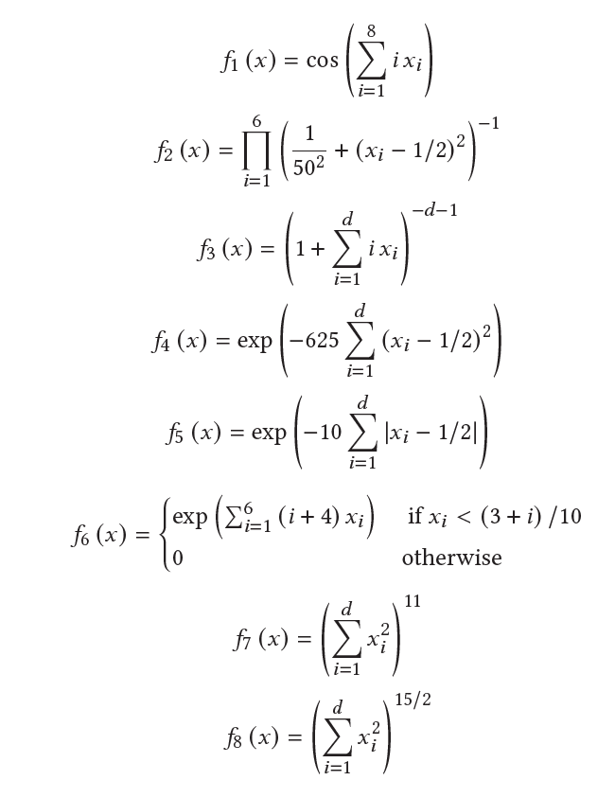
performance
TEST SUITE
Fastest GPU implementation
Parallel deterministic
Two-phase CUHRE
Parallel probabilistic
gVegas
CUDA C++
original GPU-accelerated VEGAS
ZMC
Python
Monte Carlo based
Stratified sampling + heuristic tree search

Slide 9
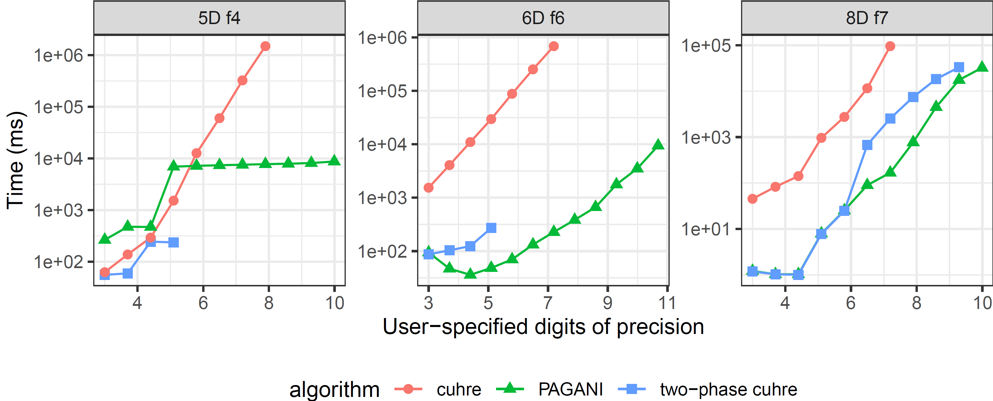
Pagani
Different algorithm than cuhre
“Easy” integrals not worth the overhead
Pagani generates more sub-regions
More digits-of-precision
More robust than two-phase cuhre

Slide 10
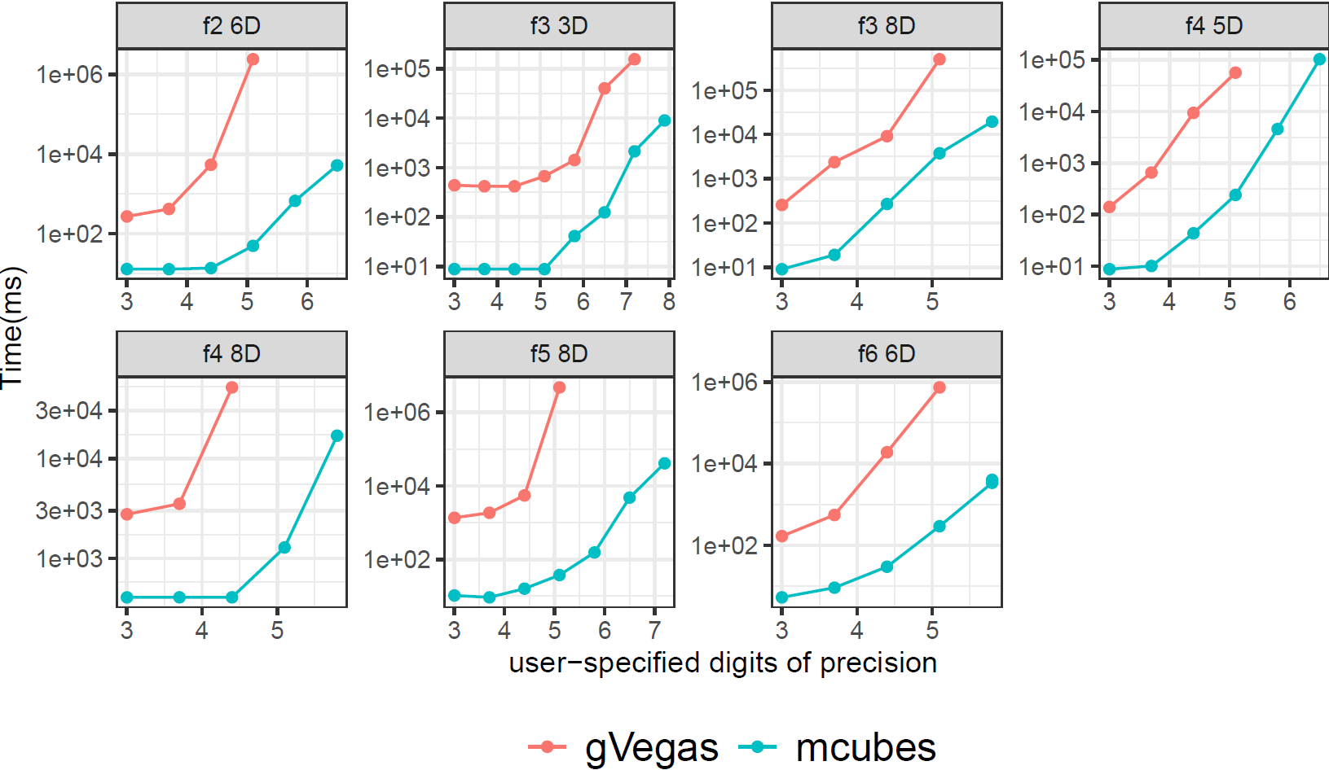

Mcubes
Very similar to VEGAS
Higher resolution importance sampling
Consistently faster than gVegas and ZMC
More digits-of-precision
fA(x) = $sin⁡(\sum_{i=1}^{6}{x_{i}})$
fB(x) = $\frac{1}{{(\sqrt{.02 π })}^{2}}exp⁡(−\frac{1}{2e−6}\sum_{i=1}^{9}{{{(x}_{i})}^{2}})$
f(x) | algorithm | true value | Integral estimate | error estimate | Time (ms)
fA | zmc | -49.165 | -48.64740 | 1.98669 | 4.75e4
fA | mcubes |  | -49.27284 | 1.19551 | 1.07e3
 |  |  | -49.27284 | 1.19551 | 1.07e3
fB | zmc | 1.0 | 0.99939 | 0.00133 | 8.3e3
 | mcubes |  | 1.00008 | 0.00005 | 9.8e2

Slide 11
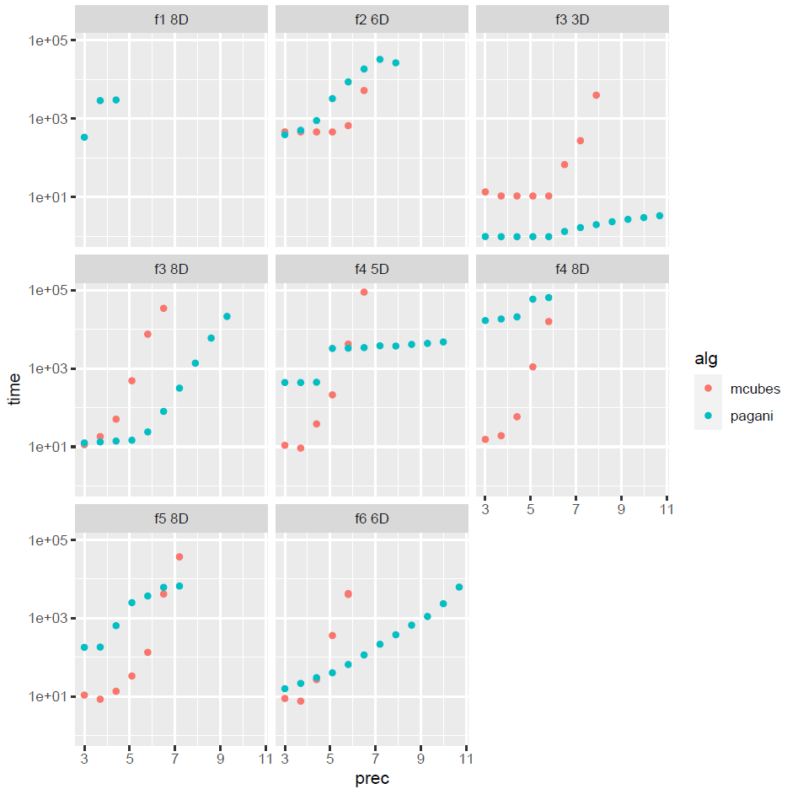

Pagani vs mcubes
f1 : oscillatory
f2: product peak
f3: corner peak
f4: gaussian
f5: $C^{0}$ function
f6: discontinuous

Slide 12
Interface
Easy to use without parallel computing expertise
Use functors to define integrands
GPU compatible containers

Slide 13
How to use
Available at https://github.com/marcpaterno/gpuintegration
Pagani, mCubes are header only libraries
Optional build of tests utilizing the catch2 testing framework
Optional build of demos, executing closed form integrands on various accuracies
Required software: cMake
Usage requirements
CUDA: nvcc to replace gcc
Kokkos: kokkos-kernels library
C++17

Slide 14
Defining Integrands
class Gaussian {
public:
__device__ __host__
double
operator()(double x, double y, double z, double w)
{
double beta = .5;
return exp(-1.0 *
(pow(25., 2.) * (pow(x - beta, 2) + pow(y - beta, 2) + pow(z - beta, 2) + pow(w - beta, 2) )));
}
};
Pagani<double, ndim> workspace;
Gaussian integrand;
double epsrel = 1.e-3, epsabs = 1.e-20;
workspace.integrate< Gaussian >(integrand, epsrel, epsabs);

Slide 15
Custom integration bounds
double lows[] = {0., 0., 0., 0., 0., 0.};
double highs[] = {10., 10., 10., 10., 10., 10.};
quad::Volume<double, ndim> volume(lows, highs);
double epsrel = 1.e-3;
double epsabs = 1.e-20;
workspace.integrate< integrand_type >(integrand, epsrel, epsabs, volume);

Slide 16
Stateful integrands
Integrand is evaluated on the GPU
Integrand is copied to GPU memory
Integrand is invoked by multiple threads in parallel
CUDA compatible computations and data-structures
Use our types
quad::cudaArray
quad::Interp1D
quad::Interp2D
quad::Volume

Slide 17
Custom type for 2D interpolation
class Gaussian {
public:
__device__ __host__
double
operator()(double x, double y, double z, double w)
{
return (f(x,y) * f(z,w));
}
quad::Interp2D f;
};
std::array<double, 3> xs = {1., 2., 3.};
std::array<double, 2> ys = {4., 5.};
std::array<double, ny * nx> zs; // ← VALUES
std::array<double, 3 * 2> zs;
quad::Interp2D f(xs, ys, zs);

Slide 18
Architecture portability
Initial implementation in CUDA
Best performance on NVIDIA GPUs
Limited to NVIDIA GPUs
Requires use of CUDA qualifiers
Support for alternative platforms
Easier to maintain single code-base
Kokkos: completed initial implementation
oneAPI: in development

Slide 19
Intel OneAPI defining integrand
class GENZ_3_3D {
public:
double
operator()(double x, double y, double z)
{
return pow(1 + 3 * x + 2 * y + z, -4);
}
};

Slide 20
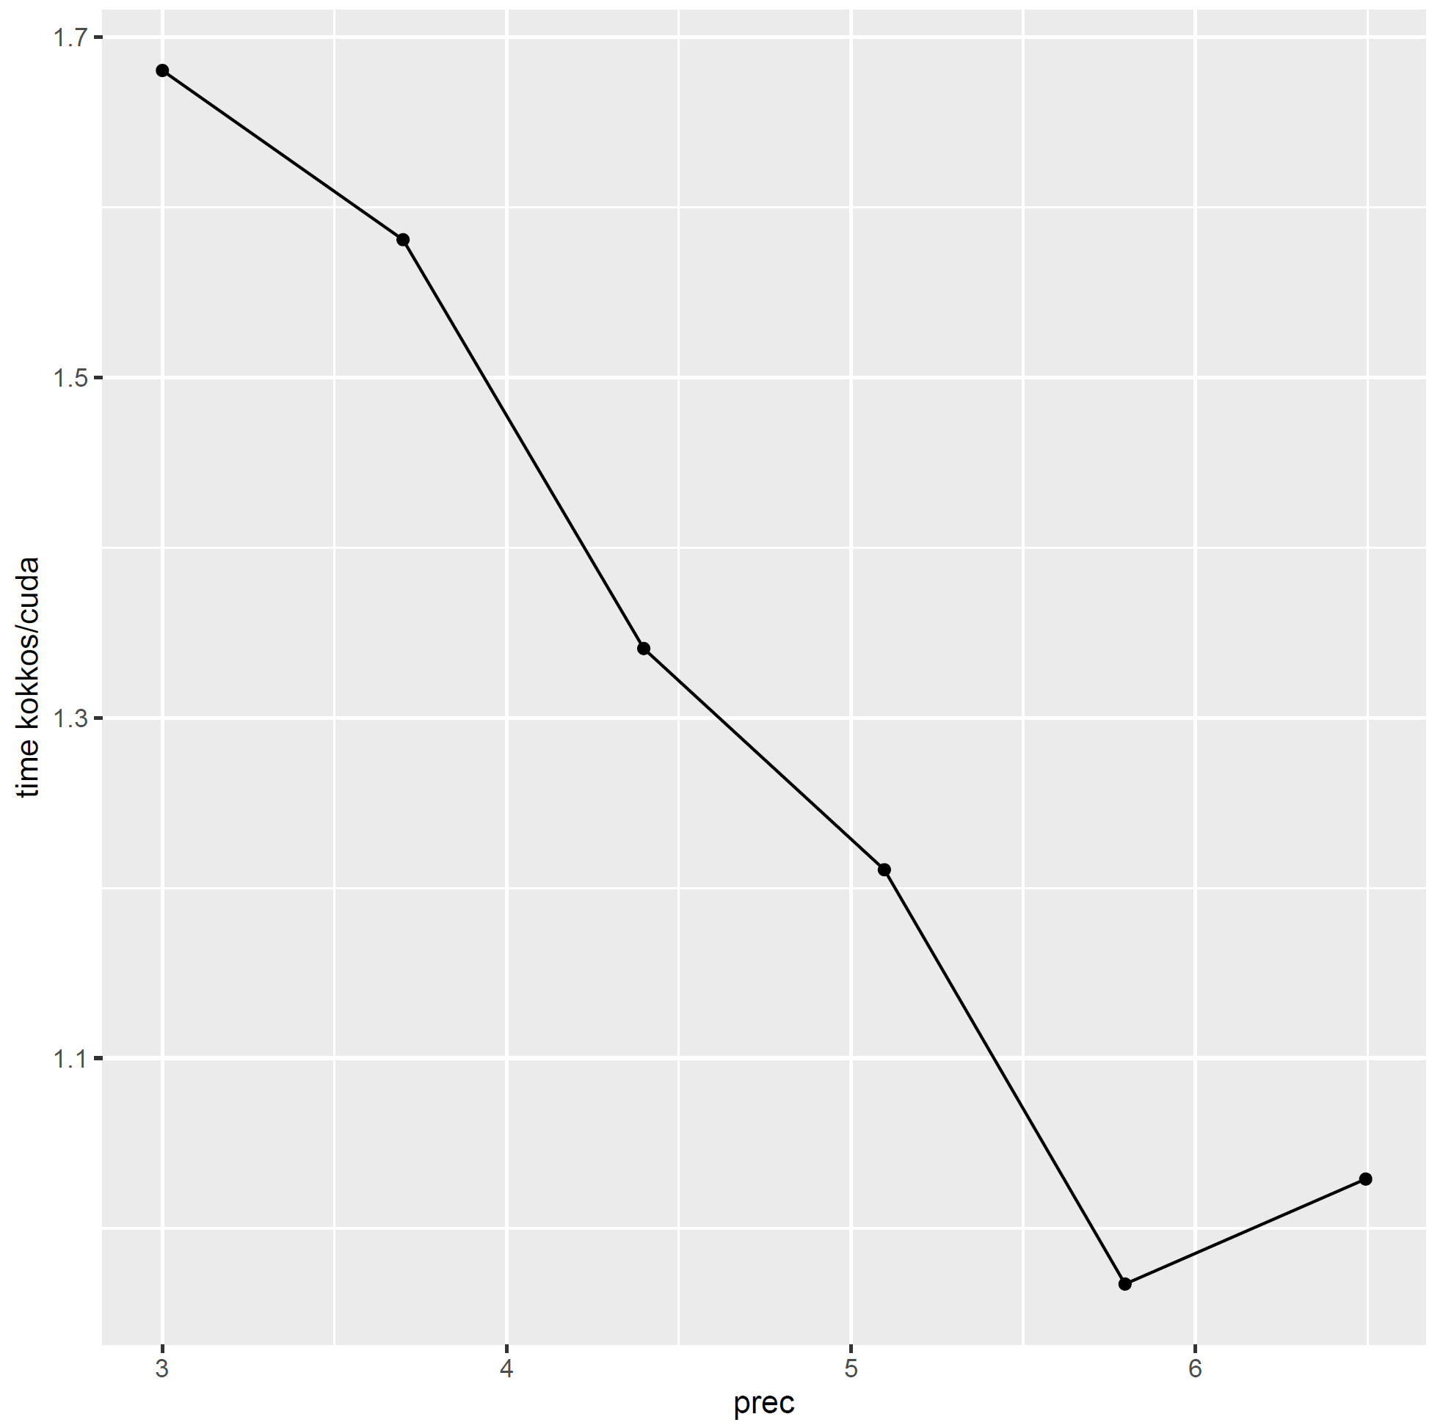
Mcubes in kokkos
Can maintain identical hierarchical parallelism as CUDA
No major overhead
Greater consistency in computationally intense parallel code
Slightly different number of registers
Slightly different cache configurations
~15% overhead in kernel code
Sequential code can vary
Notes:
- Kokkos took a few more iterations on average for the last point

Slide 21
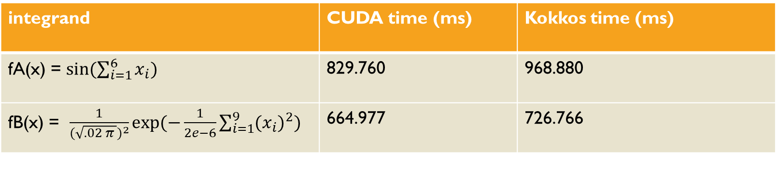
Mcubes (Kokkos)
integrand | CUDA time (ms) | Kokkos time (ms)
fA(x) = $sin⁡(\sum_{i=1}^{6}{x_{i}})$ | 829.760 | 968.880
fB(x) = $\frac{1}{{(\sqrt{.02 π })}^{2}}exp⁡(−\frac{1}{2e−6}\sum_{i=1}^{9}{{{(x}_{i})}^{2}})$ | 664.977 | 726.766

Slide 22
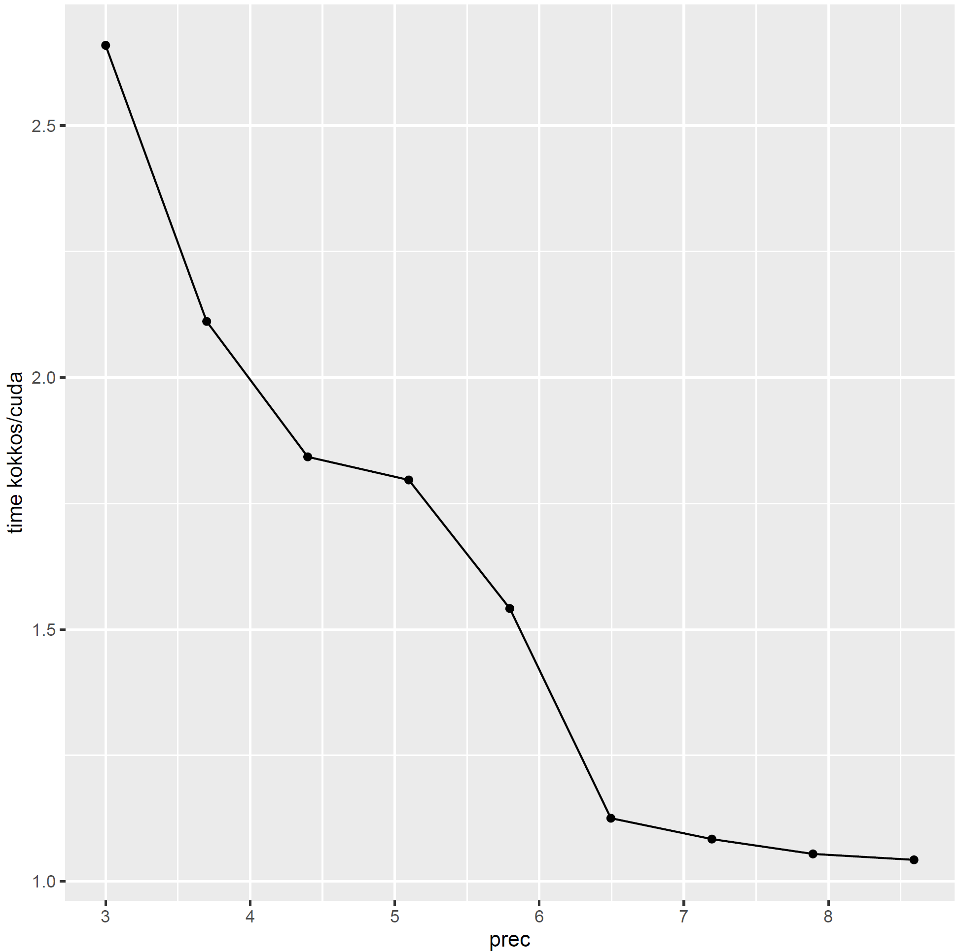
Kokkos overhead in pagani

Slide 23
Accuracy
Integrals known a priori
Mathematica provided true integral
Investigate results with various relative errors tolerances
Evaluated the achieved relative error

Slide 24
Integrand Test Suite
Integrands represent challenging integrand families
Product and corner peaks, oscillatory, Gaussian, etc.
Typically, randomized parameters
Fixed parameters
Notes:
Introduced in paper [X}
Box integrals are the expectation of distance from a fixed point q of a point r chosen at random over the unit- hyper-cube

Slide 25
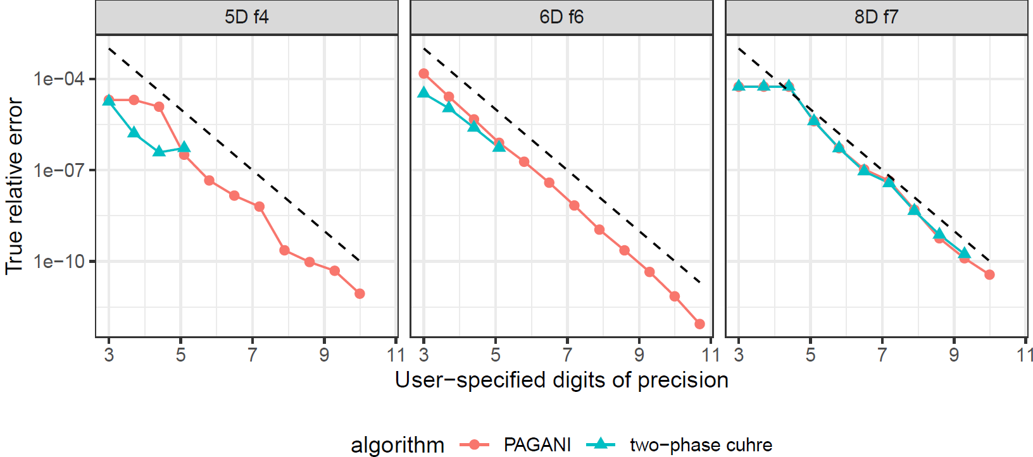
Pagani Accuracy
Evaluate error-estimate
Claimed vs true relative-error
Proximity to line indicates sub-division efficiency

Slide 26
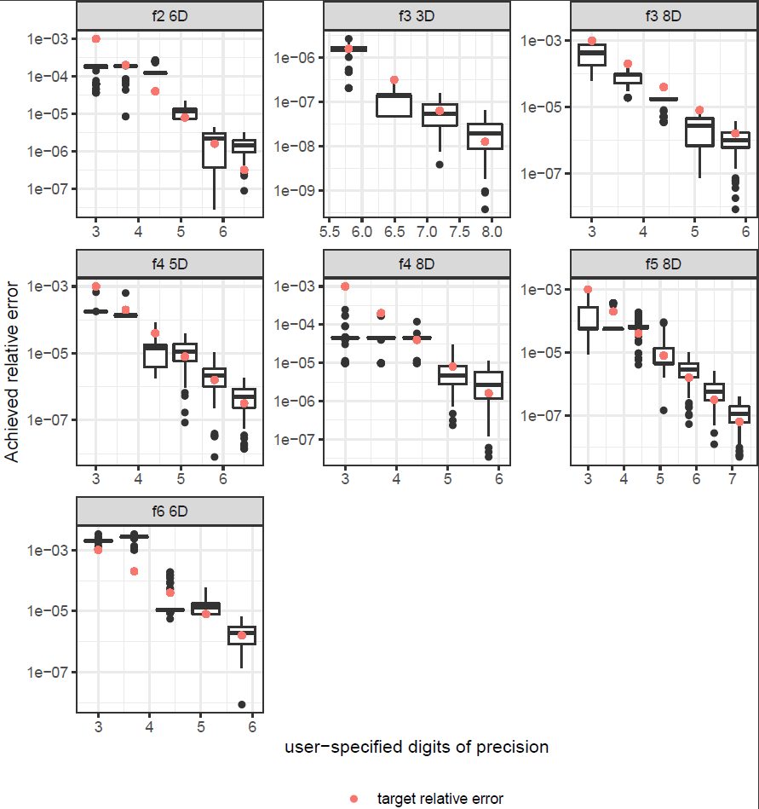
Mcubes Accuracy
Error-estimate: standard deviation of integral estimate
More samples and iterations required for more digits of precision
Expected deviation in results
Achieved relative error is consistent with user’s target relative error
100 runs per experiment

Slide 27
Accuracy
Convergence status
Integral and error estimates per iteration
PAGANI verbose mode
Generated sub-region bounds
Generated sub-region integral and error estimates
m-Cubes verbose mode
Function evaluations and generated numbers per sample
Importance sampling bin bounds per iteration

Slide 28
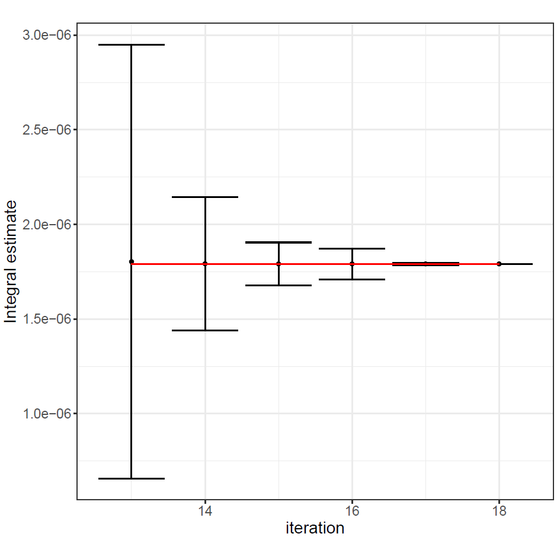
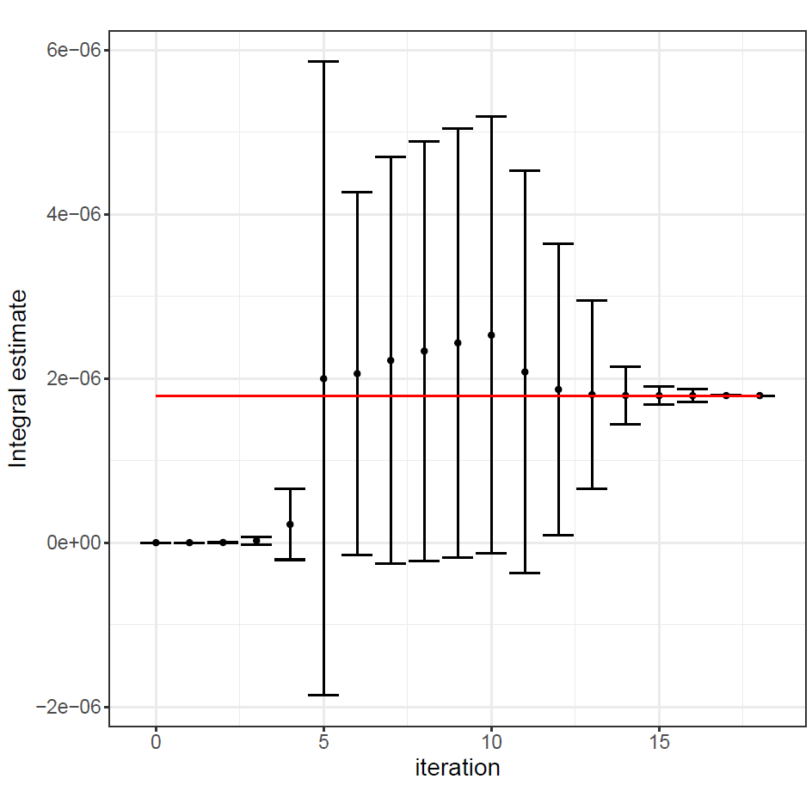
Per-iteration evaluation
Estimates as measurement
Consistency across iterations
Overlapping error-bars
3-digits of precision
Red line = true value

Slide 29
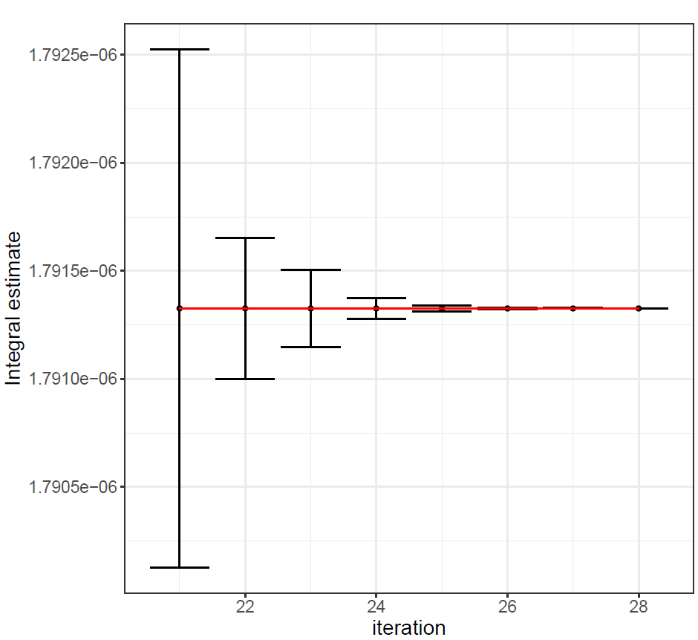
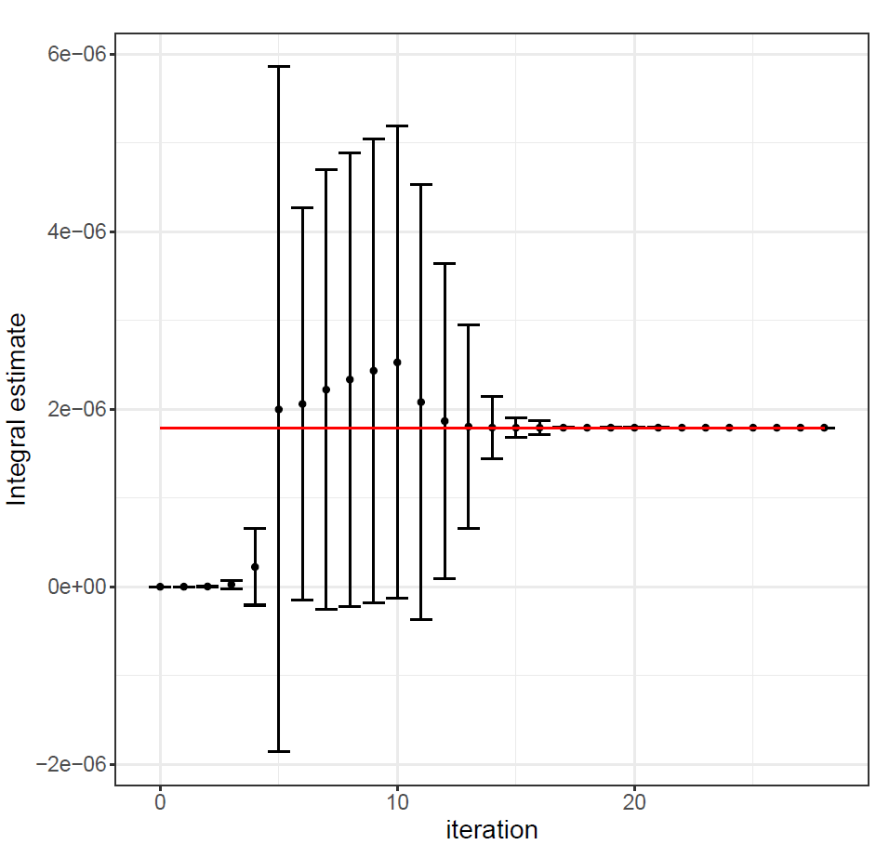
Per-iteration evaluation
Estimates as measurement
Consistency across iterations
Overlapping error-bars
6-digits of precision
Red line = true value
More iterations

Slide 30
A closer look to the algorithms
High level quadrature
Parallelization schemes for parallel quadrature
What other methods did differently

Slide 31
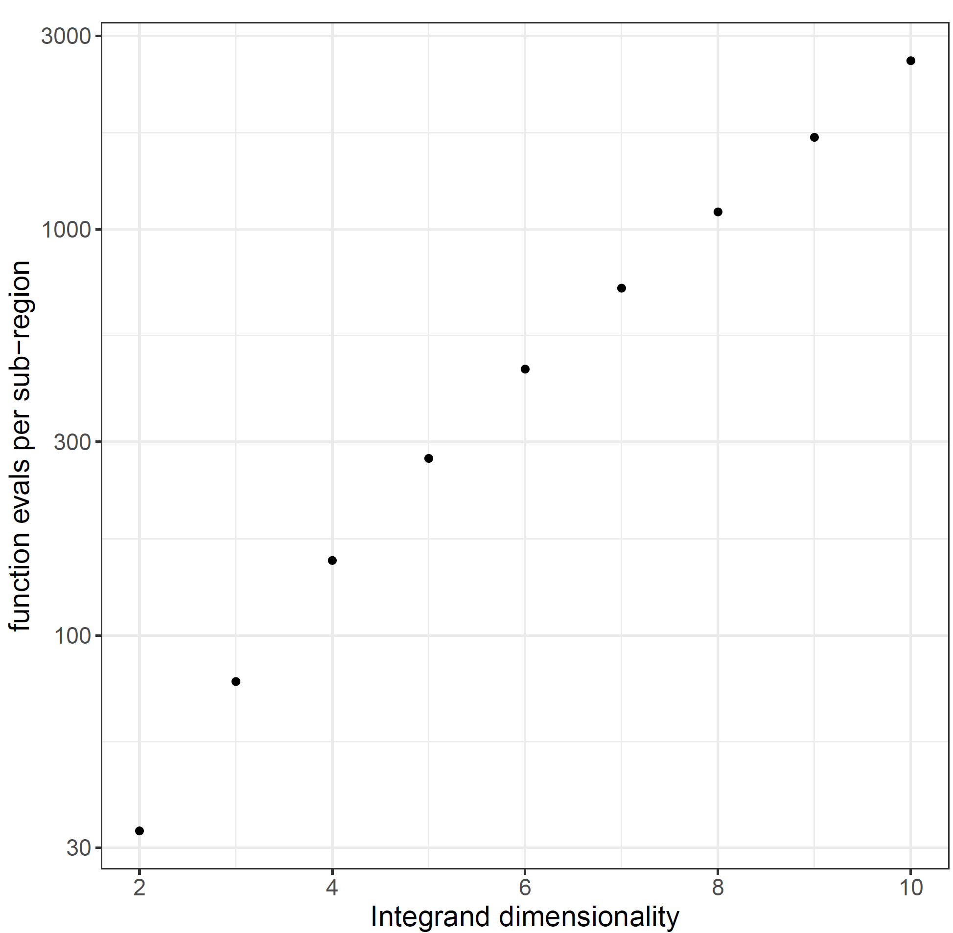
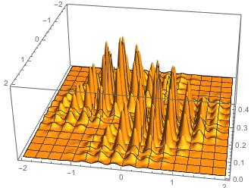
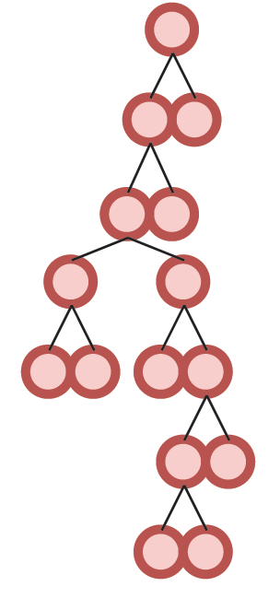
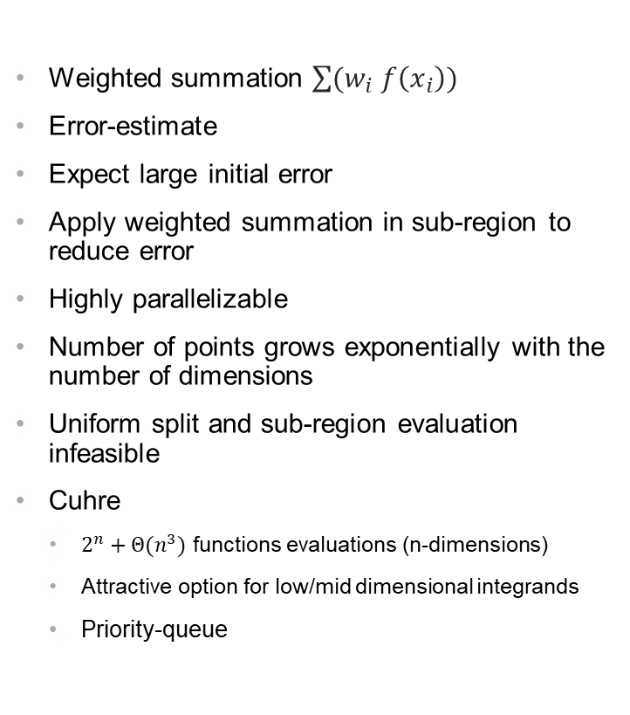
BACKGROUND: Quadrature
Weighted summation $\sum{(w_{i} f\left(x_{i}\right))}$
Error-estimate
Expect large initial error
Apply weighted summation in sub-region to reduce error
Highly parallelizable
Number of points grows exponentially with the number of dimensions
Uniform split and sub-region evaluation infeasible
Cuhre
$2^{n}+Θ(n^{3})$ functions evaluations (n-dimensions)
Attractive option for low/mid dimensional integrands
Priority-queue
https://mathematica.stackexchange.com/questions/222184/whats-the-most-difficult-multidimensional-integral-that-mathematica-has-solved
Notes:
Assume total lack of knowledge regarding integrand’s behavior
Integration rule is a weighted sum at some pre-specified points, different rules have different points, weights, degree
Degree is n: if formula’s error is zero for all polynomials up to degree n, but is not zero for some polynomial of degree n+1
Cuhre’s rules are fully symmetric: all permutations of points are found in point-set with the same weight
Main rule: polynomial degree 2m+1, null rules have polynomial degree (2m-1, 2m-1, 2m-3, 2m-5)
Integration rule of degree 9

Slide 32
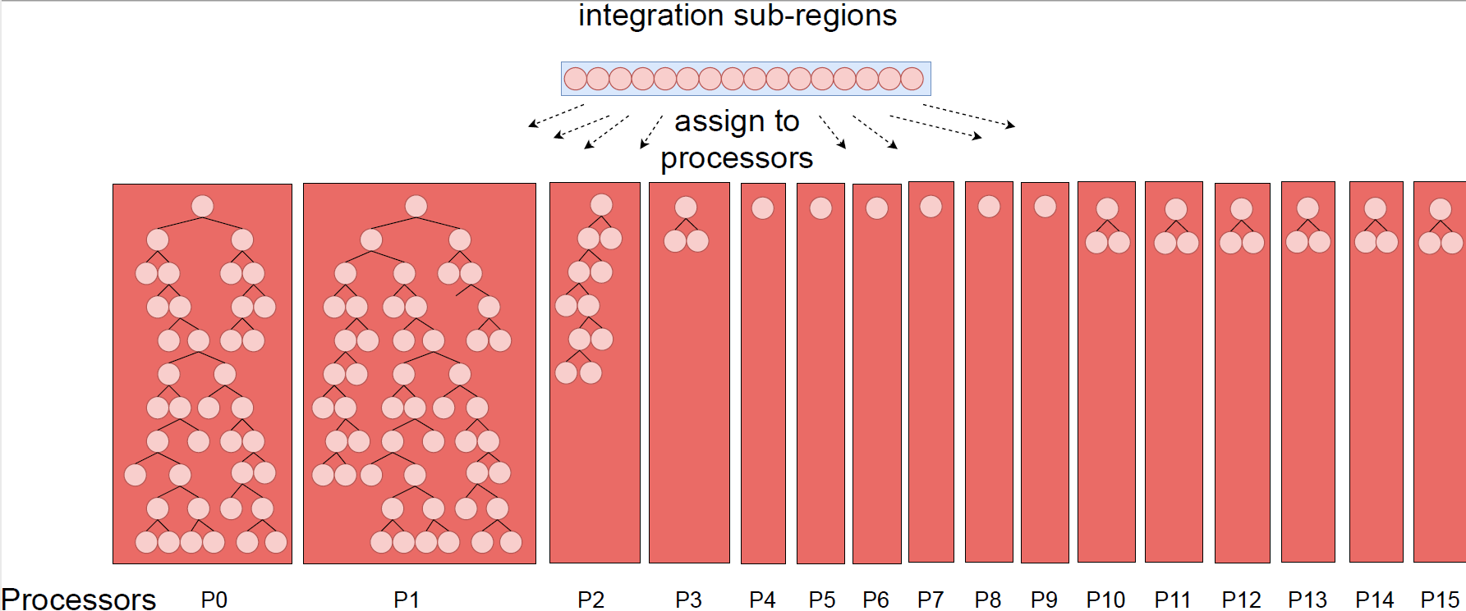
NAÏVE Parallelization
Notes:
- Sub-region evaluations are independent amongst each other so we can easily parallelize them
- Assign workload (specific sub-regions) to independent processors
- Can’t assume knowledge of the integrand’s behavior or distribution
- Can’t predict how each sub-region’s computational complexity compares against other regions
- Redistribution is costly and requires synchronization
- Communication requires synchronization
- Equal resource distribution

Slide 33
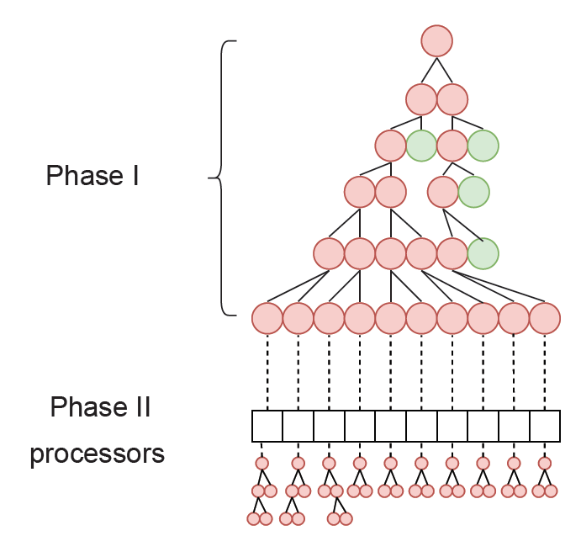
BACKGROUND: Two-phase Cuhre
GPU-targeted algorithm
Assign each sub-region to a processor
Applies the Cuhre algorithm on each sub-region in parallel
Utilizes pre-processing Phase 1
Generate sufficiently large workload (# of sub-regions)
Load-balancing
No synchronization between processors
Local termination
Notes:
- Core computations same as cuhre

Slide 34
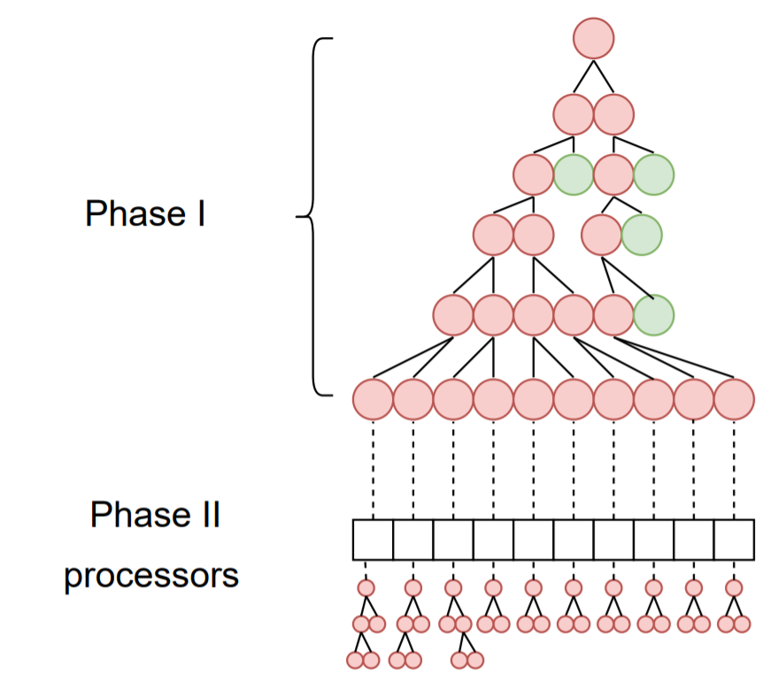
Two-Phase Cuhre
Utilization of sequential algorithm by parallel processors
Poor load-balancing when high-precision
Local data-structures
Unknown global state (unless global sync.)
Local termination
Notes:
- Local data-structures maintained by the processors, limits resources, how to not over-assign space, want to avoid dynamic allocation

Slide 35
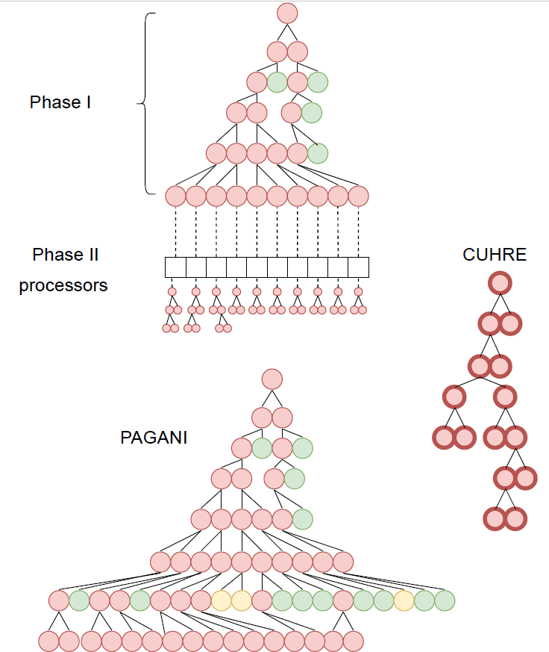
PAGANI
Parallel algorithm designed for massively parallel architectures
Avoid sequential scheme
Sub-divide all sub-regions
Filtering instead of sorting
Green/yellow = accurate enough
Avoid synchronization after isolated processing
Uniform workload
Bound by memory
Notes:
- Breadth-first expansion of sub-region “tree”
- Exposes greater parallelization

Slide 36
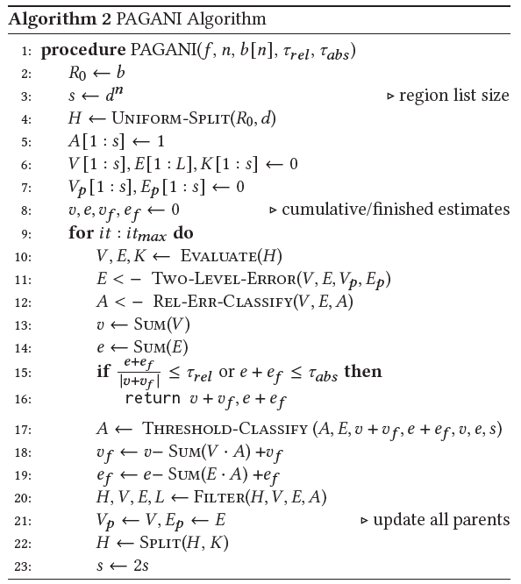
Algorithm Description
Initial uniform-split
Parallel sub-region evaluation
Two-level error-estimate
Relative error classification
Finished/active
Summations
Termination conditions
Conditional threshold classification
Filtering
Split all active regions
Notes:
3) number of splits d is dimension-based : for <=4 dims, four splits per dimension, for ndim >=5 && <=7, two splits per dimension, else 1 split per dimension
4) no persistence in region-processor mapping
6) Relative/absolute error dictates global termination
7) Counter-act extreme memory demands

Slide 37
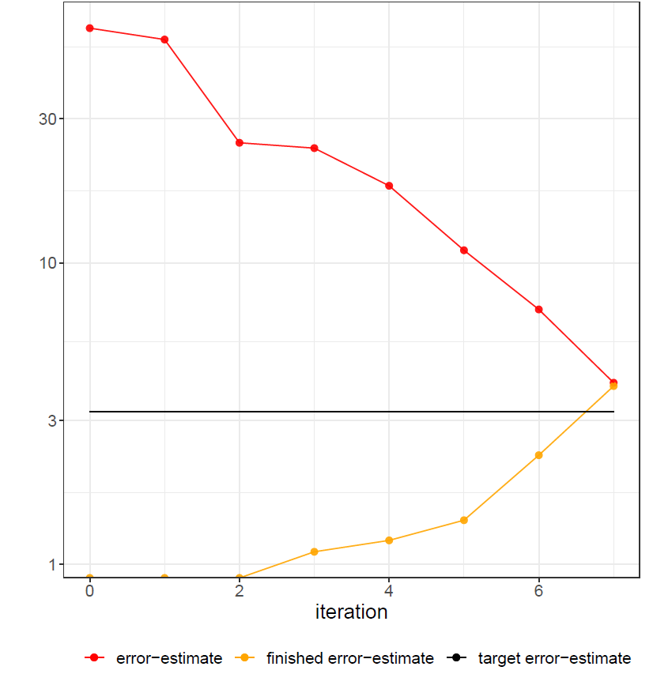
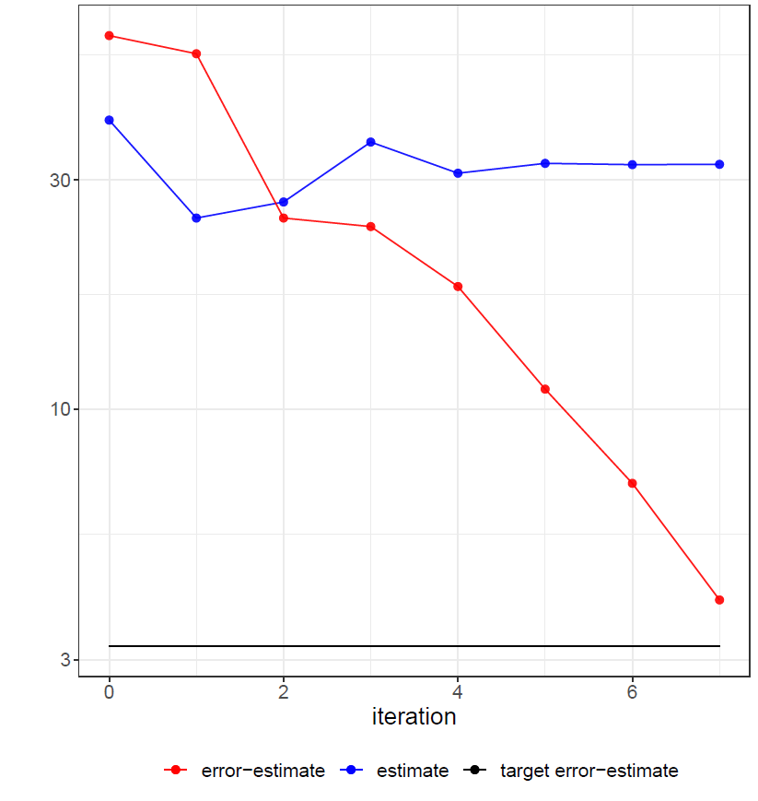
Sub-region Classification
Why classify finished/active?
Only keep active regions in memory
Use relative error for global termination and finished/active classification
Regions with small estimates may not satisfy relative error termination
Remove regions that don’t contribute “significantly”
Aggressive filtering
How to define “significantly”?
Finished regions irrecoverable for performance
Balance finished and active estimates
Pick a threshold (initially the average) and adapt until criteria are met
Criteria: conserved memory, finished vs. active ratio
Perform if memory exhaustion or convergence of significant digits
Notes:
For all finished regions, we have a sum of their integral and error estimates
Adaptiveness: classification
4) Relative error filtering is not sufficient, too many regions with “tiny” integral estimates, insignificant in grand scheme but their error-estimate is often not small enough for relative error filtering to catch them

Slide 38
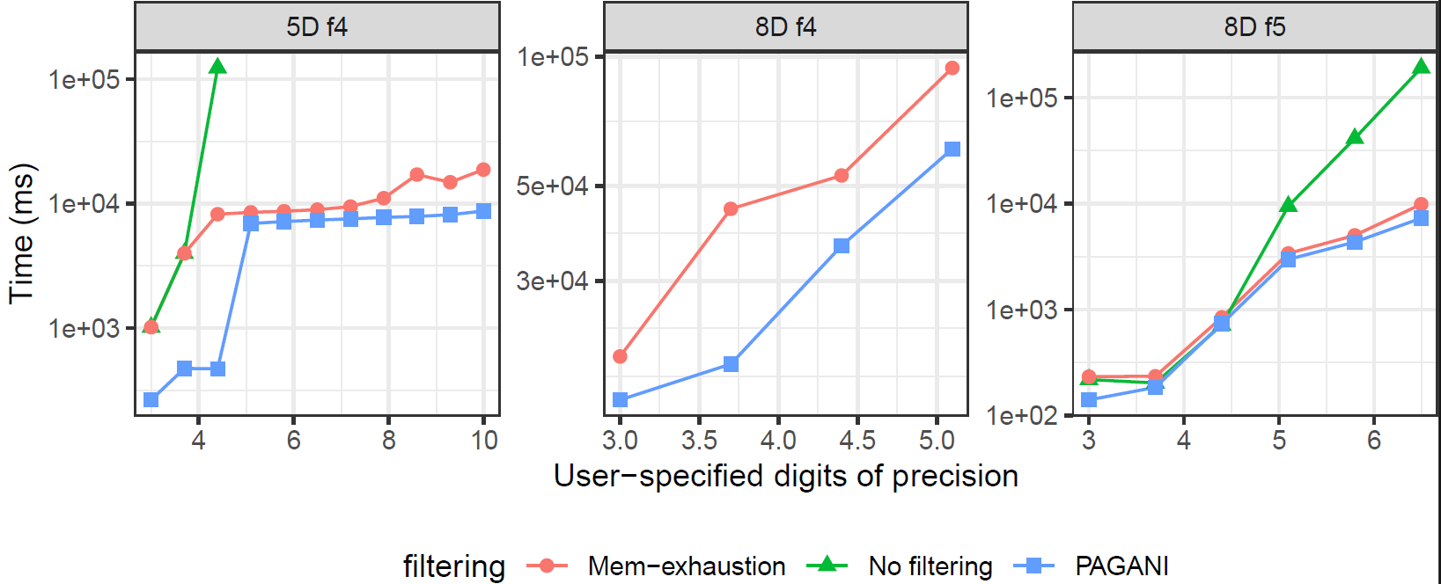
Performance: Heuristic Search Filtering

Slide 39
Pagani Characteristics
All operations utilize parallelization
Function-evaluations within sub-region
Sub-region evaluations
No use of sequential algorithm
No persistence in region-processor mapping
Global data-structure
Global state through reduction
Implicit synchronization
Limited by memory

Slide 40
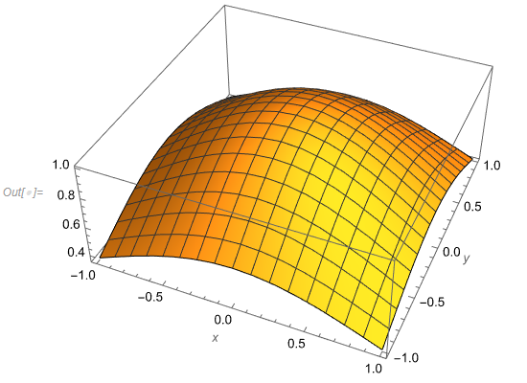
mcubes
Parallel Vegas
Importance sampling
Uses bins on each dimensional axis to draw sample
Adjust bin bounds based on sample point contribution
High contribution leads to smaller bins
Identical update contribution in each dimensional axis
Stratified sampling
Samples separate parts of integration space
Helps issues with high contributions along dimensional axis diagonals

Slide 41
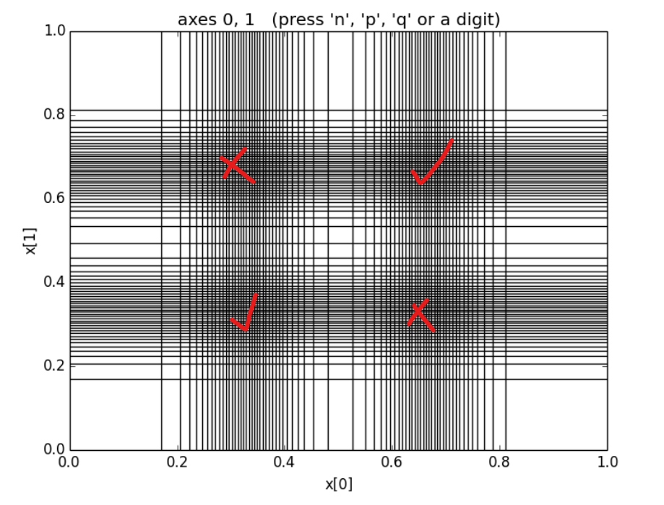
mcubes
4D integrand
Peaks are at x [.33, .33, .33, .33], y = [.67, .67, .67, .67]
Bins concentrate on all peaks
Additional phantom peaks lead to wasted sampling
https://vegas.readthedocs.io/en/latest/background.html#adaptive-stratified-sampling

Slide 42
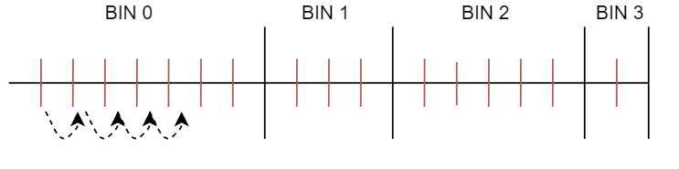
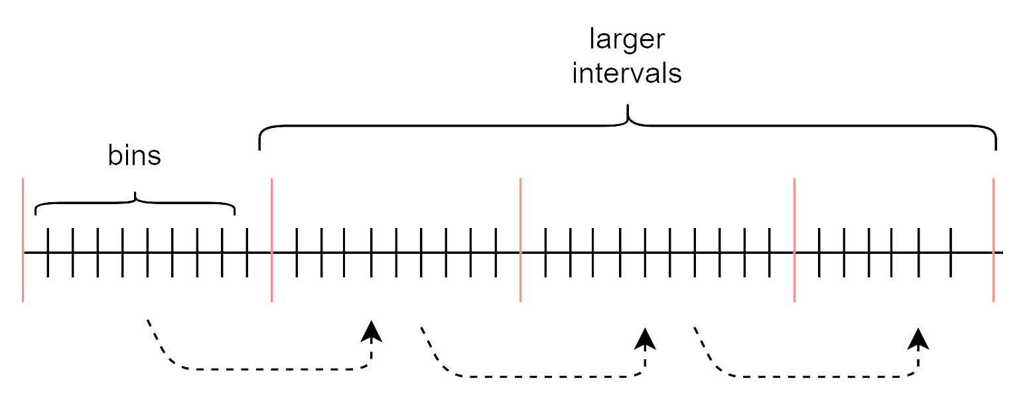
Importance sampling

Slide 43
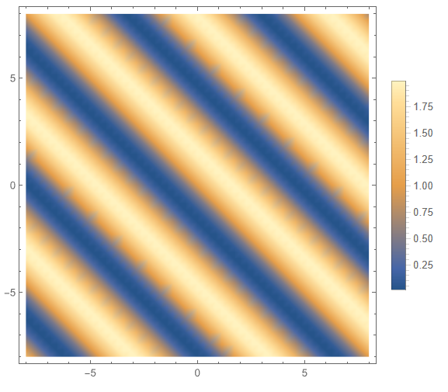
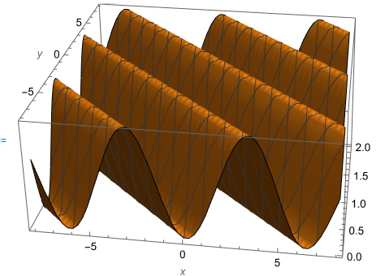
Monte Carlo – importance sampling
mCubes uses constant memory
Limited by maximum samples and iterations
Step-wise function approximates distribution
Difficult to capture when no alignment with axis
Greater efficiency when contribution can be localized

Slide 44
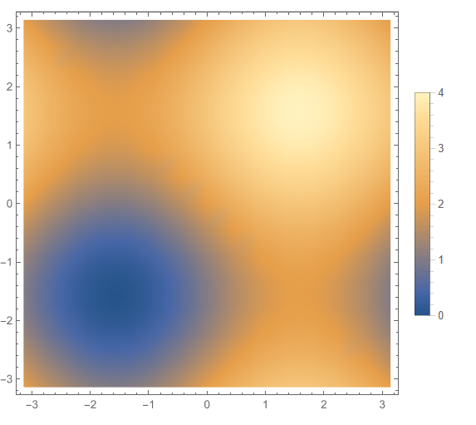
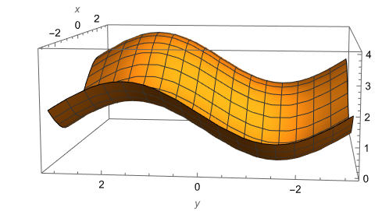
Monte Carlo – importance sampling
mCubes uses constant memory
Limited by maximum samples and iterations
Step-wise function approximates distribution
Difficult to capture when no alignment with axis
Greater efficiency when contribution can be localized

Slide 45
Mcubes-1D
Applicable for fully symmetrical functions
Maintains a single set of bins for all axis
Reduces the number of expensive atomic operations

Slide 46
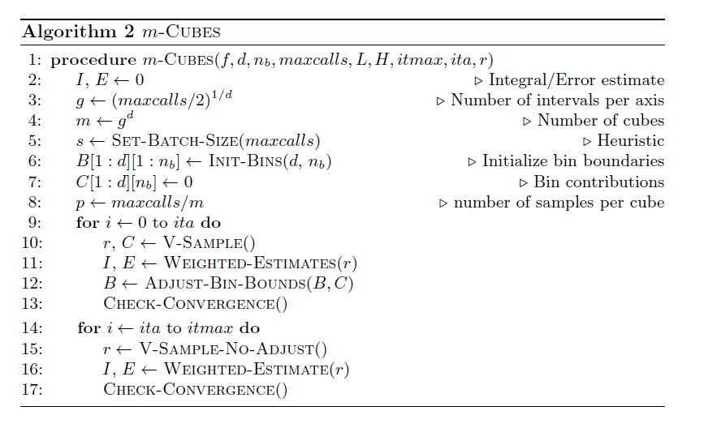
algorithm

Slide 47
DES USE-CASE
Thousands of stateful integrands
Lookup-tables set at run-time
State includes objects with Bilinear interpolation: 1D, 2D cases
Prior use of CUBA
Slow executions times, lack of convergence
More than 2 orders of magnitude speedup compared to single-threaded CPU
Multiple mpi-ranks, each with invoking an independent integration call

Slide 48
Conclusion
Two algorithms for multi-dimensional numerical integration
Most performant versions in CUDA for use with NVIDIA GPUs
Kokkos, Intel oneAPI
Designed for challenging intergrands
Easy to use header only libraries
Use requires no parallel programming expertise
Seamless to transition from VEGAS/CUHRE
Improved robustness and execution time
Reliable error-estimation

