Slide 1



Pagani & M-cubes: Parallel Adaptive GPU Algorithms for Numerical Integration
Ioannis Sakiotis (isaki001@odu.edu), Kamesh Arumugam, Marc Paterno, Desh Ranjan, Balsa Terzic, Mohammad Zubair

Slide 2
Introduction
Parameter estimation, simulation of beam dynamics, risk management, ray-tracing
Probabilistic, deterministic
Curse of dimensionality
Workload balancing
Specify desired accuracy: relative error tolerance
No algorithm guarantees on accuracy of results
Enable easy highly-performant MD-integration across all major platforms
https://github.com/marcpaterno/gpuintegration

Slide 3
outline
PAGANI
m-Cubes
Performance
Interface/ease of use
Execution platform portability

Slide 4

PAGANI

Slide 5
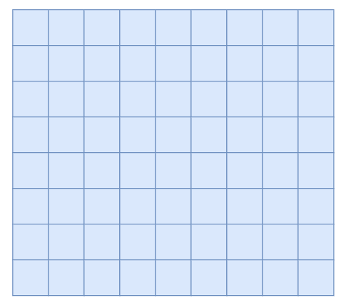

PAGANI
Deterministic: quadrature rules
Estimate: $\sum{(w_{i} f\left(x_{i}\right))}$
Evaluate: integral ± error
Evaluate: 5 weighted sums
Iterative
Improve estimates
Evaluated by a block of threads
y
x
Multiple blocks
work in parallel

Slide 6
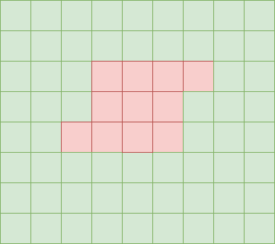
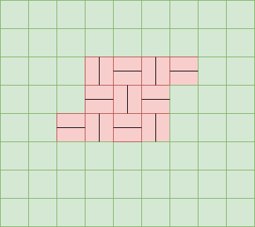
PAGANI
no more evaluation
Iteration 0
Iteration 1
y
inaccurate
y
accurate
x
x

Slide 7
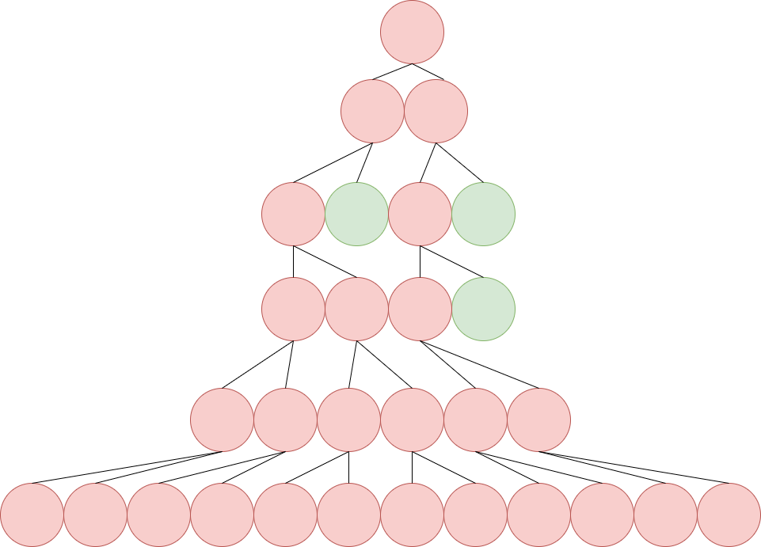
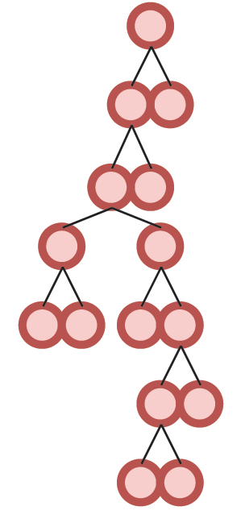
PAGANI
Based on the CUHRE integrator
Parallelization targeted algorithmic changes

Slide 8
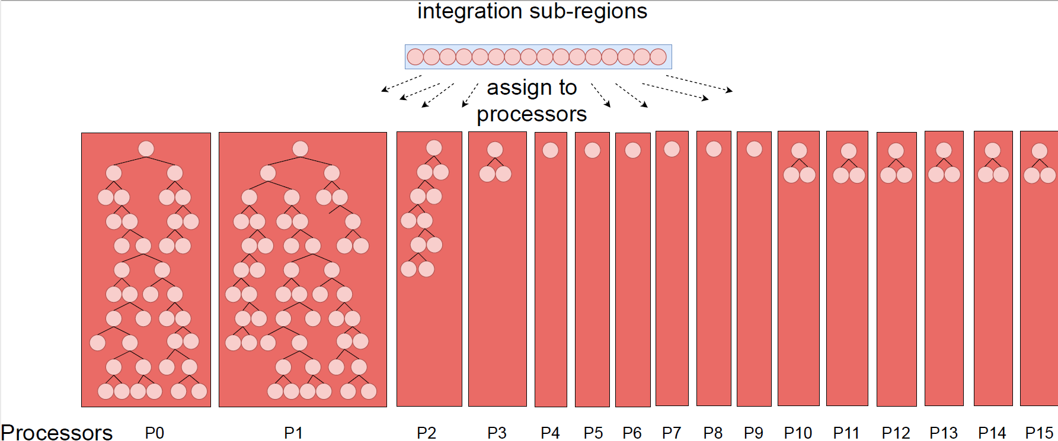
NAÏVE Parallelization

Slide 9
PAGANI
Designed for massively parallel architectures
Avoid sequential scheme
Sub-divide all sub-regions
Filtering instead of sorting
Green/yellow = accurate enough
Avoid synchronization after isolated processing
Uniform workload
Bound by memory

Slide 10
Sub-region Classification
Only keep active regions in memory
Use relative error for classification
Finished: relative error ≤ relative error tolerance
Regions with trivially small estimates can be active
Remove regions that don’t contribute “significantly”

Slide 11
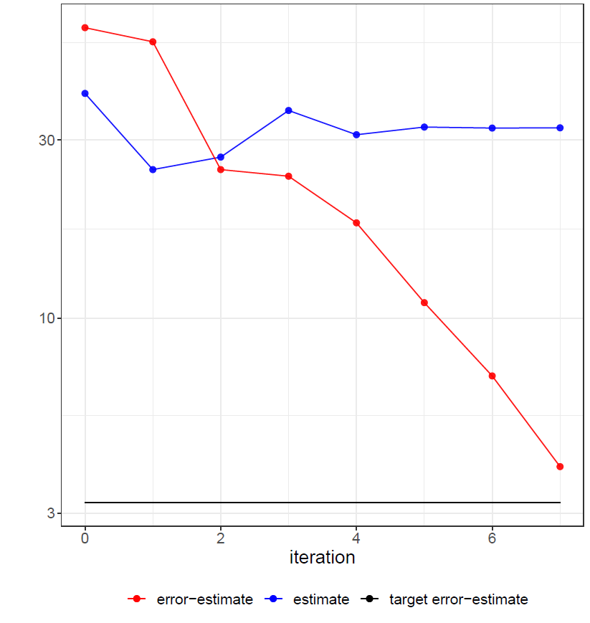
Aggressive filtering
Significantly small?
Finished regions irrecoverable
Balance finished and active estimates
Pick a threshold (initially the average)
Move threshold until criteria are met
Then move to next iteration
Criteria: conserved memory, finished vs. active ratio
Perform if memory exhaustion or convergence of significant digits

Slide 12
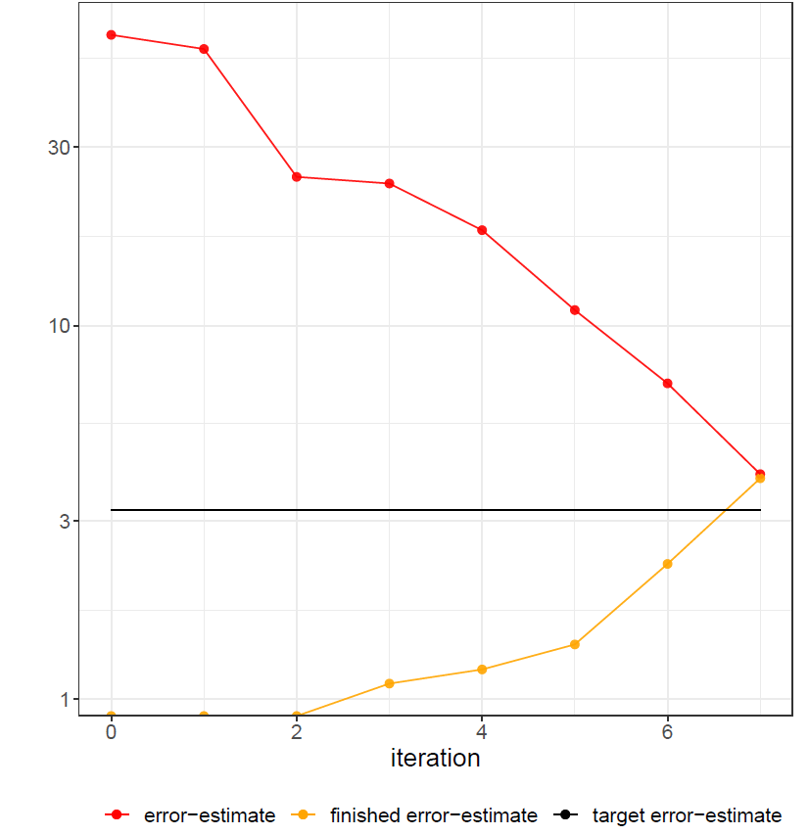
Aggressive filtering
Significantly small?
Finished regions irrecoverable
Balance finished and active estimates
Pick a threshold (initially the average)
Move threshold until criteria are met
Then move to next iteration
Criteria: conserved memory, finished vs. active ratio
Perform if memory exhaustion or convergence of significant digits

Slide 13
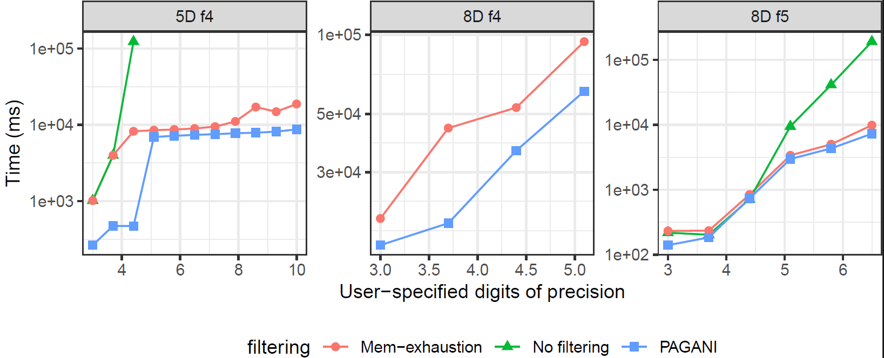
Performance: Heuristic Search Filtering

Slide 14
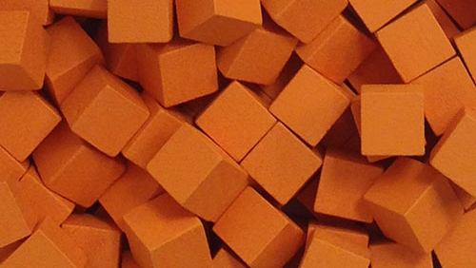
M-CUBES

Slide 15
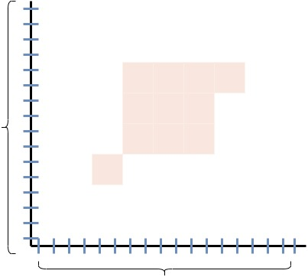
m-Cubes
Probabilistic: Monte Carlo integration
Evaluate the integrand at random points
Convergence rate independent of dimensionality
Based on VEGAS integrator
Error: standard deviation of MC estimate
Iterative
y
x

Slide 16
Importance sampling
Adaptive integration
Randomly select bin
Keep track of bin contributions
Change bin bounds at end of iteration
y
x

Slide 17
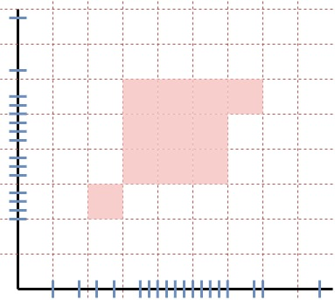
Importance sampling
Number of bins is constant
Bin contribution proportional to function evaluation
Single sample updates a bin from each axis
y
x

Slide 18
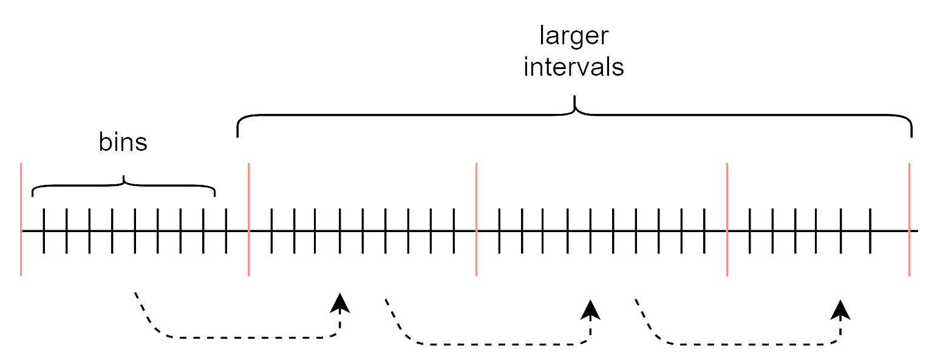
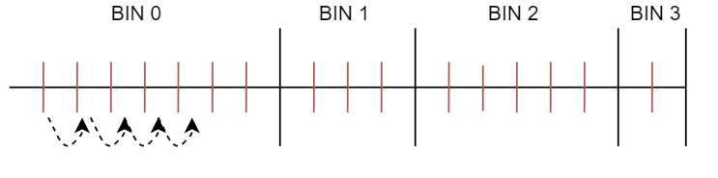
Stratified Sampling
Uniform sub-division of integration space
2-point MC on each cube
# of required samples dictate # of hyper-cubes
Bins remain constant

Slide 19
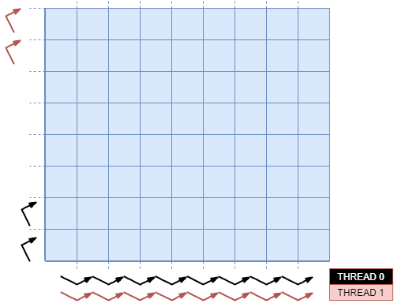
Parallelization approach
Threads mapped to a # of cubes
2 samples per cube
Threads are independent
Workload balanced

Slide 20
Parallelization
Workload Balance
Constant # of samples per cube
Constant # of cubes per thread
Accumulate estimates from cubes
All Threads serially accumulate from cubes
All threads: thread-block reduction
1 thread per block: Atomic-add
Accumulation of bin contributions
All threads: atomic-add

Slide 21
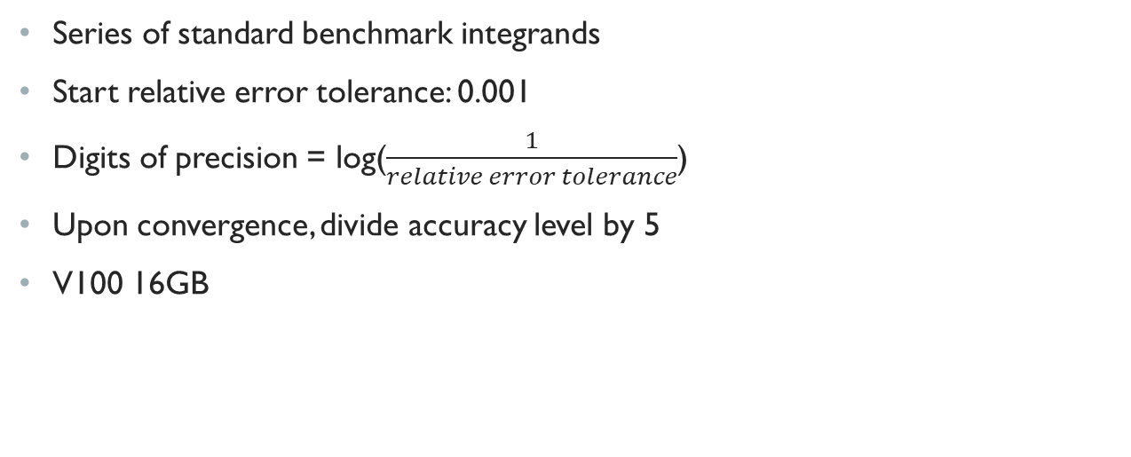
EXPERIMENTS
Series of standard benchmark integrands
Start relative error tolerance: 0.001
Digits of precision = log($\frac{1}{relative error tolerance}$)
Upon convergence, divide accuracy level by 5
V100 16GB

Slide 22
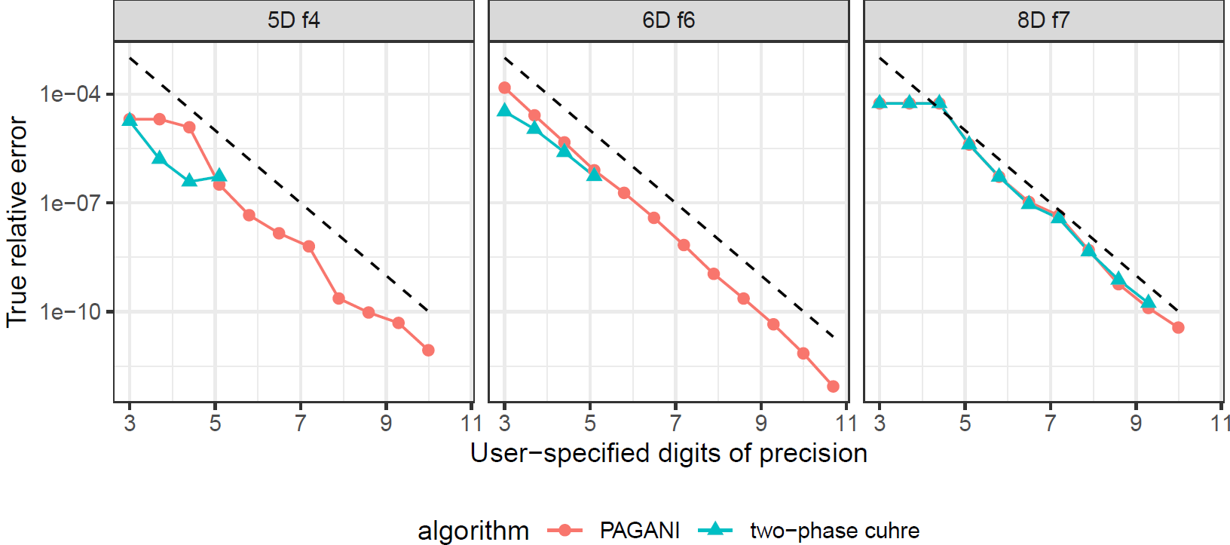
RELIABILITY
Evaluate error-estimate
Claimed vs true relative-error
Proximity to line indicates sub-division efficiency

Slide 23
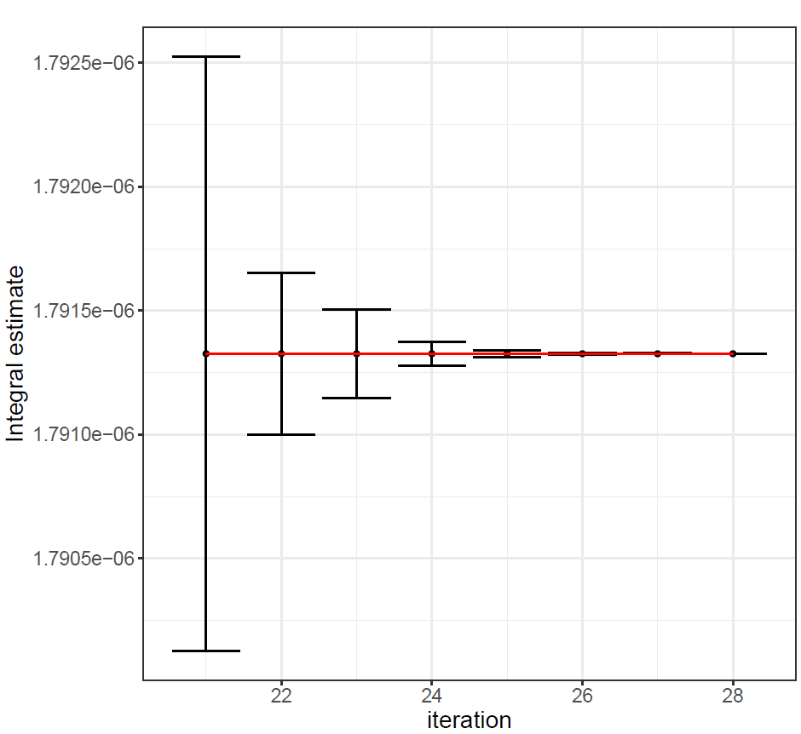
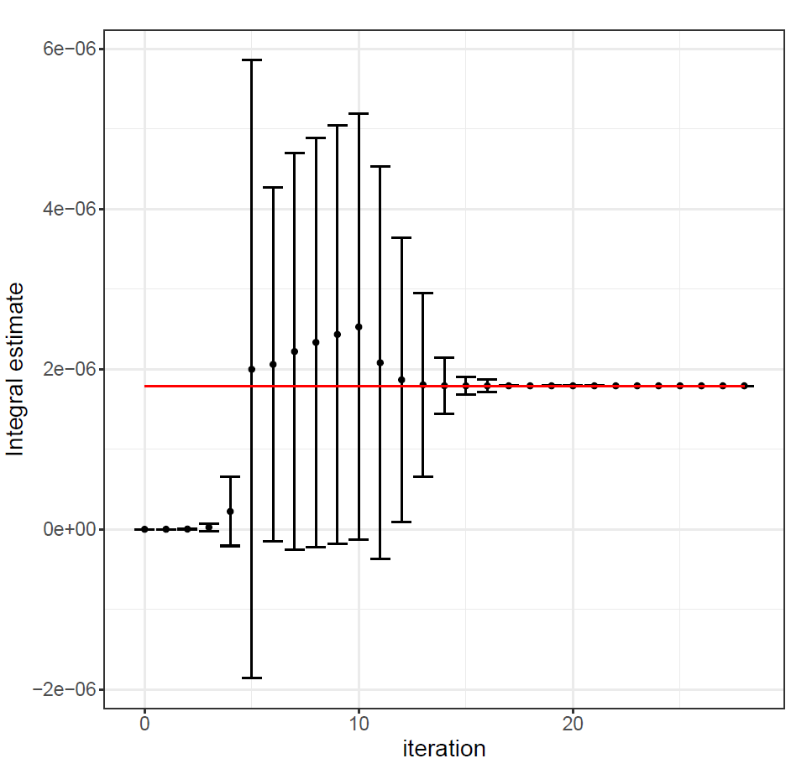
Per-iteration evaluation
Estimates as measurement
Consistency across iterations
Overlapping error-bars
6-digits of precision
Red line = true value
More iterations

Slide 24
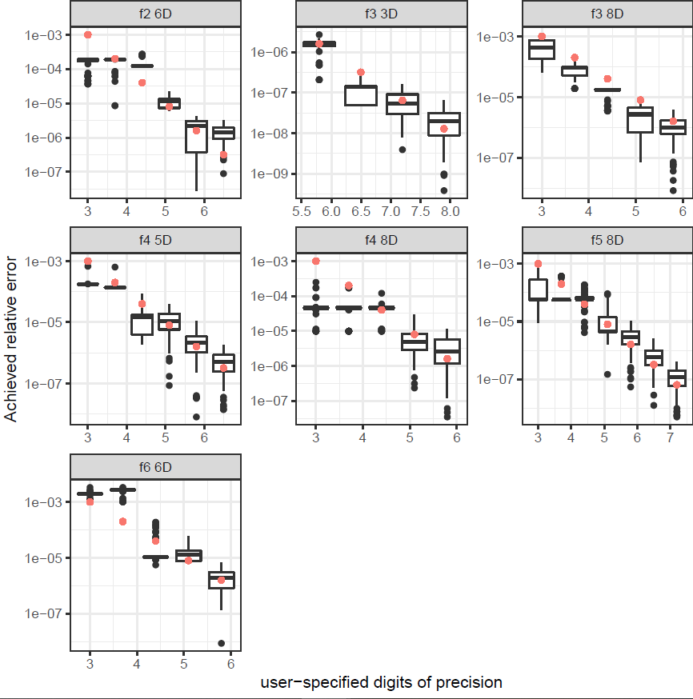
RELIABILITY

Slide 25
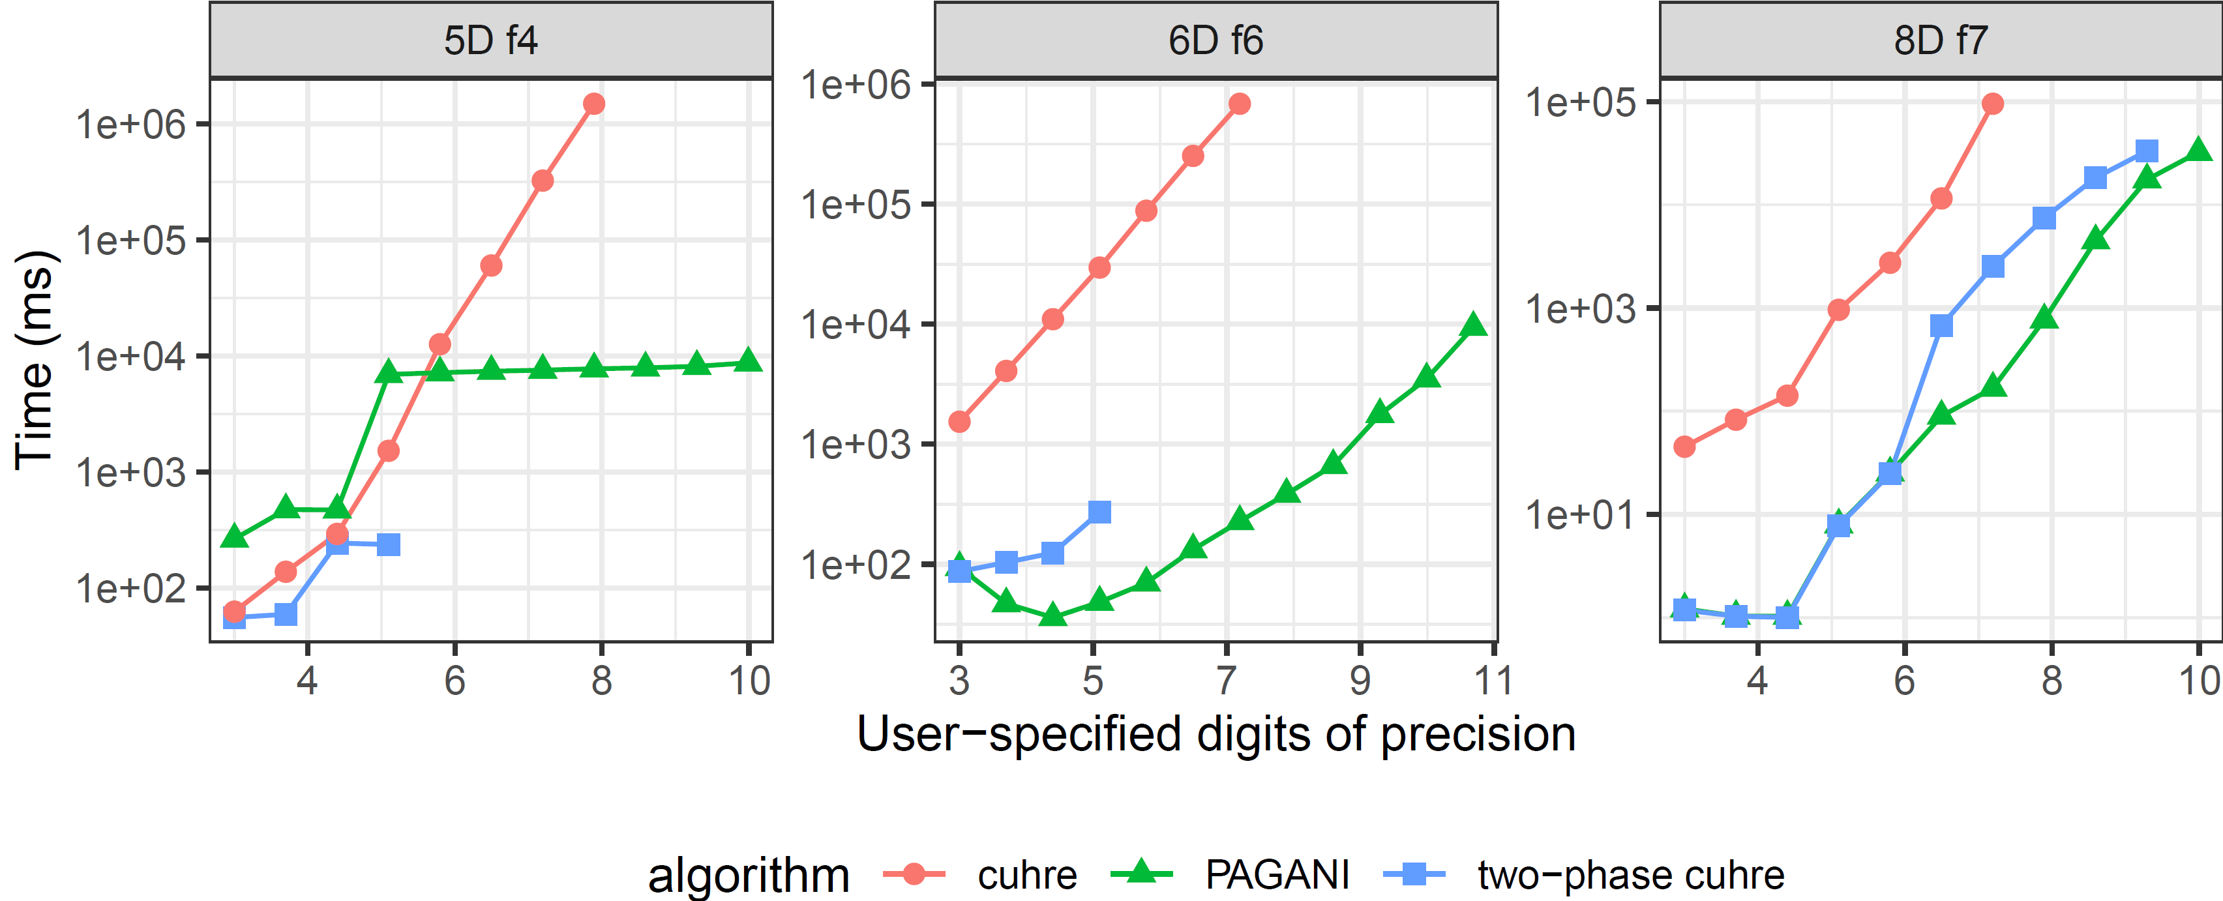
PAGANI
Generates more sub-regions
“Easy” integrals probably not appropriate
Outperform other serial and deterministic GPU integrators

Slide 26
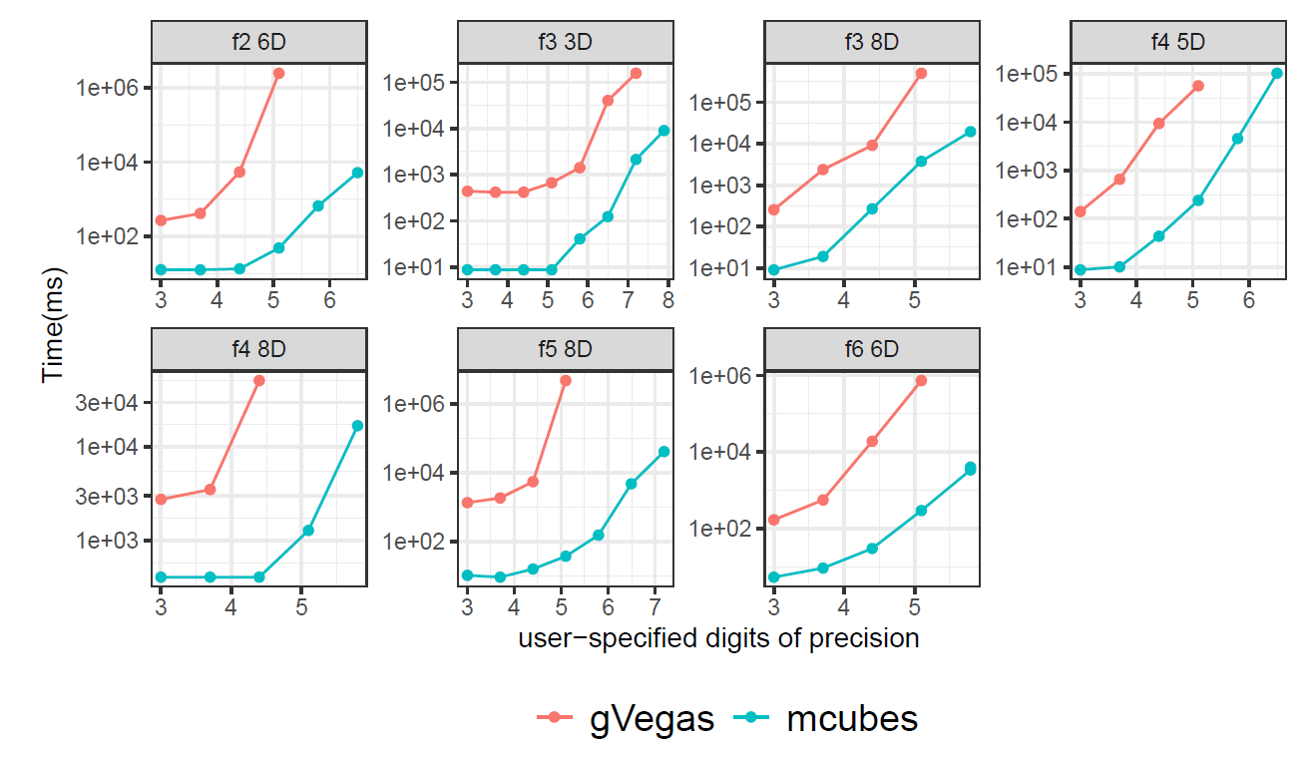
M-CUBES
Minimal data-movement to/from GPU
Accumulate estimates within GPU
500 bins per axis

Slide 27
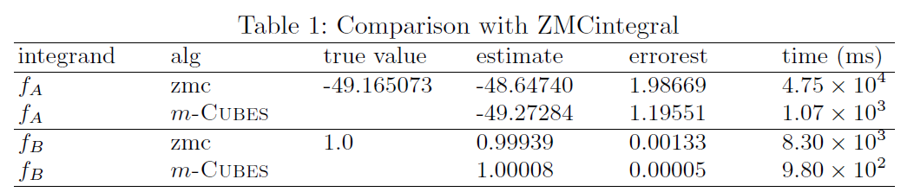
M-cubes

Slide 28
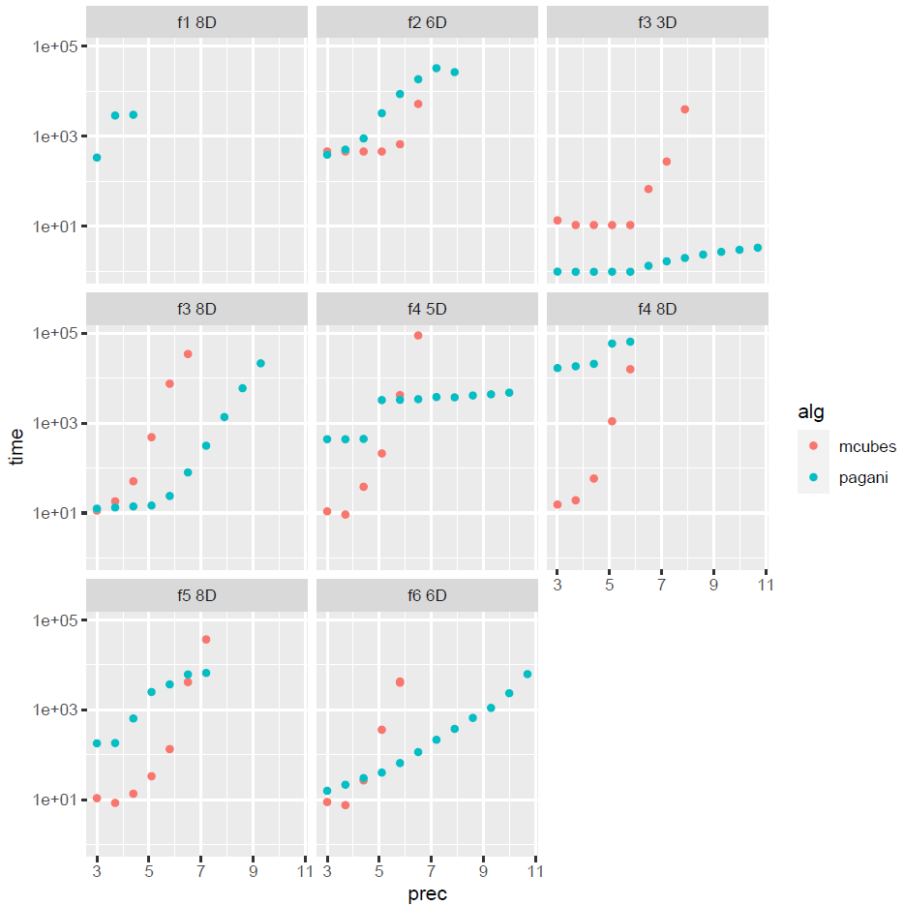
PAGANI vs M-CUBES
m-Cubes is simpler
m-Cubes not memory hungry
m-Cubes is great on separable integrands

Slide 29
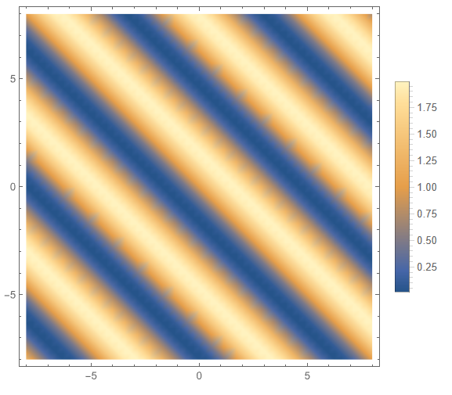
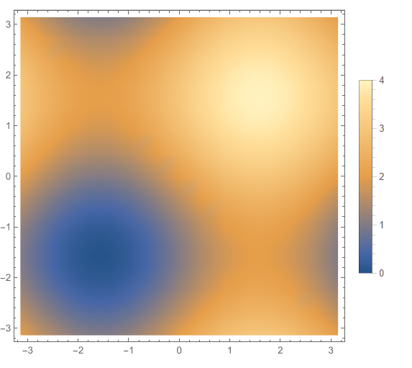
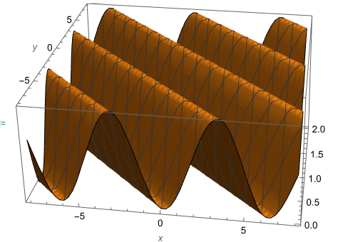
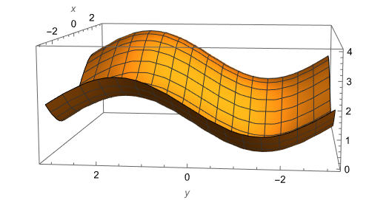
PAGANI vs M-CUBES

Slide 30
EASE of USE
struct Gaussian {
__device__ __host__
double
operator()(double x, double y, double z, double w)
{
const double beta = .5;
return exp(-1.0 *
(pow(25., 2.) * (pow(x - beta, 2) + pow(y - beta, 2) + pow(z - beta, 2) + pow(w - beta, 2) )));
}
};
Header only
Allow stateful integrand
Function arguments
Integrand
Relative/absolute error tolerances
Integration-space bounds

Slide 31
EASE of USE
CMake
Demos
Profile
double epsrel = 1.e-3;
double epsabs = 1.e-20;
workspace.integrate< integrand_type >(integrand, epsrel, epsabs, volume);

Slide 32
DARK ENERGY SURVEY
Millions of integrands
Complex and stateful integrands
State includes objects for interpolation: 1D, 2D cases
Experiment was infeasible with CUBA integrators
Multiple MPI-ranks, each with invoking an independent integration call
Speedup with PAGANI/m-Cubes: ~600

Slide 33
EXECUTION PLATFORMs
CUDA: Main kernel takes ~90% total time
Kokkos
oneAPI
10-15% overhead on parallel code

Slide 34
SUMMARY
Two algorithms for multi-dimensional numerical integration
Designed for challenging integrands
Most performant versions in CUDA for use with NVIDIA GPUs
Kokkos, Intel oneAPI
Use requires no parallel programming expertise
Seamless to transition from VEGAS/CUHRE

Slide 35
QUESTIONS

Slide 36
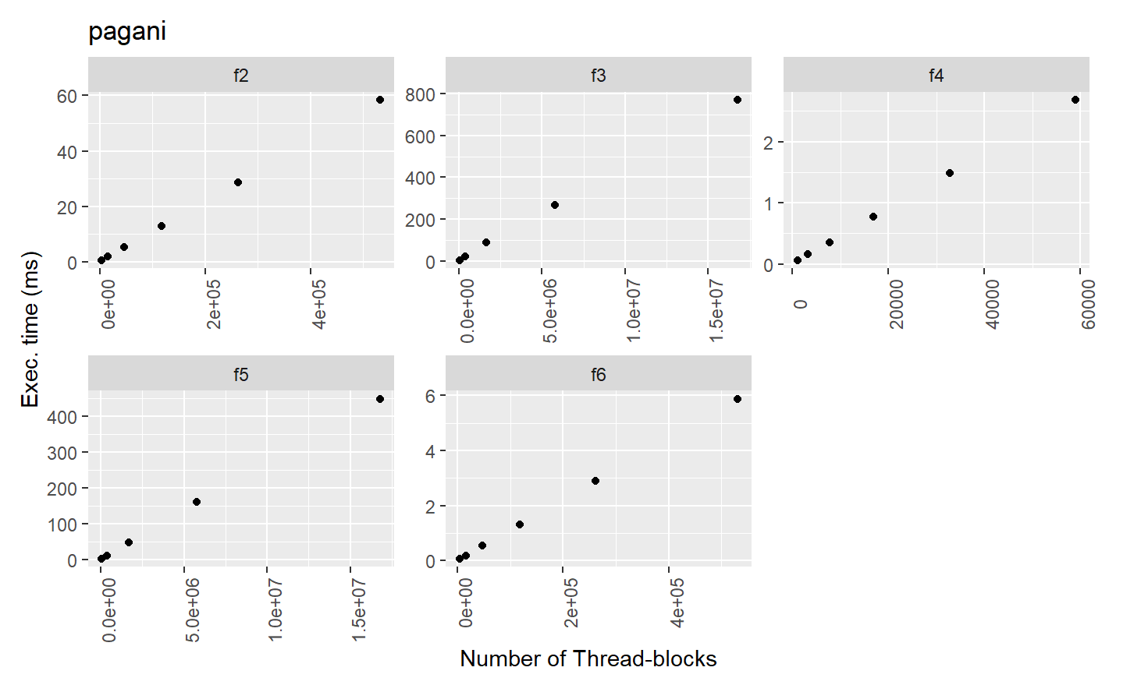

Slide 37
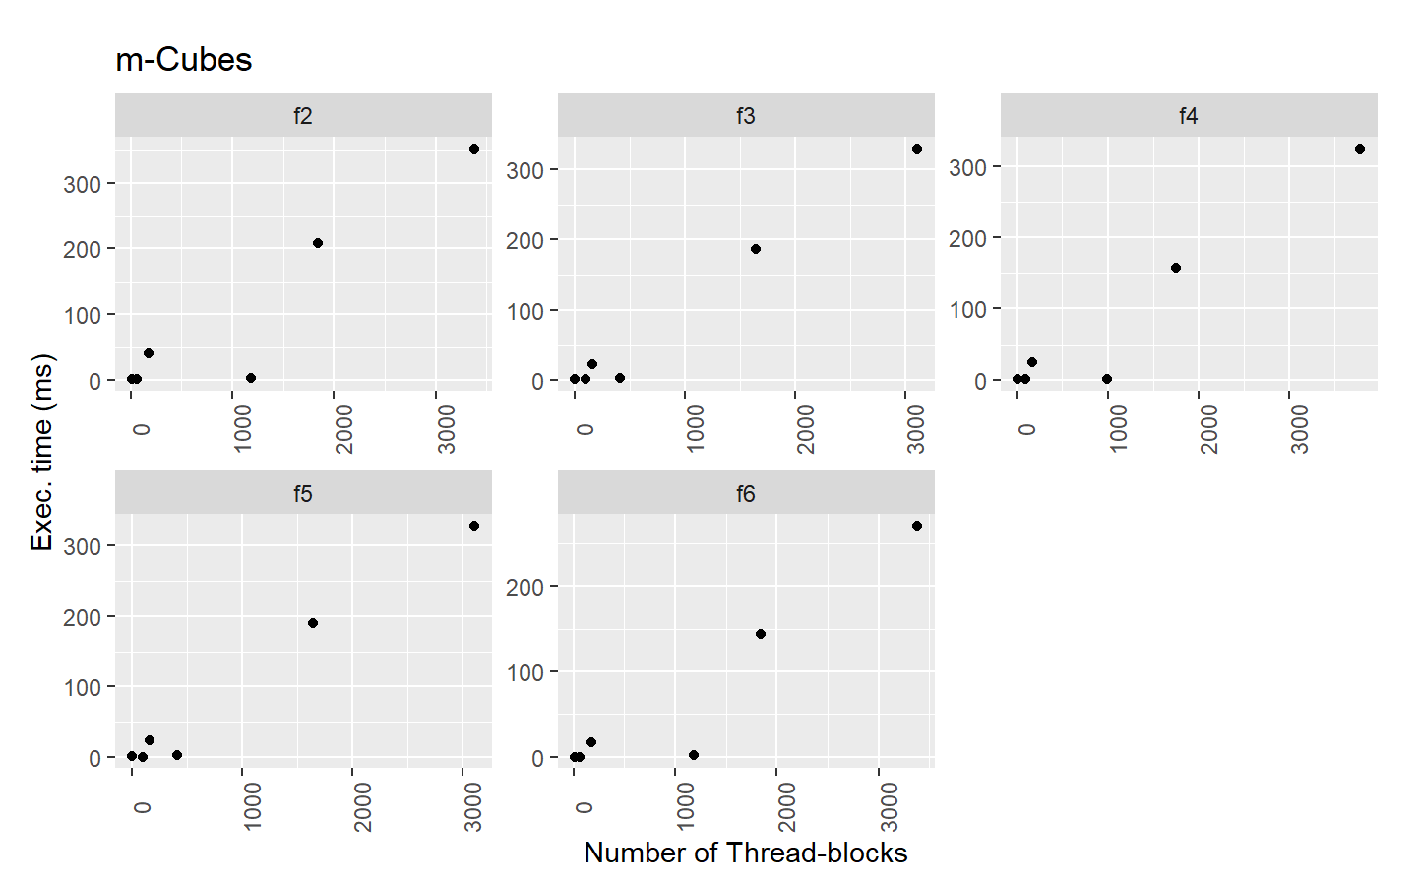

Slide 38
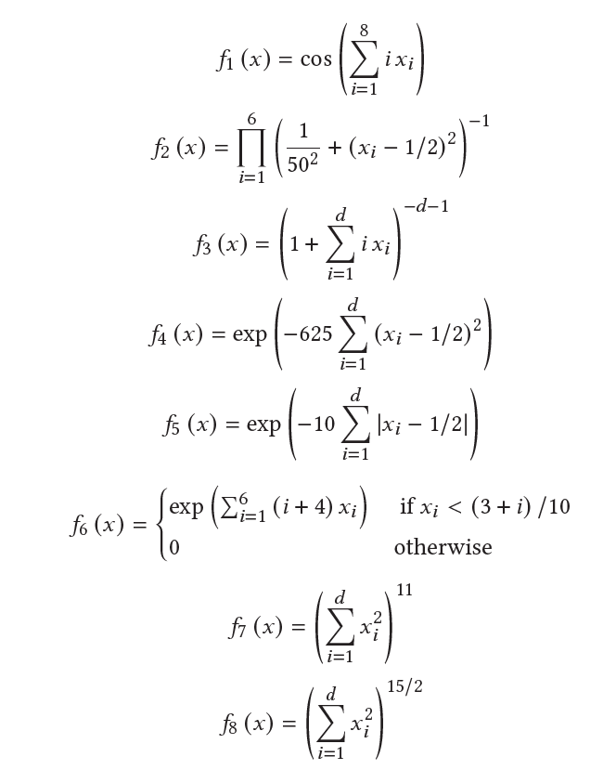
Notes:
F1 – nonseparable
- f6 is 30% with 2.1 TFlops (11ms vs 22ms)
- f5 is 60% with 4.2 TFlops ( 154 ms vs 523ms)
- f4 is 55% with 3.8 TFflops (835us vs 8 ms)
- f3 is 60% with 4.2 (154 ms vs 900 ms)
- f2 is 57% (11ms vs 173 ms)
-f6 1.4 TFlops
-f5 1.5 TFlops
-f4 1.01 TFlops
-f3 1.5 TFlops
-f2 1.4 TFlops
m-Cubes: depends on ncall heavily
for 2e9 ncall per iteration
f6 -
f5
f4 - 55%
f3 - 14%
f2 - 55%

Slide 39
Function evaluations
DIMENSIONALITY | # OF POINTS
2 | 33
3 | 77
4 | 153
5 | 273
6 | 453
7 | 717
8 | 1105
9 | 1687
10 | 2605

