Slide 1




PAGANI: A Parallel Adaptive GPU Algorithm for Numerical Integration
Authors: Ioannis Sakiotis, Kamesh Arumugam, Marc Paterno, Desh Ranjan, Balsa Terzic, Mohammad Zubair

Slide 2
Introduction
Applications: parameter estimation, simulation of beam dynamics, risk management, ray-tracing
Probabilistic, deterministic
No algorithm guarantees the accuracy of its estimated results
Evaluate accuracy
Specify desired accuracy (relative error tolerance, digits of precision, etc.)
Goal: Bring adaptive quadrature to GPUs

Slide 3
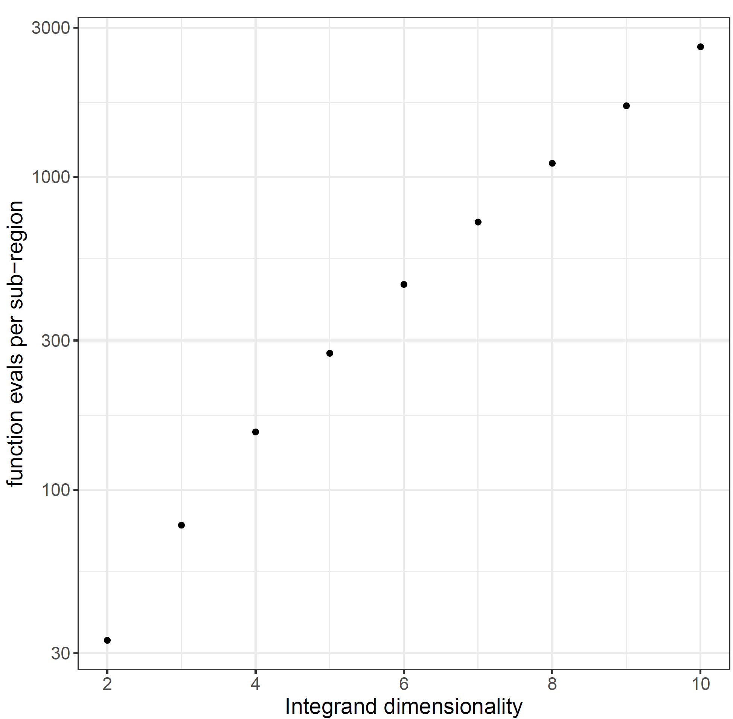
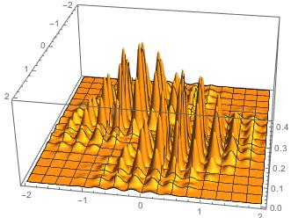
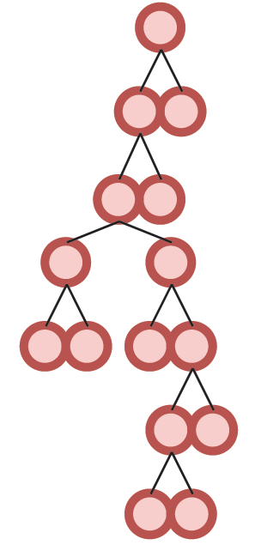
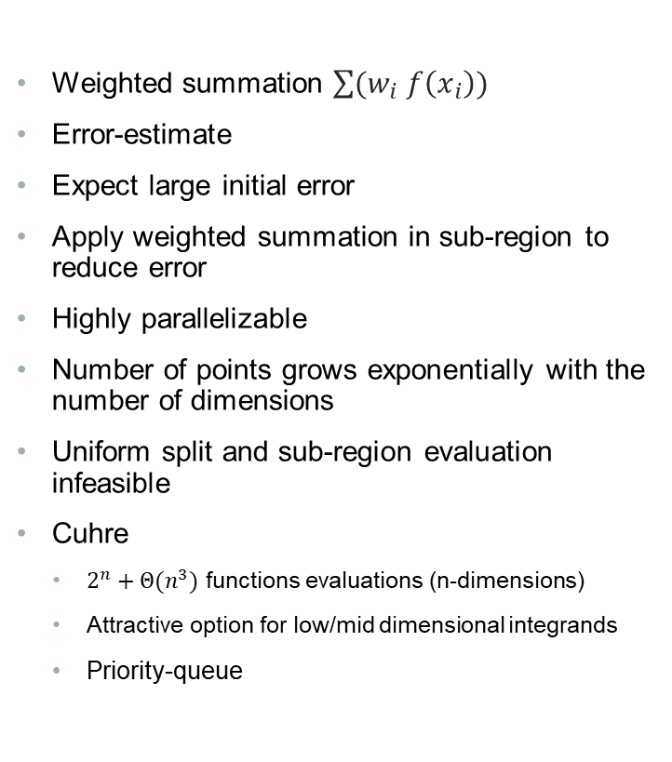
BACKGROUND: Quadrature
Weighted summation $\sum{(w_{i} f\left(x_{i}\right))}$
Error-estimate
Expect large initial error
Apply weighted summation in sub-region to reduce error
Highly parallelizable
Number of points grows exponentially with the number of dimensions
Uniform split and sub-region evaluation infeasible
Cuhre
$2^{n}+Θ(n^{3})$ functions evaluations (n-dimensions)
Attractive option for low/mid dimensional integrands
Priority-queue
https://mathematica.stackexchange.com/questions/222184/whats-the-most-difficult-multidimensional-integral-that-mathematica-has-solved
Notes:
Assume total lack of knowledge regarding integrand’s behavior
Integration rule is a weighted sum at some pre-specified points, different rules have different points, weights, degree
Degree is n: if formula’s error is zero for all polynomials up to degree n, but is not zero for some polynomial of degree n+1
Cuhre’s rules are fully symmetric: all permutations of points are found in point-set with the same weight
Main rule: polynomial degree 2m+1, null rules have polynomial degree (2m-1, 2m-1, 2m-3, 2m-5)
Integration rule of degree 9

Slide 4
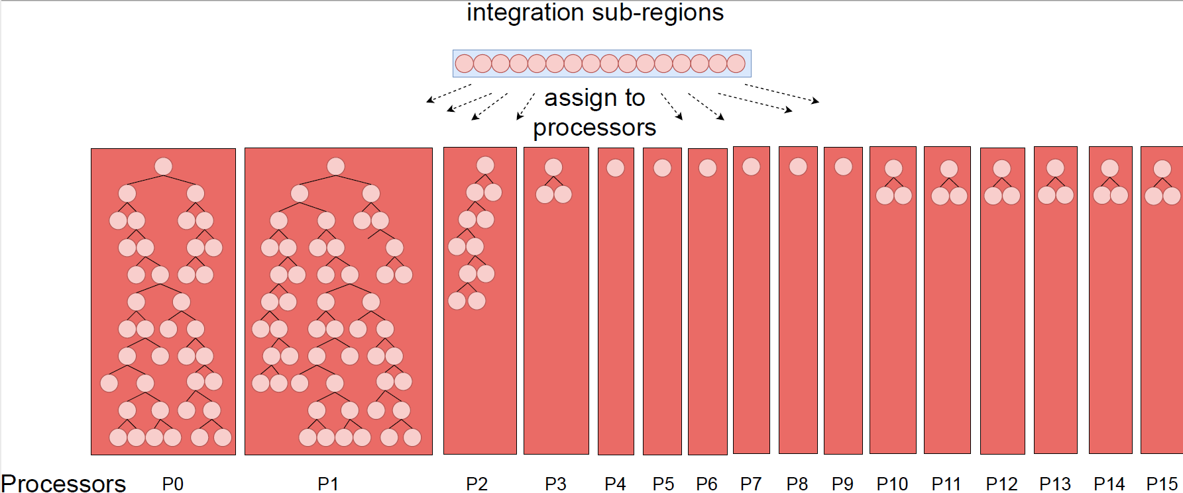
NAÏVE Parallelization
Notes:
- Sub-region evaluations are independent amongst each other so we can easily parallelize them
- Assign workload (specific sub-regions) to independent processors
- Can’t assume knowledge of the integrand’s behavior or distribution
- Can’t predict how each sub-region’s computational complexity compares against other regions
- Redistribution is costly and requires synchronization
- Communication requires synchronization
- Equal resource distribution

Slide 5
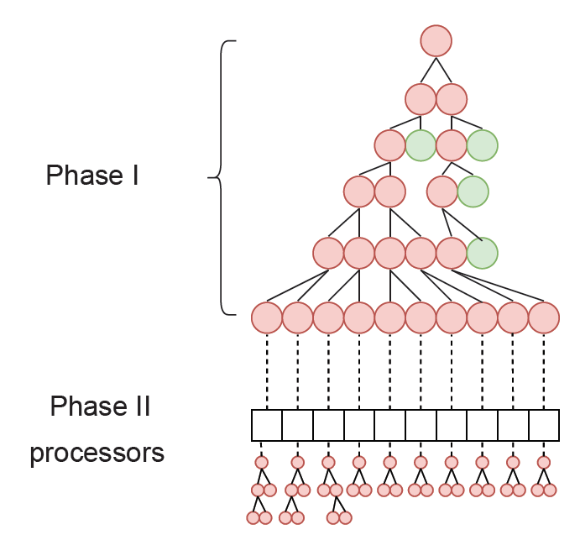
BACKGROUND: Two-phase Cuhre
GPU-targeted algorithm
Assign each sub-region to a processor
Applies the Cuhre algorithm on each sub-region in parallel
Utilizes pre-processing Phase 1
Generate sufficiently large workload (# of sub-regions)
Load-balancing
No synchronization between processors
Local termination
Notes:
- Core computations same as cuhre

Slide 6
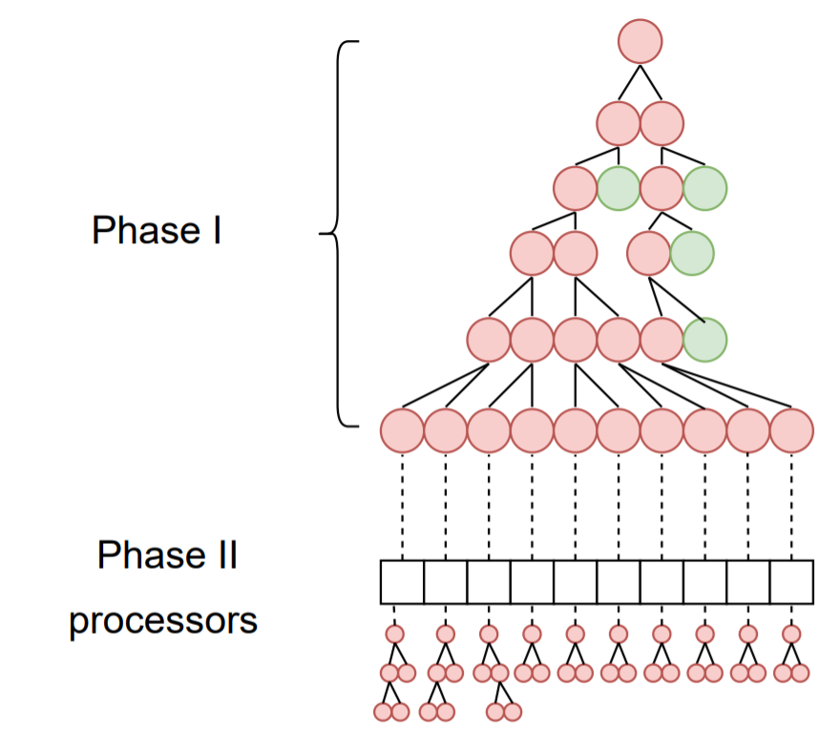
Two-Phase Cuhre
Utilization of sequential algorithm by parallel processors
Poor load-balancing when high-precision
Local data-structures
Unknown global state (unless global sync.)
Local termination
Notes:
- Local data-structures maintained by the processors, limits resources, how to not over-assign space, want to avoid dynamic allocation

Slide 7
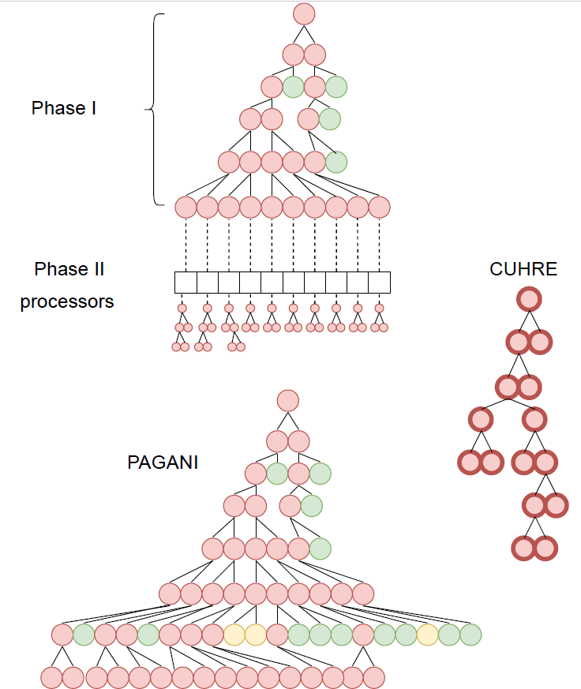
PAGANI
Parallel algorithm designed for massively parallel architectures
Avoid sequential scheme
Sub-divide all sub-regions
Filtering instead of sorting
Green/yellow = accurate enough
Avoid synchronization after isolated processing
Uniform workload
Bound by memory
Notes:
- Breadth-first expansion of sub-region “tree”
- Exposes greater parallelization

Slide 8
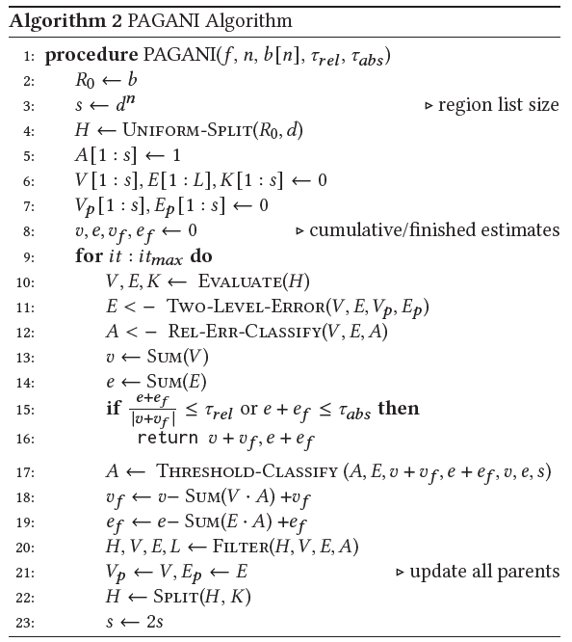
Algorithm Description
Initial uniform-split
Parallel sub-region evaluation
Two-level error-estimate
Relative error classification
Finished/active
Summations
Termination conditions
Conditional threshold classification
Filtering
Split all active regions
Notes:
3) number of splits d is dimension-based : for <=4 dims, four splits per dimension, for ndim >=5 && <=7, two splits per dimension, else 1 split per dimension
4) no persistence in region-processor mapping
6) Relative/absolute error dictates global termination
7) Counter-act extreme memory demands

Slide 9
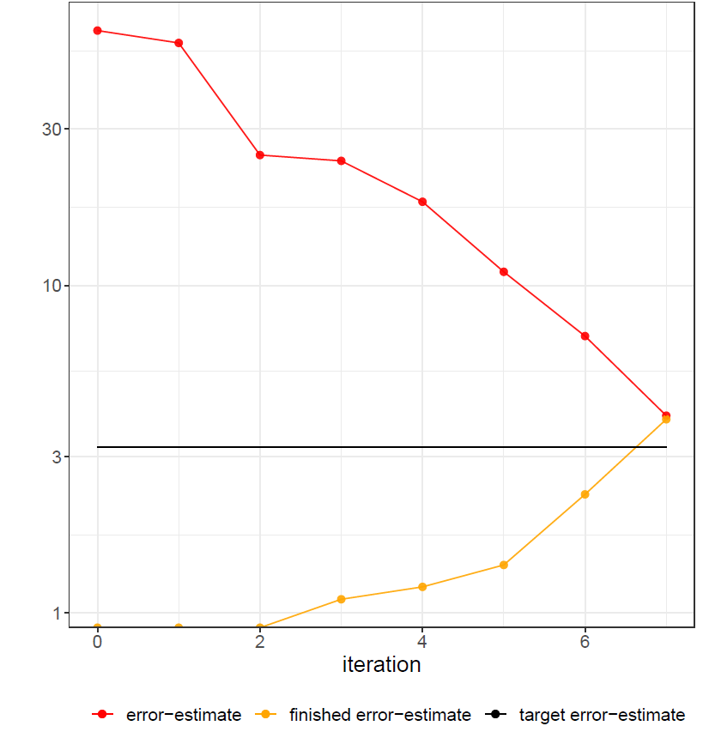
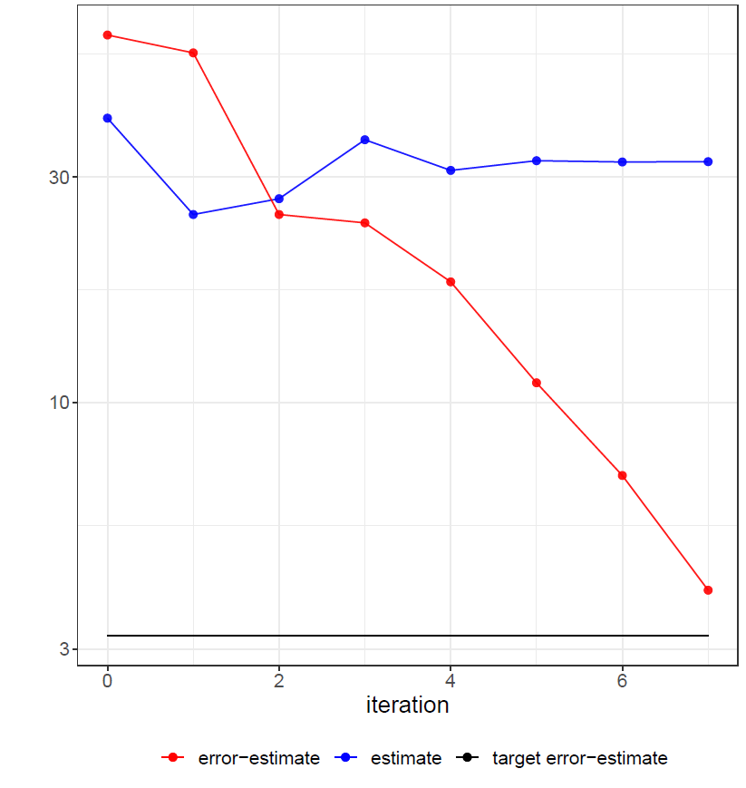
Sub-region Classification
Why classify finished/active?
Only keep active regions in memory
Use relative error for global termination and finished/active classification
Regions with small estimates may not satisfy relative error termination
Remove regions that don’t contribute “significantly”
Aggressive filtering
How to define “significantly”?
Finished regions irrecoverable for performance
Balance finished and active estimates
Pick a threshold (initially the average) and adapt until criteria are met
Criteria: conserved memory, finished vs. active ratio
Perform if memory exhaustion or convergence of significant digits
Notes:
For all finished regions, we have a sum of their integral and error estimates
Adaptiveness: classification
4) Relative error filtering is not sufficient, too many regions with “tiny” integral estimates, insignificant in grand scheme but their error-estimate is often not small enough for relative error filtering to catch them

Slide 10
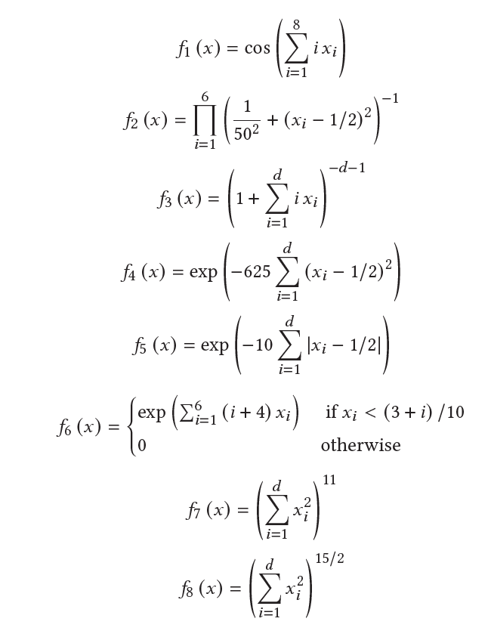
Integrand Test Suite
First six integrands represent challenging integrand families
Product and corner peaks, oscillatory, Gaussian, etc.
Typically, randomized parameters
Fixed parameters
Notes:
Introduced in paper [X}
Box integrals are the expectation of distance from a fixed point q of a point r chosen at random over the unit- hyper-cube

Slide 11
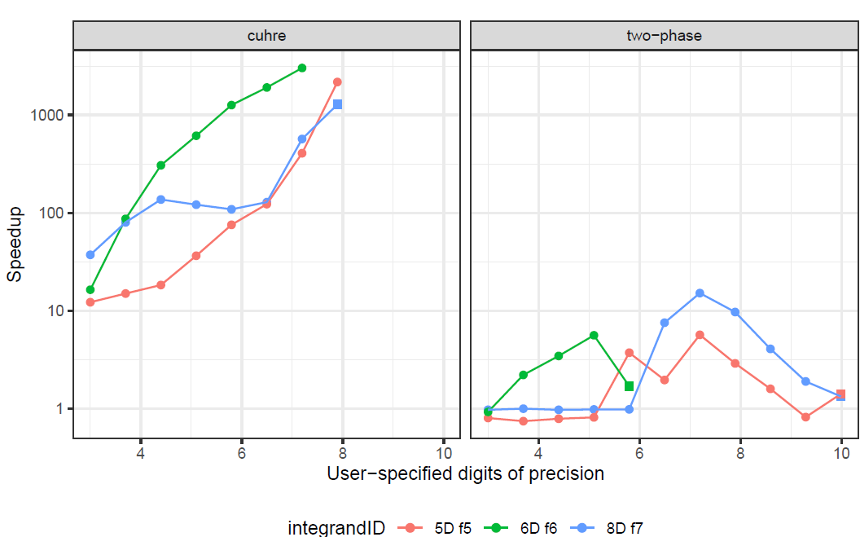
Experimental Results
3 digits of precision = 1e-3 relative-error tolerance
4 digits of precision = 1e-4 relative-error tolerance
CUDA 11 implementation
Executed on V100 16 GB
2.4 GHz Xeon R Gold 6130 CPU
Orders of magnitude speedup over sequential Cuhre
Improved robustness over two-phase
Improved load-balancing on higher precision
More reliable error-estimate
Comparable performance on low-precision

Slide 12
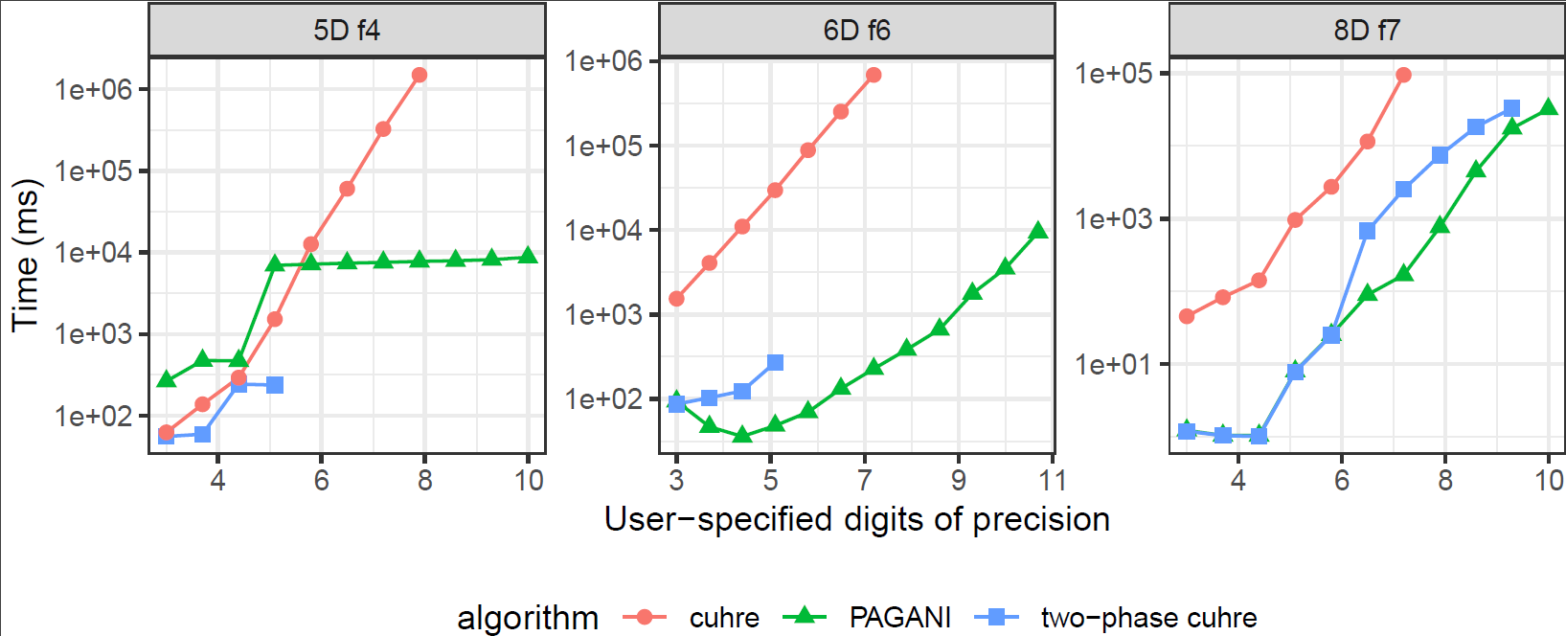
Performance
Pagani generates more sub-regions
“Easy” integrals not worth the overhead
More digits-of-precision

Slide 13
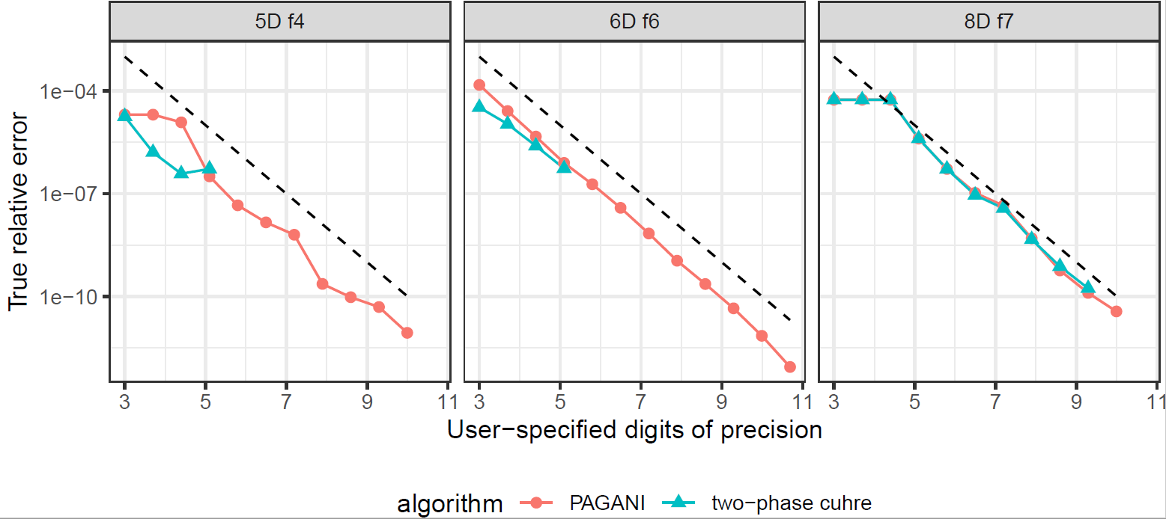
Accuracy
No randomized parameters
Evaluate error-estimate
Claimed vs true relative-error
Proximity to line indicates sub-division efficiency
Check bounds of error estimate

Slide 14
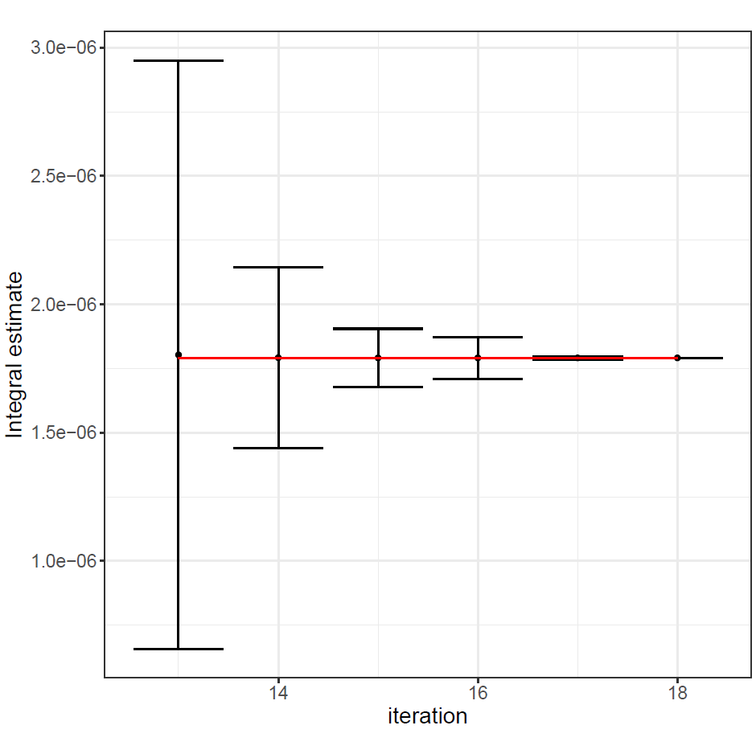
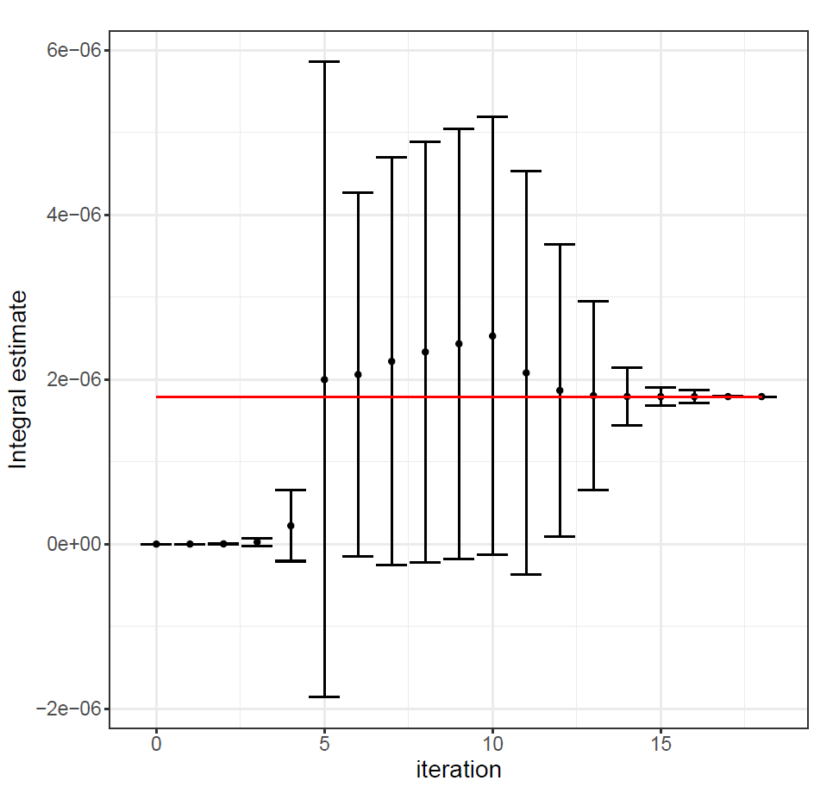
Accuracy
Estimates as measurement
Consistency across iterations
Overlapping error-bars
3-digits of precision
Red line = true value
Notes:
iteration, estimate, errorest
0, 3.437185473964994e-11, 3.586912798583651e-11
1, 3.083548320175041e-10, 5.957700620442790e-10
2, 2.767456461309512e-09, 5.347111332516770e-09

Slide 15
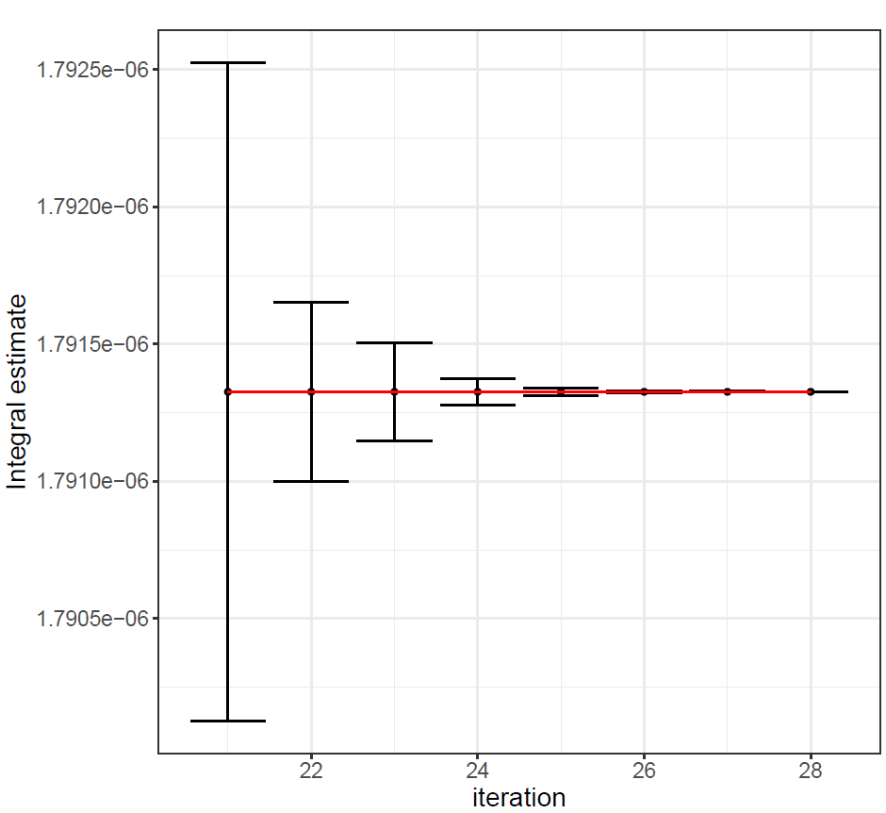
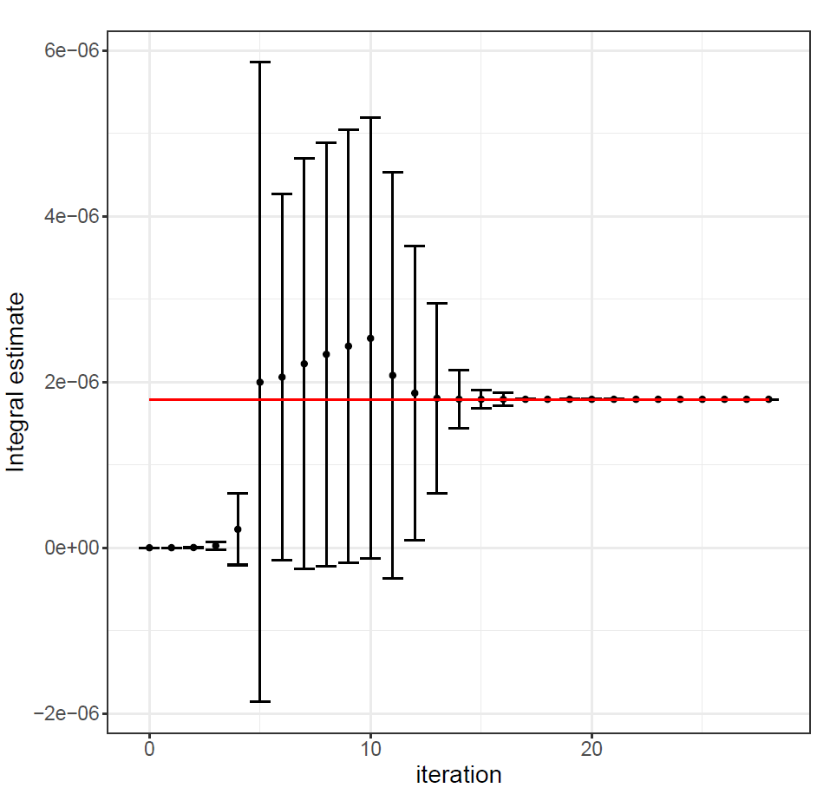
Accuracy
Estimates as measurement
Consistency across iterations
Overlapping error-bars
6-digits of precision
Red line = true value
More iterations

Slide 16
Conclusion
New deterministic adaptive algorithm for highly parallel architectures
No use of sequential algorithm
Orders-of-magnitude speedup on challenging integrals
Comparable performance with Two-Phase on low-precision
4-15 speedup over Two-Phase on medium/high precision
Improved robustness and execution time
Reliable error-estimation
At least as reliable as Cuhre

Slide 17
Future Work
Ampere architecture
Multi-GPU
Kokkos: 15% overhead in main computational kernels

Slide 18
QUESTIONS

Slide 19
Important Algorithm Characteristics
All operations utilize parallelization
Function-evaluations within sub-region
Sub-region evaluations
No use of sequential algorithm
No persistence in region-processor mapping
Global data-structure
Global state through reduction
Implicit synchronization

Slide 20
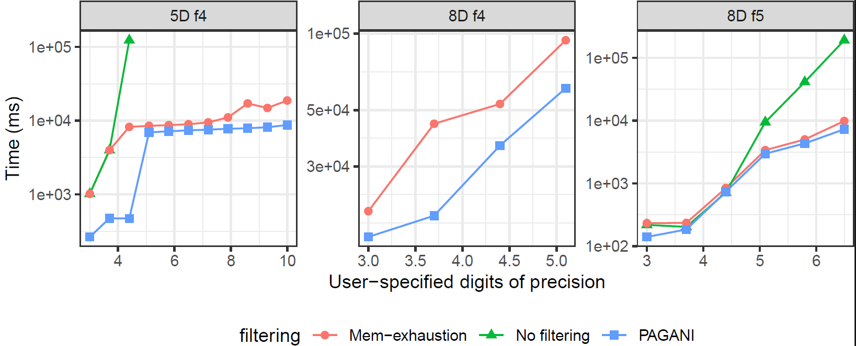
Performance: Heuristic Search Filtering

Slide 21
APPENDIX

Slide 22
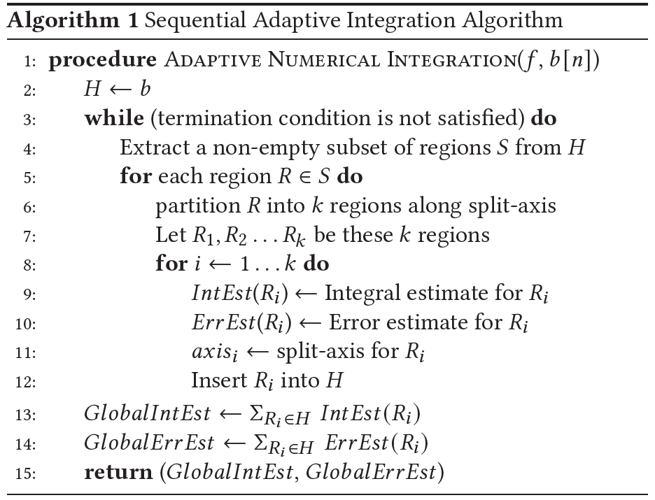
BACKGROUND: Cuhre
Maintains priority list based on highest error-estimate
Sub-divides sub-region with highest error-estimate
Sum integral estimate of all sub-regions to yield final integral estimate
“Harder” integrals require more sub-regions
Disjoint sub-region are independent
Notes:
Cuhre’s error-est: a posteriori error analysis, because we compute the error after having computed the approximation

Slide 23
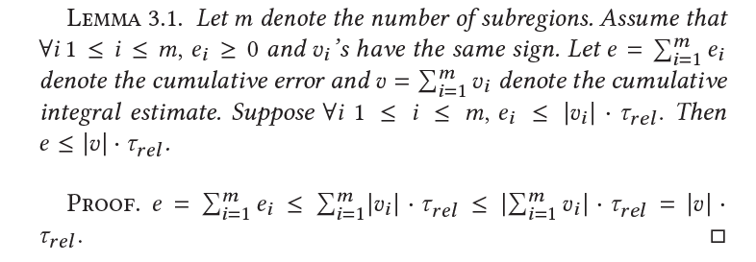
Relative Error Classification

Slide 24

Pure error estimate
Error coefficients
If $coeff\left[0\right]∗rule\left[1\right]≤rule\left[2\right] \&\& coeff\left[0\right]∗rule\left[2\right]≤sum[3]$
Return $coeff\left[1\right]∗rule[1]$
Otherwise return $coeff\left[2\right]∗max⁡(max⁡(rule\left[1\right], rule\left[2\right]), rule\left[3\right])$

Slide 25
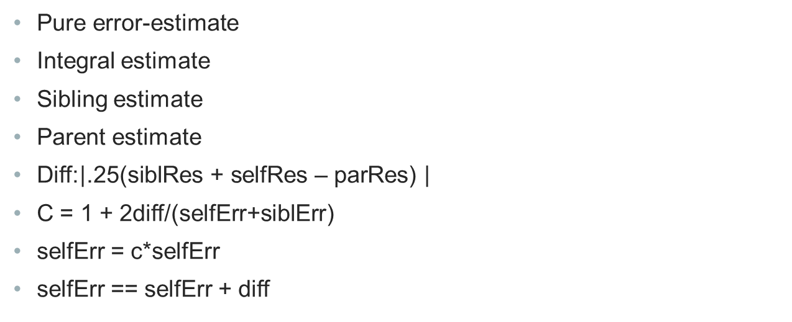
Two-level error estimate
Pure error-estimate
Integral estimate
Sibling estimate
Parent estimate
Diff:$\left|\text{.25(}\text{siblRes}\text{ + }\text{selfRes}\text{ – }\text{parRes}\text{) }\right|$
C = 1 + 2diff/(selfErr+siblErr)
selfErr = c*selfErr
selfErr == selfErr + diff

Slide 26
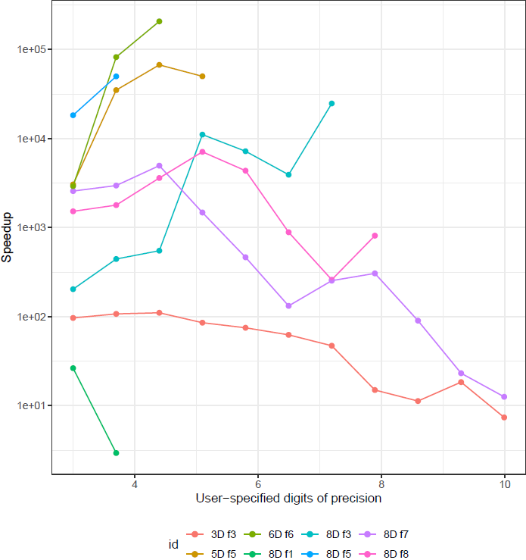
Speedup over Quasi-Monte Carlo

Slide 27
Performance Breakdown
Sub-region Evaluation: more than 90% of execution time
40% peak-performance for double-precision
Compute-bound
Limited number of memory accesses (initial read, final write)
Post-processing, classification, filtering, sub-division
Thrust library
All operations on GPU
Notes:
Filtering/sub-division take longer than post-processing and classification

Slide 28
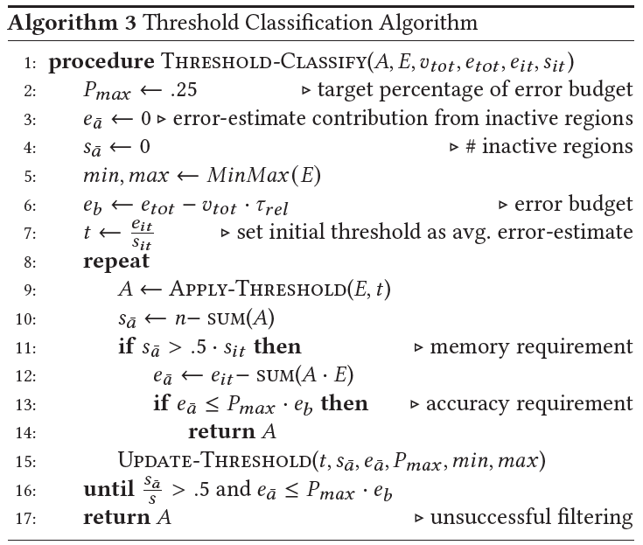

Slide 29
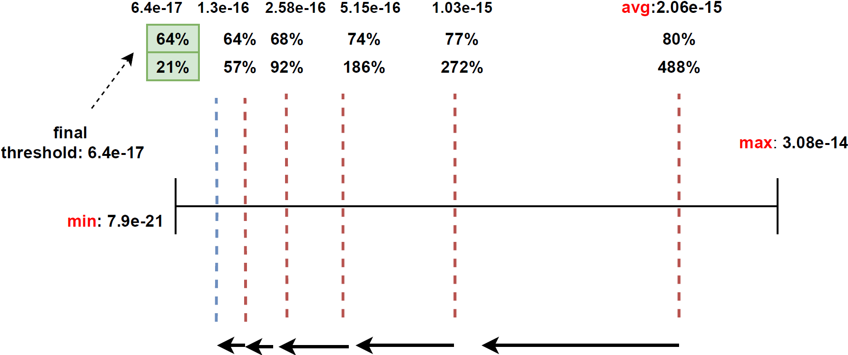
Heuristic Threshold Search
Classify many regions with “small” contributions
How small is small enough?
Try a different values and observe effect before committing to filtering
Heuristic filtering: average error-estimate as initial threshold
Try current threshold
If % of finished regions is too small, move towards max
Else move towards min
Try again
Notes:
TOP VALUE: % of regions that will be removed
BOTTOM VALUE: % amount of error that will be removed compared to the error-budget
Predict criteria for global termination
How much we need to decrease our current error-estimate
Already have a number of active regions, we need more to mark as finished or “polished”
Mark as polished, all regions whose’ error-estimate is smaller than “some” threshold value
Computations are cheap, we can see memory impact and then do more classification until one works
Only do if memory is exhausted or sig-digits converge

