Slide 1


Porting Multi-dimensional Numerical Integration Methods from CUDA to oneAPI
Authors: Ioannis Sakiotis, Kamesh Arumugam, Marc Paterno, Desh Ranjan, Balsa Terzic, Mohammad Zubair
This work is partially supported by Jefferson Lab and the oneAPI Center of Excellence at Old Dominion University
IXPUG Annual Conference 2022

Slide 2
Agenda
Progress in porting CUDA code to oneAPI
Application: multi-dimensional numerical integration
Algorithms/implementations:
PAGANI: quadrature rules
mCubes: Monte Carlo
Execute on Intel P630 GPU and NVIDIA V100 (CUDA-backend)
DPCT vs. manually converted code
Ease of use

Slide 3
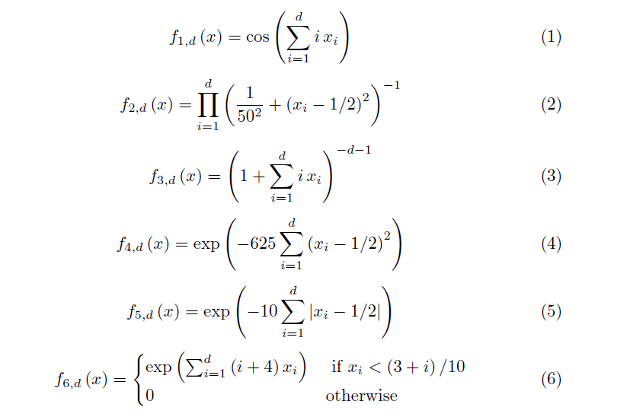
Interface
Integrand as C++ object
struct Gaussian {
__device__ __host__
double
operator()(double x, double y, double z, double w)
{
const double beta = .5;
return exp(-1.0 *
(pow(25., 2.) * (pow(x - beta, 2) + pow(y - beta, 2) + pow(z - beta, 2) + pow(w - beta, 2) )));
}
};

Slide 4

PAGANI
Evaluated by a block of threads
Iterative
Operate in parallel across regions
Compute integral/error estimate
y
x
Multiple thread-blocks work in parallel
Notes:
2D example

Slide 5
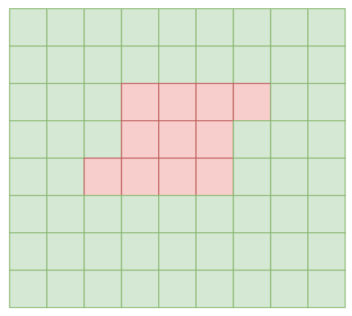
PAGANI
Evaluated by a block of threads
Iterative
Operate in parallel across regions
Compute integral/error estimate
Classify, split, filter regions
Accumulate results at each iteration
Region evaluation > 90% total time
y
x

Slide 6
Verifying correctness of oneAPI implementation
Comparison to CUDA implementation
Convergence on the same user-specified accuracy requirements
Convergence on the same integrands
Same results at each level of computation
Notes:
DPCT conversion did not work on CUDA backend with zero tweaks
3m

Slide 7
Key computations
Compute bound
Read from global memory for function evaluation point generation
Shared memory
Region bounds
Volume
Region axis ranges
ID of region axis with greatest range
Reduction of function evaluations
Reduction for sub-group using shift_group_left
Thread 0 writes region results back to global memory at the end

Slide 8
Comparing CUDA and oneAPI on V100
All data-structures are allocated on the device
Use of malloc_device instead buffer/accessor
Shared memory
sycl::accessor<double , 1, sycl::access_mode::read_write, sycl::access::target::local>
Timer: use get_profiling_info on main kernel
Notes:
5m

Slide 9
PAGANI: CUDA and oneAPI on CUDA backend

Slide 10
Comparing CUDA and oneAPI on V100
Experimental setup
5 integrands
Starting relative error tolerance: 1e-3
Upon convergence, divide accuracy level by 5
10 runs per accuracy level
Collect execution time of each call to the main kernel

Slide 11
Comparing CUDA and oneAPI on V100
ID | oneAPI (ms) | CUDA (ms) | oneAPI/CUDA
f2 | 378.36 | 350 | 1.08
f3 | 0.069 | 0.028 | 2.479
f4 | 416.39 | 396.55 | 1.05
f5 | 206.67 | 135.78 | 1.52
f6 | 9.86 | 2.3811 | 4.14
Notes:
Relative error tolerance for these runs: 1e-3, f6 largest kernel size: 24,204 blocks with 64 threads per block
Key-point variation is performance ratio
Value of 1 would be perfect

Slide 12
Comparing CUDA and oneAPI on V100
ID | oneAPI/CUDA | nregions | iterations
f2 | 1.08 | 1594048 | 30
f3 | 2.479 | 129 | 3
f4 | 1.05 | 4136000 | 19
f5 | 1.52 | 2097152 | 14
f6 | 4.14 | 80425 | 27
Notes:
Relative error tolerance for these runs: 1e-3, f6 largest kernel size: 24204 blocks with 64 threads per block
Not clear if constant overhead or cost of integrand is what causes the different exec. time ratios
nregions: the count of the number of sub-divided regions at the moment of termination(leaves in the tree)
Fewest regions/iterations != largest or smallest ratio f3 has the fewest of all but not the smallest or largest ratio
Even if we don’t consider f3, Fewer regions != larger ratio : f2 has fewer regions than f4 but smaller ratio
F2 and f6 has similar iterations but very different ratios

Slide 13
Comparing CUDA and oneAPI on V100
platform | ID | ndim | nregions | avg. time (ms) | standard deviation | time min (ms) | time max (ms)
CUDA | f4 | 5 | 32768 | 1.49 | 0.02 | 1.49 | 1.73
oneAPI |  |  |  | 1.69 | 0.08 | 1.63 | 1.88
Notes:
Look at averaged results of some particular iteration
count is in the order of 100
nregions: regions processed at that particular iteration

Slide 14
Comparing CUDA and oneAPI on V100
platform | ID | ndim | nregions | avg. time (ms) | standard deviation | time min (ms) | time max (ms)
CUDA | f4 | 5 | 32768 | 1.49 | 0.02 | 1.49 | 1.73
oneAPI |  |  |  | 1.69 | 0.08 | 1.63 | 1.88
platform | ID | ndim | nregions | avg. time (ms) | standard deviation | time min (ms) | time max (ms)
CUDA | f4 | 5 | 4118208 | 186 | 0.354 | 185.9 | 187.6
oneAPI |  |  | 4118208 | 207 | 0.076 | 207.5 | 207.8
Notes:
ratios small run = 1.13 big run = 1.13

Slide 15
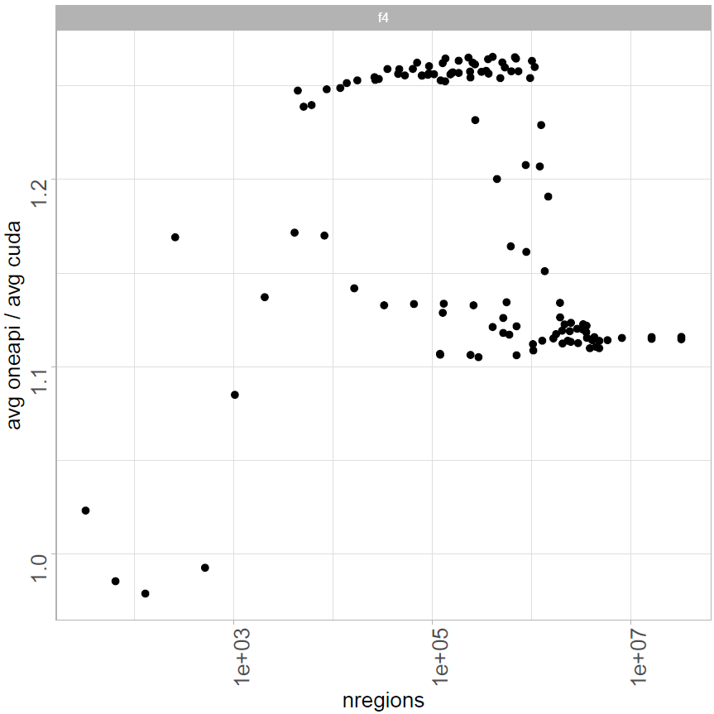
Comparing CUDA and oneAPI on V100
Notes:
As in table before, each point is an average of kernel calls

Slide 16
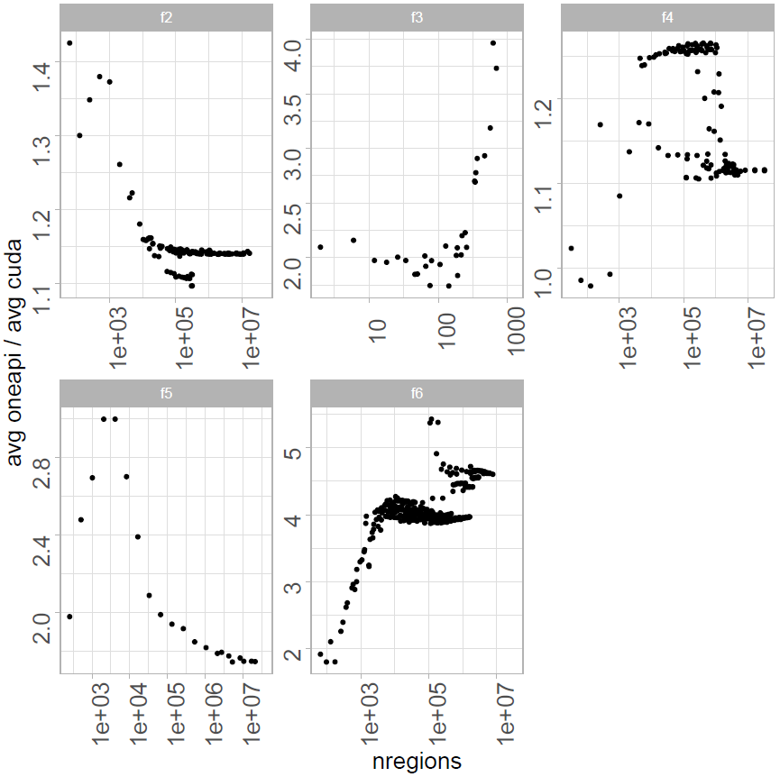
Comparing CUDA and oneAPI on V100
Notes:
f2: starting ratio: 1.42 (64 regs), f5: 1.97 (256 regs), f6 : 1.92 (64 regs),
11m

Slide 17
mCubes

Slide 18
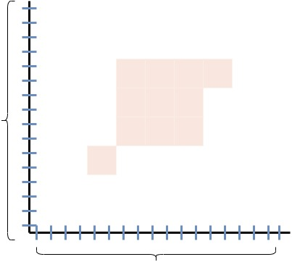
mCubes
Iterative
Monte Carlo integration method
Based on VEGAS
Each thread is mapped to hyper-cubes
Randomly select bin
Keep track of bin contributions
Change bin bounds at end of iteration
y
x

Slide 19
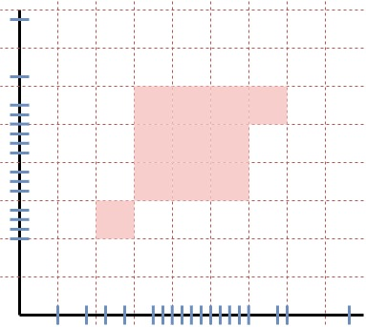
mCubes
Each thread evaluates many samples
Atomic additions for bin-tracking
Block reduction on accumulated per-thread values
Atomic addition from thread 0 in each block
y
x

Slide 20
Comparing CUDA and oneAPI on V100
Collect exec. time of each kernel call
Sample sizes tested: 1e7, 1e8, 1e9, 2e9
100 runs per sample size

Slide 21
Comparing CUDA and oneAPI on V100
ID | oneAPI (ms) | CUDA (ms) | oneAPI/cuda
f2 | 368.1702 | 29.036 | 12.67
f3 | 117.6202 | 4.9955 | 23.54
f4 | 157.5219 | 9.9644 | 15.80
f5 | 147.04 | 13.567 | 10.83
f6 | 170.4264 | 11.42 | 14.92
Notes:
Number of samples per iteration: 1e7
Single run on some precision level
14m

Slide 22
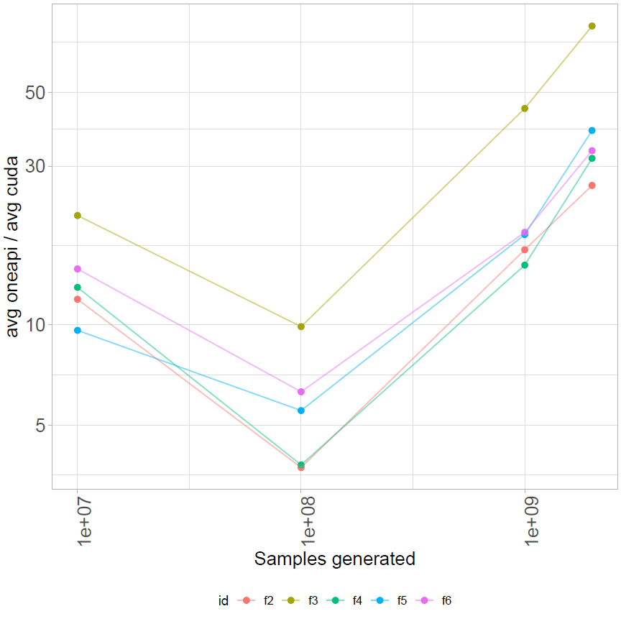
mCubes: CUDA and oneAPI on CUDA backend
Example
oneAPI: 11,148 ms
Cuda: 511 ms
oneAPI is ~20x slower
Significant deviation
Main factor atomics
Notes:
Averaged results
Example in bullets is from a single run

Slide 23
Impact of atomics
//ATOMIC
for (int j = 0; j < ndim; ++j) {
atomicAdd(&d[i], f2);
}
//NO ATOMIC
for (int j = 0; j < ndim; ++j) {
d[i] += f2;
}
 | Atomic | No Atomic
CUDA | 509 ms | 511 ms
oneAPI | 695 ms | 11,148 ms
Notes:
oneAPI ratio: ~16
15m

Slide 24
Atomics impact on P630
with atomics: 91,551.4 ms
without atomics: 14,219.3 ms
Notes:
Ratio: 6

Slide 25
EASE OF USE
Notes:
17m

Slide 26
DPC++ compatibility tool
Automate conversion of CUDA code
Not 100% conversion
Faster to use than manual implementation
Demonstrate techniques unknown to beginners
DPCT is easy to use
No performance loss

Slide 27
Manual Implementation
DPCT | MANUAL
sycl::queue& q_ct1 = dev_ct1.default_queue(); | Passing sycl::queue references throughout
Use .get_pointer() | Pass accessors for shared memory
nd_item<3> | nd_item<1>
Notes:
Indicate which options were better and which were not
nd_item 1 or 3 didn’t matter for mcubes same number of registers
Pagani: nd_item1 (1.429591 ms for 24204 regions) 64 registers
Pagani:nd_item3 96 registers (2.151858 ms for 24204 regions)

Slide 28
Notation Difference
No impact on performance
SYCL
DPCT Library
auto v = sycl::atomic_ref<double,
sycl::memory_order::relaxed,
sycl::memory_scope::device,
sycl::access::address_space::global_space>(d[i]);
v += val;
dpct::atomic_fetch_add(&d[i], val);

Slide 29
oneAPI Ease of use: Library Calls
Library usage not on hotspots
Parallel STL
Use STL libraries with execution policy modifiers
std::exclusive_scan
dpl::experimental::reduce_async
oneMKL
oneapi::mkl::blas::column_major::dot
oneapi::mkl::stats::min_max
Notes:
Things will vary from user to user: this is just my experience with my background

Slide 30
oneAPI Ease of use
Copying member variables on stack for parallel_for capture
Did not find KOKKOS_CLASS_LAMBDA equivalent
Placement of DPL and MKL headers in specific order
Using sycl::stream
Shared mem requires passing variables to parallel_for

Slide 31
oneAPI ease of use: CUDA backend
Initially execution on v100 did not work with identical code
dpct::inner_product with dpct::get_device_pointer
Certain functions in row_major namespace not implemented for MKL
Could not use mkl::stats::min_max (undefined reference)
Used mkl::blas::iamax, iamin
CMake issues
Utilization of Catch2 for testing
Changed calls for returning available memory
V100 16GB
dpct::get_current_device().get_device_info().get_global_mem_size()
device.get_info<sycl::info::device::max_mem_alloc_size>()
Notes:
Instead of thrust::inner_product and dpct’s dpct::inner product, I used mkl::blas::column_major::dot

Slide 32
Conclusion
DPCT is easy to use
Execution on V100 may require code changes
Performance varies based on integrand function
Obserserved some similar exec. times on PAGANI
1: 5.4 times slower on PAGANI
4 : 80 times slower on mCubes (mostly due to atomics)

Slide 33
Future
Execute on high-end Intel GPUs
Investigate performance factors
Address impact of atomics on mCubes

