Slide 1
EasyInventory
Manage your inventory seamlessly
Md. Sakibul Islam
31/12/2024

Slide 2
Overview
What it is: A C-based inventory management system to add, update, delete, and manage products.
Why it’s useful: Simplifies stock management and ensures data persistence.
Key Features:
Insert, view, update, delete products
Search by category or price
Sell products and manage stock
File-based persistence for saving records

Slide 3
Technical Details
Language: C
Data Storage: Text file (products.txt)
Features:
Struct-based product management
File I/O for persistence
Validation for user inputs
Dynamic ID generation
Support for 100 products

Slide 4
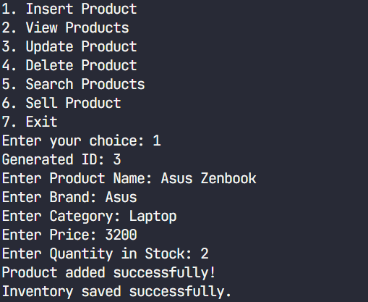
Features Breakdown
Insert Product: Add new items with details like name, brand, category, price, and quantity.

Slide 5
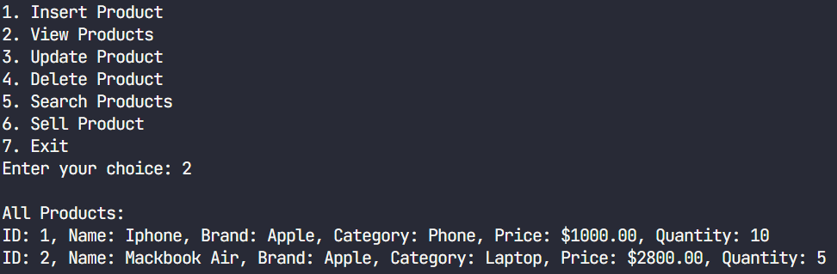
View Products: Display all stored products in a formatted view.
Update/Delete: Modify or remove products using their unique ID.
Search:
By category
By price range
Sell Product: Deduct sold quantities and update inventory.

Slide 6
Challenges Faced
Handling file I/O operations efficiently.
Ensuring input validation to avoid runtime errors.
Managing memory for large inventory datasets.

Slide 7
Future Improvements
Integrate with a database (e.g., MySQL) for scalability.
Add user authentication for security.
Implement a GUI for better user experience.
Enhance reporting with sales and stock analytics.

Slide 8
Thanks
Does anyone have any questions?

